Slide 1
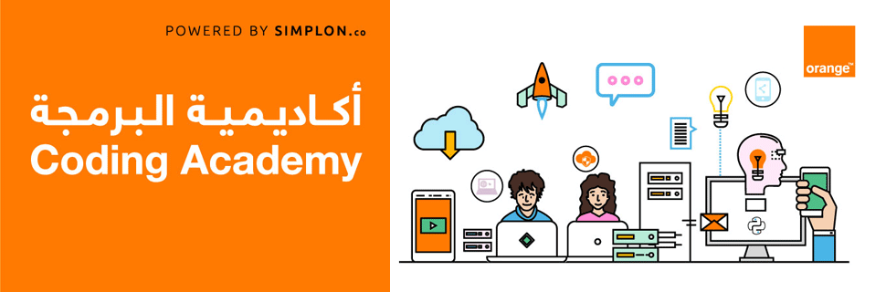

Mohammad Al-Bittar

Slide 2

Who Am I ?

Slide 3
Lets Talk

Slide 4

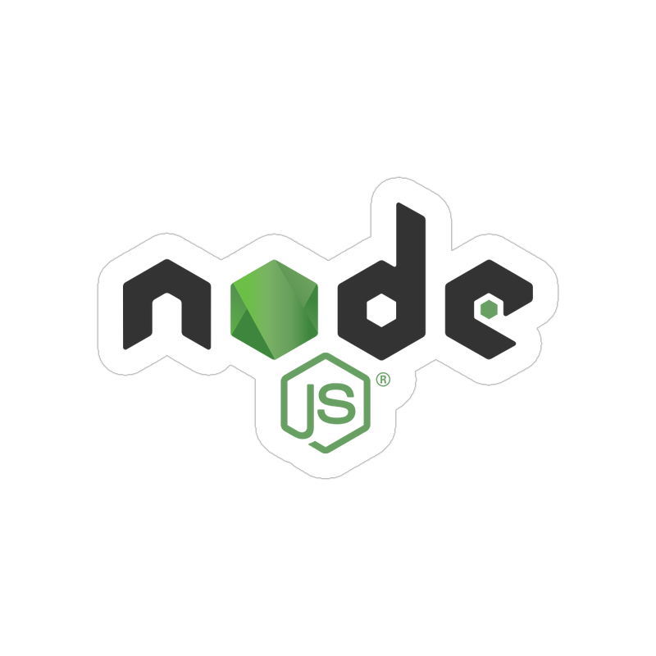

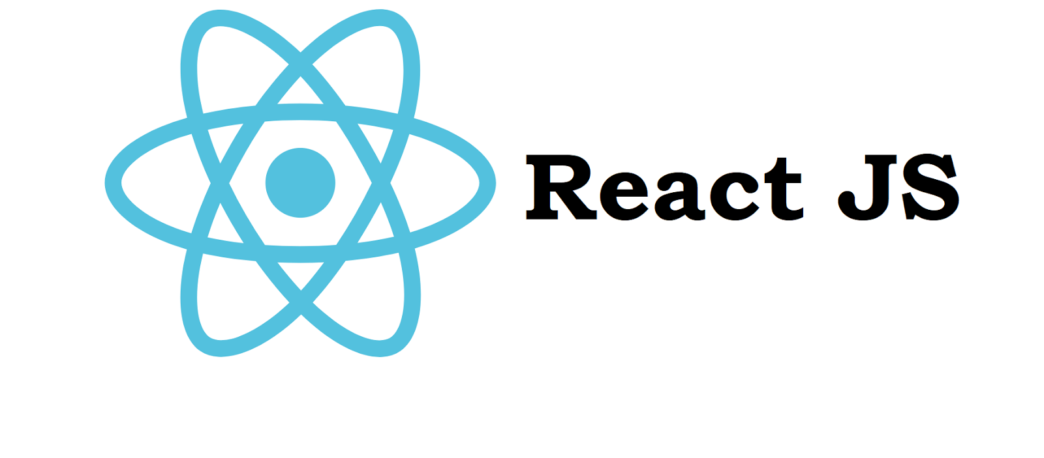
Technologies

Slide 5
Mockup

Slide 6
Main Components
Web Application:
Dashboard Component
Offers Component
Mobile Application:
Get Trip Component
Build Your Trip Component

Slide 7


Slide 8
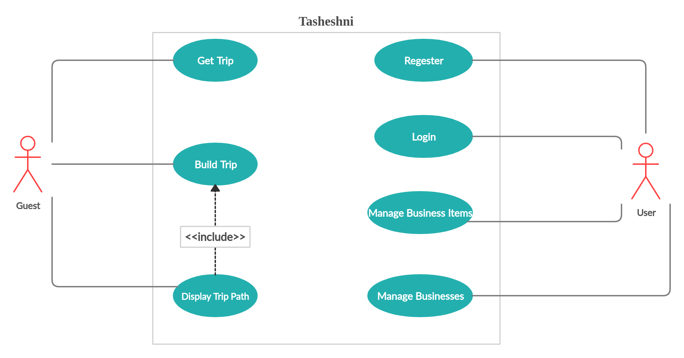
Use-Case Diagram

Slide 9
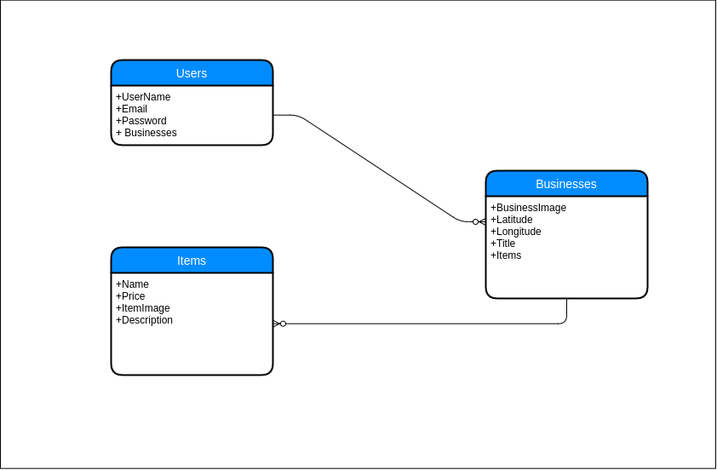
ER Diagram

Slide 10


Slide 11
Future Work
Add natural,archeological areas in Jordan.
Enable hotels to add their offers.
Enable car rentals stores to add their offers.
Share users experience.
Add others types of businesses to cover all things that people interested in it.
Using external apis or integrated with other system to find all business’s items without add them manual.

Slide 12
Conclusion
Developed Mobile And Web App By MERN Stack.
The main goals of theme are :
  Help users to find best trip based on their budget.
  Help users to discover new places in Jordan.
  Help owner business to self market.
Add others features to make it more benefit for both of users,businesses.

Slide 13
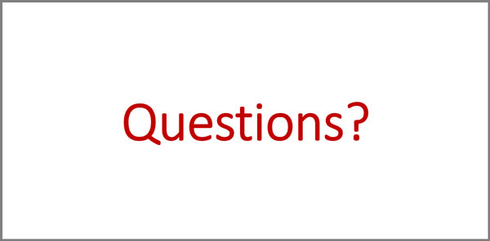

Slide 14


