Slide 1
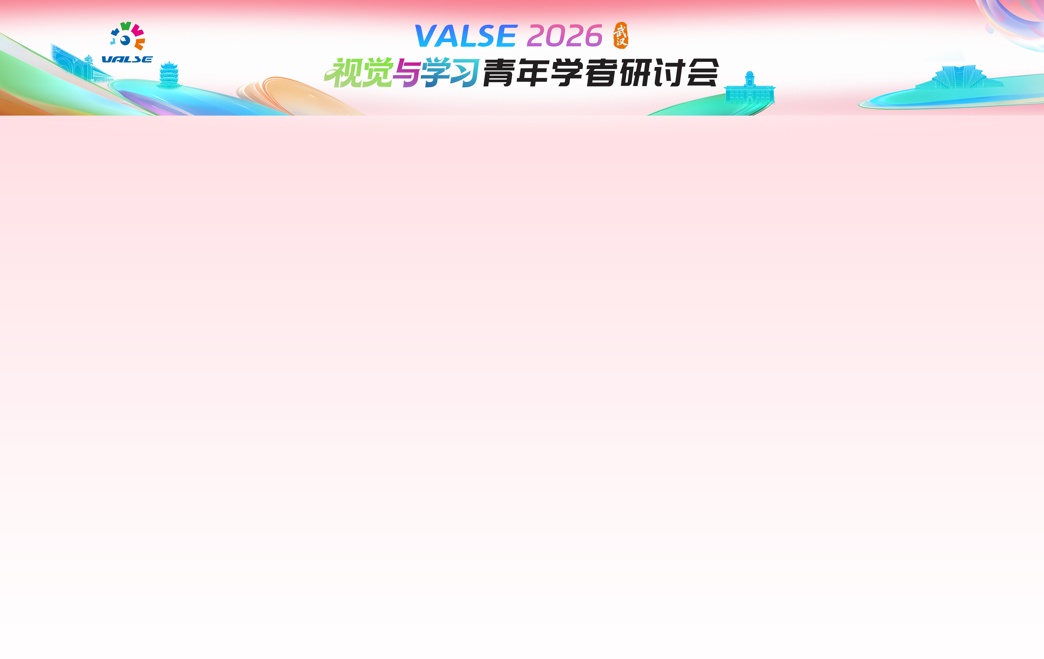



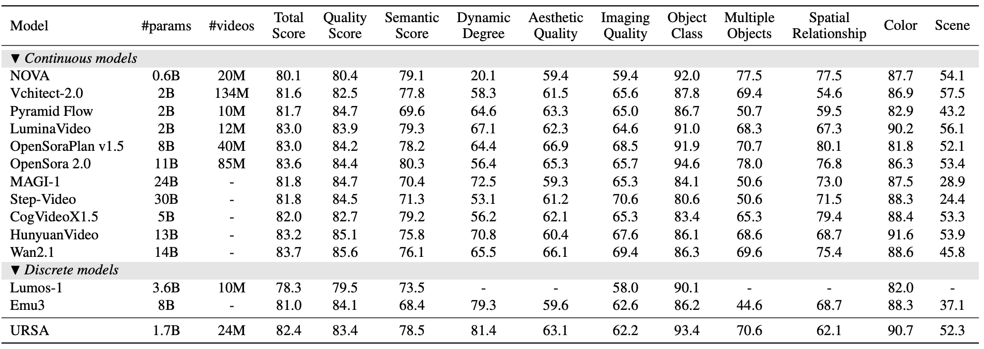
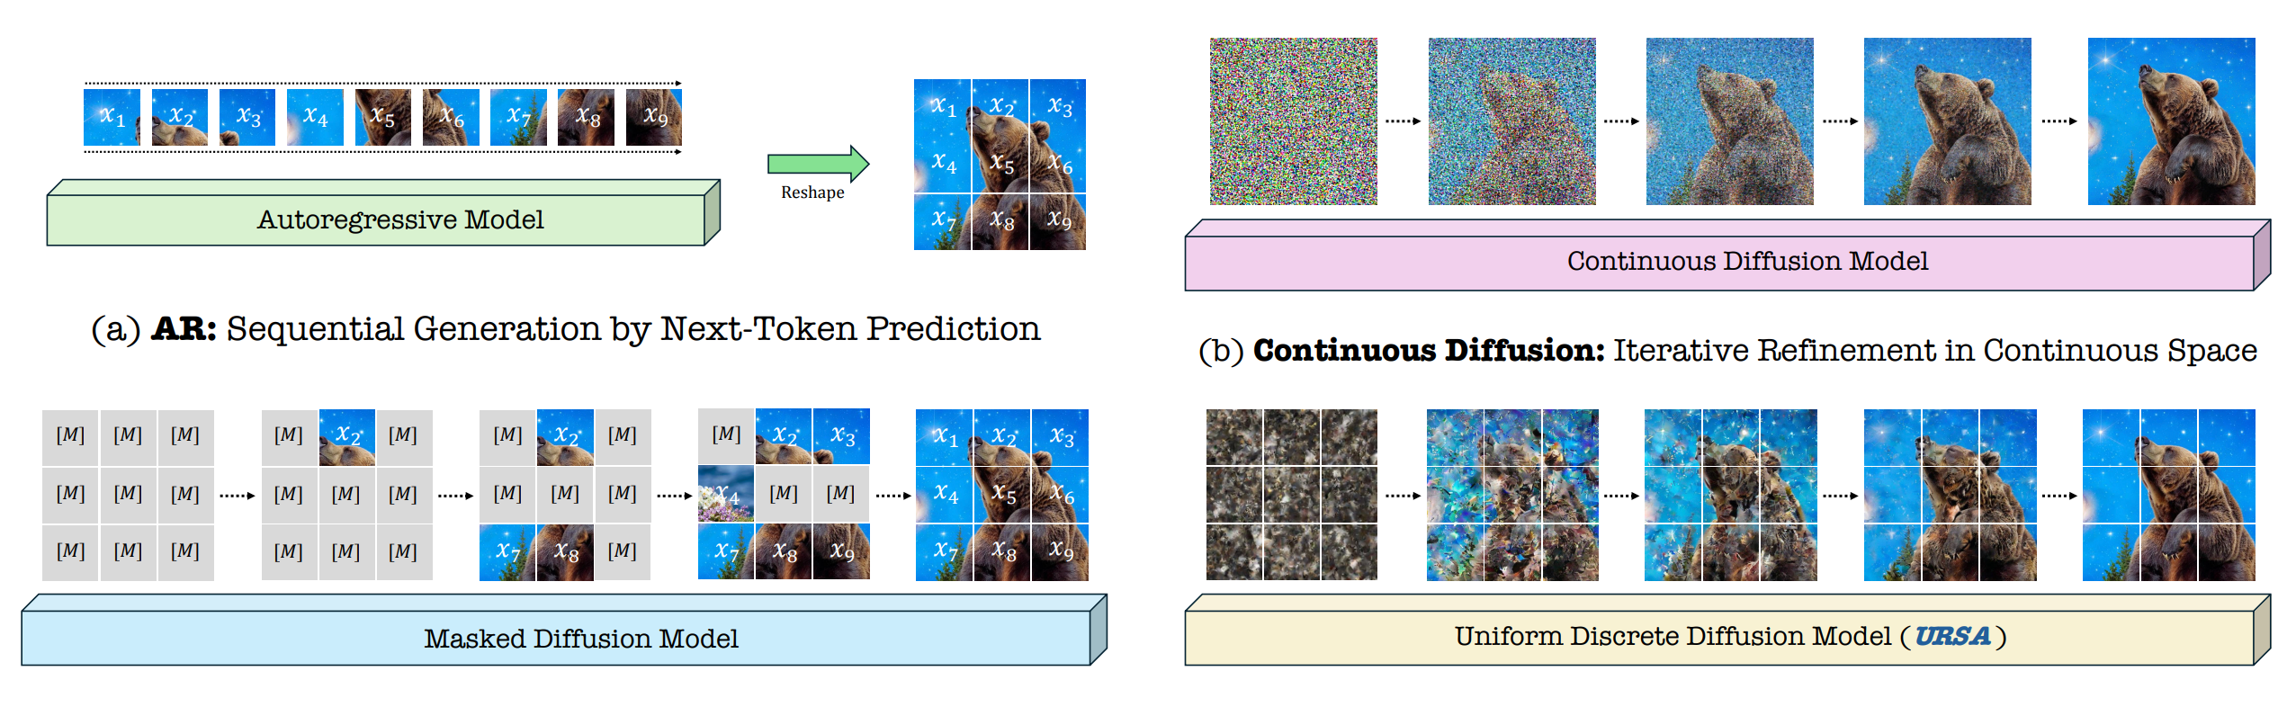
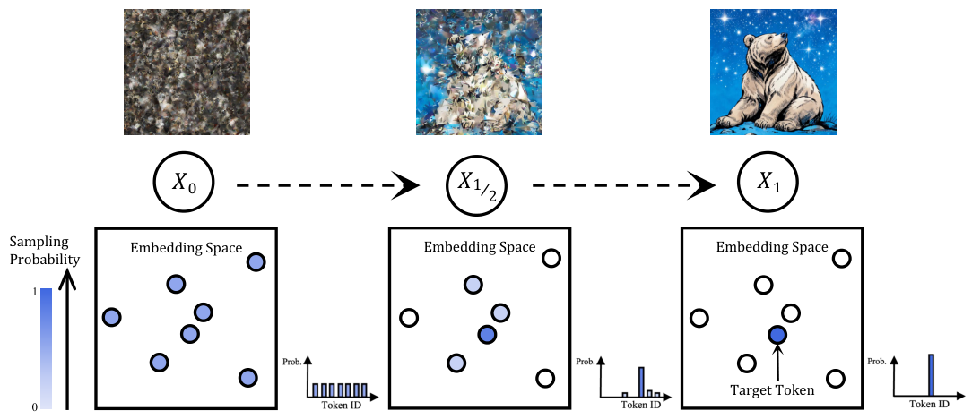
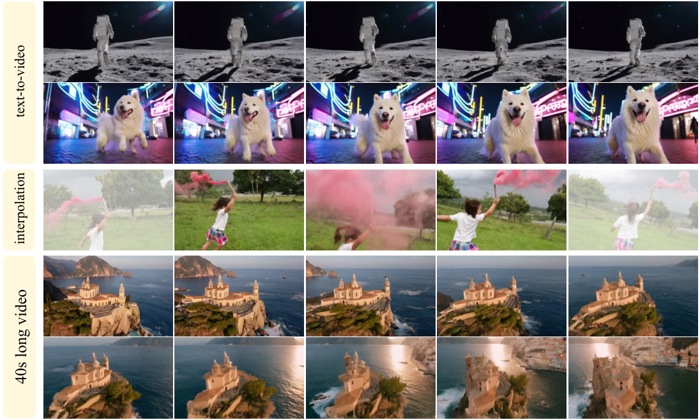
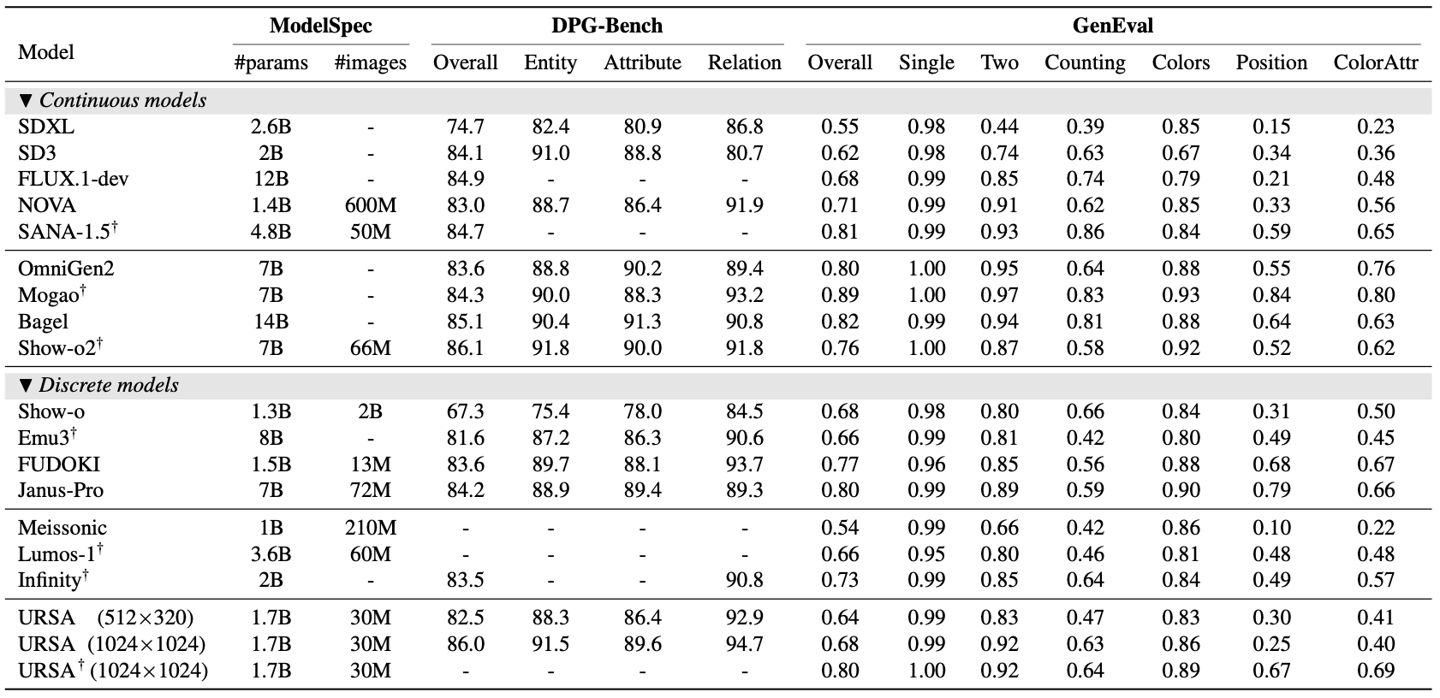
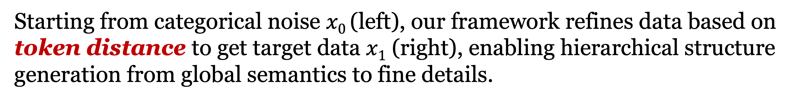
Wechat
Github
Uniform DiscRete DiffuSion with Metric PAth for Video Generation
Haoge Deng^{1,4*}, Ting Pan^{2,4*}, Fan Zhang^{4*}, Liu Yang^{3,4*}, Zhuoyan Luo⁴, Yufeng Cui⁴ , Wenxuan Wang⁴
Chunhua Shen³, Shiguang Shan², Zhaoxiang Zhang¹† , Xinlong Wang⁴†
* Equal contribution † Corresponding Author
1 National Laboratory of Pattern Recognition, CASIA 2 Key Laboratory of Intelligent Information Processing, CASICT 3 Zhejiang University 4 Beijing Academy of Artificial Intelligence
Introduction
Results
Unlike classic AR models and MDM that adopt non-refinable local generation, where produced tokens are fixed once generated,
URSA emphasizes iterative refinement over global discrete tokens, conceptually aligning discrete methods with continuous counterparts,
and substantially narrowing their performance gap.
URSA rivals Sora-like text-to-video generation models despite using a discrete video tokenizer and performs
on par with the state-of-the-art models in generating high-resolution images.
Methods
Starting from categorical noise $x0$ (left), our framework refines data based on
token distance to get target data $x1$ (right), enabling hierarchical structure
generation from global semantics to fine details.

