Slide 1
Pipeline for fine-tuning YT Script Writer
Directives for style & structure
Evaluation
Framework
Generated Advises
Step 1
Create Video Idea on GenAI
Step 2
Synthesize Video Scripts
Step 3
Critic & Score Generated Scripts
Step 4 & 5
Enforce Specific Style & Measure
Fine-Tune Model w/ generated conversation
Step 6
Enhance original script w/ ft Model
Step 7
Critic & score enhanced script
Step 8
Benchmark

Slide 2
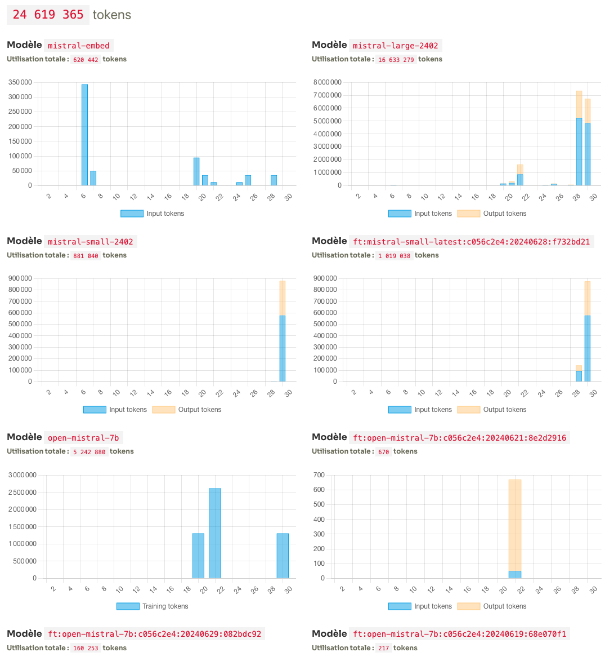
24 millions of tokens used for Hackathon

Slide 3
Benchmark on video script revision task
Model | Overall | Tone | Structure & Content
Original Script | 6.26024 | 7.19397 | 5.33728
Small Fine Tuned | 6.51767 | 7.33264 | 5.73493
Small Latest | 6.64936 | 7.44861 | 5.86296
Large Latest | 6.92848 | 7.68582 | 6.23627
Task is to revised an original video script based on a set of directives for style, structure and content.
Fine-tuned model underperform latest mistral small model.
Training dataset contains cases that decrease the score of original script
Original Script with a good score (> 7.5) should not be revised
Unitary test shows that fine-tuned model gives better result on script generation than the stock model.

