Slide 1
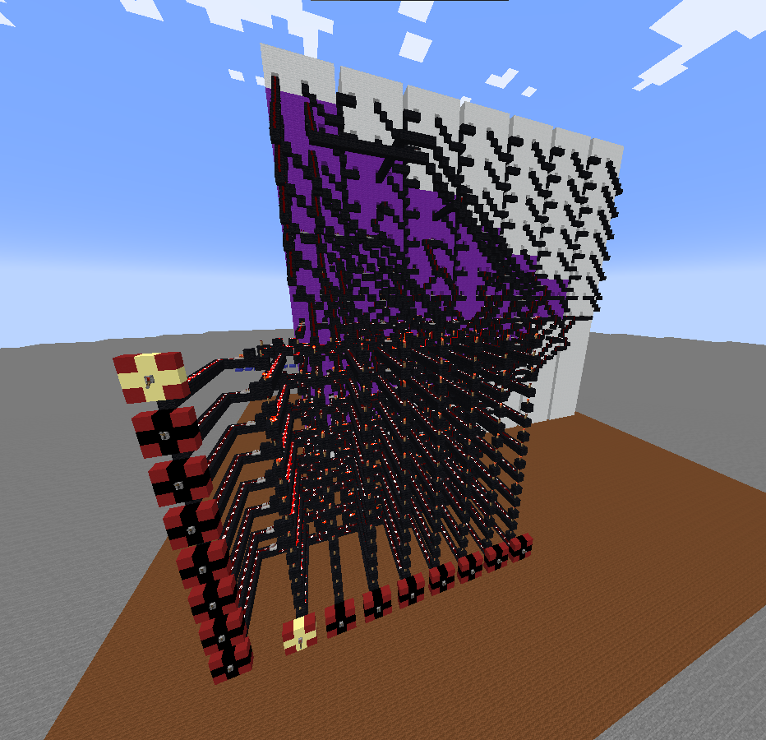
Minecraft meets Computer Science

Slide 2
Das binaersystem

Slide 3
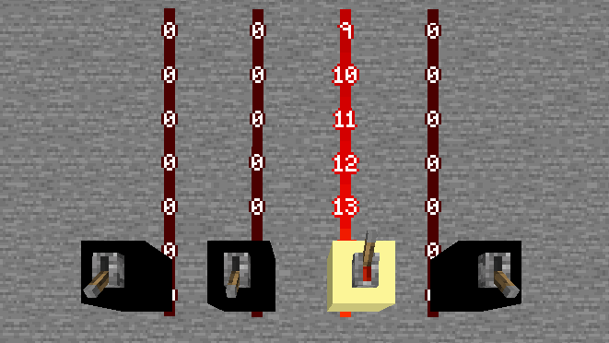
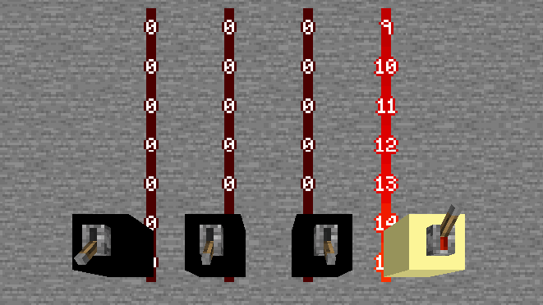
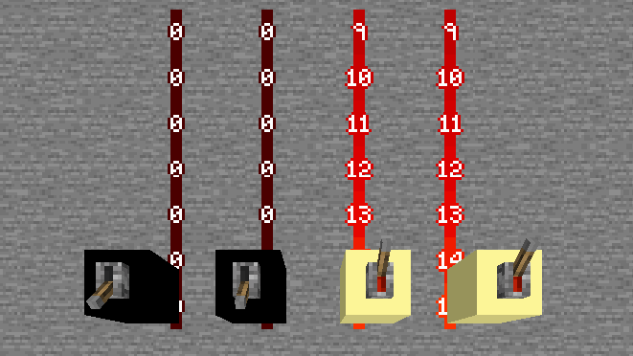
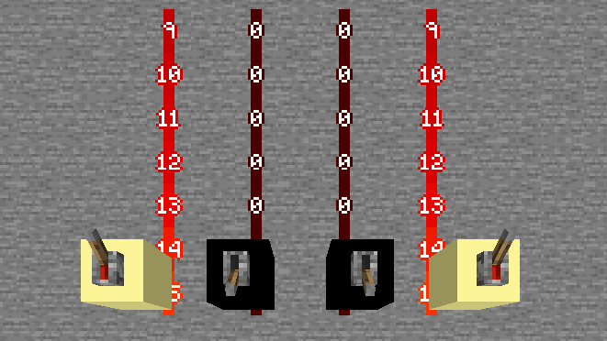
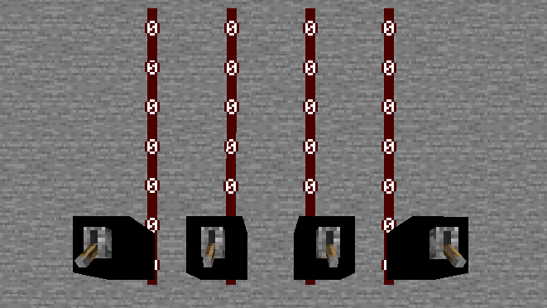

Slide 4



Double dabble
1010
0001 0000
10
0

Slide 5



Double Dabble
0000 0000
1010
0000 0001
010
0000 0010
10
0000 0101
0
0000 1000
0
0001 000
0001 0000
10
0

Slide 6
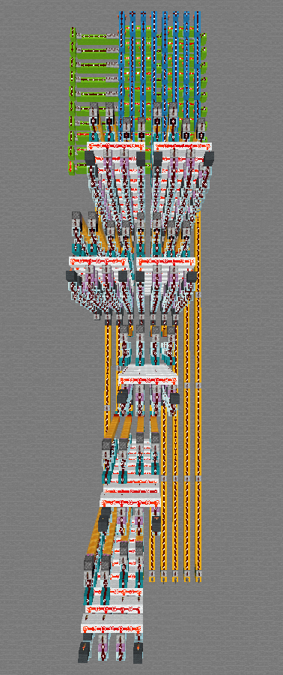
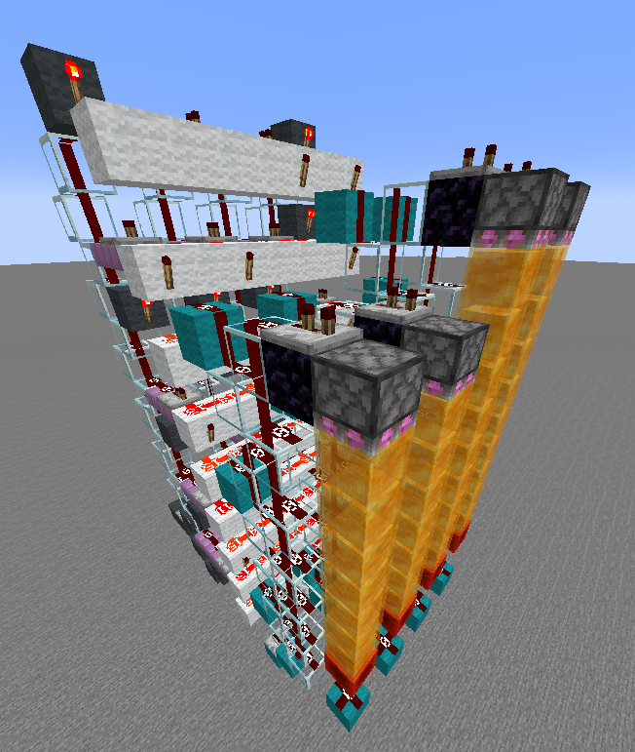
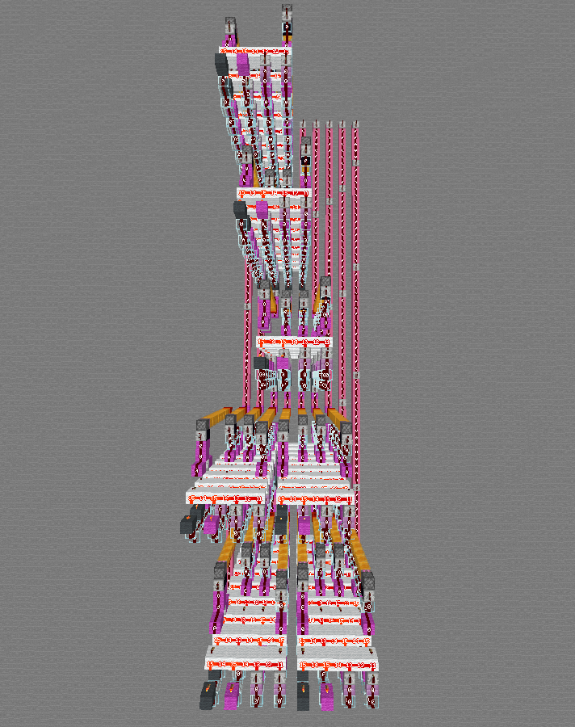
In Minecraft

Slide 7
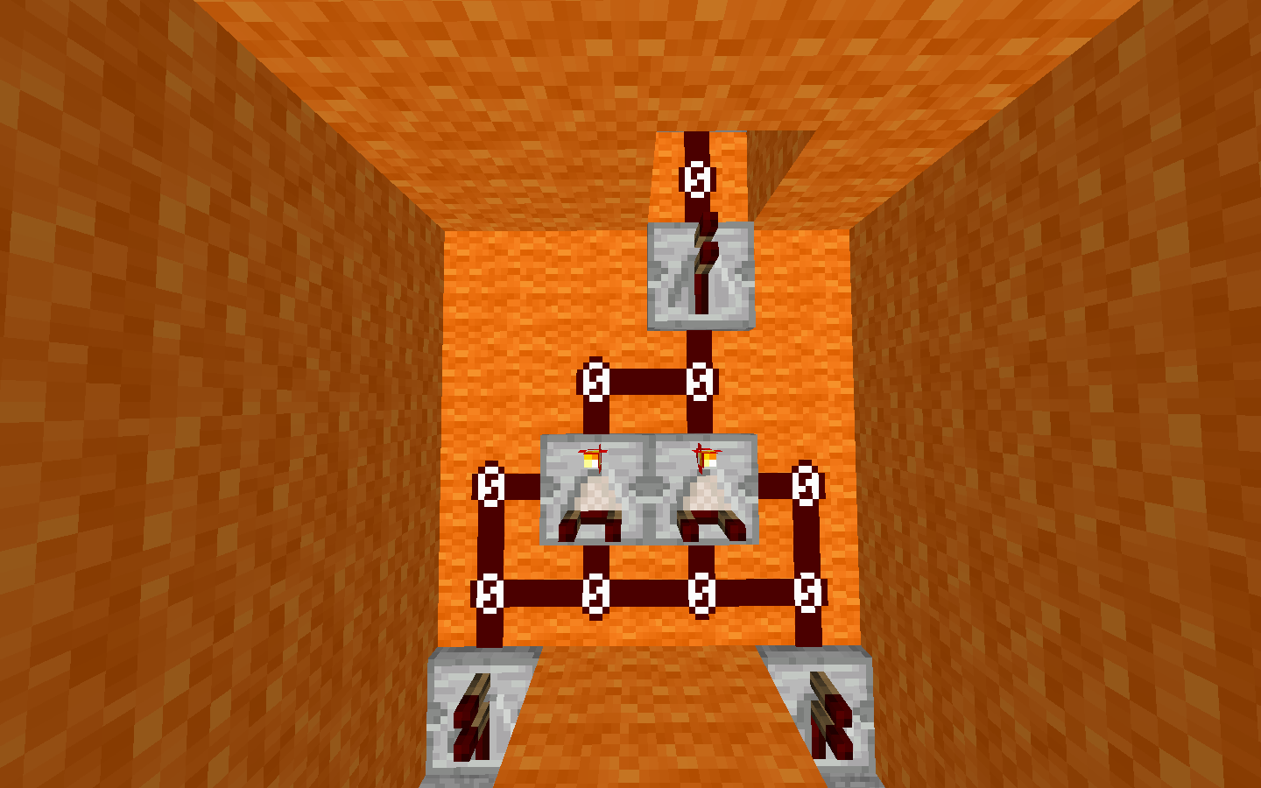
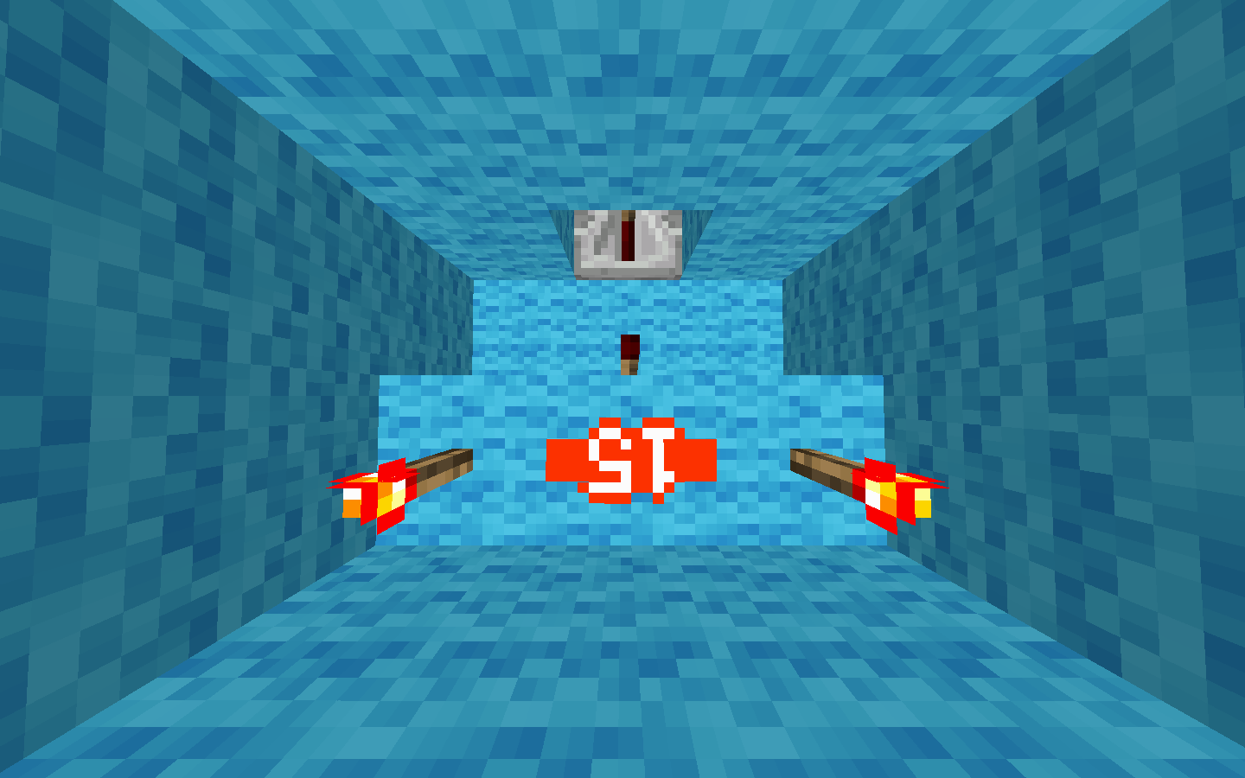
addition
+
0
1
+
1
1
1
1
+
0
0
1
0

