Slide 1
De-extinction
By: Eden Candelaria

Slide 2
Overview:
History
Implementation
Pros
Cons
References
Summary

Slide 3
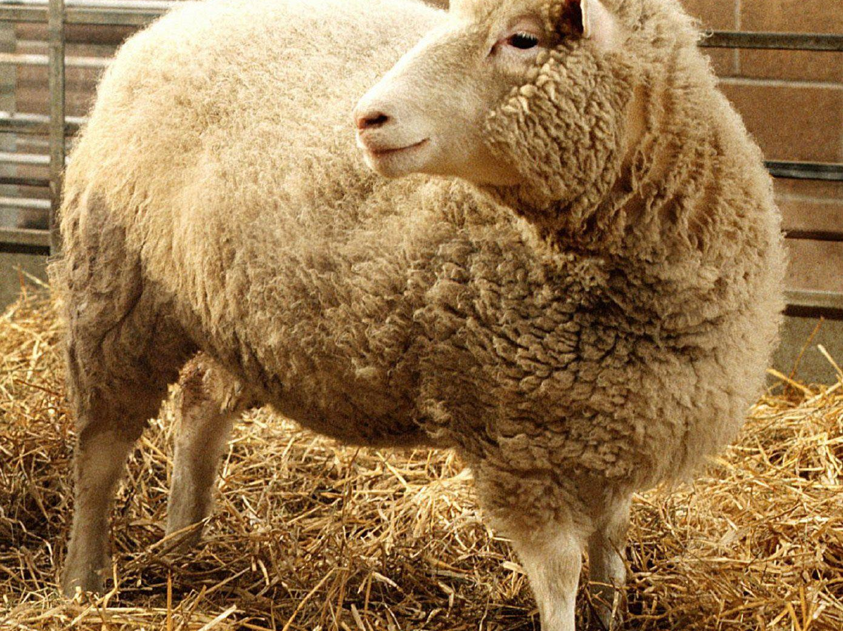
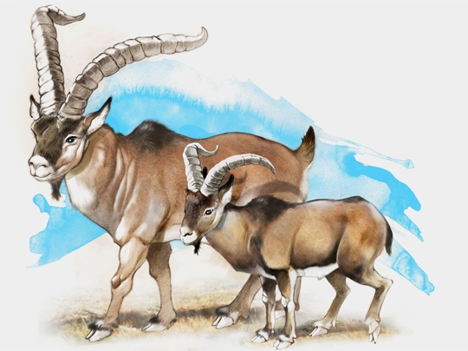
History:
Also known as resurrection biology
In the 1990s somatic cell nuclear transfer(SCNT) was created.
In 2009 scientists came close to successfully bringing an extinct animal back to life.
This was the Pyrenean Ibex
Notes:
SCNT was used to create the first clone, Dolly the sheep who lived seven years
The animal was an Pyrenean ibex. They used preserved tissues. The poor animal only lived for a few minutes due to a severe lung defect. This would cause many to ask if cloning is ethical.

Slide 4
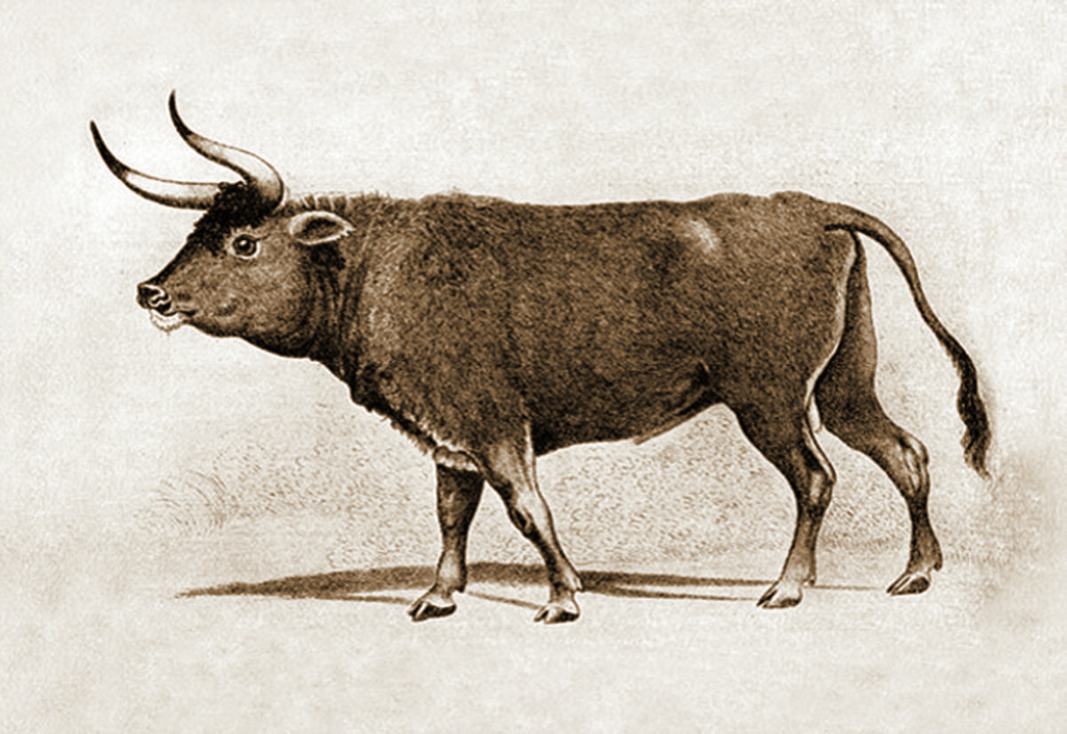
History Continued:
The idea started to be entertained during the early 20th century.
Started with back breeding.
Around the 1920s, 1930s two German zoologists, Lutz and Heinz Heck tried back breeding.
Notes:
Back breeding stems of the idea of selective breeding. It where it makes it so the animal shows more traits of the extinct animal.
They wanted try to get the auroch, this did this by breeding two different cattle to get the desired trait of the auroch. Which is cattle that lived in Europe before it went extinct.
They did not have any genetic insight on the genetic makeup, they had other information. But without any genetic insight they failed.

Slide 5
History Continued:
Methods to clone:
Isolating and Analyzing DNA
Genome Editing
Cloning
Notes:
They use hair, bones, and other tissues from dead animals, through that they were able to find relatives of auroch(previous slide). They got a sperm from one of species and a egg from the other to get a species similar to the auroch.
Genome editing is a form of synthetic biology. It adds and removes a specific pieces of a animal’s DNA. The discovery of CRISPR( Clustered Regularly Interspaced Short Palindromic Repeats) helped greatly with gene editing. Specifically in genome editing.
Cloning mainly us SCNT. SCNT is when nucleus of a body from a animal is put into an egg cell of another animal that had its nucleus removed. It would then go through a process to become an embryo and would be transferred to a female of the species. When doing this with a de-extinct animal the mother of the animal will be its closest relative.

Slide 6
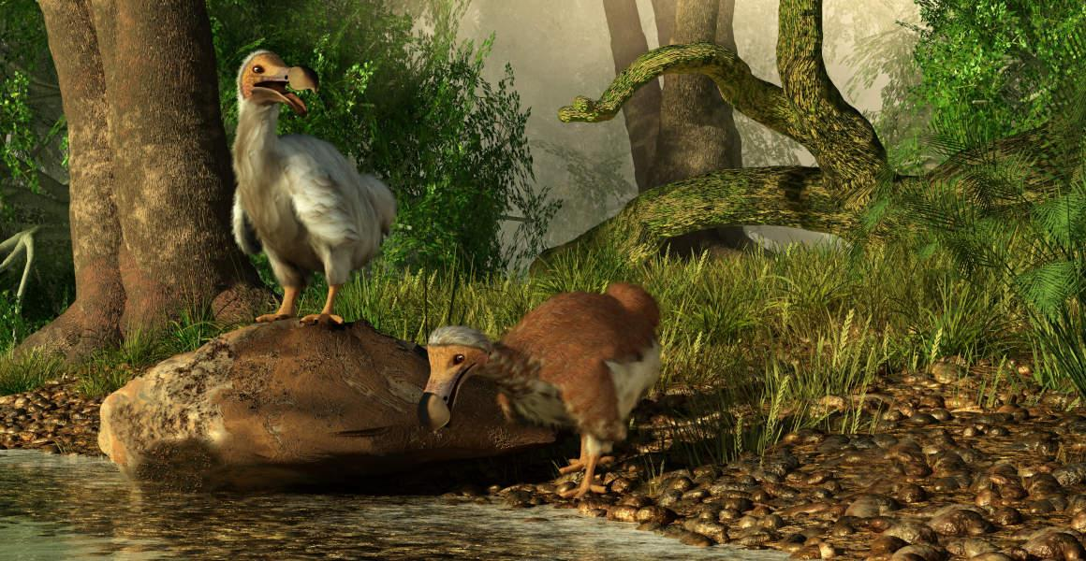
Implementation:
It can help bring back ecosystems
Could compromise biodiversity
It causes moral dilemmas
Notes:
When a species dies it can cause ecosystems to be unbalanced(especially with major animals from that ecosystem). So with de-extinction we can help certain ecosystems from disappearing.
Our focus could change from preserving the things that are currently going extinct to reviving what was extinct

Slide 7
Pros:
Animals brought back from extinction could positively affect the environment.
Can help Animals on the brink of extinction.
They can start giving back what was lost when they went extinct
Notes:
Example: The mammoth helped garden the area in which it occupied, so when it died we lost some biodiversity.

Slide 8
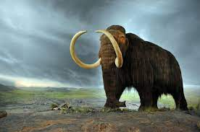
Cons:
It costs a lot of money
It won’t be the original species
There could be unforeseen problems
Notes:
We can get close but we can’t get the exact species. Due to our abilities.
We could bring back sicknesses and other things that caused the animals to go extinct. It could also cause lines that shouldn’t be crossed to be crossed.

Slide 9
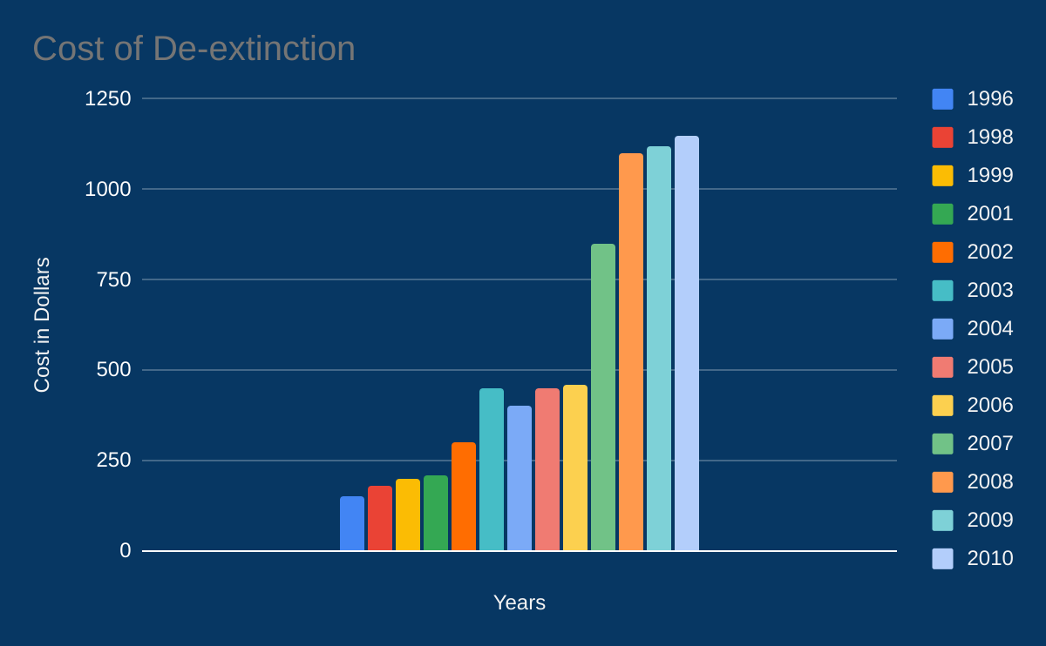

Slide 10
Summary:
Before I thought that de-extinction was not a good idea. After learning more about it I still feel like it is a bad idea. Even though there are some good things that could come out of it. Which is really nice. The is also many risks that accompany it, risks that out weight the benefits. Therefor I still think that de-extinction is a bad idea.

Slide 11
References:
“de-extinction”, the Britannica
“De-extinction: Can we bring extinct animals back from the dead?”, Science Focus
To de-extinct or not to de-extinct?, The Official PLOS Blog
How much does it cost to save a species from extinction? Costs and rewards of conserving the Lear's macaw, Royal Society Open Science
13 Biggest Pros and Cons of De-Extinction, ConnectUS

