Slide 1
De-extinction
By: Eden Candelaria

Slide 2
Overview:
History
Implementation
Pros
Cons
References

Slide 3
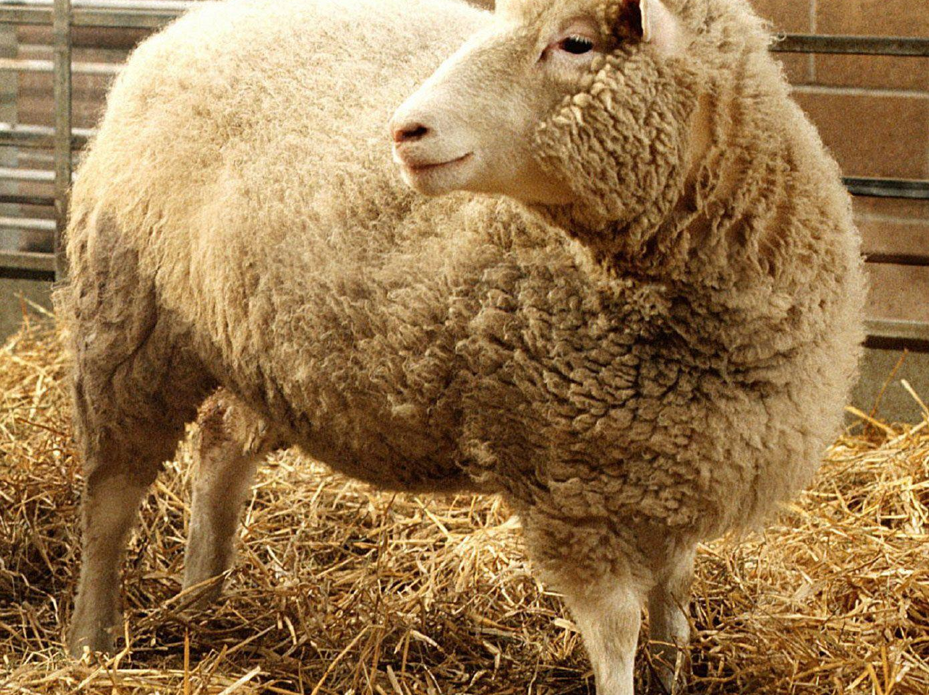
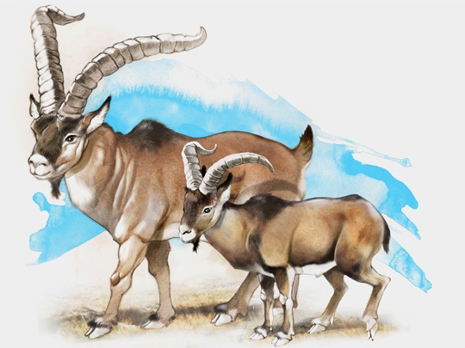
History:
Also known as resurrection biology
In the 1990s somatic cell nuclear transfer(SCNT) was created.
In 2009 scientists came close to successfully bringing an extinct animal back to life.
This was the Pyrenean Ibex
Notes:
SCNT was used to create the first clone, Dolly the sheep who lived seven years
The animal was an Pyrenean ibex. They used preserved tissues. The poor animal only lived for a few minutes due to a severe lung defect. This would cause many to ask if cloning is ethical.

Slide 4
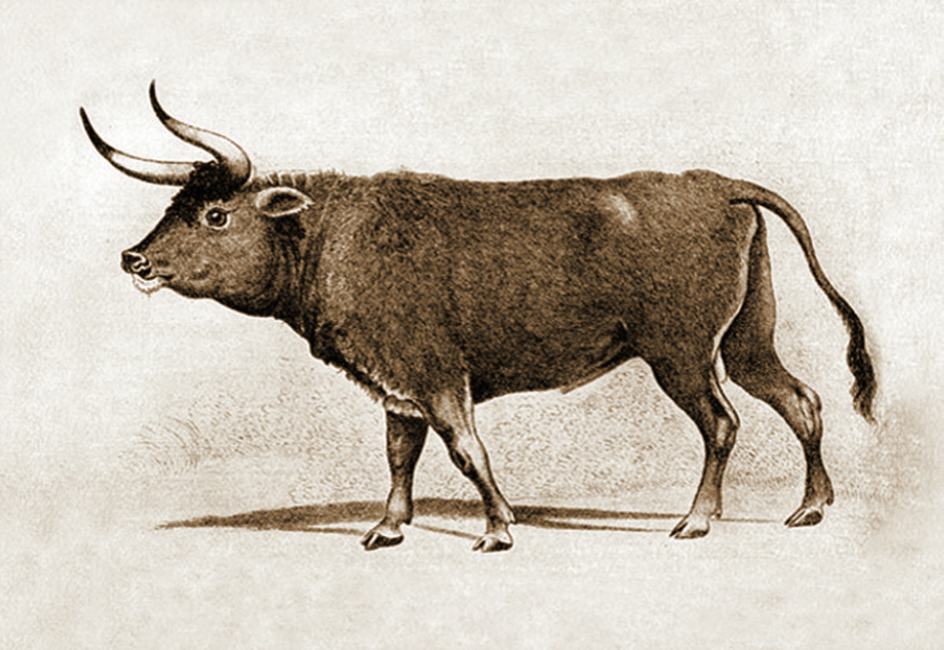
History Continued:
The idea started to be entertained during the early 20th century.
Started with back breeding.
Around the 1920s, 1930s two German zoologists, Lutz and Heinz Heck tried back breeding.
Notes:
Back breeding stems of the idea of selective breeding. It where it makes it so the animal shows more traits of the extinct animal.
They wanted try to get the auroch, this did this by breeding two different cattle to get the desired trait of the auroch. Which is cattle that lived in Europe before it went extinct.
They did not have any genetic insight on the genetic makeup, they had other information. But without any genetic insight they failed.

Slide 5
History Continued:
Methods to clone:
Isolating and analyzing DNA
Notes:
They use hair, bones, and other tissues from dead animals

Slide 6
Implementation

Slide 7
Pros:
Animals brought back from extinction could positively affect the environment.
Can help Animals on the brink of extinction.
They can start giving back what was lost when they went extinct
Notes:
Example: The mammoth helped garden the area in which it occupied, so when it died we lost some biodiversity.

Slide 8
Cons:

Slide 9
References:
“de-extinction”, the Britannica
“De-extinction: Can we bring extinct animals back from the dead?”,

