Slide 1
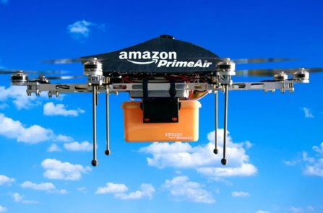
🚁
BIG DATA
ARCHITECTURE
for Autonomous Drone
Swarm Coordination
A Case Study of Amazon Prime Air
B001 Shatakshi Pandey
B010 Nihar Sahu
MSc Data Science | Big Data Technology
B018 Firdaus Khan
B025 Bitu Singh
B027 Neha Singh
amazon prime air
BIG DATA ARCHITECTURE | AMAZON PRIME AIR CASE STUDY

Slide 2
About Amazon & Prime Air
ABOUT AMAZON
AMAZON PRIME AIR
Founded
1994 by Jeff Bezos in Seattle, USA
What is Prime Air?
Amazon Prime Air is an autonomous drone delivery service designed to deliver packages up to 5 lbs in 30 minutes or less using unmanned aerial vehicles (UAVs).
HQ
Seattle, Washington, USA
CEO
Andy Jassy (since 2021)
Key Highlights:
Delivers packages within 30 minutes
Employees
1.5 Million+ worldwide
Handles packages up to 5 lbs (2.3 kg)
Operates via fully autonomous navigation
Revenue
$575 Billion+ (2023)
FAA-approved for commercial operations (2019)
Core Business
E-Commerce, Cloud (AWS), AI, Logistics
Active in: Lockeford CA, College Station TX
Uses AI + Big Data for real-time decisions

Slide 3
How Amazon Collects Data
Amazon drones collect 4 major categories of data every second during flight:
Location Data
Flight Data
Environmental Data
Obstacle Data
GPS coordinates
Speed & direction
Wind speed & direction
Buildings & trees
Altitude readings
Battery level
Weather conditions
Moving objects
Route information
Motor performance
Temperature
Other drones
Current position
Vibration sensors
Terrain mapping
Birds & hazards
This real-time data helps drones: navigate safely | avoid obstacles | coordinate with other drones | deliver packages accurately

Slide 4
Data Collection Techniques
Sensors
Cameras & Computer Vision
GPS sensor — precise location tracking
High-res cameras capture surroundings
Gyroscope — orientation & stability
AI algorithms detect obstacles in real-time
Barometer — altitude measurement
Identifies safe landing zones
Ultrasonic sensors — close-range detection
Detects moving objects & people
LiDAR — 3D environment mapping
Stereo vision for depth perception
5G & IoT Communication
Drone-to-Drone (V2V)
5G enables real-time cloud communication
Vehicle-to-Vehicle data sharing
Drones act as IoT devices on network
Share position & route information
Low latency data transmission (<10ms)
Collision avoidance coordination
Continuous uplink to AWS cloud servers
Swarm intelligence algorithms
Redundant communication channels
Mesh networking between drones

Slide 5
Data Collection Architecture Diagram
Drone Sensors
& Cameras
Data
Collection
Wireless Network
(5G / IoT)
Cloud Storage
(AWS S3)
Big Data
Processing
AI Decision
Making
Safe Drone
Delivery
▶
▶
▶
▶
▶
▶
GPS, LiDAR,
Gyroscope, Camera
Raw sensor
data captured
Real-time
transmission
Petabyte-scale
storage
Kafka, Spark,
Flink, Lambda
ML models &
route optimization
30-min delivery
achieved
"In Amazon Prime Air, drones collect real-time data using sensors, cameras, GPS & communication networks. This data is transmitted to cloud systems where Big Data analytics and AI help drones navigate safely and coordinate delivery operations."
Data Volume: Each drone generates ~1GB/hour | 1,000-drone swarm = ~1TB+/day | All processed in real-time via AWS infrastructure
Drone-to-Drone (V2V) Communication:
Drone A ⟷ Drone B
Drone B ⟷ Drone C
All Drones ⟷ AWS Cloud
Cloud ⟷ Control Center

Slide 6
The 5 V's of Big Data in Drone Systems
V1 VOLUME
V2 VELOCITY
V3 VARIETY
Massive Scale
Real-Time Speed
Diverse Formats
~1TB+/day
<10ms latency
10+ data types
Each drone generates ~1GB/hour of sensor data. A 1,000-drone swarm produces terabytes daily — location, telemetry, images, and logs.
Data must be processed in milliseconds. Flight corrections, collision avoidance, and routing need instantaneous analysis for safe delivery.
Structured GPS logs, unstructured camera feeds, semi-structured weather APIs, LiDAR point clouds, and audio sensor readings.
V4 VERACITY
V5 VALUE
Data Quality
Business Impact
99.99% accuracy
30-min delivery
Sensor noise, GPS drift, and interference affect reliability. AI-driven validation ensures only accurate data drives autonomous decisions.
Analyzing delivery routes, battery patterns, and failure rates enables optimization — reducing costs and improving delivery SLAs.

Slide 7
Frameworks & Methods
DATA INGESTION
Used since 2018
BATCH PROCESSING
Used since 2019
Apache Kafka
Apache Spark
Kafka acts as the central nervous system for drone data. It collects millions of real-time events per second from all drones — GPS, battery, LiDAR, camera frames — and routes them to the right processing systems without any data loss, even under extreme load.
Spark processes massive historical datasets — past flight logs, delivery records, maintenance history. It powers weekly ML model retraining and generates optimized route maps. Handles terabytes of drone data in hours using distributed computing across AWS clusters.
STREAM PROCESSING
Used since 2020
STORAGE & WAREHOUSE
Core since 2017
Apache Flink
AWS S3 + Redshift
Flink processes live drone data streams with sub-50ms latency. It runs continuous queries: 'Is drone X about to collide?' or 'Has wind speed exceeded safe limits?' and triggers instant flight corrections — making real-time autonomous decisions non-stop, 24/7.
AWS S3 stores raw petabyte-scale drone telemetry with 99.999% durability. Redshift warehouses cleaned, structured data for analytics teams to query delivery performance, SLA compliance, and battery degradation trends using standard SQL at massive scale.
ON-DEVICE AI PROCESSING
Since 2024 MK30 drone
ML PIPELINE
Used since 2021
Edge Computing (MK30)
AWS SageMaker
Amazon's MK30 drone processes critical safety data ON the device itself — no cloud round-trip needed. Obstacle detection, emergency landing decisions, and collision avoidance all run locally in microseconds. This makes the drone truly autonomous even in poor network zones.
SageMaker trains, tests and deploys ML models that power flight path optimization, demand prediction, and anomaly detection. Models are automatically retrained every week using the latest flight data, continuously improving drone performance and reducing delivery failures.

Slide 8
Big Data Architecture Overview
DATA SOURCES
INGESTION LAYER
PROCESSING LAYER
STORAGE LAYER
APPLICATIONS
Drone Sensors
Apache Kafka
Apache Spark
Amazon S3
Route Optimization
GPS / LiDAR
AWS Kinesis
Flink / Storm
DynamoDB
Swarm Control
▶
▶
▶
▶
Weather APIs
Real-time Streams
Lambda Architecture
HDFS / Data Lake
Predictive Maint.
Camera Feeds
Message Queues
ML Inference
Time Series DB
Delivery Analytics
Lambda Architecture: All data passes through BOTH batch processing (Spark) and speed processing (Flink) for real-time + historical intelligence

Slide 9
Drone Swarm Coordination Mechanisms
Collision Avoidance
Dynamic Route Optimization
Centralized Command Center
LiDAR + computer vision fusion
Reinforcement learning routing
AWS-based cloud control platform
Real-time 3D airspace mapping
Weather-adaptive flight paths
Real-time swarm monitoring dashboard
V2V (Vehicle-to-Vehicle) comm.
Geofencing & restricted zones
Emergency override & recall protocols
Predictive path adjustment
Priority-based delivery queuing
Fleet health & battery management
Live traffic & airspace data
Real-time rerouting algorithms
Delivery status tracking system

Slide 10
Challenges in Big Data Handling
FAA BVLOS Approval Delays (2025)
Regulatory
Urban 5G Signal Dropout (2025)
Connectivity
Amazon cannot fly drones Beyond Visual Line of Sight freely. FAA grants city-by-city approvals only — Prime Air waited 2+ years to expand from 2 to 5 cities, blocking rapid national growth.
In dense cities, tall buildings block 5G signals mid-flight. When drones lose cloud connectivity, real-time swarm coordination breaks — causing delivery failures in the highest-value urban zones.
Battery Life & Weather Limits (2025)
Hardware
GPS Spoofing & Cyber Attacks (2026)
Cybersecurity
MK30 has ~30 min flight time and 10-mile range. Rain, strong winds or long delivery routes drain batteries before completion. Prime Air had to cancel 18% of deliveries in winter 2024 due to weather.
Security researchers in 2025 demonstrated live GPS spoofing that forced Prime Air drones off course. At scale, a single spoofing attack can redirect an entire drone swarm to wrong locations.
Public Privacy & Noise Lawsuits (2025)
Social/Legal
Petabyte Cloud Cost Explosion (2026)
Cost/Scale
Residents in Lockeford CA filed class-action lawsuits over drone cameras filming private yards. Several Texas cities proposed no-fly zones citing 65+ decibel noise from drone swarms overhead.
At 500M deliveries/year, AWS bills for drone data processing & storage are projected to exceed $2.5B/year. Amazon is urgently developing cost-optimized edge-first data architectures to survive this.

Slide 11
Solutions to Big Data Challenges
CHALLENGE
BIG DATA SOLUTION
FAA BVLOS Restrictions
→
Amazon is partnering directly with FAA under BEYOND program (2025) — testing automated BVLOS approval systems using real-time airspace data shared via AWS GovCloud.
Urban Signal Dropout
→
Drone-to-drone mesh networking (V2V) allows drones to relay data through each other when cloud signal is lost — no single point of failure in the swarm (deployed 2024).
Battery & Weather Limits
→
MK30 upgraded with hybrid solar-assist panels (2025 trials) + AI weather prediction using NOAA APIs to pre-cancel risky flights before launch, saving 23% wasted battery cycles.
GPS Spoofing Attacks
→
Amazon deployed multi-constellation GNSS (GPS + Galileo + GLONASS) cross-verification in 2025. If signals diverge by >2m, drone auto-lands safely and alerts security operations center.
Privacy & Noise Lawsuits
→
MK30 camera data is automatically blurred for private property using on-device AI (2024). Noise reduced 25% via new rotor design. FAA privacy compliance module integrated into all drones.
Cloud Cost Explosion
→
Amazon shifting to Edge-First architecture (2025-26): 70% of data processed ON the drone, only summaries sent to cloud. Estimated to cut AWS drone data bills by $1.8B/year by 2026.

Slide 12
Amazon Prime Air: With vs Without Big Data
WITHOUT BIG DATA
WITH BIG DATA
Cannot process 1TB+/day sensor data
VS
Handles petabytes daily via distributed systems
Manual route planning — hours of delay
VS
AI-optimized routes in real-time (<50ms)
Drone collisions with no collision avoidance
VS
LiDAR + ML prevents all mid-air collisions
No weather adaptation — flights cancelled
VS
Live weather data reroutes drones instantly
Battery failures undetected — lost drones
VS
Predictive maintenance prevents all failures
30-min delivery impossible at scale
VS
30-min delivery guaranteed at massive scale

Slide 13
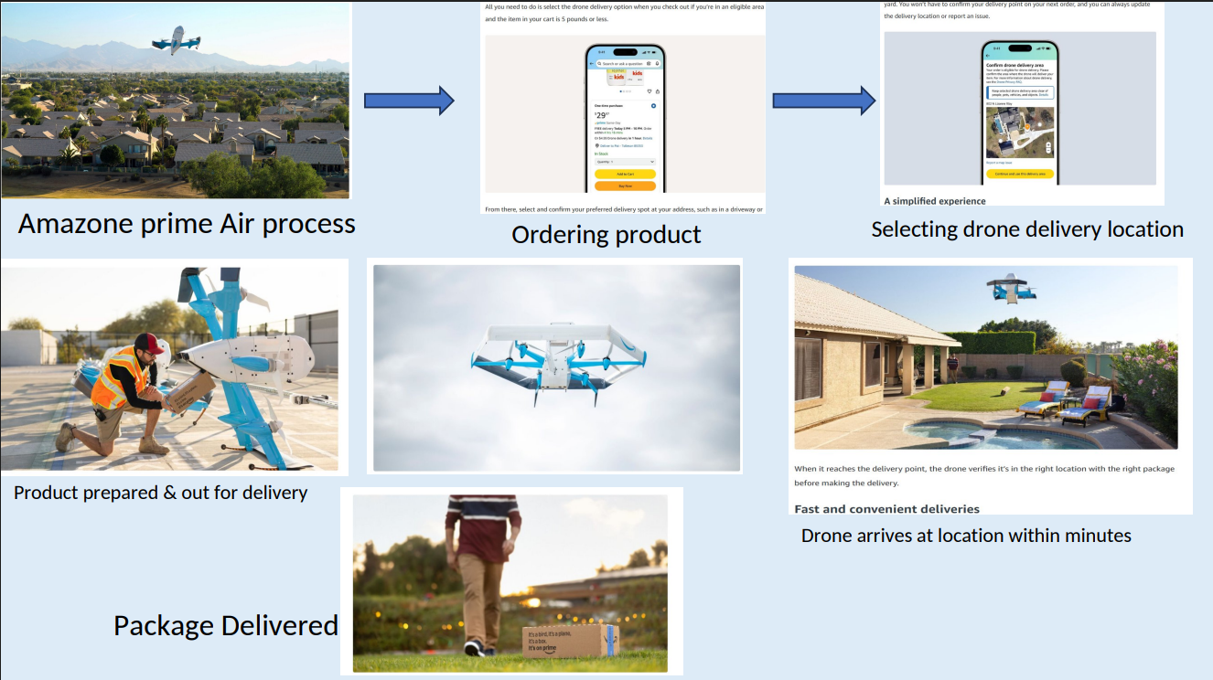

Slide 14
Future Scope
6G + Real-Time Data Transmission
Quantum-Enhanced Analytics
Fully Autonomous Swarm Intelligence
6G networks will enable terahertz-speed data transfers, allowing drones to process and share data 100x faster than current 5G infrastructure.
Quantum computing will allow complex fleet optimizations — routing thousands of drones simultaneously — that would take current systems days to compute.
AI agents will coordinate without human intervention, using federated learning to improve flight decisions continuously across the entire drone fleet.
Urban Air Mobility (UAM)
Green Big Data Infrastructure
Predictive Delivery Intelligence
Prime Air will expand into smart city airspace, integrating with flying taxis and emergency services for a unified Urban Air Traffic Management system.
AWS will power drone operations with 100% renewable energy data centers, reducing carbon footprint while scaling to millions of daily drone deliveries.
Big Data will predict customer demand before orders are placed — pre-positioning drones for instant delivery using historical purchase pattern analysis.

Slide 15
KEY
TAKEAWAYS
1
Big Data is the backbone enabling real-time autonomous drone navigation at scale
2
The 5 V's framework explains why traditional systems cannot handle drone data
Big Data Drives
the Future of
Drone Delivery
3
Distributed processing (Kafka, Spark, Lambda) is essential for swarm coordination
4
Edge computing + cloud hybrid architecture delivers required low-latency performance
5
Amazon Prime Air proves Big Data technology can transform logistics at a global scale

