Slide 1
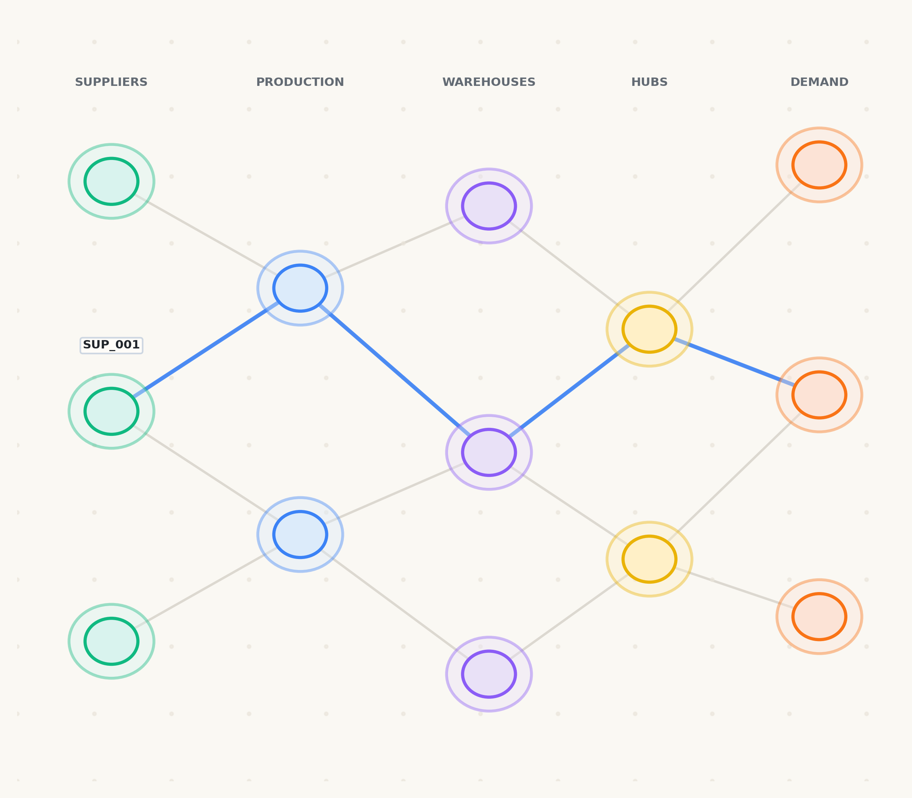
PROJECT REVIEW & TECHNICAL EVALUATION
NEXUS
AI-Powered Supply Chain Intelligence,
Risk Prediction & Optimization
MONITOR → PREDICT → IMPACT → SIMULATE → OPTIMIZE → RECOMMEND
Shreyansh Uttam
B.Tech CSE (Artificial Intelligence & Machine Learning)
VIT Bhopal University
NEXUS — AI-Powered Supply Chain Intelligence & Optimization | Shreyansh Uttam | Slide 1 of 13
Notes:
Good morning, respected faculty members. My name is Shreyansh Uttam, and today I am presenting NEXUS—an AI-powered supply chain intelligence, risk prediction, and optimization platform.
Modern supply chains are complex multi-echelon networks that face constant volatility. NEXUS unifies empirical data, machine learning forecasting, graph-based impact propagation, what-if simulation, and mathematical optimization into a single closed decision loop. In the next 10 minutes, I will show you how NEXUS detects an upstream disruption, traces its downstream network impact, and automatically computes the optimal reallocation in milliseconds.

Slide 2
02 / 13 • PROBLEM MOTIVATION
Supply chains don't fail at one point.
A small disruption can cascade across the entire network.
01
FRAGMENTED DATA
Forecasting, inventory, and logistics exist in separate systems, preventing unified end-to-end visibility.
02
DELAYED DECISIONS
Teams often identify the impact only after safety inventory starts running out at distribution hubs.
03
RIGID RESPONSE
Static supplier allocations make it difficult to quickly reroute supply when a primary facility fails.
THE DISRUPTION CASCADE:
Supplier Disruption → Inventory Depletion → Production Starvation → Customer Shortages
Without automated intelligence, a regional boiler failure or strike halts downstream retail deliveries within days.
NEXUS — AI-Powered Supply Chain Intelligence & Optimization | Shreyansh Uttam | Slide 2 of 13
Notes:
Supply chains do not fail at a single point—they cascade.
Today's enterprise operations suffer from three major bottlenecks: First, data is fragmented between ERP, WMS, and planning spreadsheets. Second, decisions are delayed because teams only notice stockouts when warehouse shelves are already empty. And third, contracts are rigid—when a primary vendor shuts down, businesses struggle to quickly calculate alternatives.
As shown at the bottom, an upstream supplier failure ripples through warehouses and factories, ultimately leaving retail demand unfulfilled. To solve this, we need a unified system that connects signals to decisions.

Slide 3
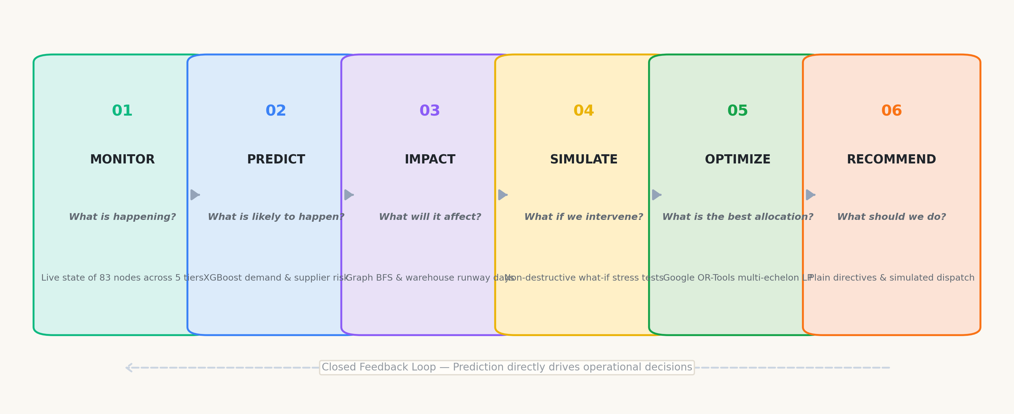
03 / 13 • SYSTEM CONCEPT
One disruption. One decision loop.
A unified decision intelligence platform closing the gap between prediction and operational action.
Prediction becomes useful only when it leads to a decision.
NEXUS — AI-Powered Supply Chain Intelligence & Optimization | Shreyansh Uttam | Slide 3 of 13
Notes:
This is the core concept of NEXUS: a closed six-stage decision loop.
Many AI projects stop at prediction—they forecast a number or flag a risk, but leave the manager wondering what to do. NEXUS answers six progressive questions:
MONITOR asks: what is happening right now?
PREDICT asks: what is likely to happen next?
IMPACT asks: what downstream warehouses and products will be affected?
SIMULATE asks: what if we intervene?
OPTIMIZE asks: what is the best feasible allocation of inventory and transit?
And RECOMMEND asks: what exact directives should the executive approve?
Prediction becomes useful only when it directly informs an operational decision.

Slide 4
04 / 13 • DATA FOUNDATION
Built on empirical data + a calibrated digital twin
Combining real-world sales volatility and delivery delays with a multi-echelon spatial topology.
PUBLIC EMPIRICAL DATA
WALMART
421,570
Weekly historical records across 45 stores and 81 departments.
PRIMARY PURPOSE:
DEMAND FORECASTING
PUBLIC EMPIRICAL DATA
DATACO
35,000+
Representative shipments (180,519 corpus) with authentic delivery delay records.
PRIMARY PURPOSE:
SUPPLIER RISK + BEHAVIOR
CALIBRATED SYNTHETIC
INDIAN TWIN
83 Nodes
160 Corridors, 50,000 Orders, and 500 SKUs mapped across Indian freight corridors.
PRIMARY PURPOSE:
SIMULATION & OPTIMIZATION
Academic Integrity: Empirical datasets ground the models; the Indian network is a simulated digital twin.
NEXUS — AI-Powered Supply Chain Intelligence & Optimization | Shreyansh Uttam | Slide 4 of 13
Notes:
Every engineering system must stand on credible data. In supply chain management, real enterprise operational data is proprietary and confidential. Therefore, NEXUS employs a hybrid data strategy.
For demand forecasting, we use Walmart's empirical dataset of 421,570 weekly sales records from Kaggle, capturing real retail seasonality and holiday surges. For supplier risk, we utilize the DataCo Global Supply Chain dataset from Mendeley, containing over 35,000 shipments with real delivery delays.
We then map these statistical distributions onto an 83-node Indian logistics network. As clearly stated at the bottom, this Indian topology is a calibrated synthetic digital twin, ensuring academic honesty while maintaining realistic multi-echelon complexity.

Slide 5
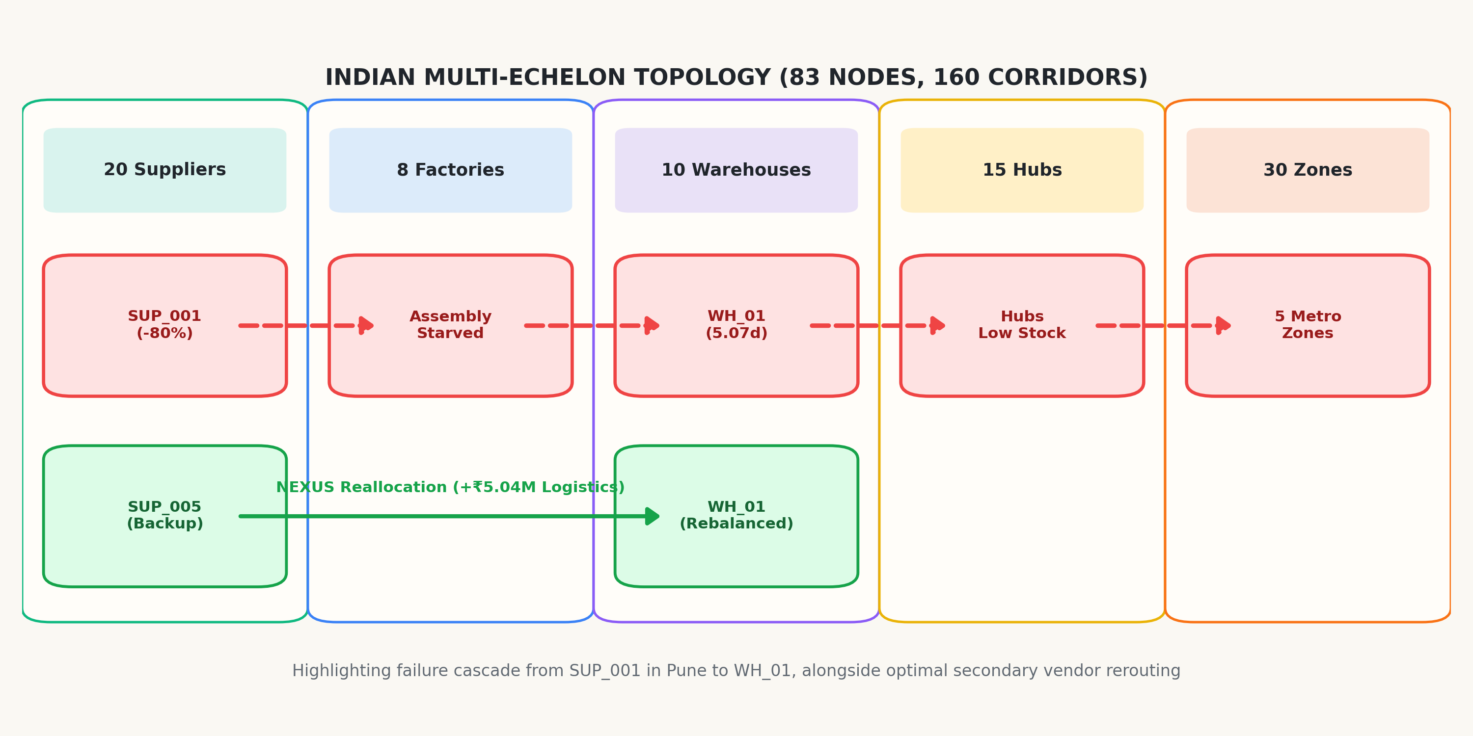
05 / 13 • DIGITAL TWIN TOPOLOGY
A supply chain you can see, trace and stress-test.
An 83-node, 160-corridor digital representation across five operational tiers.
83
Facility Nodes — Suppliers, plants, warehouses, hubs, zones
160
Freight Corridors — Multimodal highway & rail freight lanes
30
Demand Zones — Tier-1 & Tier-2 consumption centers
₹45.9M
Inventory Value — 500 SKUs tracked across central warehouses
NEXUS — AI-Powered Supply Chain Intelligence & Optimization | Shreyansh Uttam | Slide 5 of 13
Notes:
Here is the NEXUS Digital Twin. It models a complete multi-echelon network spanning 83 facilities and 160 multimodal corridors across India.
The network is partitioned into five distinct echelons: 20 suppliers, 8 manufacturing plants, 10 central distribution warehouses tracking 45.9 million rupees in inventory, 15 transit hubs, and 30 consumer demand zones.
On the map visual, you can see our highlighted disruption test: an 80% failure at supplier SUP_001 in Pune cascading down to Western Warehouse WH_01, alongside the green rerouting corridor from alternative vendor SUP_005 in Jamshedpur. The digital twin makes every dependency visible and computable.

Slide 6
06 / 13 • INTELLIGENCE LAYER
Three models. Three questions.
Machine learning detects the operational signal before failure cascades.
01 — DEMAND FORECASTING
XGBoost Regressor
CORE QUESTION:
"How much will we need?"
OUTPUT SIGNAL:
4-week multi-step demand forecast with seasonal confidence intervals.
02 — SUPPLIER RISK
XGBoost Classifier
CORE QUESTION:
"Who is likely to fail?"
OUTPUT SIGNAL:
Vendor disruption probability based on lead-time volatility and delay history.
03 — ANOMALY DETECTION
Isolation Forest
CORE QUESTION:
"What looks unusual?"
OUTPUT SIGNAL:
Real-time unsupervised detection of sudden demand surges and transit outliers.
ML detects the signal. NEXUS then traces its operational impact.
NEXUS — AI-Powered Supply Chain Intelligence & Optimization | Shreyansh Uttam | Slide 6 of 13
Notes:
The Intelligence Layer is built around three specific operational questions rather than generic AI buzzwords.
First, Demand Forecasting asks: 'How much will we need?' It uses an XGBoost Regressor trained on 14 lag and calendar features to output a 4-week demand curve.
Second, Supplier Risk asks: 'Who is likely to fail?' An XGBoost Classifier predicts vendor failure probability from lead-time volatility and delay frequency.
Third, Anomaly Detection asks: 'What looks unusual right now?' An unsupervised Isolation Forest flags unprecedented order surges or highway transit delays.
Critically, machine learning provides the detection signal; NEXUS then determines what that signal actually means for the network.

Slide 7
07 / 13 • EMPIRICAL BENCHMARKING
Does the model actually improve the decision signal?
Empirical out-of-sample evaluation against established industry baselines.
DEMAND FORECASTING (WALMART DATASET)
SUPPLIER RISK (DATACO / 10 UNSEEN VENDORS)
Model Architecture | RMSE | sMAPE
Naive Persistence | 136,255.10 | 7.20%
4-Week Moving Average | 153,446.84 | 8.42%
XGBoost (NEXUS Model) | 96,042.50 | 4.35%
Model Architecture | Precision | Recall | F1
Logistic Regression | 0.7531 | 0.7349 | 0.7439
XGBoost (NEXUS Model) | 0.7442 | 0.7711 | 0.7574
29.51% RMSE Reduction
XGBoost lowers forecasting error by 29.51% over Naive persistence and 37.41% over 4-Week Moving Average, significantly dampening the Bullwhip effect.
77.11% Out-of-Sample Recall
Evaluated via GroupShuffleSplit on 10 completely unseen vendors. High recall ensures early warning of supply failure where missing a disruption carries massive penalty costs.
NEXUS — AI-Powered Supply Chain Intelligence & Optimization | Shreyansh Uttam | Slide 7 of 13
Notes:
Here we evaluate whether machine learning actually improves the decision signal compared to established baselines.
On the left, for demand forecasting, our XGBoost Regressor achieves an RMSE of 96,042 and an sMAPE of 4.35%. This is a verified 29.51% reduction in root mean squared error over the Naive baseline, directly dampening Bullwhip order distortion.
On the right, for supplier risk, we evaluated the models across 10 completely unseen test vendors using GroupShuffleSplit. XGBoost achieves an F1-score of 0.7574 with a high recall of 77.11%. In supply chains, high recall is vital because missing an impending supplier collapse is far more catastrophic than a minor false alarm.

Slide 8
08 / 13 • DECISION MATRIX
From signal → impact → action
Prediction alone does not make decisions; NEXUS connects signals to operational responses.
Signal Detected | Operational Meaning | NEXUS Prescriptive Response
● Demand surge | Safety stock may deplete prematurely | Dynamically increase procurement allocations
● Supplier capacity loss | Critical component shortage risk | Shift sourcing to qualified secondary vendors
● Route delay / blockage | Transit lead-time increases by 2-5 days | Reroute freight via multimodal rail/road
● Low inventory runway | Imminent warehouse stockout (< 7 days) | Trigger inter-warehouse safety stock transfer
● Multi-node shock | Multiple constraints interact across tiers | Execute Google OR-Tools global optimization
NEXUS does not stop at prediction. It connects the prediction to an operational response.
NEXUS — AI-Powered Supply Chain Intelligence & Optimization | Shreyansh Uttam | Slide 8 of 13
Notes:
This slide shows how NEXUS bridges the gap between signals and actions through our Decision Matrix.
Each detected signal has a specific physical consequence and a prescribed operational response. For example, when a supplier loses capacity, the system doesn't just sound an alarm—it identifies component risk and initiates secondary vendor sourcing. When a highway corridor is blocked, it routes freight through rail corridors. And when multiple shocks strike simultaneously, it triggers global optimization.
This answers a fundamental faculty question: NEXUS is not just an analytics dashboard—it is an automated decision-support engine.

Slide 9
09 / 13 • DISRUPTION SIMULATION
What happens when a critical supplier loses capacity?
Simulating an 80% capacity shock on supplier SUP_001 in Pune.
SHOCK
SUP_001 (Tata AutoComp Pune)
80% Capacity Loss for 10 Days
THE CENTRAL STRATEGIC QUESTION:
"Does the network actually lack capacity?"
+160,750 Units
Net Network Capacity Surplus Post-Shock
Total Network Demand = 153,600 units | Remaining Supplier Capacity = 314,350 units.
Key Takeaway: The problem is allocation — not total network capacity.
CASCADE
Western Warehouse (WH_01)
1,420 units stock vs 280 units/day burn rate = 5.07 Days Runway
IMPACT
69,843 Units Potential Shortage
Service level drops to 54.57% without intervention
NEXUS — AI-Powered Supply Chain Intelligence & Optimization | Shreyansh Uttam | Slide 9 of 13
Notes:
To evaluate NEXUS in action, we simulate a severe operational crisis: supplier SUP_001 in Pune loses 80% capacity for 10 days.
On the left, you see the cascade: Western Warehouse WH_01 only has 5.07 days of stock runway remaining, meaning complete stockout on Day 6. Without reallocation, 69,843 units of customer demand would be dropped, plunging service levels to 54.57%.
However, look at the right side: does the network actually lack capacity? No! Even after the shock, remaining suppliers possess 314,000 units of capacity against a network demand of 153,600 units—a net surplus of 160,000 units. The crisis exists solely because traditional allocations are rigid. This brings us directly to optimization.

Slide 10
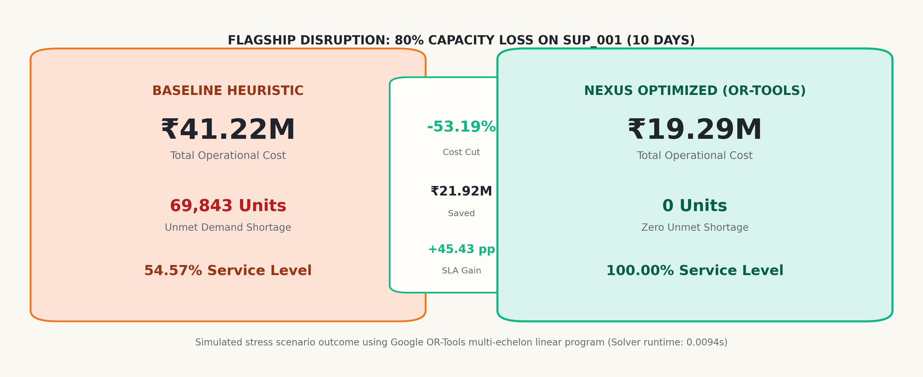
10 / 13 • OPTIMIZATION OUTCOME
NEXUS turns the crisis into an allocation decision.
Google OR-Tools multi-echelon linear optimization achieves global cost minimization in 0.0094 seconds.
Simulated stress scenario using Google OR-Tools multi-echelon optimization (Solver runtime: 0.0094s).
NEXUS — AI-Powered Supply Chain Intelligence & Optimization | Shreyansh Uttam | Slide 10 of 13
Notes:
This is our flagship result: baseline operations versus NEXUS optimization.
Under unoptimized baseline operations, the company incurs 41.22 million rupees in total operational cost—dominated by 24.45 million in contractual stockout penalties—with a service level of just 54.57%.
NEXUS changes this completely. In 9.4 milliseconds, Google OR-Tools computes a global multi-echelon reallocation. By proactively spending 5 million rupees in secondary procurement and freight rerouting from Jamshedpur and Pantnagar, it completely eliminates all 24.45 million rupees of stockout penalties.
The result is a 53.19% reduction in total operational cost—saving nearly 22 million rupees—while restoring customer fulfillment to 100%.

Slide 11
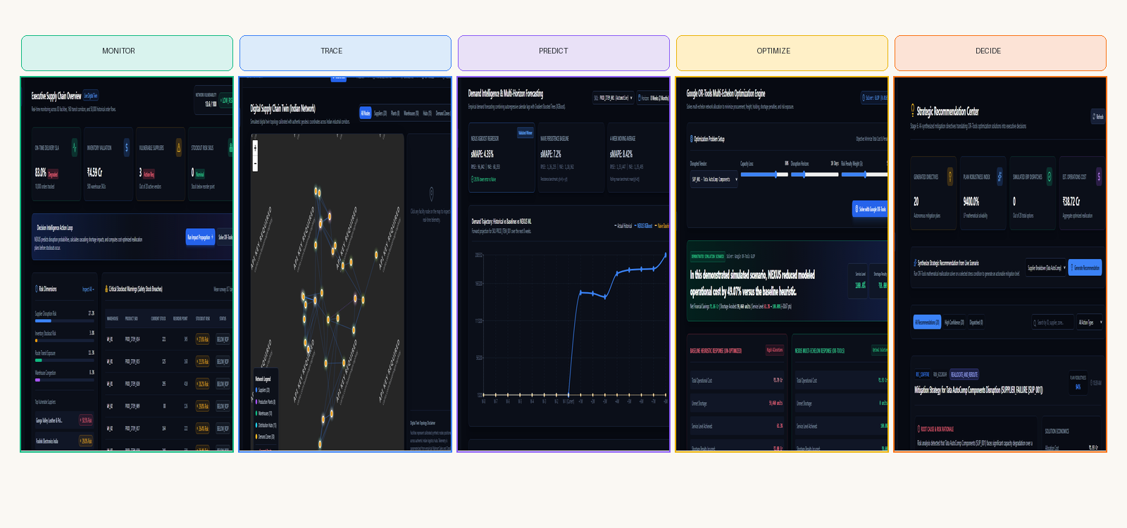
11 / 13 • CONTROL ROOM INTERFACE
From model pipeline to working control room
An interactive enterprise SaaS control room built with React 19, TypeScript, and FastAPI.
TECH STACK: React 19 • TypeScript • FastAPI • Leaflet GIS • Recharts • Google OR-Tools • SQLite / PostgreSQL
NEXUS — AI-Powered Supply Chain Intelligence & Optimization | Shreyansh Uttam | Slide 11 of 13
Notes:
A decision algorithm is only useful if managers can interact with it. Here you see the live NEXUS control room.
Built with React 19, TypeScript, and Tailwind CSS, the platform organizes intelligence into five dedicated views: MONITOR on the executive dashboard, TRACE on the interactive Leaflet GIS map, PREDICT on demand charts, OPTIMIZE on cost waterfall comparisons, and DECIDE on executive action cards.
The frontend is dynamically code-split into lightweight bundles of 365 kilobytes and builds in under 2.5 seconds, delivering a snappy, enterprise-grade user experience.

Slide 12
12 / 13 • QUALITY ASSURANCE
Built, tested and verified.
Comprehensive full-stack verification ensuring complete system stability and zero silent failures.
29 / 29
Backend Tests Passed
Pytest suite (2.66s) covering ML, graph & LP
10 / 10
Frontend Tests Passed
Vitest unit tests for UI and currency formats
0
Build Errors
TypeScript strict compiler & Vite 8.3 bundler
20
REST API Endpoints
FastAPI endpoints verified with HTTP 200 OK
INTEGRATION PIPELINE: React UI → FastAPI → ML / Graph / Simulation → Google OR-Tools → SQLite Persistence
Fixed random seeds (seed=42) • Zero silent mock fallbacks • 100% reproducible execution
Academic Honesty: The platform does not claim live connection to SAP/Oracle or real GPS telematics; ERP dispatch is simulated.
NEXUS — AI-Powered Supply Chain Intelligence & Optimization | Shreyansh Uttam | Slide 12 of 13
Notes:
Every engineering system must be verified. NEXUS has undergone rigorous automated testing across both backend and frontend.
On the backend, all 29 pytest tests pass with 100% success in 2.66 seconds, validating schemas, forecasting algorithms, graph traversal, and optimization constraints. On the frontend, all 10 Vitest tests pass, and the production build compiles with zero TypeScript errors.
Furthermore, our codebase adheres to strict credibility standards: there are zero silent mock fallbacks in the production frontend. Every figure traces directly to the live backend. And as noted at the bottom, we transparently state that live enterprise ERP and GPS connections are simulated.

Slide 13
13 / 13 • CONCLUSION & DEFENSE
NEXUS in one picture.
Transforming fragmented supply chain data into mathematically verified, actionable decisions.
DATA → UNDERSTAND → PREDICT → TRACE → SIMULATE → OPTIMIZE → DECIDE
"From fragmented supply-chain data to actionable decisions."
NEXUS bridges the gap between predictive AI and operations research, providing supply chain operators with the tools to foresee disruption, trace cascading consequences, and execute optimal mitigation.
Thank You! | Questions & Discussion
Shreyansh Uttam • B.Tech Computer Science & Engineering (AI & ML)
School of Computing Science and Engineering (SCSE) • VIT Bhopal University
NEXUS — AI-Powered Supply Chain Intelligence & Optimization | Shreyansh Uttam | Slide 13 of 13
Notes:
To conclude, NEXUS transforms supply chain management from reactive firefighting into proactive decision intelligence.
By connecting empirical data, digital twin graph analysis, machine learning, scenario simulation, and Google OR-Tools optimization, the platform doesn't just predict problems—it solves them. In our verified demonstration, NEXUS eliminated 24.45 million rupees in stockout penalties, maintained 100% service level, and reduced total operational costs by 53.19% in under 10 milliseconds.
Thank you very much for your time and guidance. I would be delighted to answer any questions and demonstrate the live platform.

