Slide 1
Benchmarking Spark Vs. Flink
By
Bivas Ranjan Dutta (2021MCS2128)
Bikram Mondal (2021MCS2127)
Sayak Roy (2021MCS2148)

Slide 2
Spark Streaming
Spark is a high-throughput, scalable and fault-tolerant stream processing system.
It can manage the data from various sources. It takes data from various streams and then divides the streams into multiple batches and then processes it.

Slide 3
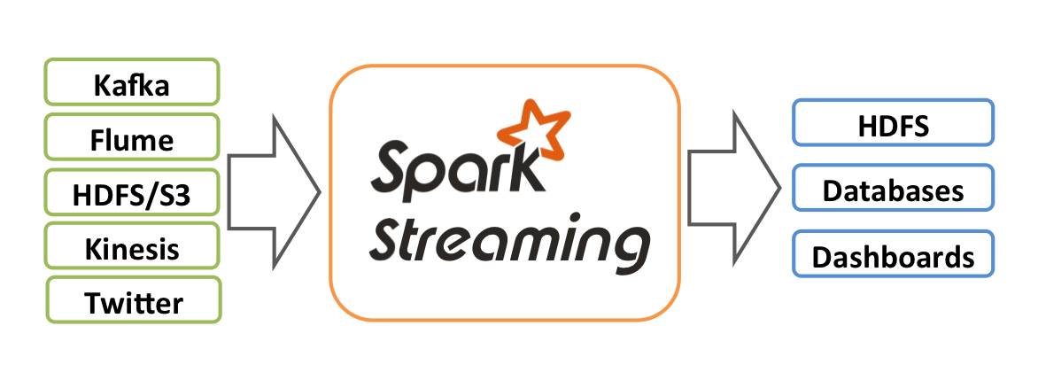
Image link: https://spark.apache.org/docs/latest/img/streaming-arch.png

Slide 4
Our Dataset:
We have taken dataset of stock market.
The columns of dataset are:
Date - specifies trading date
Open - opening price
High - maximum price during the day
Low - minimum price during the day
Close - close price adjusted for splits
Adj Close - adjusted close price adjusted for both dividends and splits.
Volume - the number of shares that changed hands during a given day

Slide 5
Our work in Spark
We have make a spark stream using the csv files.
Then, we have find the average high price for each day.
Create Spark Stream
Outputs average MAX value in the console.
CSV Files

