Slide 1

Machine learning project 2025
Under engineer:
Mohamed Abdelmawgoud Mostafa Khedr

Slide 2
Team members
Bevnoty Mamdouh Beshay Bekhit Gerges 2300536
Andrew Ashraf Ibrahim 2300540
Amr Danny Aly 2300515
Mohamed Mostafa Mohamed Mostafa Elshamy 2300487
Mohamed Ahmed Mohamed Ahmed Taha Smaha 2300531

Slide 3
Project Idea
Our project idea is to create a machine learning model capable of predicting houses' prices using Jupiter notebook and a dataset from Kaggle.com

Slide 4
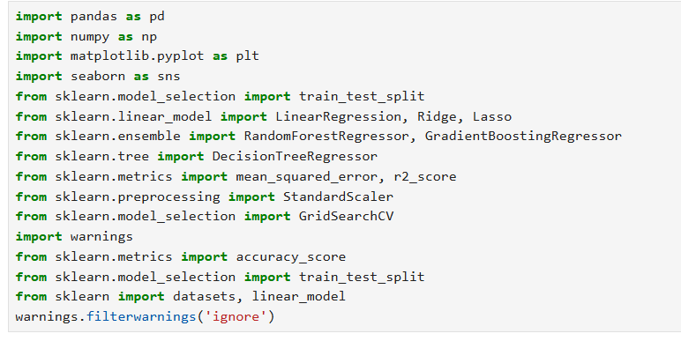
This script imports essential libraries and modules for data analysis, machine learning, and visualization. Key functionalities include:
Data manipulation (pandas, numpy).
Visualization (matplotlib, seaborn).
Machine learning models (LinearRegression, Ridge, Lasso, RandomForestRegressor, GradientBoostingRegressor, DecisionTreeRegressor).
Model evaluation metrics (mean_squared_error, r2_score, accuracy_score).
Data preprocessing (StandardScaler).
Hyperparameter tuning (GridSearchCV).
Dataset splitting (train_test_split).
Warning suppression (warnings.filterwarnings('ignore')).

Slide 5
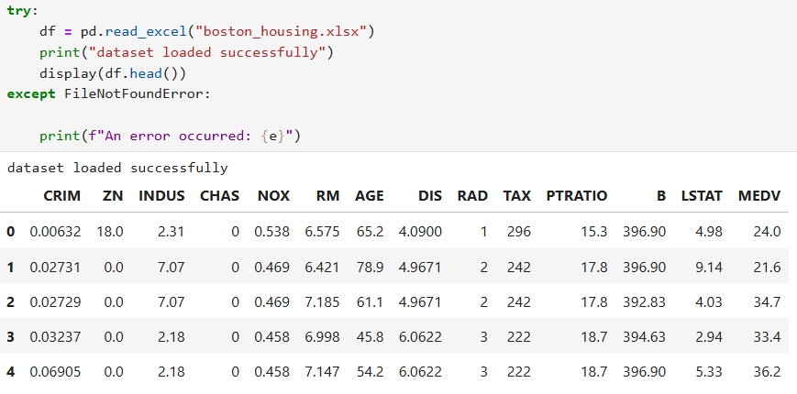
Load the Boston Housing dataset from an Excel file (boston_housing.xlsx) into a pandas DataFrame.
Verify success by printing a confirmation message and displaying the first 5 rows.
Handle errors (e.g., missing file) using a try-except block, though the error handling is incomplete.
Purpose:
the initial step in a machine learning pipeline to load and inspect data before preprocessing/modeling.

Slide 6
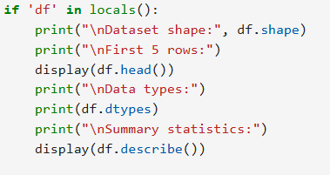
This code block inspects the loaded dataset (df) by:
Checking if df exists (to avoid errors if loading failed earlier).
Printing key metadata:
Shape: Dimensions of the dataset (rows × columns).
First 5 rows: Sample data for quick inspection.
Data types: Checks for numeric/categorical columns.
Summary statistics: Mean, min, max, quartiles (helps detect outliers or scaling needs).

Slide 7

This code snippet checks for missing values in the DataFrame df by:
Verifying that df exists (to avoid NameError).
Counting and displaying null/NaN values per column.
Purpose:
Critical for data cleaning before modeling (missing values can break ML algorithms).
Helps decide whether to drop rows/columns with missing values or impute values (e.g., mean/median).

Slide 8
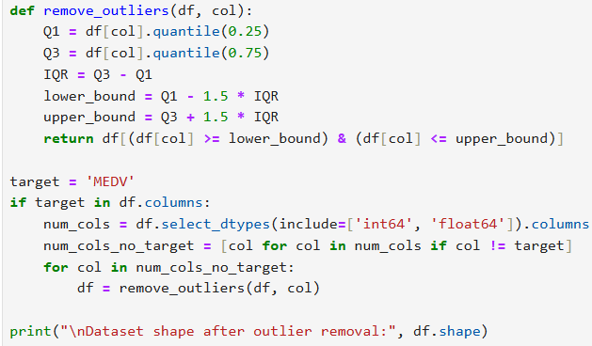
Removes outliers from all numeric features (excluding the target MEDV) using the IQR method.
Preserves rows where values fall within [Q1 - 1.5*IQR, Q3 + 1.5*IQR].

Slide 9
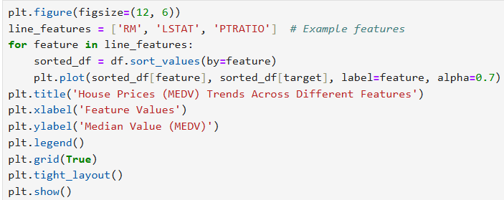
This code plots how house prices (MEDV) change based on 3 features (RM, LSTAT, PTRATIO), showing:
Upward lines = Good for prices
Downward lines = Bad for prices
Messy lines = No clear effect.

Slide 10
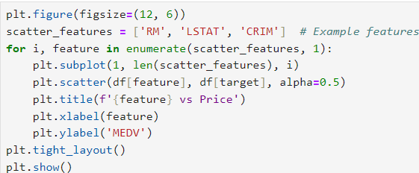
This code creates three scatter plots side by side to analyze the relationship between housing price ('MEDV') and three features:
'RM' (average rooms per dwelling)
'LSTAT' (percentage of lower-status population)
'CRIM' (per capita crime rate) Purpose:
Quickly visualize how each feature correlates with housing prices for exploratory data analysis (EDA).

Slide 11
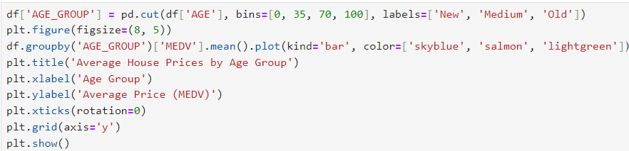
This Python code creates a bar plot to visualize the average house prices (MEDV) across different age groups of houses.
Purpose:
To compare how house age affects average prices, helping identify trends (e.g., older houses may be cheaper or more expensive depending on the market).

Slide 12
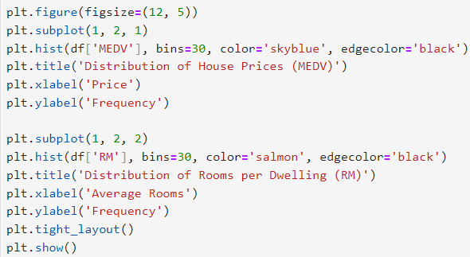
This code creates a side-by-side histogram plot to visualize the distributions of two key variables from a housing dataset:
Purpose:
Left Plot: Shows how house prices are distributed (e.g., normal, skewed, or multi-modal).
Right Plot: Reveals the distribution of room counts (e.g., common room ranges or outliers).

Slide 13
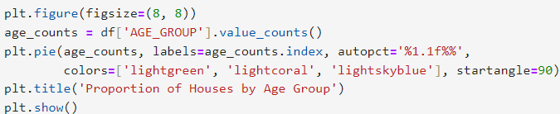
This code creates a pie chart to visualize the proportion of houses in different age groups within a dataset.
Purpose:
Quickly compare the relative distribution of houses across age groups (e.g., majority 'Medium’-aged houses).
Useful for real estate market analysis or portfolio overviews.

Slide 14

Purpose:
Creates a boxplot to analyze the distribution of house prices (MEDV) and identify outliers.

Slide 15
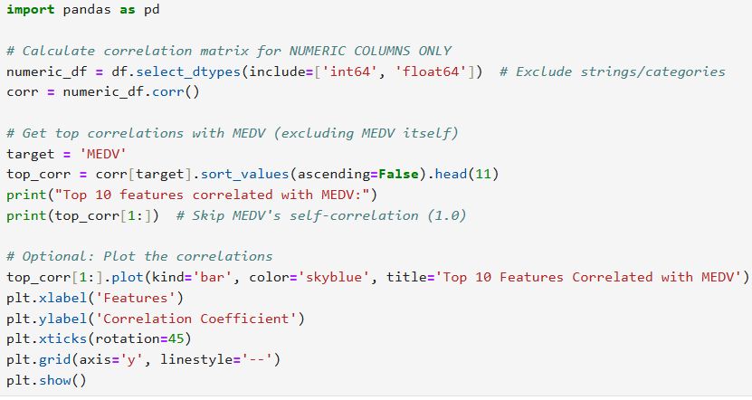
Calculates correlations between all numeric features and house prices (MEDV)
Identifies top 10 features most strongly correlated with MEDV
Visualizes results in a bar chart for easy interpretation

Slide 16
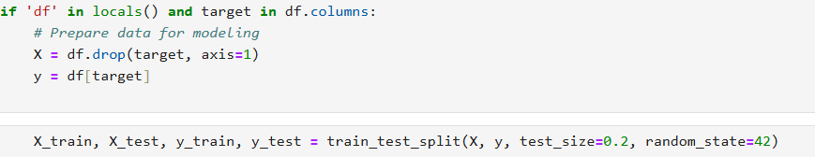
Purpose:
Splits the dataset into training (80%) and testing (20%) sets
Separates features (X) from the target variable (y = MEDV)

Slide 17
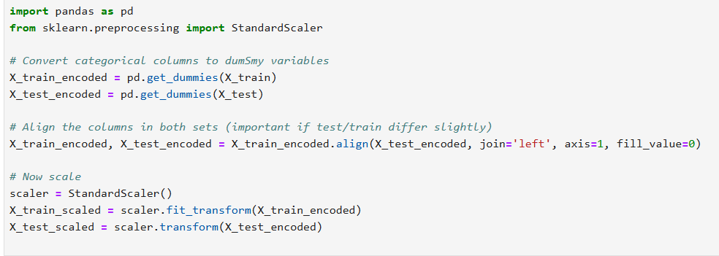
Purpose:
Makes Data Model-Ready
Prevents Data Leakage
Normalizes Feature Scales
Handles Real-World Data Quirks

Slide 18

Purpose:
Trains a Linear Regression model to predict house prices (MEDV) using the pre-processed features.

Slide 19
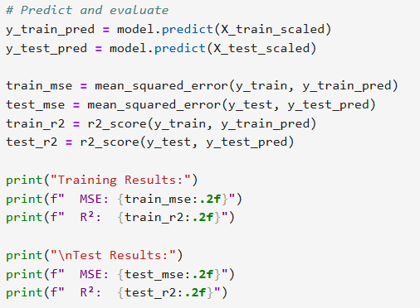
Purpose:
Compares model performance on seen (train) vs unseen (test) data
Detects overfitting (good train but poor test performance)
Provides quantitative benchmarks for model improvement

Slide 20
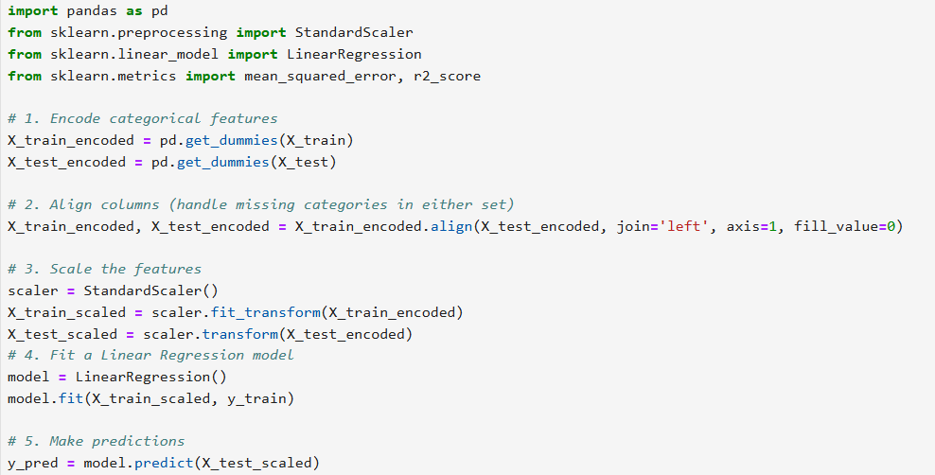
Purposes:
Predict Home Prices
Identify Value Drivers
Ensure Data Readiness
Provide Transparency
Establish a Baseline

Slide 21
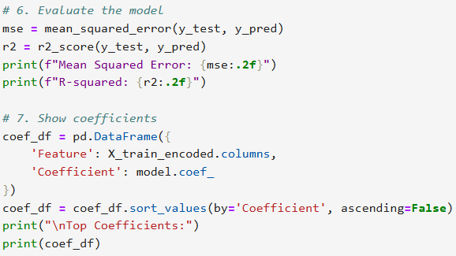
Purposes:
Quantify Prediction Accuracy
Reveal Feature Impact
Ensure Transparency
Benchmark Improvements
Guide Business Decisions

Slide 22
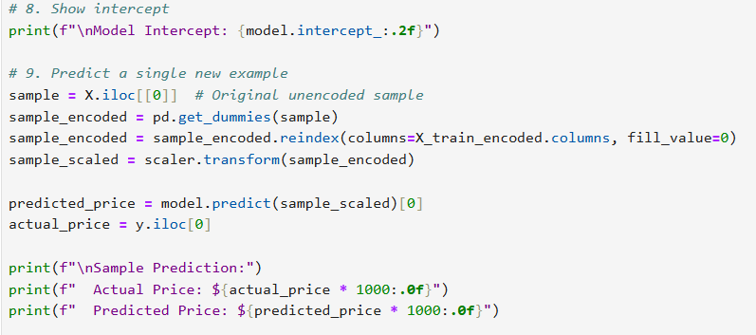
Purposes:
Enable Case-by-Case Predictions
Validate Real-World Applicability
Support Client Conversations
Test Data Pipeline Robustness

Slide 23
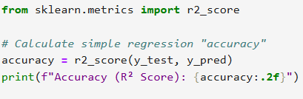
Purposes:
Quantify Model Effectiveness
Benchmark Performance
Compare Across Models
Communicate Business Value
Identify Improvement Areas

Slide 24

THANK YOU

