Slide 1

Kansas Market ANALYSIS
BY Kansas capital consulting

Slide 2
GROUP 12 TEAM MEMBERS
Gideon Biwott
Silah Rugut
James Nyamu
Caroline Kisaulu
Eunita Nyengo
Lorrah Ngine

Slide 3
OUTLINE
Overview
Data
Strategy
Findings
Research Questions
Recommendations

Slide 4
OVERVIEW
Problem Statement:
This project aims to provide insights into the real estate market in Kansas City. With the real estate market's volatility and complexity, investors and buyers need accurate forecasts and insights to make informed decisions.
Stakeholder:
A Real Estate company looking to expand it’s operations in Kansas City.
Business problem:
As a consultancy firm contracted by a real estate company in Kansas City, our goal is to provide actionable insights and strategic recommendations to facilitate informed decision-making for investors and buyers in the local real estate market.
Data:
The dataset consists of information on over 14,000 zip codes in the United States.

Slide 5
STRATEGY
OBJECTIVES | APPROACH
To forecast the future price outlooks for house prices in Kansas City over the next 3 years | Utilize time series analysis and the ARIMA forecasting model to analyze historical prices and predict future trends
To identify growth potential across top 5 zip codes within Kansas City and recommend areas of investment | Conduct regional comparison and growth analysis to identify regions with the most promising prospects for investment
To analyze the impact of macroeconomic events in the top performing zip codes | Explore the seasonal trends in real estate prices and asses the impact of the economical shocks on market dynamics

Slide 6

RESEARCH QUESTIONS
Forecasting Future Prices:
Will Kansas City’s housing market boom, stabilize, or
correct in the next 3 years?
Regional Comparison and Growth Analysis:
What are the top 5 zip codes in terms of growth?
Which areas should investors or buyers look out for?
Impact of Economic Events:
How do economic shocks like the financial global crisis, affect the growth in real estate prices in the top 5 zip codes?

Slide 7
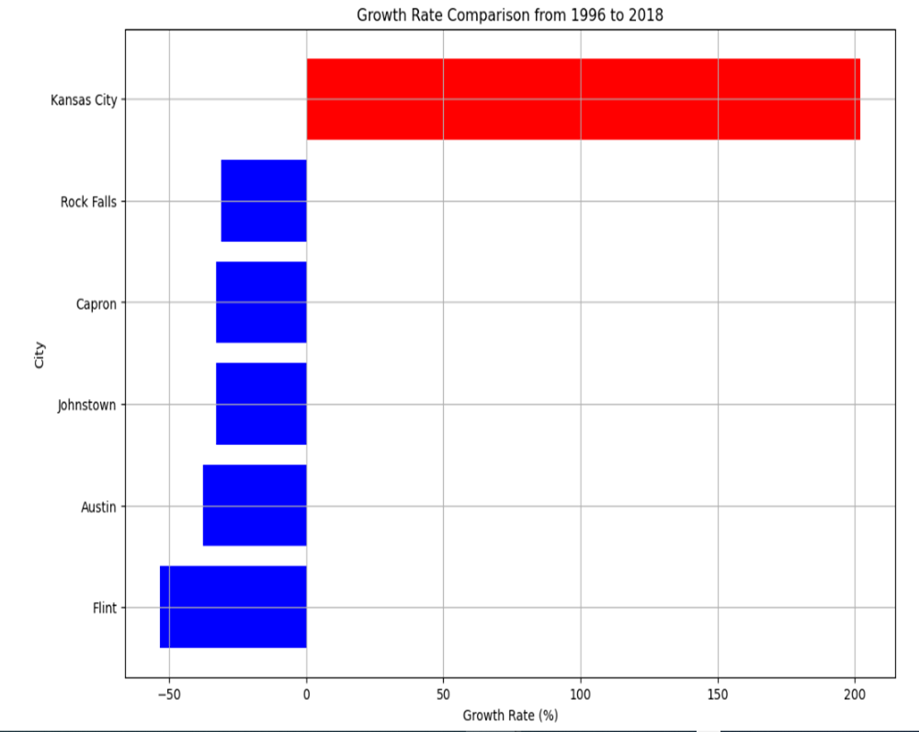
FINDINGS
Robust market with growth potential.

Slide 8
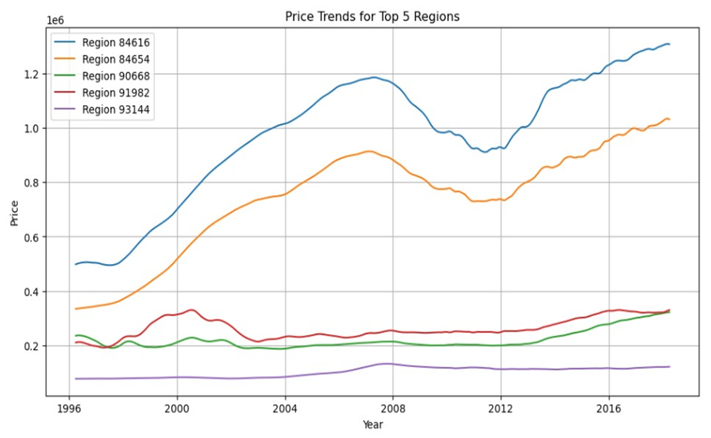
FINDINGS
Upward trend in average property prices until 2008 with correction post 2012.

Slide 9
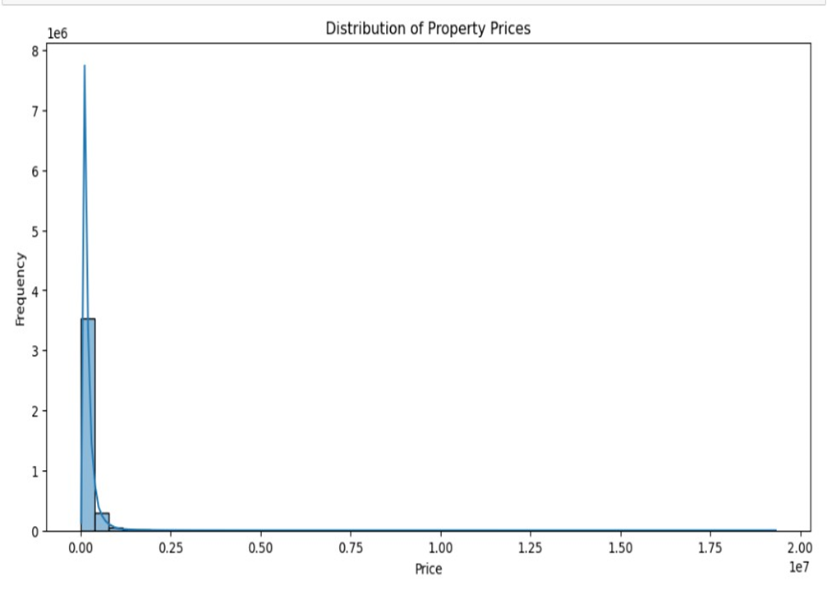
FINDINGS: DISTRIBUTION
Distribution of property prices is uneven, with most properties falling within the lower range pricing for affordable housing for the general population.

Slide 10
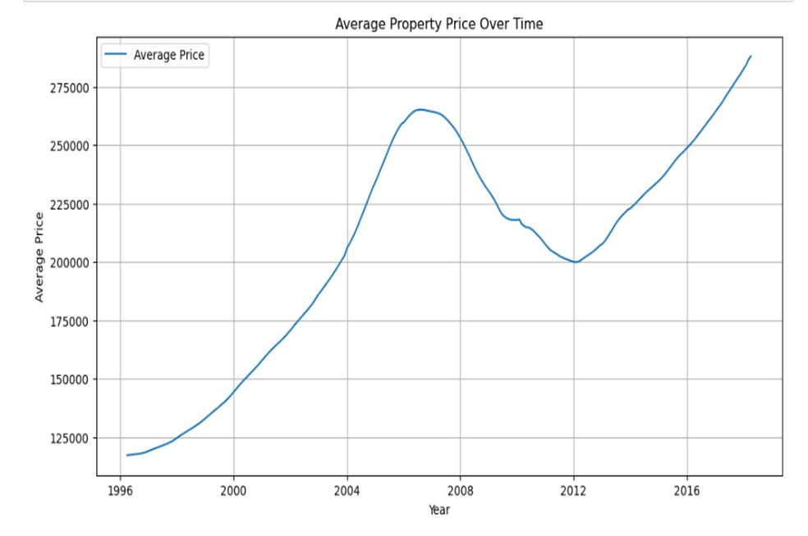
FINDINGS: PRICE
Presence of a few extremely high-value properties, possible luxury or located in high-demand areas.

Slide 11
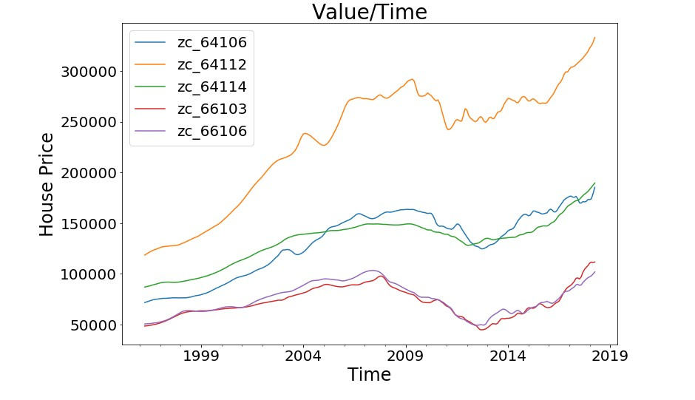
FINDINGS: TOP 5 ZIPCODES (ROI IN 3 YEARS)
ZipCode | ROI | Value ın 3 Years 1000000 Invested
64106 | 0.15 | 1147370.96
66106 | 0.14 | 1137398.54
64114 | 0.12 | 1119297.07
64112 | 0.11 | 1105926.92
66103 | 0.1 | 1101555.08

Slide 12
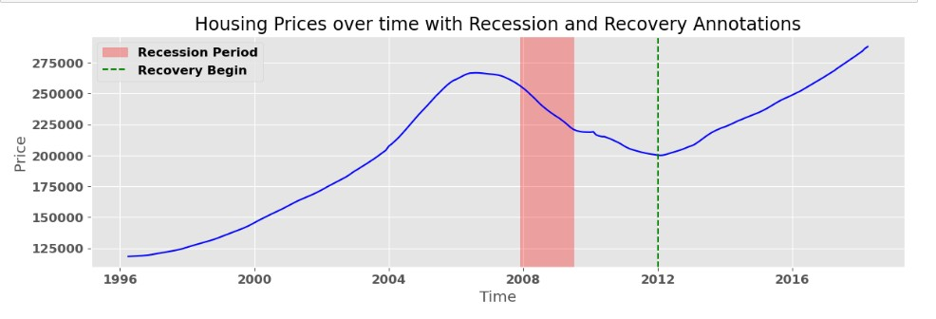
FINDINGS: EXTERNAL FACTORS
Significant recovery post-2008 financial crisis.
Consistent upward trend in property values, especially after 2012.

Slide 13

RECOMMENDATIONS
Invest in Growth Areas:
Focus on regions exhibiting strong and consistent property value increases, such as Zip Code 66103.
These areas signify robust market conditions and potential for high return on investment (ROI).
Diversify Investments:
Consider diversifying investments across multiple zip codes to mitigate risk and leverage diverse market dynamics.
Monitor Market Trends & Timing:
Monitor long-term market trends to make well-informed investment decisions.
Investors should exercise caution regarding market timing and evaluate broader economic indicators.

Slide 14
Whats next?
External Factors Integration:
Include more economic indicators and policy changes in models.
Develop hybrid models combining traditional and machine learning methods.
Collaborative Research:
Join industry forums and partner with experts & stakeholders for insights
Pool expertise to address modelling challenges and drive innovation
Model Refinement
Explore advanced techniques like deep learning for better accuracy and finer trend analysis.
Incorporate additional variables for enhanced performance.
Dynamic Evaluation:
Utilize real-time data for continuous model updates.
Develop adaptive approaches for changing market conditions.

Slide 15
CONCLUSION
Market Resilience: The market has demonstrated remarkable resilience, experiencing substantial recovery following the 2008 financial crisis.
Steady Growth: A consistent upward trend in property values, particularly evident post-2012, reflects the market's stability and growth potential.
Diverse Investment Landscape: From affordable properties to upscale markets the market offers a diverse range of investment opportunities.

Slide 16

Thank You
Any Questions?

