Slide 1
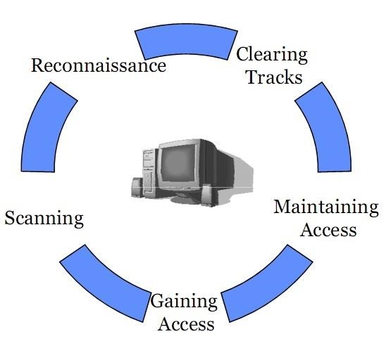
Five Phases of Penetration Testing
Notes:
1/4/18
1
1

Slide 2
Phase 1 | Reconnaissance
Reconnaissance is the act of gathering preliminary data or intelligence on your target. The data is gathered in order to better plan for your attack.
Reconnaissance can be performed actively (meaning that you are directly touching the target) or passively (meaning that your recon is being performed through an intermediary).
Notes:
1/4/18
2
2

Slide 3
Phase 2 | Scanning
The phase of scanning requires the application of technical tools to gather further intelligence on your target, but in this case, the intel being sought is more commonly about the systems that they have in place. A good example would be the use of a vulnerability scanner on a target network.
Notes:
1/4/18
3
3

Slide 4
Phase 3 | Gaining Access
Phase 3 gaining access requires taking control of one or more network devices in order to either extract data from the target, or to use that device to then launch attacks on other targets.
Notes:
1/4/18
4
4

Slide 5
Phase 4 | Maintaining Access
Maintaining access requires taking the steps involved in being able to be persistently within the target environment in order to gather as much data as possible. The attacker must remain stealthy in this phase, so as to not get caught while using the host environment.
Notes:
1/4/18
5
5

Slide 6
Phase 5 | Covering Tracks
The final phase of covering tracks simply means that the attacker must take the steps necessary to remove all semblance of detection. Any changes that were made, authorizations that were escalated etc. all must return to a state of non-recognition by the host network’s administrators.
Notes:
1/4/18
6
6

Slide 7
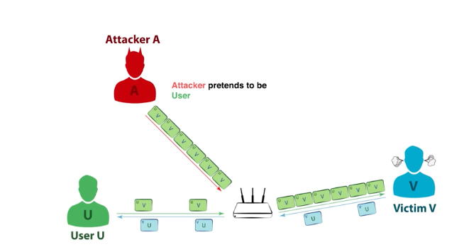

Slide 8
ARP Spoofing Attacks
ARP is short for Address Resolution Protocol, a protocol that is used to resolve IP addresses to MAC (Media Access Control) addresses for transmitting data. In an ARP spoofing attack, a malicious party sends spoofed ARP messages across a local area network in order to link the attacker’s MAC address with the IP address of a legitimate member of the network. This type of spoofing attack results in data that is intended for the host’s IP address getting sent to the attacker instead. Malicious parties commonly use ARP spoofing to steal information, modify data-in-transit or stop traffic on a LAN. ARP spoofing attacks can also be used to facilitate other types of attacks, including denial-of-service, session hijacking and man-in-the-middleattacks. ARP spoofing only works on local area networks that use the Address Resolution Protocol.

Slide 9
DNS Server Spoofing Attacks
The Domain Name System (DNS) is a system that associates domain names with IP addresses. Devices that connect to the internet or other private networks rely on the DNS for resolving URLs, email addresses and other human-readable domain names into their corresponding IP addresses. In a DNS server spoofing attack, a malicious party modifies the DNS server in order to reroute a specific domain name to a different IP address. In many cases, the new IP address will be for a server that is actually controlled by the attacker and contains files infected with malware. DNS server spoofing attacks are often used to spread computer worms and viruses.

Slide 10
CACHE POISONING ATTACK
What Is Cache Poisoning?
Cache poisoning is a type of attack in which corrupt data is inserted into the cache database of the Domain Name System (DNS) name server. The Domain Name System is a system that associates domain names with IP addresses. Devices that connect to the internet or other private networks rely on the DNS for resolving URLs, email addresses and other human-readable domain names into their corresponding IP addresses. In a DNS cache poisoning attack, a malicious party sends forged responses from an imposter DNS in order to reroute a domain name to a new IP address. This new IP address is almost always for a server that is controlled by the attacker. DNS cache poisoning attacks are often used to spread computer worms and other malware. More sophisticated uses for DNS cache poisoning include man-in-the-middle attacks and denial-of-service attacks.

Slide 11
Cache Poisoning Attacks
The success of a cache poisoning attack relies on the existence of exploitable vulnerabilities in DNS software. Once an attacker has sent a forged DNS response, the corrupt data provided by the attacker gets cached by the real DNS name server. It is at this point that the DNS cache is considered “poisoned.” As a result, future users that attempt to visit the corrupted domain will instead be routed to the new IP address selected by the attacker. Users will continue to receive inauthentic IP addresses from the DNS until the poisoned cache has been cleared.
DNS cache poisoning attacks usually incorporate elements of social engineering to manipulate victims into downloading malware. The servers and websites that attackers use to replace authentic IP addresses are set up to appear legitimate while they actually contain malware in disguise. Attackers’ use of social engineering along with the fact that domain names still appear normal can make it very difficult for users to detect cache poisoning attacks. As a result, victims willingly download malicious content that they believe to be valid and from trusted sources.

Slide 12
spoofing vs poisoning
ARP poisoning is an attack that is accomplished using the technique of ARP spoofing.
ARP spoofing is a technique that allows an attacker to craft a "fake" ARP packet that looks like it came from a different source, or has a fake MAC address in it.
An attacker uses the process of ARP spoofing to "poison" a victim's ARP table, so that it contains incorrect or altered IP-to-MAC address mappings for various attacks, such as a man-in-the-middle attack.

Slide 13
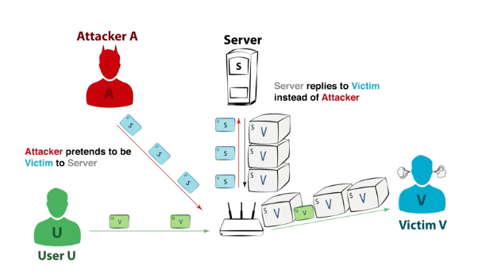

Slide 14
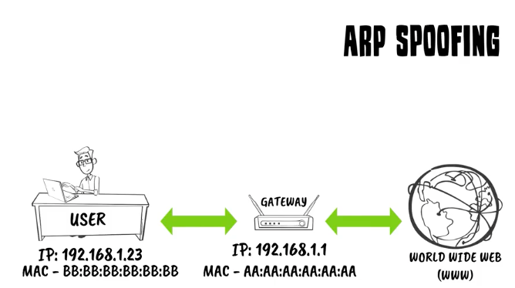

Slide 15
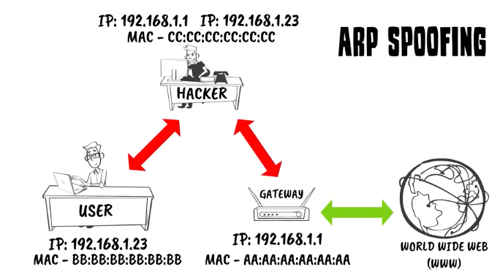

Slide 16
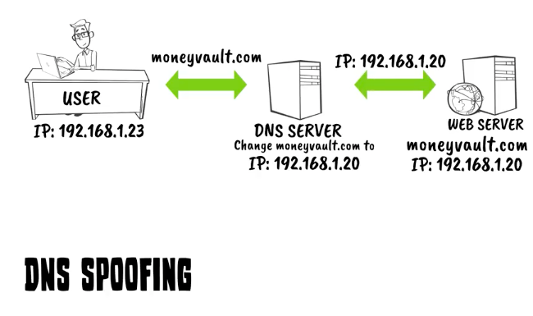

Slide 17
