Slide 1
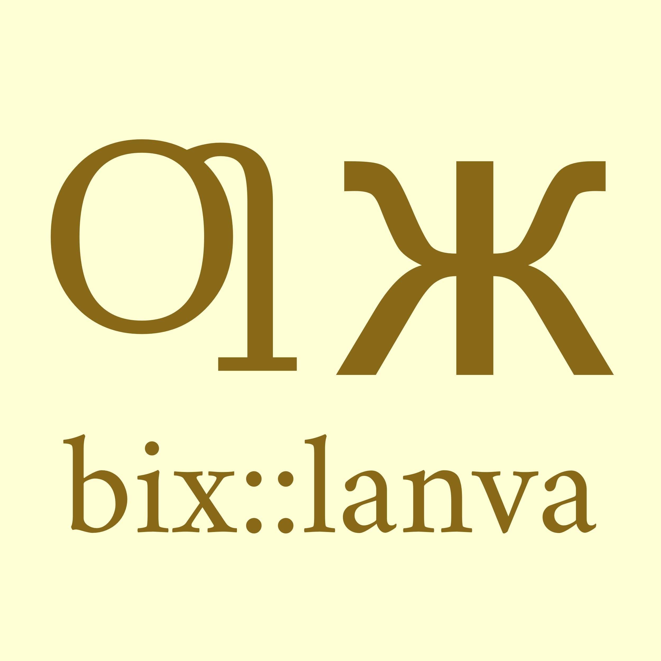
SAШASAT,
DAПALEGOTN rasic GEGWIBARUЪE ge tas
—Grammatical Cases whose Numerousness Other (Language)s don’t Have
1
2
3
4
5
6
7
ABSOLUTIVE CASE
GENITIVE CASE
OBLIQUE CASE / DATIVE CASE
ERGATIVE CASE
VOCATIVE CASE
LOCATIVE CASE
ALLATIVE CASE
-bix
-ic
-e’
-ø
-u’e
-uъe
-ako
8
9
10
11
12
13
14
ABLATIVE CASE
PROLATIVE CASE
PERTINGENT CASE
INESSIVE CASE
EXTERIORESSIVE CASE
SUPERESSIVE CASE
SUBESSIVE CASE
-end
-axu
-op
-oб
-el
-az
-es
15
16
17
18
19
20
21
APUDESSIVE CASE
TEMPORAL CASE
FREQUENTATIVE CASE
COMITATIVE CASE
TRANSLATIVE CASE
GAINIVE CASE
DEPRIVIVE CASE
-ya
-oal
-oƣa
-uпix
-wir
-ati
-atig
22
23
24
25
26
27
CAUSAL CASE
INSTRUMENTAL CASE
DISTRIBUTIVE CASE
ESSIVE- FORMAL CASE
COMPARATIVE CASE
HYPOSTATIC CASE
-eca
-iж
-aшn
-ahi
-apra
-isш

