Slide 1


Shield Insurance
Business Performance & Customer Analytics
Understanding customers, sales behaviour and insurance needs through data

Slide 2
OVERVIEW
Agenda
01
Business Context
05
Sales Mode Behaviour
Who Shield is, where it operates, its scale
Channel choice by city and by day
02
Sales Channels
06
Age Group Analysis
How customers purchase insurance
Settlement exposure, channels and life stages
03
Business Performance
07
Key Business Insights
The March surge in customers and revenue
What the data tells us
04
Customer Profile
08
Business Actions
The age group and city driving the business
Recommended next steps
Shield Insurance
2

Slide 3
01 · BUSINESS CONTEXT
Shield Insurance at a Glance
Shield Insurance sells across five Indian cities through offline and online channels, generating ₹989.25M from 26.84K customers.
What this analysis explores
Who are the customers?
Where does revenue come from?
How do they buy?
When are they most active?
Which coverage do they choose?
Shield Insurance
3

Slide 4
01 · BUSINESS CONTEXT
Shield’s Business Footprint
Five cities across India. Delhi NCR is the largest market, followed by Mumbai.
C
D
H
I
M
Chennai
Delhi
Hyderabad
Indore
Mumbai
Shield Insurance
4

Slide 5
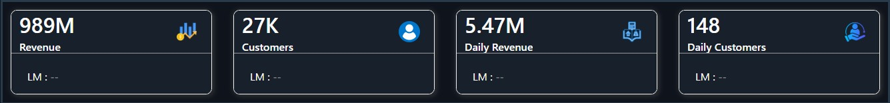
01 · BUSINESS CONTEXT
Key Metrics
₹989.25M
26.84K
₹5.47M
148
Total revenue
Total customers
Average daily revenue
Average customers a day
What the numbers say
Scale: ₹989.25M from 26.84K customers over six months, Nov 2022 to Apr 2023.
Customer value: each customer brings in about ₹37K on average.
Daily run rate: about 148 customers and ₹5.47M every day.
Why it matters
Every trend that follows, from the March surge to channel and age patterns, is read against this baseline.
Shield Insurance
5

Slide 6




02 · SALES CHANNELS
Four Ways Customers Buy Insurance
OFFLINE
ONLINE
Offline-Agent
Offline-Direct
Online-App
Online-Website
Personal guidance from an insurance agent.
55.41% of customers
Direct purchase at a branch or through a company representative.
15.86% of customers
Buy or manage policies on the mobile app.
16.03% of customers
Buy or manage policies on the company website.
12.70% of customers
Shield Insurance
6

Slide 7
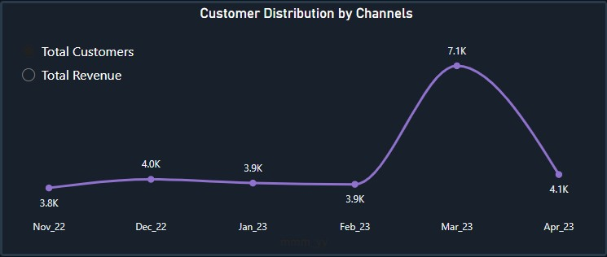
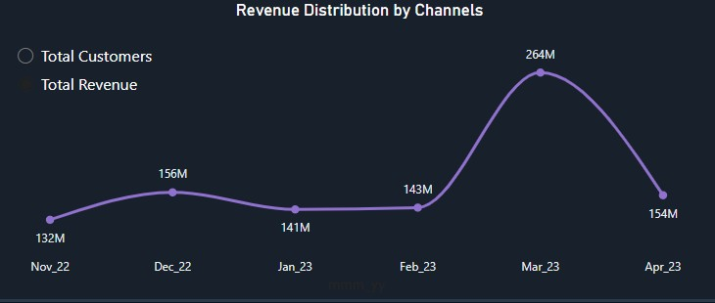
03 · BUSINESS PERFORMANCE
March Is the Peak Demand Month
Customers nearly double in March
~4K a month from Nov to Feb
7.1K in March, up from 3.9K in February
₹264M revenue in March vs ₹143M in February
More customers and more revenue. But are they buying more policies?
Shield Insurance
7

Slide 8
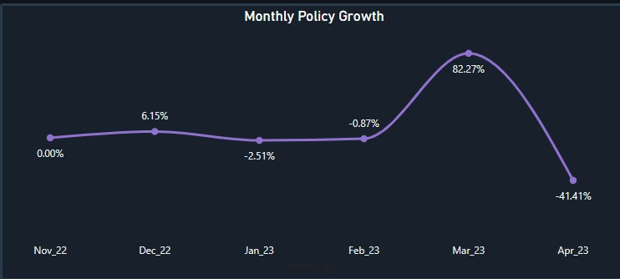
03 · BUSINESS PERFORMANCE
Policy Growth Spikes, Then Normalises
Policy growth: a spike, then a dip
March: +82.27%
April: −41.41% as demand normalises
Likely driver: year-end tax and financial decisions plus stronger sales pushes. The data does not confirm the cause.
March is a seasonal rise in customer volume, not a lasting rise in customer value.
Growth only matters if we know who drives it. Next: which customers contribute most?
Shield Insurance
8

Slide 9
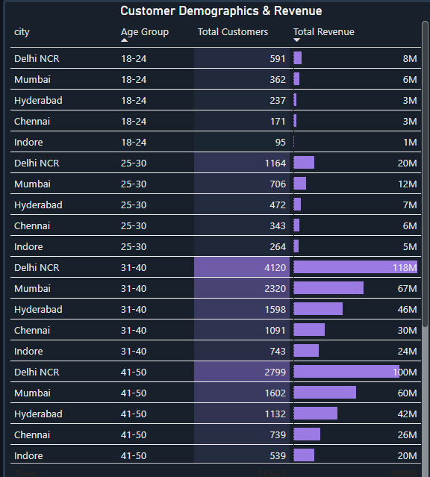
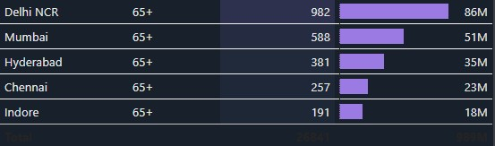
04 · CUSTOMER PROFILE
The 31–50 Age Group Anchors the Business
Age group | Role in the business
31–50 | About 62% of customers; the core revenue base
65+ | Smaller base; highest-value cover (₹1Cr)
18–24 | Smallest segment; lowest cover (₹2L)
Next: how do these customers buy?
Shield Insurance
9

Slide 10
04 · CUSTOMER PROFILE
Delhi Leads Across Every Age Group
City | Position
Delhi NCR | Leads every age group (₹118M in 31–40)
Mumbai | Second in every age group (₹67M in 31–40)
Others | Hyderabad ₹46M, Chennai ₹30M, Indore ₹24M (31–40)
Delhi and Mumbai carry the 31–50 base. Next: how do these customers prefer to buy?
Shield Insurance
10

Slide 11
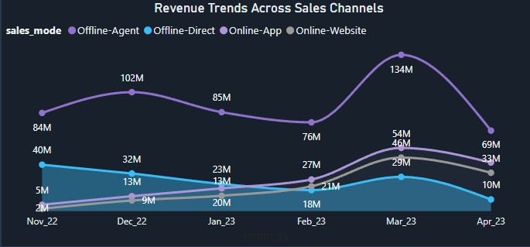
05 · SALES MODE BEHAVIOUR
Revenue Trend by Sales Mode
Agents lead revenue every month
₹134M in March, up from ₹78M in February
More than 2× any other channel in March
Every channel peaks in March, then falls in April
Agents drive the March peak. Next: how big is each channel over the full period?
Shield Insurance
11

Slide 12
05 · SALES MODE BEHAVIOUR
Customer & Revenue Distribution by Sales Mode
Channel | Customers | Revenue
Offline-Agent | 55.41% | 55.67%
Online-App | 16.03% | 16.27%
Offline-Direct | 15.86% | 15.46%
Online-Website | 12.70% | 12.60%
Offline overall | 71.27% | 71.13%
Online overall | 28.73% | 28.87%
Agents hold over half the business
55.41% of customers and 55.67% of revenue
Offline channels bring about 71%; online about 29%
Next: does this hold in every city?
Shield Insurance
12

Slide 13
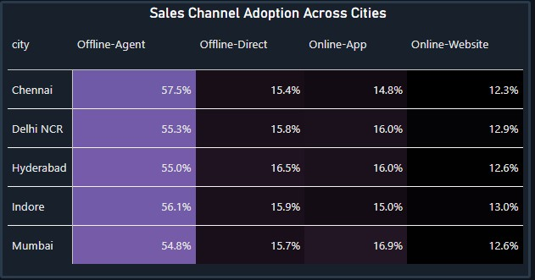
05 · SALES MODE BEHAVIOUR
Every City Leans on Agents
Channel | Stands out in
Offline-Agent | All five cities; highest in Chennai (57.5%)
Online-App | Mumbai (16.9%)
Offline-Direct | Hyderabad (16.5%)
Agents lead in all five cities
Agent share ranges from 54.8% (Mumbai) to 57.5% (Chennai)
Local gaps are small: one strategy, tuned by city
Channel mix is stable across cities. Next: does timing matter?
Shield Insurance
13

Slide 14
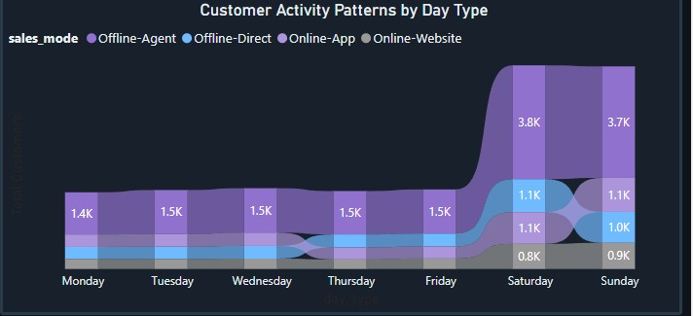
05 · SALES MODE BEHAVIOUR
Customer Activity by Day Type
1.4K–1.5K
3.8K
3.7K
2.5×+
customers a day on weekdays
customers on Saturday
customers on Sunday
weekend vs weekday activity
Why weekends?
Customers are free from work: time to discuss with family, meet agents and compare policies.
Opportunity
Concentrate agent follow-ups, policy discussions and campaigns on Saturday and Sunday.
Shield Insurance
14

Slide 15
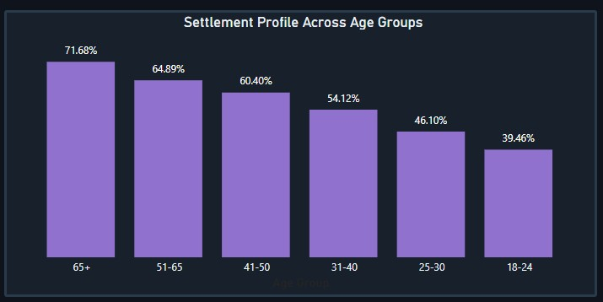
06 · AGE GROUP ANALYSIS
Settlement Profile Across Age Groups
39.46% → 71.68%
Settlement percentage, ages 18–24 to 65+
Older customers settle more
Settlement % is the share of insured amount settled
Older customers also hold higher cover, so more money is involved per policy
Age also shapes how customers buy. Next: channel preference by age.
Shield Insurance
15

Slide 16
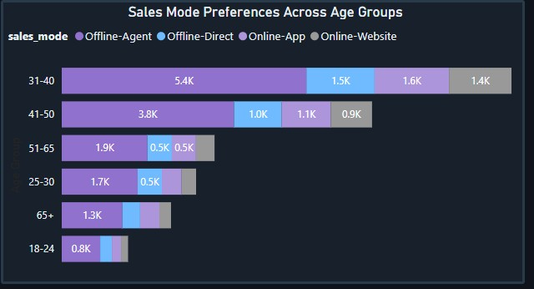
06 · AGE GROUP ANALYSIS
Sales Mode Preference Across Age Groups
Offline-Agent leads every age group
31–40: 9.9K customers, 5.4K through agents
Agents lead in every age group, and digital use shows up at every age.
Even younger customers use digital channels, yet agents dominate important financial decisions.
Last step: which policy values do customers choose?
Shield Insurance
16

Slide 17
06 · AGE GROUP ANALYSIS
Policy Adoption Across Age Groups
Early career: affordable protection, lower coverage.
18–24
Age | Coverage | Premium
18–24 | ₹2L | ₹5K
25–40 | ₹5L–₹7.5L | ₹12K–₹17K
41–65 | ₹7.5L (stronger adoption) | ₹17K
65+ | ₹1Cr | ₹1.2L
Rising commitments increase the need for protection.
25–40
Stronger protection as responsibilities continue.
41–65
Smaller base, but some hold much higher-value policies.
65+
Cover and premium rise with age, from ₹2L / ₹5K at 18–24 to ₹1Cr / ₹1.2L at 65+. Offers should follow life stage.
Shield Insurance
17

Slide 18
07 · KEY BUSINESS INSIGHTS
What the Data Tells Us
Insight | Evidence
Growth is volume-led | ₹36K–₹37K per customer stays flat while customers jump ~82% in March
March is the peak | +82.27% policy growth in March, then −41.41% in April
Agents remain vital | 55.41% of customers and 55.67% of revenue
Digital is meaningful | About 29% of customers and revenue come online
Life stage shapes value | 31–50 is ~62% of customers; 65+ hold ₹1Cr cover
Weekends are busiest | Saturday and Sunday run 2.5×+ weekday activity
Shield Insurance
18

Slide 19
08 · BUSINESS ACTIONS
Recommended Business Actions
Strengthen Agent Engagement
Equip agents with customer insights; they bring 55.67% of revenue.
1
Improve the Digital Journey
Simplify online discovery and purchase; ~29% already buy online.
2
Target Customers by Life Stage
Match messaging and offers to life stage, from ₹2L to ₹1Cr cover.
3
Focus on Weekend Engagement
Concentrate agent follow-ups and campaigns on weekends.
4
Prepare for March Demand
Add sales and support capacity before March, when policy growth hits 82%.
5
Monitor Higher-Value Policies
Track high-coverage policies, where settlement exposure is greatest.
6
Shield Insurance
19

Slide 20
KEY TAKEAWAY
Insurance decisions are shaped by who the customer is, where they live, how they prefer to buy, and their stage of life.
Understanding these patterns helps Shield serve customers better while managing growth and risk.
Who they are
Where they live
How they buy
Life stage

