Slide 1
HW3
Biying Wan

Slide 2
1
install.packages("digest")
library("digest")
digest("I learn a lot from this class when I am proper listening to the professor","sha256")
[1]"c16700de5a5c1961e279135f2be7dcf9c187cb6b21ac8032308c715e1ce9964c"
digest("I do not learn a lot from this class when I am absent and playing on my Iphone","sha256")
[1]"2533d529768409d1c09d50451d9125fdbaa6e5fd4efdeb45c04e3c68bcb3a63e"

Slide 3
2 DSA (Digital Signature Algorithm)
A digital signature is basically a way to ensure that an electronic document (e-mail, spreadsheet, text file, etc.) is authentic. Digital signatures are used to verify that a message or document was authored by a certain person, and that it was not altered or modified by anyone else.
One of the most common digital signature mechanisms is DSA. The Digital Signature Algorithm (DSA) is the basis of the Digital Signature Standard (DSS), a U.S. Government document.

Slide 4
2 DSA (Digital Signature Algorithm)
DSA lets one person with a secret key “sign” a document, so that others with a matching public key can verify it must have been signed only by the holder of the secret key.
Digital signatures depend on hash functions, which are one-way computations done on a message. They are called “one-way” because there is no known way (without infeasible amounts of computation) to find a message with a given hash value. The result has a fixed length, which is 160 bits in the case of the Secure Hash Algorithm (SHA) used by DSA.

Slide 5
2 DSA (Digital Signature Algorithm)
In practice, digital signatures are used to sign the hash values of messages, not the messages themselves. Thus it is possible to sign a message’s hash value, without even knowing the content of the message. This makes it possible to have digital notaries, who can verify a document existed (and was signed), without the notary knowing anything about what was in the document.

Slide 6

3
install.packages("rjson")
library("rjson")
json_file3="D:/研二/研二上/大数据与互联网金融/HW3/test.json"
json_data3<- fromJSON(paste(readLines(json_file3), collapse=""))
json_data3<- as.data.frame(json_data3)
print(json_data3)

Slide 7
4.1
install.packages("ggplot2")
install.packages("scales")
library("rjson")
json_file="D:/研二/研二上/大数据与互联网金融/HW3/crix.json"
json_data <- fromJSON(paste(readLines(json_file), collapse=""))
json_df <- as.data.frame(c(json_data[[1]][1],json_data[[1]][2]))
for (i in 2:length(json_data)){
json_df <- rbind(json_df,as.data.frame(c(json_data[[i]][1],json_data[[i]][2])))
}
json_df$date <- as.POSIXct(json_df$date)
library(ggplot2)
library(scales)
ggplot(json_df)+
geom_line(aes(x=date,y=price))+
scale_x_datetime(breaks=date_breaks("6 month"),labels=date_format("%Y/%m"))

Slide 8
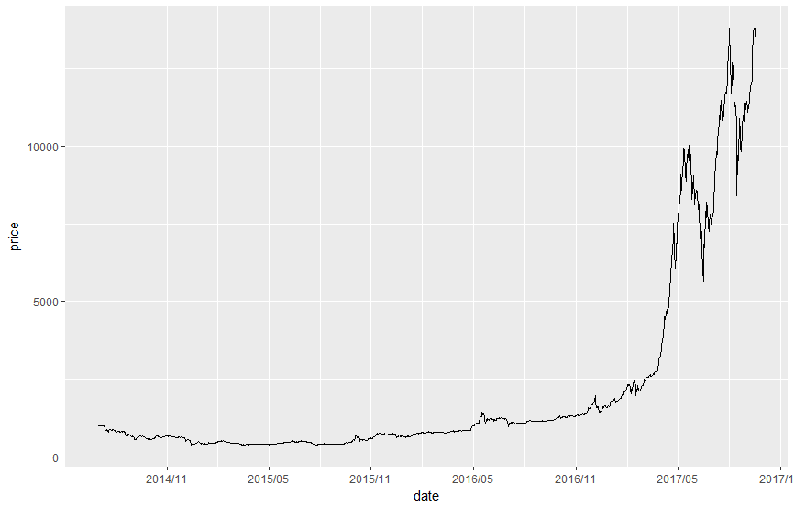
4.1 Price of CRIX

Slide 9
4.2
x<-json_df[,2]
return<-log(x[2:nrow(json_df)])-log(x[1:nrow(json_df)-1])
return<-c(NA,return)
json_return<-as.data.frame(cbind(json_df,return))
json_return<-json_return[,-2]
plot(json_return,type="l")

Slide 10
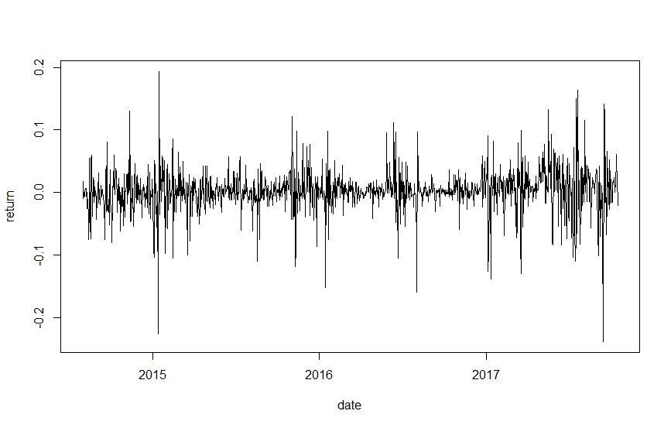
4.2 Stochastic Property of CRIX

Slide 11
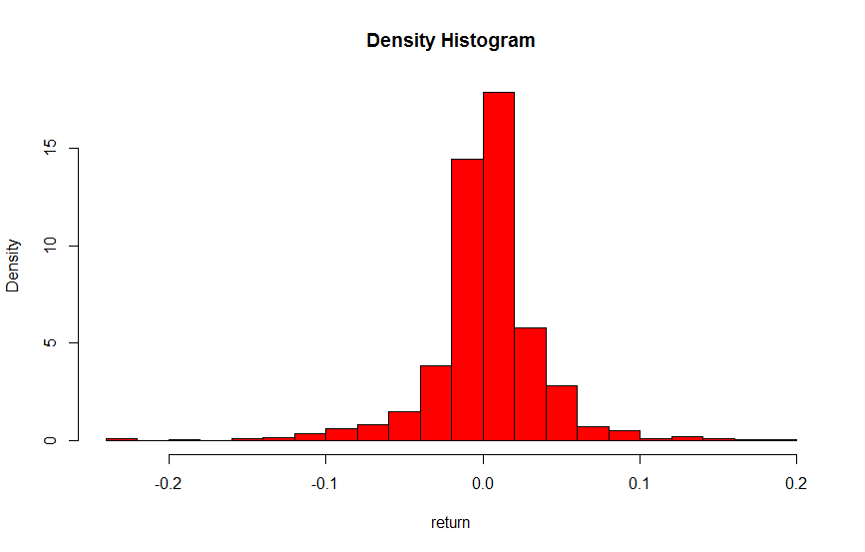
4.3 Distributional Properties of CRIX
hist(json_return$return,freq=FALSE,breaks=12,col="red",xlab="return",main="Density Histogram")

Slide 12
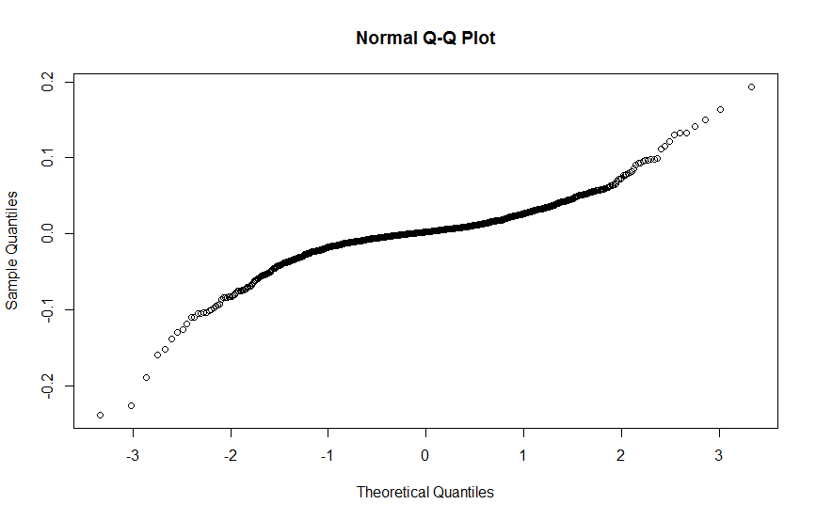
4.3 Distributional Properties of CRIX
qqnorm(json_return$return)
CRIX returns is not normally distributed.

