Slide 1
ITK Implementation
Topics Covered
IMAGE ADAPTORS ( chapter 7 )
HOW TO WRITE A FILTER ( chapter 8 )
Geometric Transformations ( chapter 2, section 9)
Region Growing and Watersheds ( chapter 4, section 1 and 2)

Slide 2
IMAGE ADAPTOR
CHAPTER SEVEN

Slide 3
Image Casting Vs Image Adaptors
A typical example is to take an image of pixel type unsigned char and present it as an image of pixel type float.
The float image requires four times the memory of the original image and contains no useful additional information
Image adaptors, on the other hand, do not require the extra memory as pixels are converted only when they are read using image iterators
Image adaptors are particularly useful when there is infrequent pixel access, since the actual conversion occurs on the fly during the access operation

Slide 4
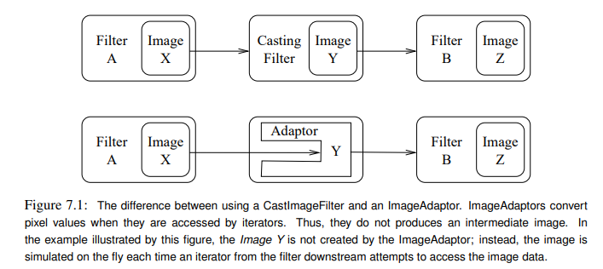
Image Casting Vs Image Adaptors

Slide 5
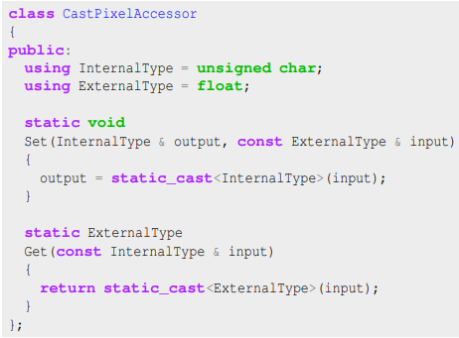
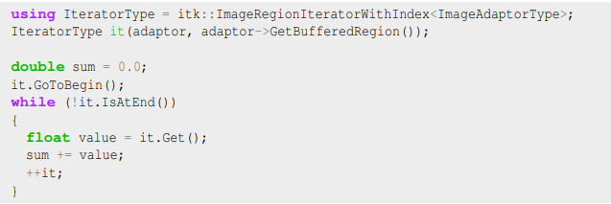
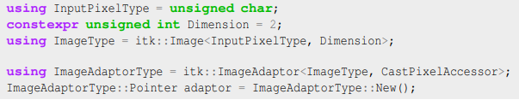
example

Slide 6
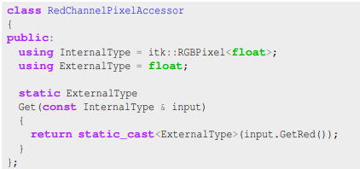
Adapting RGB Images

Slide 7
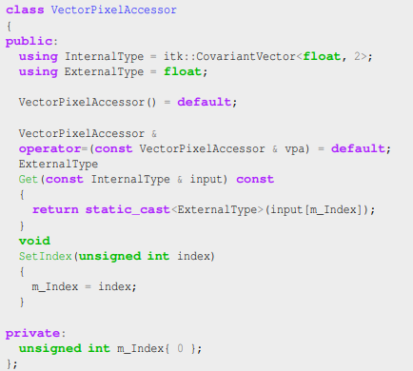
Adapting Vector Images

Slide 8

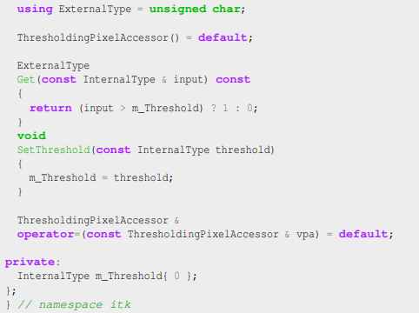
Adaptors for Simple Computation

Slide 9
HOW TO WRITE A FILTER
( Chapter 8 )

Slide 10
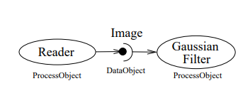
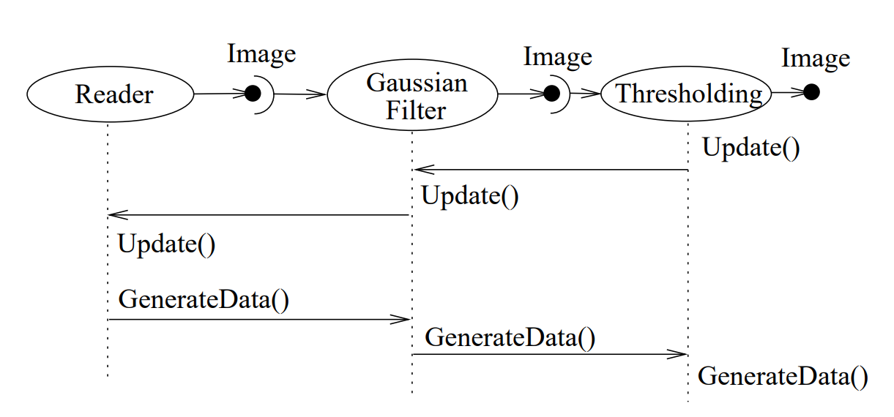
Pipeline Execution
It determines which filters, in a pipeline of filters, need to execute. This prevents redundant execution and minimizes overall execution time.
It initializes the (filter’s) output data objects, preparing them for new data. In addition, it determines how much memory each filter must allocate for its output, and allocates it.
The execution process determines how much data a filter must process in order to produce an output of sufficient size for downstream filters
It subdivides data into sub pieces for multi-threading
It may free (or release) output data if filters no longer need it to compute, and the user requests that data is to be released.

Slide 11
Pipeline Execution
Typically pipeline execution is initiated when a process object receives the ProcessObject::Update() method invocation.
The DataObject::Update() method in turn invokes three other methods:
DataObject::UpdateOutputInformation()
- to check that all required inputs are set and all parameters are valid and consistent.
DataObject::PropagateRequestedRegion()
- call propagates upstream to satisfy a data request
DataObject::UpdateOutputData()
- to determine whether a particular filter needs to execute in order to bring its output up to date
the filter is modified as a result of modifying an instance variable
the input to the filter changes
the input data has been released
an invalid Requested Region was set previously and the filter did not produce data.

Slide 12
Threaded Filter Execution
Filters that can process data in pieces can typically multi-process using the data parallel, shared memory implementation built into the pipeline execution process.
The key to threading is to generate output for the output region given as the parameter.
In ITK, this is simple to do because an output iterator can be created using the region provided.
Hence the output can be iterated over, accessing the corresponding input pixels as necessary to compute the value of the output pixel.

Slide 13
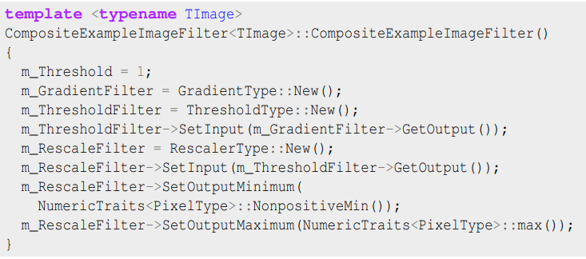
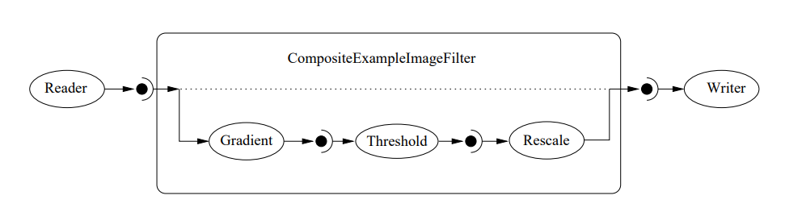
A Composite Filter
It is often very useful to be able to make a new filter by combining two or more existing filters, which can then be used as a building block in a complex pipeline.
This approach follows the Composite pattern, whereby the composite filter itself behaves just as a regular filter, providing its own interface and using other filters for the implementation

