Slide 1

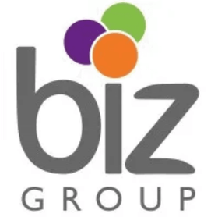
AI Sales Discovery Agent
Automating Lead Qualification
Biz Group © 2026 | Powered by n8n

Slide 2
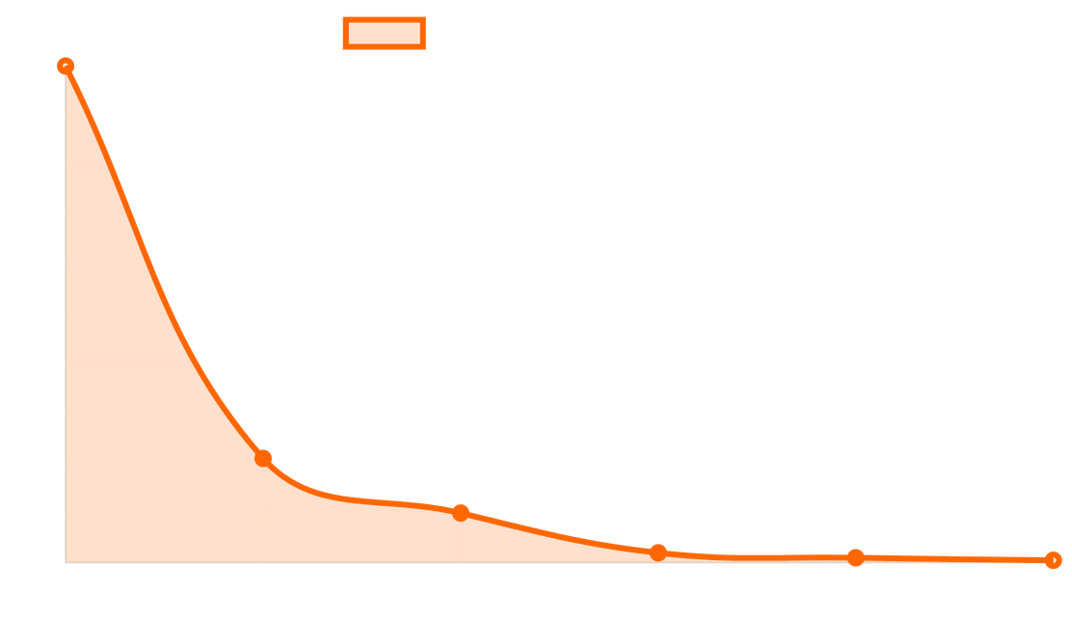
Solving the Speed-to-Lead Challenge
The Lead Decay Problem
Website leads lose interest within minutes. Manual callback processes can take hours or days, leading to missed opportunities and revenue leakage.
Instant Response Capability
The AI agent initiates contact the moment a lead submits interest, capturing prospects when they are most ready to discuss their needs.
Unmatched Scale
Unlike human teams, the AI can handle unlimited concurrent calls with 100% adherence to company guidelines and quality standards.
Source: Lead Response Management Study

Slide 3



Meet Your New AI Teammate
Our AI agent is built to mirror the professionalism of the Biz Group sales team. It is transparent about its identity, secures consent, and uses adaptive conversation techniques to build rapport from the first second.
Learning Technology
Training Programs
Team Building
Focuses on platforms like Axonify for frontline enablement, microlearning, and performance tracking.
Covers leadership development, capability building, and structured workshops.
Handles engagement events, culture initiatives, and team bonding activities.

Slide 4
How It Works: The Discovery Flow
The conversation follows a structured yet flexible flow, moving from initial consent to deep discovery and strategic value alignment.
1
2
3
4
Consent
Discovery
Qualification
Alignment
Transparent AI disclosure and recording consent upfront to maintain trust.
Adaptive questioning to explore needs, audience, and current frustrations.
Conversational exploration of scope, stakeholders, timeline, and budget.
Reflecting back goals and pain points to ensure strategic value alignment.

Slide 5

Handling Objections with Precision
The ARC Principle
Lead Says
AI Agent Response
"Not interested"
"Understood. Before I go — was it more about timing, priority, or this isn't your area?"
A
Acknowledge
Validate the lead's concern immediately to
build rapport and lower resistance.
"Too expensive"
"Makes sense. What range would feel reasonable for the impact you're after?"
R
Clarify
Ask a gentle follow-up question to understand
"I'm busy"
"No problem — would a 15-minute slot next week work, or should I email a short summary first?"
the root cause of the objection.
C
Redirect
"Just send info"
"Happy to. To make it relevant — is it closer to a learning platform, training, or team building?"
Pivot the conversation back to the value Biz
Group provides for their specific pain.

Slide 6



Beyond the Call: Comprehensive Data Extraction
While the agent manages the conversation, a sophisticated backend system extracts deep, structured insights from every verbal interaction, turning dialogue into actionable intelligence.
The Analytical Core
Lead Profiling
Contextual Intelligence
A separate analysis system processes the conversation afterward to produce structured data, ensuring the agent remains focused on natural dialogue.
Captures granular details beyond basic
Identifies the environment and constraints:
contact info:
Team Size & Scope
Job Roles & Industries
Key Decision Stakeholders
Specific "Trigger Phrases"
Budget Ranges & Timelines
Product Category Interest

Slide 7



Evaluation Criteria: Quality at Scale
Every call is automatically audited against 12 key performance indicators to ensure 100% compliance and conversational excellence.
Compliance & Identity
Conversational Flow
AI Disclosure Given
Conversational, Not Interrogative
Recording Consent Obtained
Caller Engagement Maintained
Axonify Naming Compliance
Professional Call Closure
No Unauthorized Promises
Appropriate Routing Decision
Strategic Discovery
"Automated QA ensures that the AI agent represents Biz Group with the same integrity as our human team."
Pain Points Identified
Objections Handled Well
Caller Identity Captured
Clear Next Step Agreed

Slide 8




Data Collection: The Sales Intelligence Dashboard
Data Point
Sales Value
Urgency Detection
Lead Interest Level
Prioritize high-intent prospects immediately.
The system automatically flags leads requiring immediate attention.
Trigger Phrases
Identify specific needs like "Axonify" or "Onboarding".
Budget & Timeline
Qualify leads based on financial and time fit.
URGENT FOLLOW-UP REQUIRED
Stakeholder Map
Know who else needs to be in the room.
Handoff Briefs
Pain Point Summary
Tailor your pitch to their specific frustrations.
Concise summaries including pain points and next steps, so you never start from scratch.
Lead Scoring
Interest levels and scores assigned based on conversation depth and quality.

Slide 9



The Handoff: From AI to Human Sales
The agent is the bridge, not the destination. It ensures that when you take over, the lead is fully prepared for a high-value strategic conversation.
Streamlined Transitions
Data-Backed Success
Optimized Conversion
The agent is empowered to book meetings directly into your calendar or initiate professional email introductions, ensuring no momentum is lost.
You are armed with the lead's budget, timeline, and key stakeholders before the first call, allowing for a much more strategic and informed approach.
By the time you speak to the lead, they are already warmed up, qualified, and expect a high-value conversation with a Biz Group expert.

Slide 10



Benefits to the Sales Team: More Wins, Less Admin
This tool is designed to reclaim your time, allowing you to focus on high-value closing activities while the AI handles the heavy lifting of initial discovery.
Focus on Closing
Data-Driven Strategy
Scalable Growth
Reclaim your calendar for high-value
Enter every call with deep intelligence:
Scale your impact without the burnout:
activities:
Tailored pitches from the start
Handle unlimited lead volume
0% time on "cold" follow-ups
Pre-identified pain points
Reduced administrative burden
100% focus on qualified leads
Clear objection summaries
Consistent qualification standards
Eliminate lead decay entirely

Slide 11



Summary and Next Steps
The AI Sales Discovery Agent is a strategic partner designed to make the Biz Group sales team faster, smarter, and more effective in a competitive market.
Immediate Impact
Feedback Loop
Winning Together
The agent is live and processing website leads today, ensuring no opportunity is missed regardless of the time of day.
Your input on lead quality is essential; we will use your insights to further refine the agent's discovery questions.
This tool is built to support your growth, allowing you to focus 100% on closing high-value, qualified prospects.
READY FOR LAUNCH | BIZ GROUP SALES EMPOWERMENT

