Slide 1
CSCI E-96
Intro to R
Data Types & EDA

Slide 2










About me…
Education
https://www.linkedin.com/in/edwardkwartler/
Work
Side Hustles

Slide 3
Agenda
Start | End | Item
 |  | What is R, R-Studio, scripting basics
 |  | Executing a first script
 |  | Visualizing Real Data & EDA
 |  | Working with Geospatial Information
 |  | Break
 |  | R’s Data Structures in Detail
 |  | EDA
 |  | Housekeeping, Reading & Homework

Slide 4
Intro to R
Learning Objectives
What is R?
What is R Studio?
Why learn R?
Scripting Structure

Slide 5

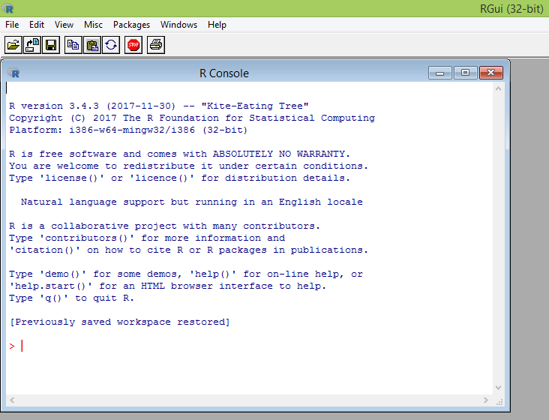
What is R?
Flexible
Open source
Academic but growing in industry
Language agnostic, SQL, Weka, C, Fortran, Java etc
R is a language and environment for statistical computing and graphics. It is the most popular statistical software in circulation today, and is used by more than 2 million data scientists and statisticians worldwide.
How Companies Use R to Compete in a Data-Driven World, Data-informed.com

Slide 6

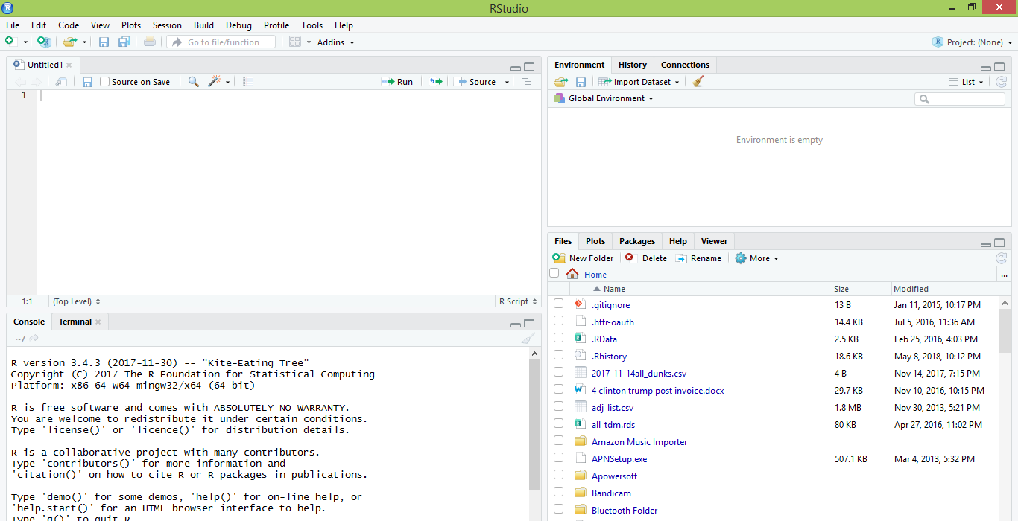
What is R Studio?
IDE – Integrated Development Environment
Adds additional functionality e.g. git, shiny projects, markdown templates
R studio is the most popular IDE for R although there are others & you don’t actually need it to perform R tasks.

Slide 7
What is the relationship between R & R studio?
Nice interface & additional functionality for faster programming, analysis & production.
Statistical & graphing software
R Studio sits atop of the installed R version. Without base R, R studio cannot function. By programmatically accessing base R, R Studio improves the interface and functionality.

Slide 8
R Studio has four main panes
Scripting
Environment
Commands are written & adjusted here then executed in the console. Then saved for future quick execution.
List of objects & values
e.g. loaded “excel” files
Files, Plots, Packages, Help
Console
Find files, load packages, see visualizations and quickly find help
Execution of scripts and commands, data exploration and code results
R Studio works on Linux, Windows and iOS.

Slide 9
R: Where is it being used?
Media
Google
Facebook
Twitter
Foursquare
Kickstarter
New York Times
Economist
Services
Zillow
Trulia
eHarmony
DataSong
PredictWise
Nationwide
Finance
Lloyd’s Bank
Credit Suisse
American Century
Australia and New Zealand Banking Group
Technology
SAS
Oracle
IBM
Teradata
Coursera
SAP
DataCamp
Alteryx
TIBCO
OneTick
Amazon
Google
Microsoft
U.S Government
Food & Drug
Administration
National Weather
Service
National Institute
of Standards
in Technology
R is ubiquitous in various industries used for analysis, prototyping and visualization. However, more often python is used in production environments.

Slide 10
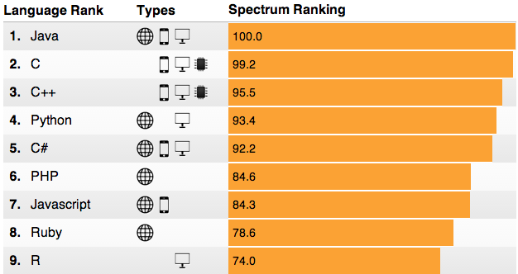
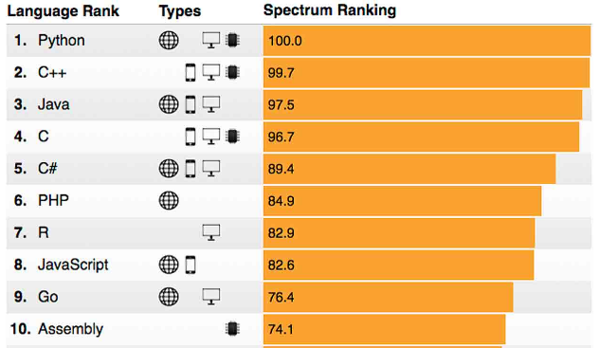
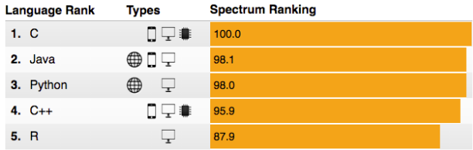
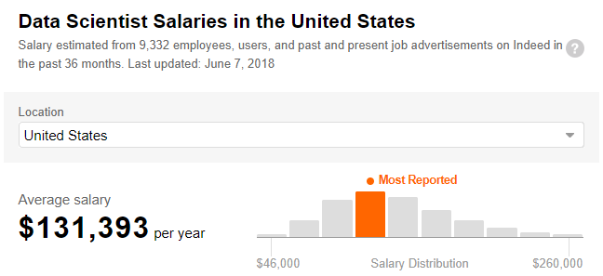
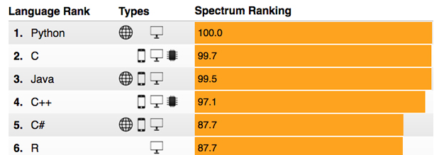
R: Do you get rewarded for knowing it?
Top 10 Languages ieee.org
2015
2018
2016
2017
R salaries are very strong and given the language’s popularity, the need for more R fluent business leaders and programmers is likely to remain for some time.

Slide 11
Ok, it’s awesome but…
Pros
Cons
VERY extensible
10K+ packages
Built by stats, made for stats
Free, open source
Cutting edge
Diverse applications
Outstanding graphical capabilities
Large community based help
Tough to do “big data”
In memory data constraints w/o extra effort
Official documentation is terse
Not as polished as a commercial application
Slow compared to lower level languages
Production worthy apps can be difficult to create
Large community based help

Slide 12
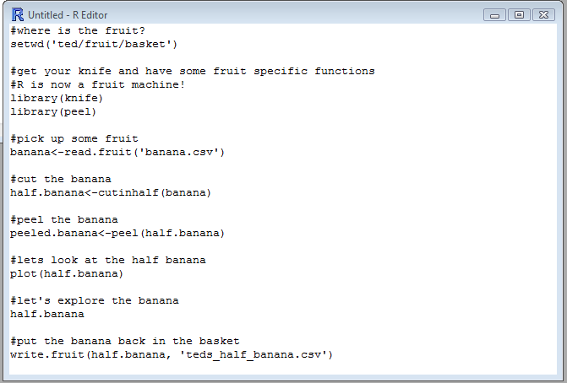
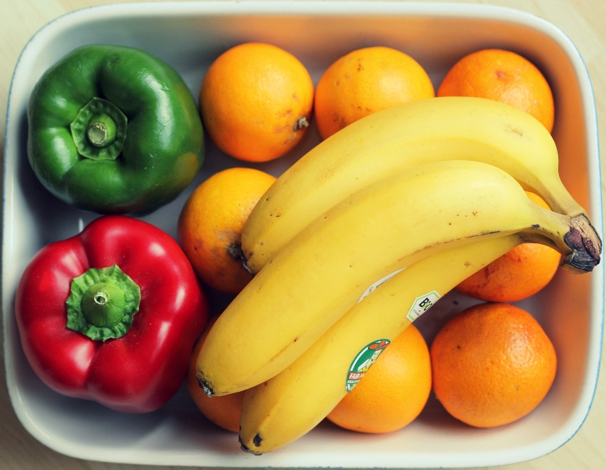
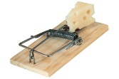
R Uses Functions, Libraries & Objects
Let’s eat a banana for breakfast. Where is the fruit?
Use the function setwd (set working directory) to declare the folder where your data files are within quotes…the fruit basket containing the stuff you want. Ever wonder what the current working directory is? Use getwd() with empty parentheses!
The folder path needs to be in quotes and slashes are reversed in Windows not on Apple or Linux.

Slide 13

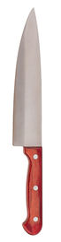
R Uses Functions, Libraries & Objects
Found the fruit! What tools do I need?
Use library() with the name of a specialized package, without quotes, to change R to a specialized piece of software.
Before loading a library use install.packages(“name of package”). You only need to do this once.

Slide 14

R Uses Functions, Libraries & Objects
Now R is a fruit cutting machine. Let’s pick our fruit.
Use a read.csv() or similar function to get the object from the working directory. There are multiple read-like functions to get SQL connections, APIs, Excel, and other file types.
The object name must be in quotes and actually be in the directory…watch spelling and capitalization!.

Slide 15

R Uses Functions, Libraries & Objects
Use a function from the knife library to create a new object.
Functions are applied to an object to change it in some way or create a new object. Here the R instance has two objects, banana & half.banana
Be careful, you can overwrite an object pretty easily!

Slide 16


R Uses Functions, Libraries & Objects
Use a function from the hand library to create another new object.
Functions are applied to an object to change it in some way or create a new object. Here the R instance has three objects, banana, half.banana & peeled.banana
Be careful, you can overwrite an object pretty easily!

Slide 17
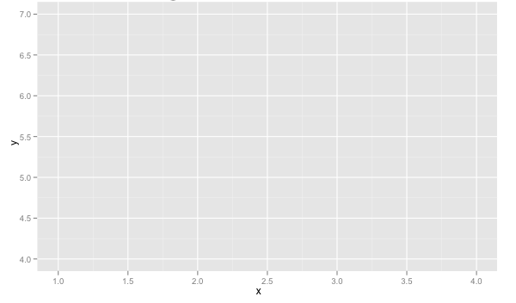
R Uses Functions, Libraries & Objects
Now it’s time to consume the outcome.
Here we call plot on the object to consume it after our adjustments.
You can save files, view graphs, adjust databases, send emails, make reports, update values and more as the result of an R script.
Be careful, you can overwrite objects when SAVING too!

Slide 18







Let’s Review.
1
Use setwd() to point to your files.
Load some customized libraries with library() for your specific analysis and methodology.
2
Read in the file so the object is “in-memory” with read.csv() or similar.
3
Apply a function from a library to adjust or create new objects in memory. The pseudo code for this is:
4
5
object<-function(applied to object)
6
Consume the results by saving, plotting etc.

Slide 19
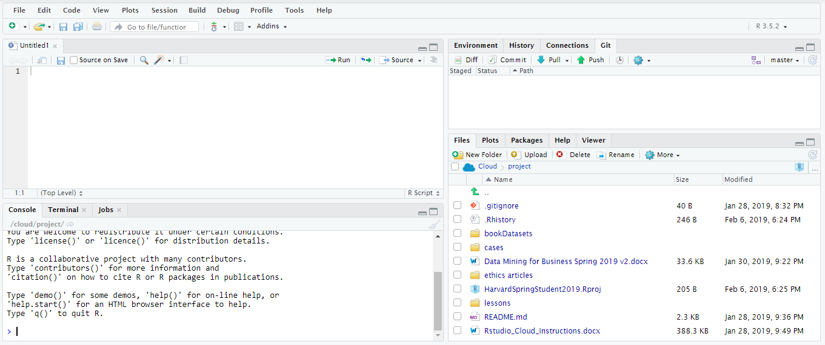
Open R Studio
If you haven’t set up your cloud environment please do so now!

Slide 20

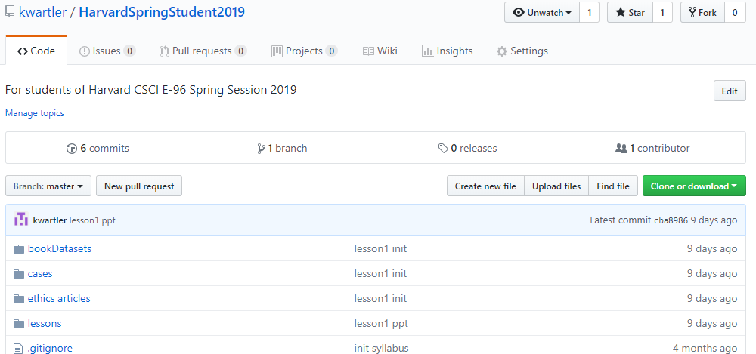
Perform a Git Pull to get the scripts & data
https://github.com/kwartler/Harvard_DataMining_Business_Student
If you have git software, when do a “git pull” in Rstudio.
Alternatively you can download a zip of the repo on github.com but this can be cumbersome with file updates.

Slide 21
Agenda
Start | End | Item
 |  | What is R, R-Studio, scripting basics
 |  | Executing a first script
 |  | Visualizing Real Data & EDA
 |  | Working with Geospatial Information
 |  | Break
 |  | R’s Data Structures in Detail
 |  | EDA
 |  | Housekeeping, Reading & Homework

Slide 22
Let’s Practice!
Open:
A_Basic_Test_Drive.R
Simple Operators ie “+”
Define Variables using “<-”
Review objects and types
Use paste()
Find help with “?”
Create a data.frame()
Add a column
Navigate the DF
write.csv()
read.csv()
scatterplot()
tables()
barplot()
Saving a visual as a .jpeg
“IF” Conditional loops
“FOR” loops
Open the first script, get familiar with the basic R operations by execution.

Slide 23
Agenda
Start | End | Item
 |  | What is R, R-Studio, scripting basics
 |  | Executing a first script
 |  | Visualizing Real Data & EDA
 |  | Working with Geospatial Information
 |  | Break
 |  | R’s Data Structures in Detail
 |  | EDA
 |  | Housekeeping, Reading & Homework

Slide 24
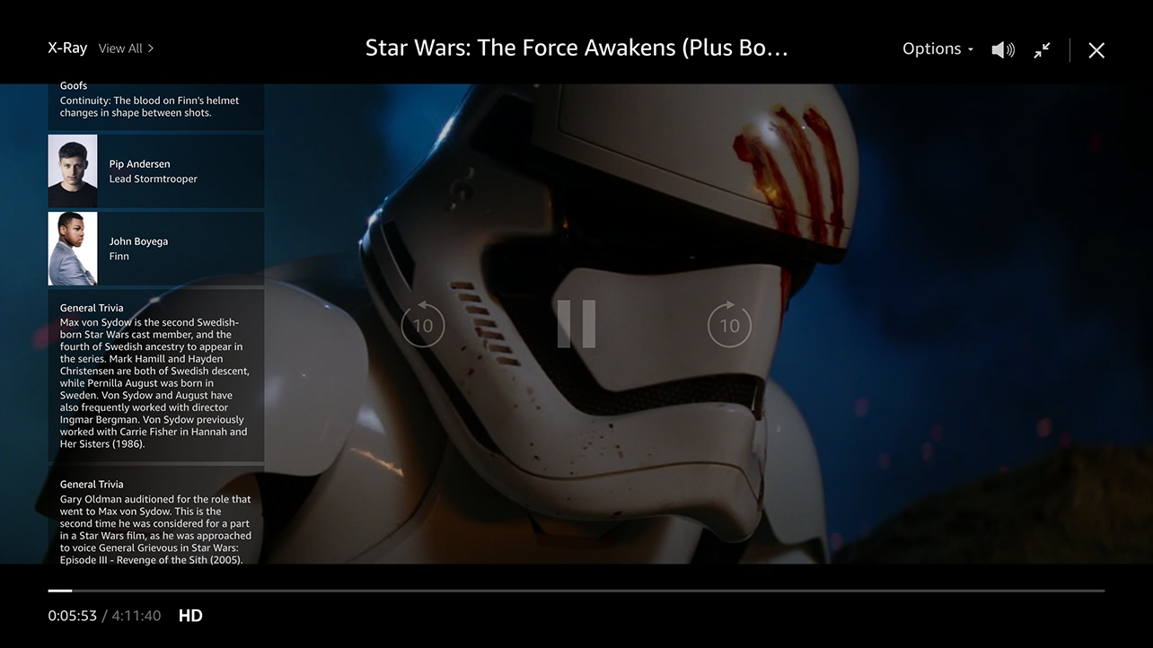
Do or Do Not There is No Try…

Slide 25
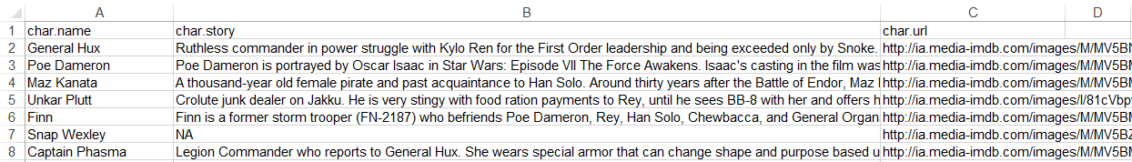
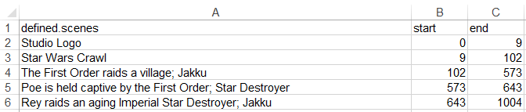
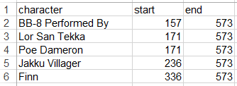
Let’s explore Amazon’s x-ray feature
Character Background
Official Scenes
Character Appearances

Slide 26

But first, what is a ggplot?
The first layer is to define a ggplot, with screenTime as the data. The aesthetics (aes) define that information should be colored by each character. However, there is no other information at this point.
ggplot(screenTime, aes(colour=screenTime$character))
Ggplot is a “grammar of graphics” package. It works by adding layers with an “+” to construct a visual.

Slide 27
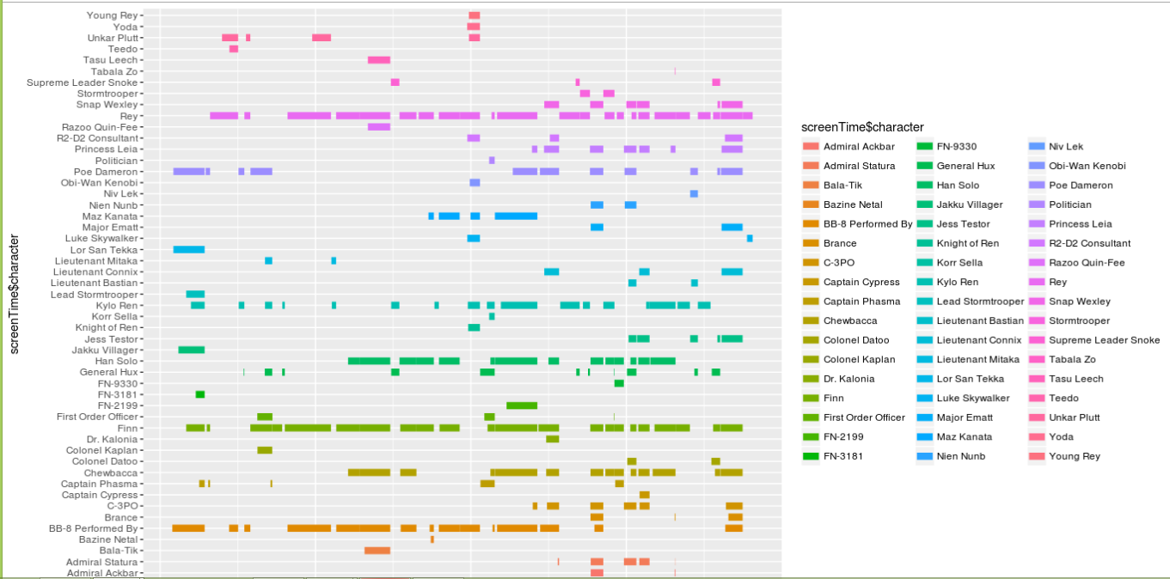
Understanding ggplot…
The second layer adds a line segment for each character and defines the size of each.
ggplot(screenTime, aes(colour=screenTime$character)) +
geom_segment(aes(x=screenTime$start, xend=screenTime$end,y=screenTime$character, yend=screenTime$character),size=3)

Slide 28
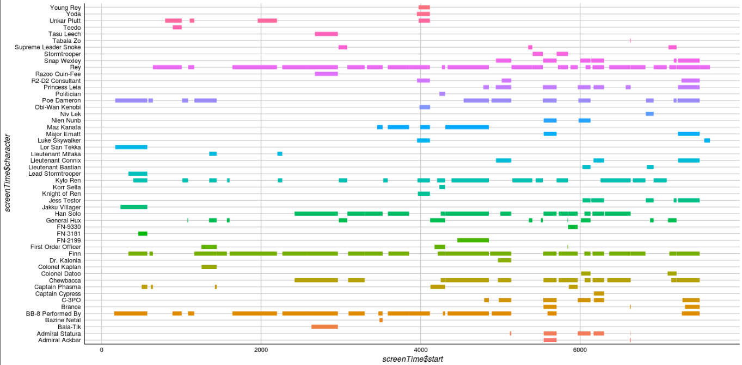
Understanding ggplot…
The third layer changes the background, axis & colors. The fourth layer removes the legend which is redundant in this context.
ggplot(screenTime, aes(colour=screenTime$character)) +
geom_segment(aes(x=screenTime$start, xend=screenTime$end,y=screenTime$character, yend=screenTime$character),size=3) + theme_gdocs() + theme(legend.position="none")

Slide 29
Let’s Practice!
Open:
B_Functions_EDA_Viz.R
read.csv
dim()
table()
indexing
subset()
sample()
as.matrix()
barplot()
ggplot()
Bokeh::figure()
Open the second script, get familiar with libraries, reading data, functions applied to objects & making visuals.

Slide 30
Agenda
Start | End | Item
 |  | What is R, R-Studio, scripting basics
 |  | Executing a first script
 |  | Visualizing Real Data & EDA
 |  | Working with Geospatial Information
 |  | Break
 |  | R’s Data Structures in Detail
 |  | EDA
 |  | Housekeeping, Reading & Homework

Slide 31
Let’s Practice on geospatial data!
Open:
C_geospatial.R
read.csv
ggplot()
Google maps with ggmap
leaflet()
Open the third file, explore geospatial information.

Slide 32
Agenda
Start | End | Item
 |  | What is R, R-Studio, scripting basics
 |  | Executing a first script
 |  | Visualizing Real Data & EDA
 |  | Working with Geospatial Information
 |  | Break
 |  | R’s Data Structures in Detail
 |  | EDA
 |  | Housekeeping, Reading & Homework

Slide 33
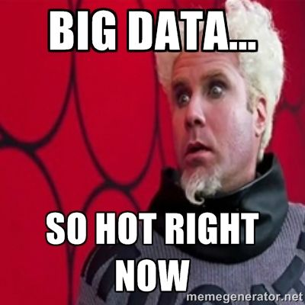
Data Structures
R Data Types
R Data Structures
Exploratory Data Analysis

Slide 34



Common R Object Types - Vectors
Objects in R can be various forms and even made to be “custom” types.
Numeric/Integer
Factors (Distinct Classes)
as.factor(c('MALE','FEMALE','FEMALE'))
Cardinality
2
1
10
12
3.47
82
MALE
FEMALE
FEMALE
Unordered
c(1,10,12,3.47)
[1] MALE FEMALE FEMALE
Levels: FEMALE MALE
High
Med
Low
as.factor(c(‘High',‘Med',‘Low'))
Cardinality
3
Ordinal
Boolean
STRING (just text)
TRUE
TRUE
FALSE
TRUE
FALSE
c('MALE','FEMALE','FEMALE')
c(T, T, F, T, F)
c(TRUE,TRUE, FALSE, TRUE,FALSE)
c(T,TRUE, F, TRUE,FALSE)
[1] "MALE" "FEMALE" "FEMALE"
In R, a vector can be numeric, Boolean (T/F), factors, or contain strings.
Notes:
Ordinal – is there an order to the factor, how does that factor level relate to other levels
Cardinality – number of distinct factor levels, the number of elements in a set

Slide 35
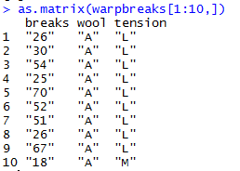
More Complex Common R Object Types - Matrix
Matrices are 2 dimensional data (rows/columns). Each column must be the same type.
RowID | breaks | wool | tension
1 | 26 | A | L
2 | 30 | A | L
3 | 54 | A | L
4 | 25 | A | L
5 | 70 | A | L
6 | 52 | A | L
7 | 51 | A | L
8 | 26 | A | L
9 | 67 | A | L
10 | 18 | A | M
All strings
Matrices are organized into rows and columns. In R, the row names are not actually a vector of the matrix but are an attribute of the matrix. In excel you would need a standalone vector to capture that information.

Slide 36
More Complex Common R Object Types – Array
Arrays aren’t widely used, except in image analysis (R,G,B matrices)
RowID | breaks | wool | tension
1 | 26 | A | L
2 | 30 | A | L
3 | 54 | A | L
4 | 25 | A | L
5 | 70 | A | L
6 | 52 | A | L
7 | 51 | A | L
8 | 26 | A | L
9 | 67 | A | L
10 | 18 | A | M
library(EBImage)
a <- imageData(x)
r <- a[,,1]
g <- a[,,2]
b <- a[,,3]
RowID | breaks | wool | tension
1 | 26 | A | L
2 | 30 | A | L
3 | 54 | A | L
4 | 25 | A | L
5 | 70 | A | L
6 | 52 | A | L
7 | 51 | A | L
8 | 26 | A | L
9 | 67 | A | L
10 | 18 | A | M
RowID | breaks | wool | tension
1 | 26 | A | L
2 | 30 | A | L
3 | 54 | A | L
4 | 25 | A | L
5 | 70 | A | L
6 | 52 | A | L
7 | 51 | A | L
8 | 26 | A | L
9 | 67 | A | L
10 | 18 | A | M
This is an example of extracting RGB data from an image but is not covered in this course since arrays are seldom used.
Arrays can be thought of similar to Excel’s workbook which can contain multiple single sheet work books.

Slide 37
More Complex Common R Object Types – List
Lists are multi-dimensional objects that can contain different data types of different lengths.
ListA
single value
Single data frame or matrix
single vector
Nested list
Nested data frame
Nested matrix
Lists are useful for data organization but can be complex and difficult to navigate to get specific information.

Slide 38
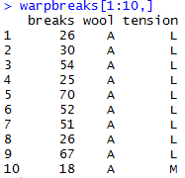
More Complex Common R Object Types – Data Frame
Data Frames are like 2 dimensional data objects but can have mixed data types.
A data frame is actually a named list but with equal length elements. Being a list lets it contain mixed data types.
RowID | breaks | wool | tension
1 | 26 | A | L
2 | 30 | A | L
3 | 54 | A | L
4 | 25 | A | L
5 | 70 | A | L
6 | 52 | A | L
7 | 51 | A | L
8 | 26 | A | L
9 | 67 | A | L
10 | 18 | A | M
Integers
Factor
Factor
Data frames are used often because they can hold different types of vectors, but can be switched back and forth with as.matrix() and as.data.frame(). Remember that the vector classes could change!!

Slide 39
Data Structure for Analysis & Modeling
Often the 1st Column is a unique identifier but the identifier could also be a row attribute (not actually a vector)
name | mfr | type | calories | protein | fat | sodium | fiber | carbo | sugars | potass | vitamins | shelf | weight | cups | rating
100%_Bran | N | C | 70 | 4 | 1 | 130 | 10 | 5 | 6 | 280 | 25 | 3 | 1 | 0.33 | 68.40297
100%_Natural_Bran | Q | C | 120 | 3 | 5 | 15 | 2 | 8 | 8 | 135 | 0 | 3 | 1 | 1 | 33.98368
All-Bran | K | C | 70 | 4 | 1 | 260 | 9 | 7 | 5 | 320 | 25 | 3 | 1 | 0.33 | 59.42551
All-Bran_with_Extra_Fiber | K | C | 50 | 4 | 0 | 140 | 14 | 8 | 0 | 330 | 25 | 3 | 1 | 0.5 | 93.70491
Almond_Delight | R | C | 110 | 2 | 2 | 200 | 1 | 14 | 8 |  | 25 | 3 | 1 | 0.75 | 34.38484
Apple_Cinnamon_Cheerios | G | C | 110 | 2 | 2 | 180 | 1.5 | 10.5 | 10 | 70 | 25 | 1 | 1 | 0.75 | 29.50954
Apple_Jacks | K | C | 110 | 2 | 0 | 125 | 1 | 11 | 14 | 30 | 25 | 2 | 1 | 1 | 33.17409
Basic_4 | G | C | 130 | 3 | 2 | 210 | 2 | 18 | 8 | 100 | 25 | 3 | 1.33 | 0.75 | 37.03856
Bran_Chex | R | C | 90 | 2 | 1 | 200 | 4 | 15 | 6 | 125 | 25 | 1 | 1 | 0.67 | 49.12025
Bran_Flakes | P | C | 90 | 3 | 0 | 210 | 5 | 13 | 5 | 190 | 25 | 3 | 1 | 0.67 | 53.31381
Cap'n'Crunch | Q | C | 120 | 1 | 2 | 220 | 0 | 12 | 12 | 35 | 25 | 2 | 1 | 0.75 | 18.04285
Generally we will use data frames to avoid complexity but you will be exposed to other data types.

Slide 40
Data Structure for Analysis & Modeling
Informative features are usually independent & do not lend information to other rows (auto-correlation). Can be called informative columns, independent variables, or features.
Remember in a DF, these can be mixed with decimals, integers, factors, strings, T/F.
name | mfr | type | calories | protein | fat | sodium | fiber | carbo | sugars | potass | vitamins | shelf | weight | cups | rating
100%_Bran | N | C | 70 | 4 | 1 | 130 | 10 | 5 | 6 | 280 | 25 | 3 | 1 | 0.33 | 68.40297
100%_Natural_Bran | Q | C | 120 | 3 | 5 | 15 | 2 | 8 | 8 | 135 | 0 | 3 | 1 | 1 | 33.98368
All-Bran | K | C | 70 | 4 | 1 | 260 | 9 | 7 | 5 | 320 | 25 | 3 | 1 | 0.33 | 59.42551
All-Bran_with_Extra_Fiber | K | C | 50 | 4 | 0 | 140 | 14 | 8 | 0 | 330 | 25 | 3 | 1 | 0.5 | 93.70491
Almond_Delight | R | C | 110 | 2 | 2 | 200 | 1 | 14 | 8 |  | 25 | 3 | 1 | 0.75 | 34.38484
Apple_Cinnamon_Cheerios | G | C | 110 | 2 | 2 | 180 | 1.5 | 10.5 | 10 | 70 | 25 | 1 | 1 | 0.75 | 29.50954
Apple_Jacks | K | C | 110 | 2 | 0 | 125 | 1 | 11 | 14 | 30 | 25 | 2 | 1 | 1 | 33.17409
Basic_4 | G | C | 130 | 3 | 2 | 210 | 2 | 18 | 8 | 100 | 25 | 3 | 1.33 | 0.75 | 37.03856
Bran_Chex | R | C | 90 | 2 | 1 | 200 | 4 | 15 | 6 | 125 | 25 | 1 | 1 | 0.67 | 49.12025
Bran_Flakes | P | C | 90 | 3 | 0 | 210 | 5 | 13 | 5 | 190 | 25 | 3 | 1 | 0.67 | 53.31381
Cap'n'Crunch | Q | C | 120 | 1 | 2 | 220 | 0 | 12 | 12 | 35 | 25 | 2 | 1 | 0.75 | 18.04285
Generally we will use data frames to avoid complexity but you will be exposed to other data types.

Slide 41
Data Structure for Analysis & Modeling
If we are doing supervised learning, there is a dependent variable.
This is the outcome and is “dependent” on the informative columns. An analysis with this vector can be binary, classification, or predictive.
name | mfr | type | calories | protein | fat | sodium | fiber | carbo | sugars | potass | vitamins | shelf | weight | cups | rating
100%_Bran | N | C | 70 | 4 | 1 | 130 | 10 | 5 | 6 | 280 | 25 | 3 | 1 | 0.33 | 68.40297
100%_Natural_Bran | Q | C | 120 | 3 | 5 | 15 | 2 | 8 | 8 | 135 | 0 | 3 | 1 | 1 | 33.98368
All-Bran | K | C | 70 | 4 | 1 | 260 | 9 | 7 | 5 | 320 | 25 | 3 | 1 | 0.33 | 59.42551
All-Bran_with_Extra_Fiber | K | C | 50 | 4 | 0 | 140 | 14 | 8 | 0 | 330 | 25 | 3 | 1 | 0.5 | 93.70491
Almond_Delight | R | C | 110 | 2 | 2 | 200 | 1 | 14 | 8 |  | 25 | 3 | 1 | 0.75 | 34.38484
Apple_Cinnamon_Cheerios | G | C | 110 | 2 | 2 | 180 | 1.5 | 10.5 | 10 | 70 | 25 | 1 | 1 | 0.75 | 29.50954
Apple_Jacks | K | C | 110 | 2 | 0 | 125 | 1 | 11 | 14 | 30 | 25 | 2 | 1 | 1 | 33.17409
Basic_4 | G | C | 130 | 3 | 2 | 210 | 2 | 18 | 8 | 100 | 25 | 3 | 1.33 | 0.75 | 37.03856
Bran_Chex | R | C | 90 | 2 | 1 | 200 | 4 | 15 | 6 | 125 | 25 | 1 | 1 | 0.67 | 49.12025
Bran_Flakes | P | C | 90 | 3 | 0 | 210 | 5 | 13 | 5 | 190 | 25 | 3 | 1 | 0.67 | 53.31381
Cap'n'Crunch | Q | C | 120 | 1 | 2 | 220 | 0 | 12 | 12 | 35 | 25 | 2 | 1 | 0.75 | 18.04285
Generally we will use data frames to avoid complexity but you will be exposed to other data types.

Slide 42
Let’s Practice!
Open D_R objects.R:
c() to combine values into a vector
as.matrix() to create a matrix object
data.frame()
as.list()
List elements by index
List elements by name

Slide 43
When should you use a specific data type?
Number of Dimensions >1
No
Yes
Use a Vector
Data Types >1
No
Yes
Matrix or Array
Data Frame or List
Most analyses start with a data frame, and change classes as needed.

Slide 44
Agenda
Start | End | Item
 |  | What is R, R-Studio, scripting basics
 |  | Executing a first script
 |  | Visualizing Real Data & EDA
 |  | Working with Geospatial Information
 |  | Break
 |  | R’s Data Structures in Detail
 |  | EDA
 |  | Housekeeping, Reading & Homework

Slide 45
Data Exploration (EDA)
Data sets are typically large, complex & messy
Need to review the data to help refine the task
Use techniques of Reduction and Visualization

Slide 46
Exploring Data: Sampling to Save Time
Data mining typically deals with huge databases
For piloting/prototyping, algorithms and models are typically applied to a sample from a database, to produce statistically-valid results
Once you develop and select a final model, you use it to “score” (predict values or classes for) the observations in the larger database

Slide 47
Rare Event Over-Sampling
Often the event of interest is rare
Examples: response to mailing, fraud in taxes, …
Sampling may yield too few “interesting” cases to effectively train a model
A popular solution: oversample the rare cases to obtain a more balanced training set
Later, need to adjust results for the oversampling
What are some cases where you think over sampling rare cases makes sense?

Slide 48
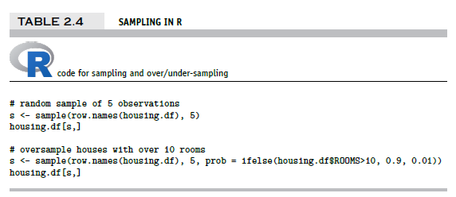
Sampling & Oversampling
Create an index of random numbers from 1 to the number of rows.
idx <- sample(a vector to choose from, the number to choose)
Use the index of randomly chosen numbers to select rows
dataFrame[ idx, ]

Slide 49
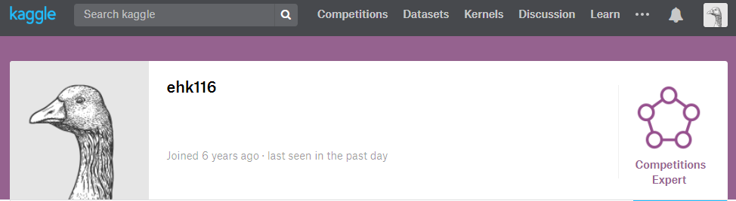
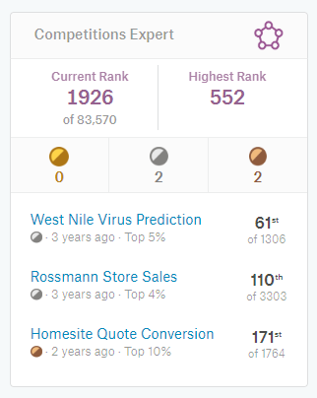
What’s the value of good EDA?
Asked to predict the presence of West Nile Virus in Chicago mosquitos traps.

Slide 50

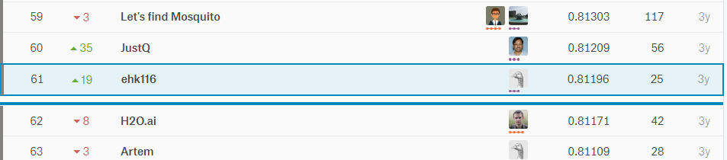
EDA let me realize a flaw!
Simple EDA by year would show that West Nile was 2x in 2012
After fitting an algorithm, I merely doubled predictions if they were within 2012 for the test set. Not great DS but an easy way to move up the leaderboard.

Slide 51
Let’s Practice
Open E_EDA work.R:
Lots of basic R options
str()
dim()
class()
head()
nlevels()
summary()
cor()
unique()
mean()
colSums()
is.na()
Specific packages make life easier
library(DataExplorer)
plot_str()
plot_missing()
plot_histogram()
plot_density()
plot_scatterplot()
library(radiant.data)
On this script you will fill in the object, vector and information into the code scaffold. Then spend 5-10min exploring the data with radiant.data

Slide 52
Agenda
Start | End | Item
 |  | What is R, R-Studio, scripting basics
 |  | Executing a first script
 |  | Visualizing Real Data & EDA
 |  | Working with Geospatial Information
 |  | Break
 |  | R’s Data Structures in Detail
 |  | EDA
 |  | Housekeeping, Reading & Homework

Slide 53
Housekeeping , Reading & Homework
Now that the cohort has a level foundation of R knowledge, the real fun begins…applications in a real business scenario!
Homework…check the syllabus
Groups will be assigned so start working on Case2 in code or with Radiant.Data!
Read Chapter 3
Day2_Homework_v2.R is in a folder on the github repo and should be in your files on your cloud instance.
Ask questions publicly on Piazza

