Slide 1
Text Mining: Unsupervised Clustering Methods
Data Mining for Business

Slide 2
Agenda
Start | End | Wednesday
 |  | K-Means Clustering
 |  | K-Mediod Clustering
 |  | Spherical K-Means Clustering

Slide 3
Machine Learning Supervised Learning
Goal: Predict a single “target” or “outcome” variable
Training data, where target value is known
Score to data where value is not known
Methods: Classification and Prediction

Slide 4
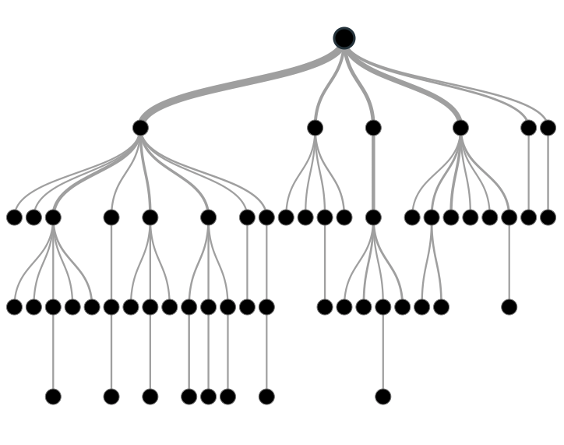

Supervised Learning
Inferring a function from labeled data.
“Learn from telling”, “Look at my data and I will tell you what to predict”
Data Setup
Method
Business Examples
Application
Marketing-Will a customer buy yes or no? How much will a customer spend?
Operations- Will an applicant default? When will a machine break?
Flat “Excel” file. Each row is a record or observation. Each column is an attribute of the record.
One column is the outcome, y or target attribute.
Modeling e.g. K-NN, linear regression, decision tree, random forest etc.
Use the model to make predictions for the target label on the new data.

Slide 5
Supervised Learning in NLP
Is this email SPAM Vs non-Spam?
Is this document making fraudulent claims or not?
Using tweet mentions or financial documents predict a company’s revenue

Slide 6
Machine Learning: Unsupervised Learning
Goal: Segment data into meaningful segments; detect patterns
There is no target (outcome) variable to predict or classify
Methods: Association rules, clustering, data reduction & exploration, visualization

Slide 7
Unsupervised Learning
Trying to find hidden structure in unlabelled data.
“Learn from observing”, “Look at my data and tell me about it”
Data Setup
Method
Business Examples
Application
Marketing-Find customer segments for specific marketing campaigns.
Operations-Identify locations for cell towers based on population density and area characteristics.
Text Analysis- Topic modeling of articles
Flat “Excel” file. Each row is a record or observation. Each column is an attribute of the record.
Clustering e.g. K-Means, Hierarchical Clustering etc
In new data find the customers/observations that most likely are part of a particular cluster.

Slide 8
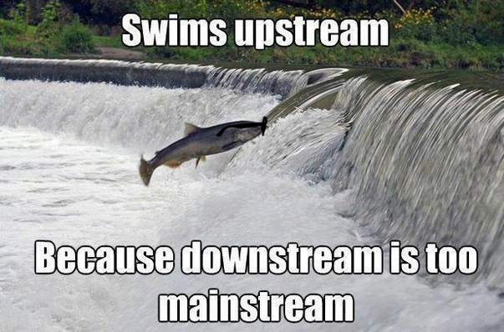
Your turn…
Methods
Scenario
How many fish did each vessel catch?
Supervised or
Unsupervised

Slide 9

Your turn…
Methods
Scenario
What observed customer personas exist in our customer data?
Supervised or
Unsupervised

Slide 10

Your turn…
Methods
Scenario
How many patients should we expect in the urgent care tomorrow?
Supervised or
Unsupervised

Slide 11
ID 3 Clusters
Select US State Fuel Cost (x) vs Sales (y)

Slide 12
Intuition for 3 clusters…
Select US State Fuel Cost (x) vs Sales (y)
low cost &
high sales
Mid cost &
Mid sales
High cost &
low sales

Slide 13
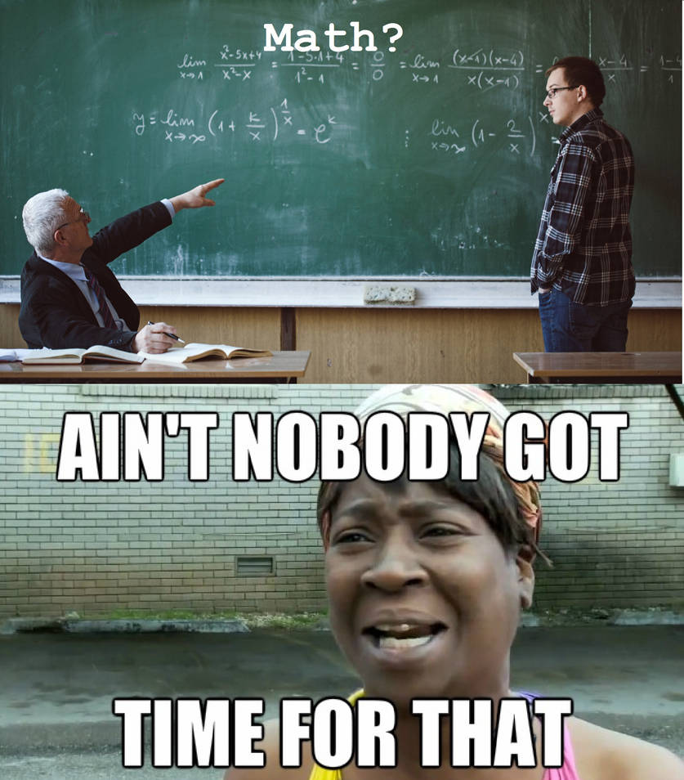
K-Means Unsupervised
Previous slide clustering was done by “eye”
“K” clusters are defined by practitioner
Need a defined distance measure between record
Euclidean Distance (common but not great for text)
Scale each vector to one so a unit of measure doesn’t dominate ie # of rooms in a house vs sq-Meter of house

Slide 14
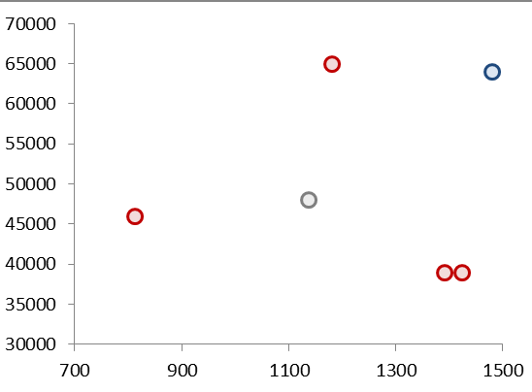
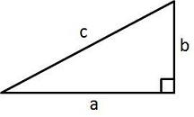
Quick Refresher remember KNN?
Remember Pythagorean Theorem?
Example Data
A²+B²=C²
b
c
a

Slide 15
K Means
Select US State Fuel Cost (x) vs Sales (y)
2
1
3
Random centroid placement

Slide 16
K Means
Select US State Fuel Cost (x) vs Sales (y)
2
1
3
Calculate the distance from each point to each centroid

Slide 17
K Means
Select US State Fuel Cost (x) vs Sales (y)
2
1
Cluster “3”
3
Cluster “1”
Pts assigned to closest centroid.

Slide 18
K Means
Select US State Fuel Cost (x) vs Sales (y)
2
1
Cluster “2”
Cluster “2”
Cluster “2”
Cluster “3”
3
Calculate the MEAN AVERAGE distance among assigned pts to centroid

Slide 19
K Means
Select US State Fuel Cost (x) vs Sales (y)
2
2
1
3
3
1
Move the centroid to the average distance among all assigned points

Slide 20
K Means
Select US State Fuel Cost (x) vs Sales (y)
2
Since “3” moved, this pt is now assigned to “2”
3
1
Pt reassignment affects the avg distances so the process repeats…

Slide 21
K Means
Select US State Fuel Cost (x) vs Sales (y)
2
2
1
2
3
3
1
1
The new pt assignments again moves the centroid. The process repeats until no reassignments occur after moving the centroids (convergence).

Slide 22
K-Means Unsupervised
Previous slide clustering was done by “eye”
“K” clusters are defined by practitioner
Need a defined distance measure between record
Euclidean Distance (common but not great for text)
Scale each vector to so one unit of measure doesn’t dominate ie # of rooms in a house vs sq-Meter of house
Because it is the mean average all data attributes must be numeric (non factor ie what is the average of “blue eyes” or “medium” or “first/second”. Luckily w/text this is not an issue!

Slide 23

Try it out!
Open A_kmeans.R

Slide 24
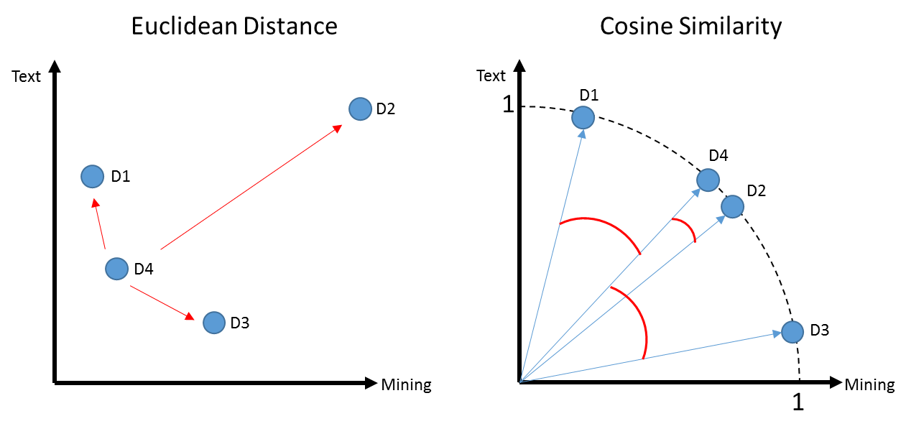
K-Means Problems
Computationally intensive (non-parametric)
Centroid will be greatly affected by an outlier
In this example a centroid would be “pulled” away from the actual cluster D1,D4 & D3

Slide 25

K- Mediod Clustering
Same steps as K-Means but instead of mean averages, uses the median distance to move centroids
Less impacted by outliers
Mean of 1,2,3,4,5,60 = 12.5
Median of 1,2,3,4,5,60 = 3.5 (closer to more points in vector space)
Open B_kmediods.R

Slide 26
K Means Vs Spherical K-Means
D1 a book for aspiring authors referring to “text” a lot
D2 & D4 refer to “text” and “mining” in equal proportions like my text book
D2 is many times longer than the other books
D3 refers to “mining” ie minerals
Using Euclidean Distance D1, D4, D3 probably appear as 1 cluster w/D2 standing alone

Slide 27
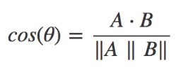
Another way to measure distance
Euclidean: How dissimilar are documents?
Cosine: How similar are documents?
Starting with a numeric Vector Representation from tokens
Doc1: 1,0,3,6,7,0
Doc2: 0,1,2,6,1,0
1. Calculate the “dot product” of the vectors:
(1*0) + (0*1) + (3*2) + (6*6) + (7*1) + (0*0)
0 + 0 + 6+ 36+ 7+ 0 = 49

Slide 28
Cosine
Cosine: How similar are documents?
Starting with a numeric Vector Representation from tokens
Doc1: 1,0,3,6,7,0
Doc2: 0,1,2,6,1,0
1. Calculate the “dot product” of the vectors:
(1*0) + (0*1) + (3*2) + (6*6) + (7*1) + (0*0)
0 + 0 + 6+ 36+ 7+ 0 = 49
2. Calculate the magnitude for a documents
Doc1: (1*1) + (0*0 )+ (3*3) + (6*6) + (7*7 )+ (0*0)
1 + 0 + 9 + 36 + 49 + 0 = 95
Sqrt(95) = 9.7
Doc2: (0*0)+(1*1)+(2*2)+(6*6)+(1*1) + (0*0)
0 + 1 + 4 + 36 + 1 + 0 = 42
Sqrt(42) = 6.4
9.7 * 6.4 = 63.1

Slide 29
Cosine
Cosine: How similar are documents?
Starting with a numeric Vector Representation from tokens
Doc1: 1,0,3,6,7,0
Doc2: 0,1,2,6,1,0
1. Calculate the “dot product” of the vectors:
(1*0) + (0*1) + (3*2) + (6*6) + (7*1) + (0*0)
0 + 0 + 6+ 36+ 7+ 0 = 49
2. Calculate the magnitude for a document
Doc1: (1*1) + (0*0 )+ (3*3) + (6*6) + (7*7 )+ (0*0)
1 + 0 + 9 + 36 + 49 + 0 = 95
Sqrt(95) = 9.7
Doc2: (0*0)+(1*1)+(2*2)+(6*6)+(1*1) + (0*0)
0 + 1 + 4 + 36 + 1 + 0 = 42
Sqrt(42) = 6.4
9.7 * 6.4 = 63.1
3. Distance Measure: 49 / 63.1 = 0.77

Slide 30
Spherical K-Means
Euclidean: How dissimilar are documents?
Cosine: How similar are documents?
Uses cosine similarity to calculate distance
Values are normalized to 0,1
Cosine is measuring similarity…so a value of 0 means orthogonal (independent)
These are similar to the cosine similarity is closer to 1
Using cosines now D4, D2 represent a cluster as expected and you may have to declare add another K

Slide 31
Side by Side
Big distance D4 to D2 means they are far apart.
D4:D1 Small angle distance so the cosine similarity will get closer to 1.

Slide 32
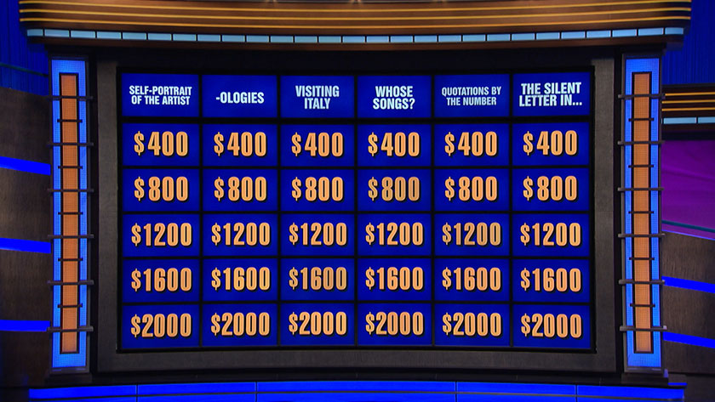
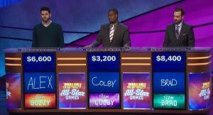
Jeopardy Data Set Explanation
Jeopardy is a US game show that contestants “ask the question to the stated answer to earn money.

Slide 33
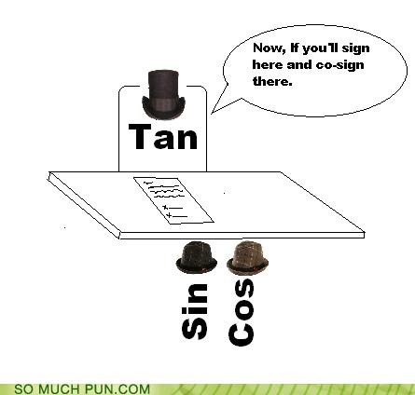
Open C_spherical_kmeans.R

Slide 34
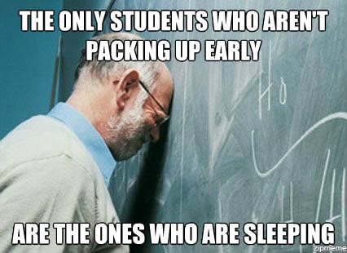
Notes
Holiday break
Read the ethics articles provided for next class!
Final Reflection Essay

