Slide 1
Growth Models
http://www.iam.fmph.uniba.sk/institute/stehlikova/ts16/ex/ex02_bass.pdf
https://faculty.biu.ac.il/~fruchtg/829/lec/6.pdf
https://www.youtube.com/watch?v=tkU3NU89OFs

Slide 2
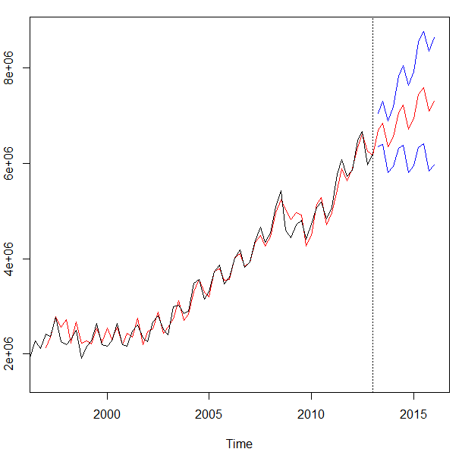
Growth Models are a form of time series forecasting
Model Based Methods
Holt Winters
Time Series Decomposition
Book Chapter 17
Regression Based Forecasting
Data Driven Methods
Forecasted value at period “n” is equal to some interactions of x-variable inputs

Slide 3
Model Based
Model Based approaches do not have x-variable inputs.
Use statistical, mathematical or other scientific model to approximate a data series.
Parameters of the model are learned in training then used to generate forecasts.
Can be used with few data points
Remember how we only had the time series to get level, trend & seasonality?

Slide 4
When to use model vs data driven forecasting
Data Driven
Needs trustworthy historical data
Variables are engineered as inputs i.e. month dummy variables lagged x days as inputs
Apply a machine learning method like XGB
Model Driven
Needs fewer data points
Assumptions can be made for curve parameters
Apply a curve fitting model like SIR
Data driven works when there is historical pattern, & data can be trusted. Model based approaches work when there is no/limited/lots of noise in the data.

Slide 5
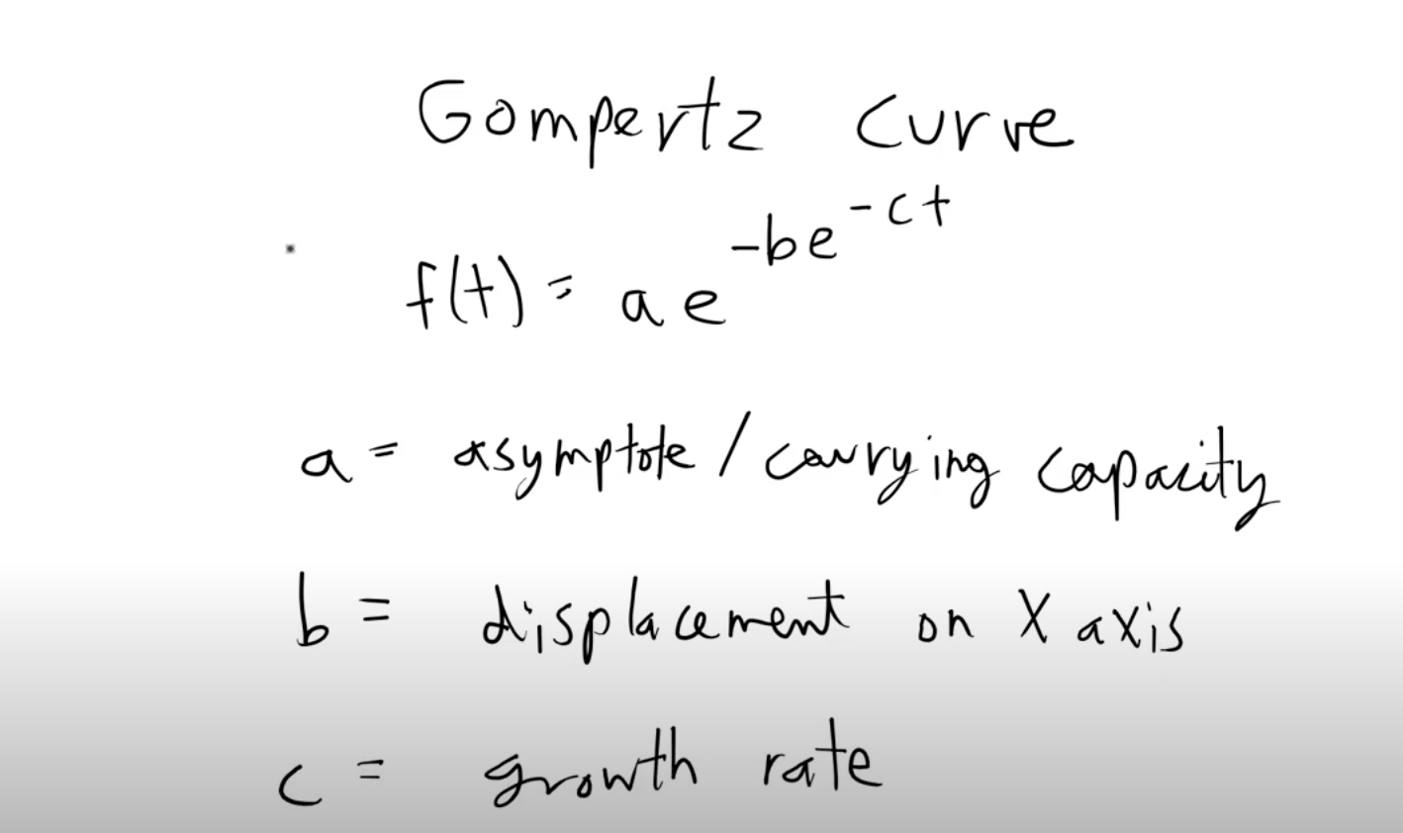
Gompertz Growth Curves
New Product Forecasting with few data points
Assumes the population doesn’t grow
Double expontential
# Facts about your business
# You make HD TVs
# Total televisions in use in 2002 = 248 million
# Analaog Transmitter Power: $44,000 per year
# Analog Transmitter Site Lease: $33,000 per year

Slide 6
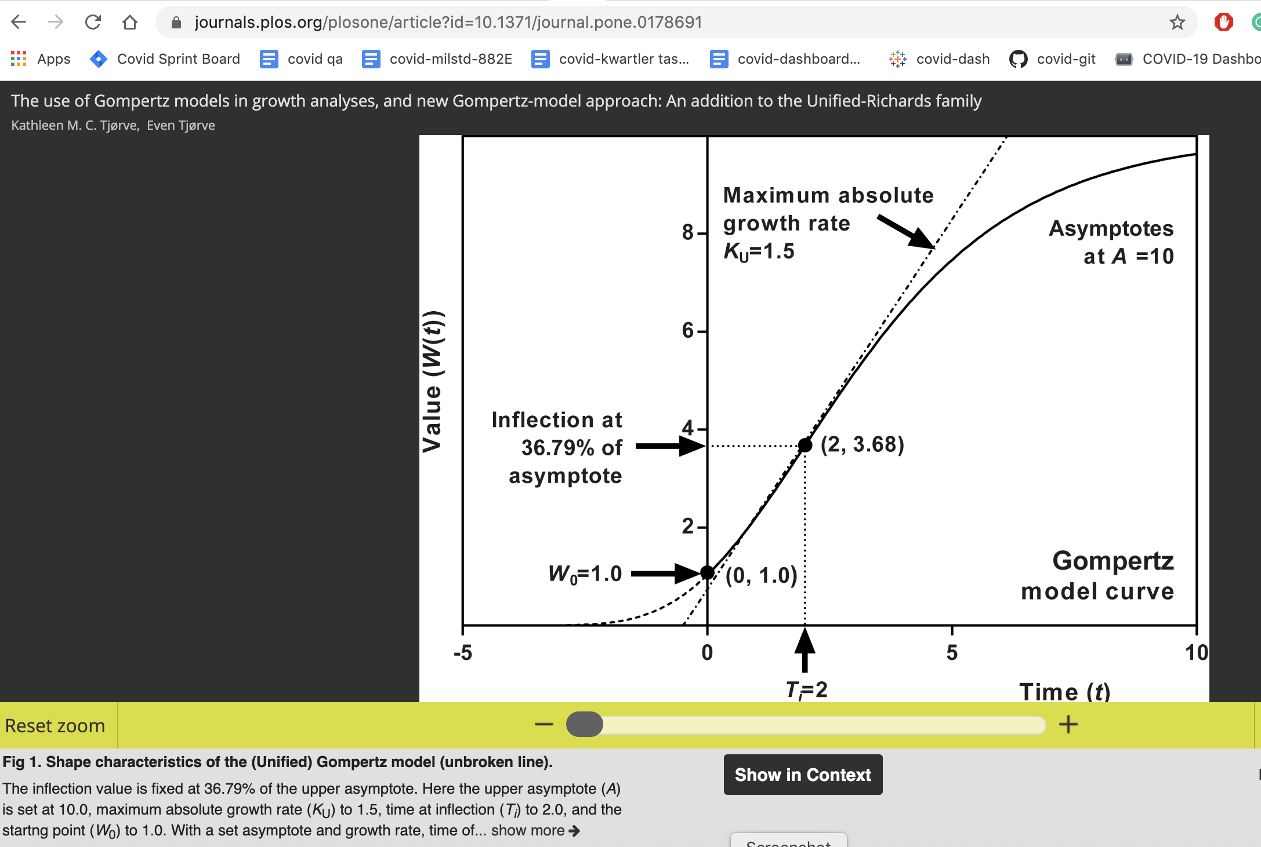
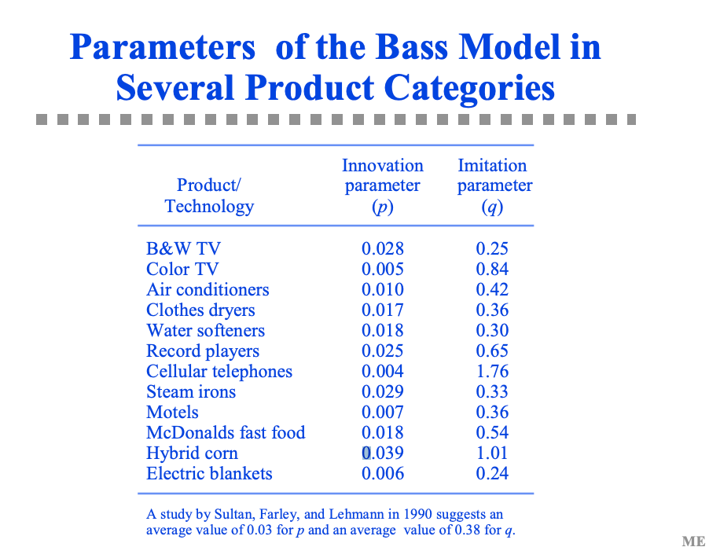
BASS Models Find analog

