Slide 1
2019-10-31 Patient Review
Dale the DataScientist

Slide 2
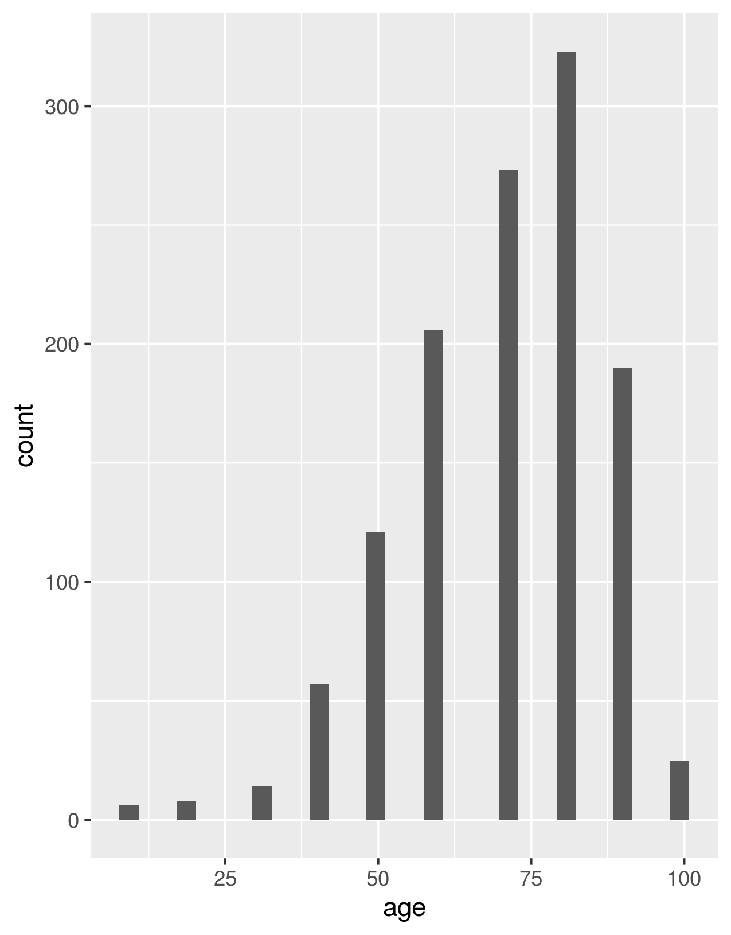
Averages & Distributions
AVGlabs | AVGage | Females | Males
42.625 | 70.221 | 640 | 583

Slide 3
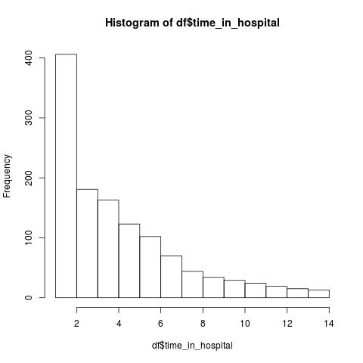
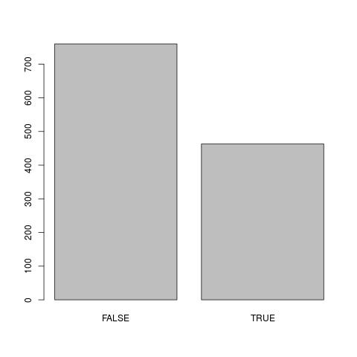
Readmissions Info
Time in Hospital
Readmissions in last 30days
Readmissions in last 7days

