Slide 1

Understanding the Career Aspirations of GEN-Z
Shrestha S Bharadwaj

Slide 2
Agenda
About
Problem Statement
Insights
Charts
Summary
Presentation Title

Slide 3

About Me
Shrestha S Bharadwaj
BE, Computer Science Engineering
Blogger | Podcaster | Biz/ Data Whizz

Slide 4

Problem Statement
Breaking down how GEN-Z decide on choosing a career path. What are they influenced by, Who influence them, What are their considerations behind choosing a Career.
Who is to be analyzed?
Gen Z, the people of this generation ,a generation born between 1997 and 2012, out to venture into their careers.

Slide 5
Tasks Performed
- Understood the nature and the scope of the analysis from the project owner - Performed market research by various means like personal interviewing, articles or white papers - Prepared a Analysis requirement documentation for all the involved stakeholder with tight deadlines - Understood the current Data Sources and Finalized the Data collection approach - Collected Data by a Survey manually (Google Form) - Performed Data Cleaning and Data Standardization/Normalization (Power Query) - Created several hypothesis questions around the business and KPI and finalized on the focus areas - Created several analysis reports and found insights to bring business impact using Excel, PowerBI and SQL - Designed and Published Dashboards for presenting the Insights (Excel & PowerBI)

Slide 6
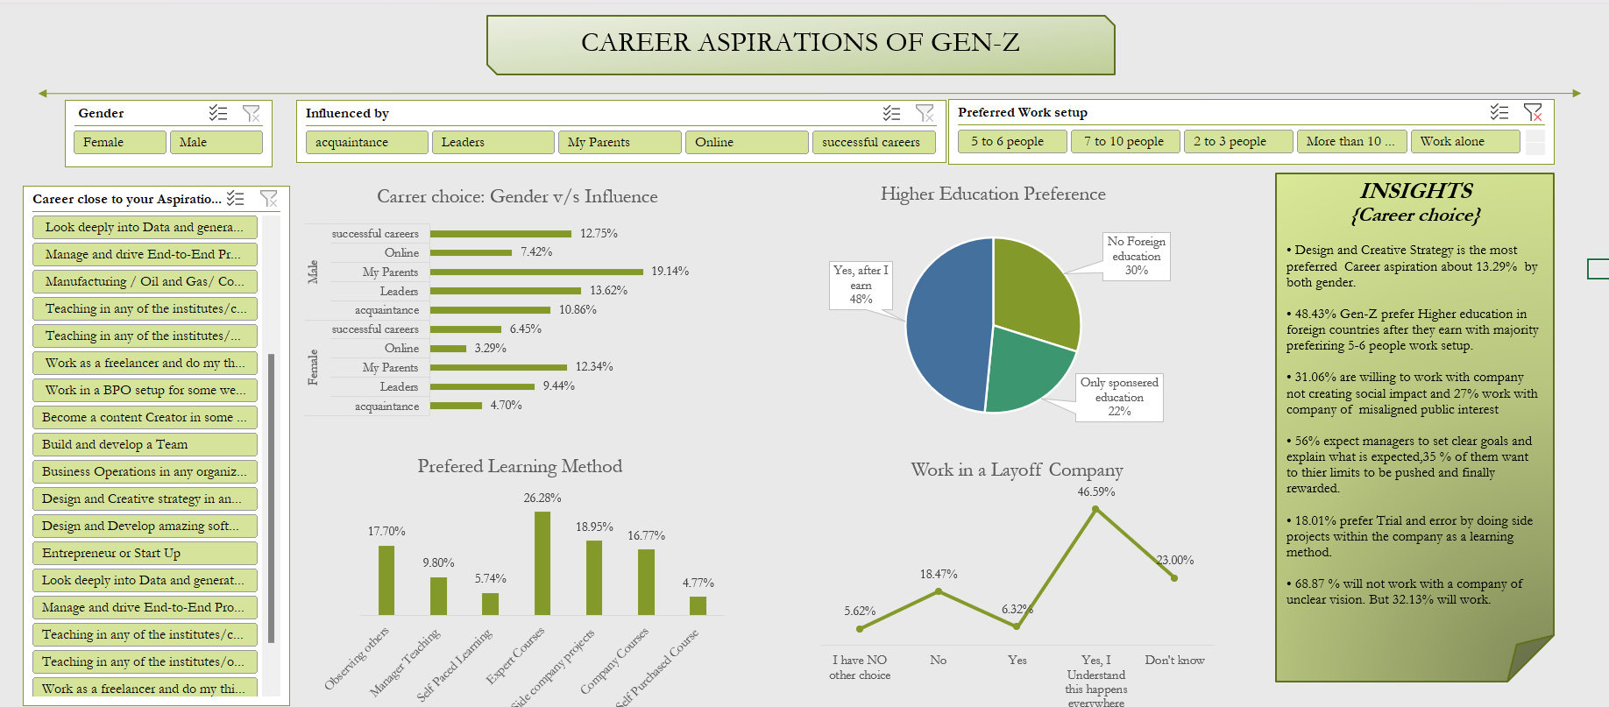

Slide 7





Insights
1
2
3
4
5

Slide 8

INSIGHTS
1] Design and Creative Strategy is the most preferred Career aspiration about 13.29% by both gender.

Slide 9
INSIGHTS
2.] 48.43% Gen-Z prefer Higher education in foreign countries after they earn with majority preferring 5-6 people work setup.

Slide 10
INSIGHTS
3] 31.06% are willing to work with company not creating social impact and 27% work with company of misaligned public interest

Slide 11
INSIGHTS
4] 56% expect managers to set clear goals and explain what is expected,35 % of them want to thier limits to be pushed and finally rewarded.

Slide 12
INSIGHTS
5] 26.28% prefer Expert course training as the most preferred learning method.

Slide 13
INSIGHTS
6] 68.87 % will not work with a company of unclear vision. But 32.13% will work.

Slide 14
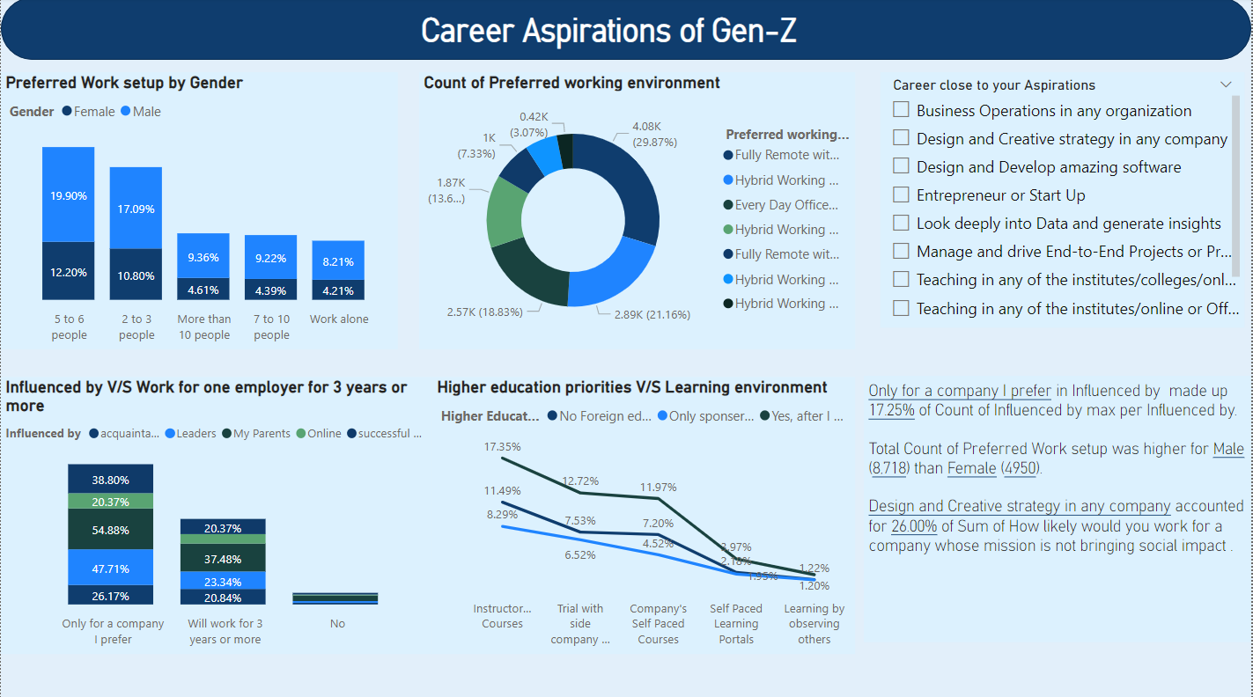

Slide 15
﻿Only for a company I prefer to work for 3 or more years made up 17.25% of Count of Influenced by max.﻿﻿ ﻿﻿ ﻿﻿ Fully remote with travel when needed was most Preferred Work setup with Male (66%) and Female (34%).﻿﻿ ﻿﻿ Design and Creative strategy in any company accounted for 26.00% working in company whose mission is not bringing social impact .﻿﻿ ﻿﻿ ﻿
AI INSIGHTS

Slide 16


Summary
In conclusion, it is necessary to solve the problem of understanding the career aspirations of Gen Z to attract and retain top talent from this generation. By understanding the values, expectations, and preferences of Gen Z, businesses can create a company culture and recruitment and retention strategies that align with these factors. This will help businesses to improve their ability to attract and retain Gen Z talent, which is becoming increasingly important as this generation continues to enter the workforce

Slide 17




Thank you
Shrestha S Bharadwaj
shresthasbharadwaj17@gmail.com
https://linktr.ee/shresthasbharadwaj

