Slide 1
Pitch Effort Injury Analysis
Matthew Rice
DSC 530 – T302
Professor Matthew Metzger

Slide 2
The Problem
Sports injuries are a concern for athletes and coaches at all levels. In the game of baseball elbow injuries are a particular concern for pitchers, and at the highest levels, team owners and managers factor in these concerns when making transactions and offering contracts. Data analysis in Major League Baseball (MLB) has driven the trend of pitchers attempting to increase both the velocity and spin rate of their pitches to obtain better outcomes. An important question being addressed in this project is: "How much (if any) effect does the attempt to maximize velocity and spin rate have on MLB players' time spent on the Injured List (IL)?"

Slide 3
The Data
Data from 196 MLB starting pitchers who have thrown at least 2,000 combined pitches over the last five seasons was obtained from baseballsavant.mlb.com.
Those statistics tics were merged with injury data from the previous five MLB seasons obtained from fangraphs.com.
After merging the datasets I selected five variables, and created one new variable, that will best help answer the question of how maximized pitch "effort" is related to time missed due to injury.
Pitch Data, Injury Data

Slide 4
Variables
variable | class | first_values
player_name | Character | Abbott, Andrew
max_release_speed | Integer | 95.8
percentage_above_95 | Integer | 97.96
Days_missed | Integer | 41
average_velo | Integer | 92.76
Average_spin | Integer | NA

Slide 5
Variables Cont.
player_name - MLB pitcher's name
max_release_speed – fastest pitch recorded by player
Days_missed - total days spent on Injured List over last five years
Average_velo - average velocity of all pitches thrown
Average_spin_rate - average spin rate of all pitches thrown
percentage_above_95 - To better define "effort", this variable was created and measures the percentage of pitches thrown that are equal to or higher than 95% of a pitcher's maximum release speed

Slide 6
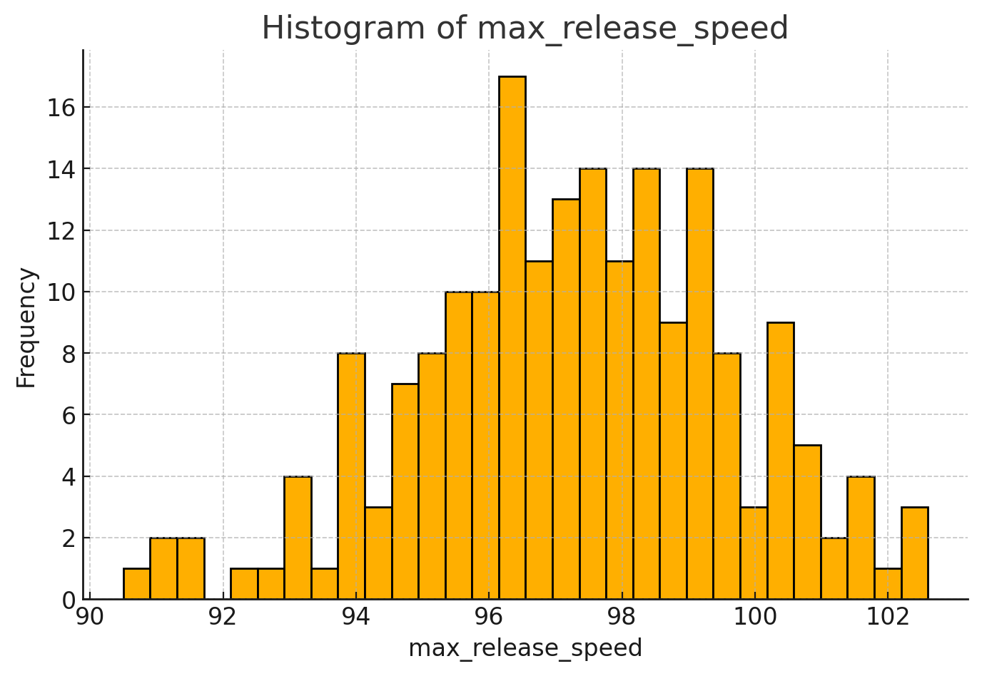
Summary:
Mean: 97.28
Median: 97.3
Mode: 96.3
Range: 12.099
Skewness: -0.262

Slide 7
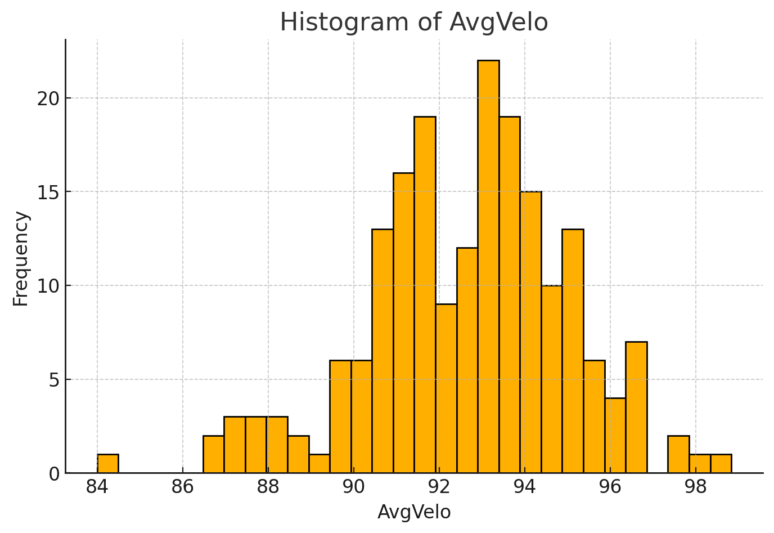
Summary:
Mean: 92.67
Median: 92.91
Mode: 83.99
Range: 14.84
Skewness: -0.403

Slide 8
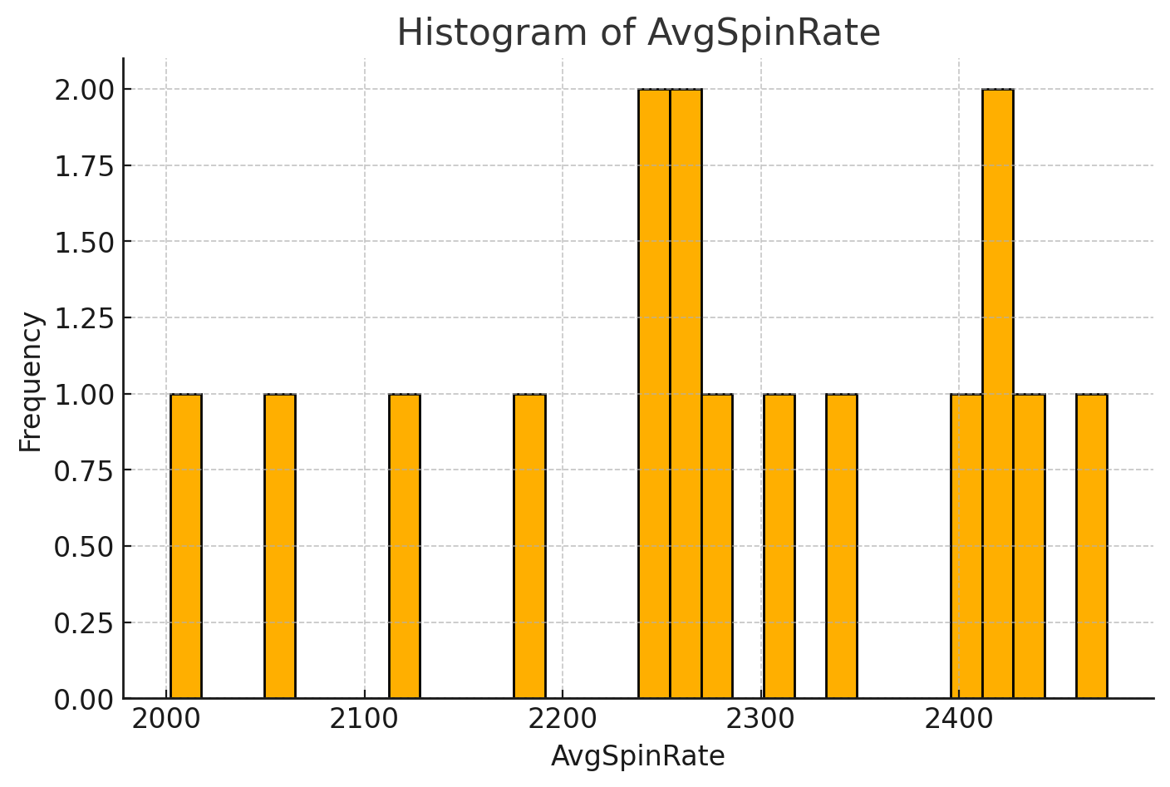
Summary:
Mean: 2279.08
Median: 2269.85
Mode: 2002.004
Range: 472.648
Skewness: -0.475

Slide 9
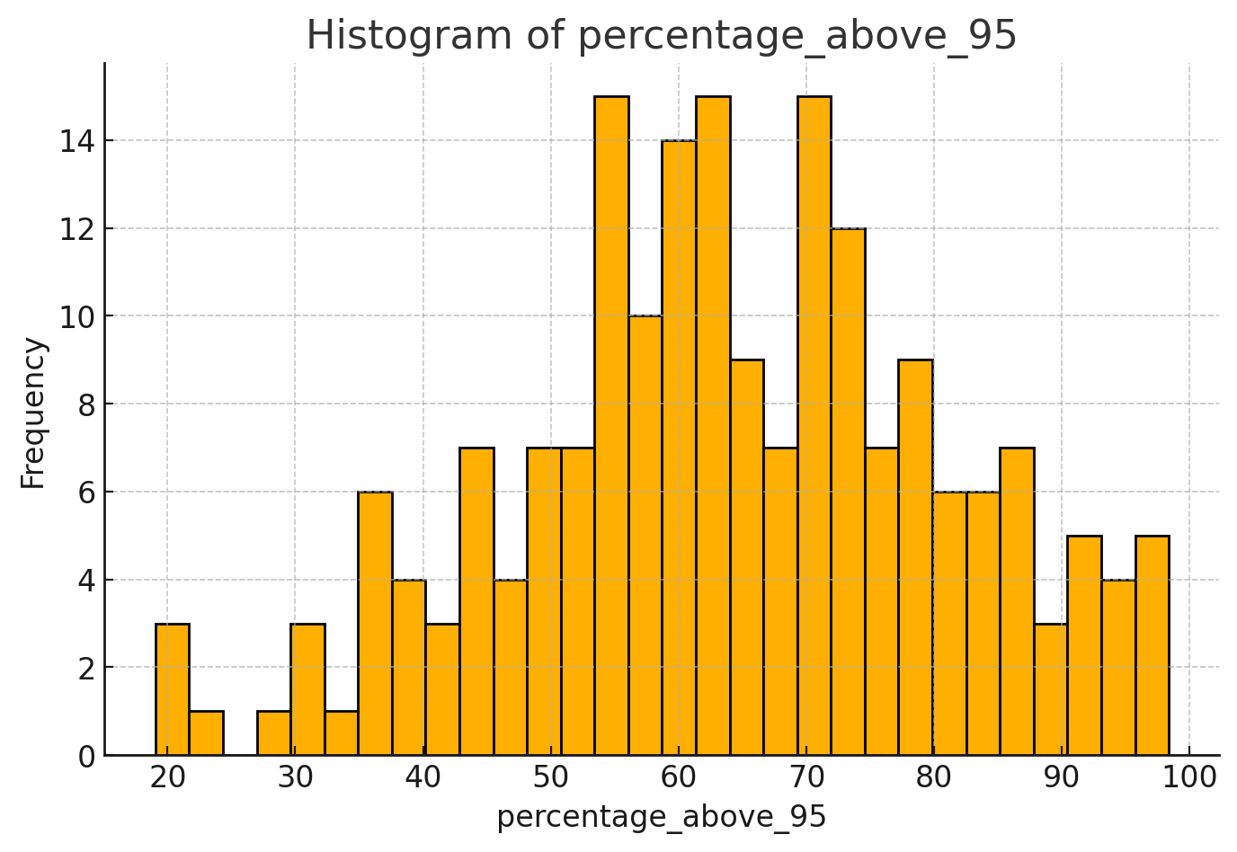
Summary:
Mean: 64.044
Median: 63.475
Mode: 19.049
Range: 79.31
Skewness: -0.205

Slide 10
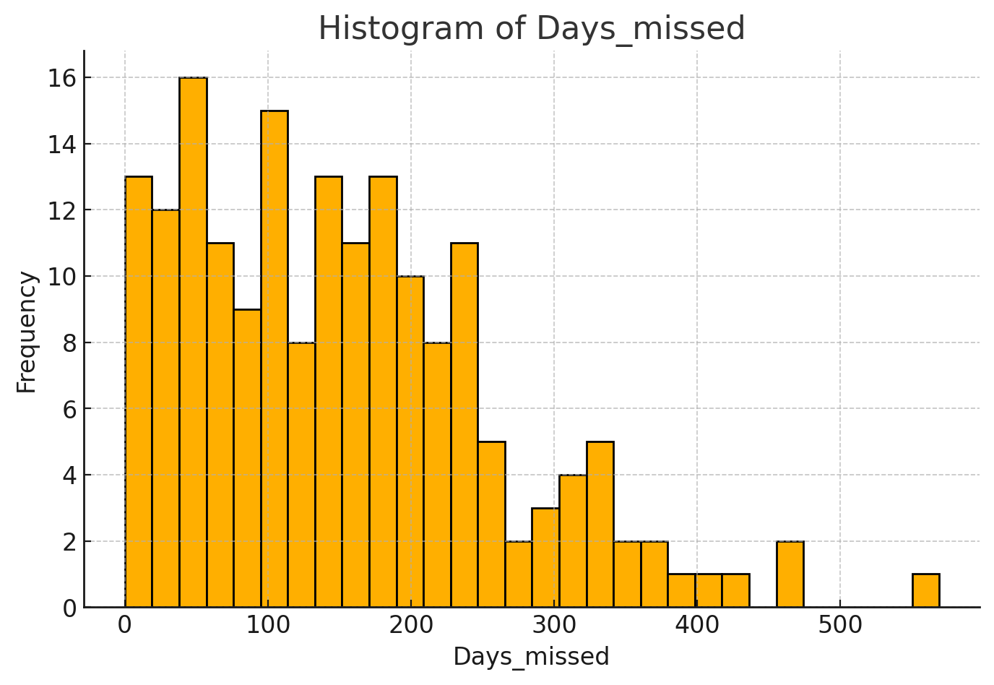
Summary:
Mean: 151.24
Median: 138.0
Mode: 0.0
Range: 569.0
Skewness: 0.890

Slide 11
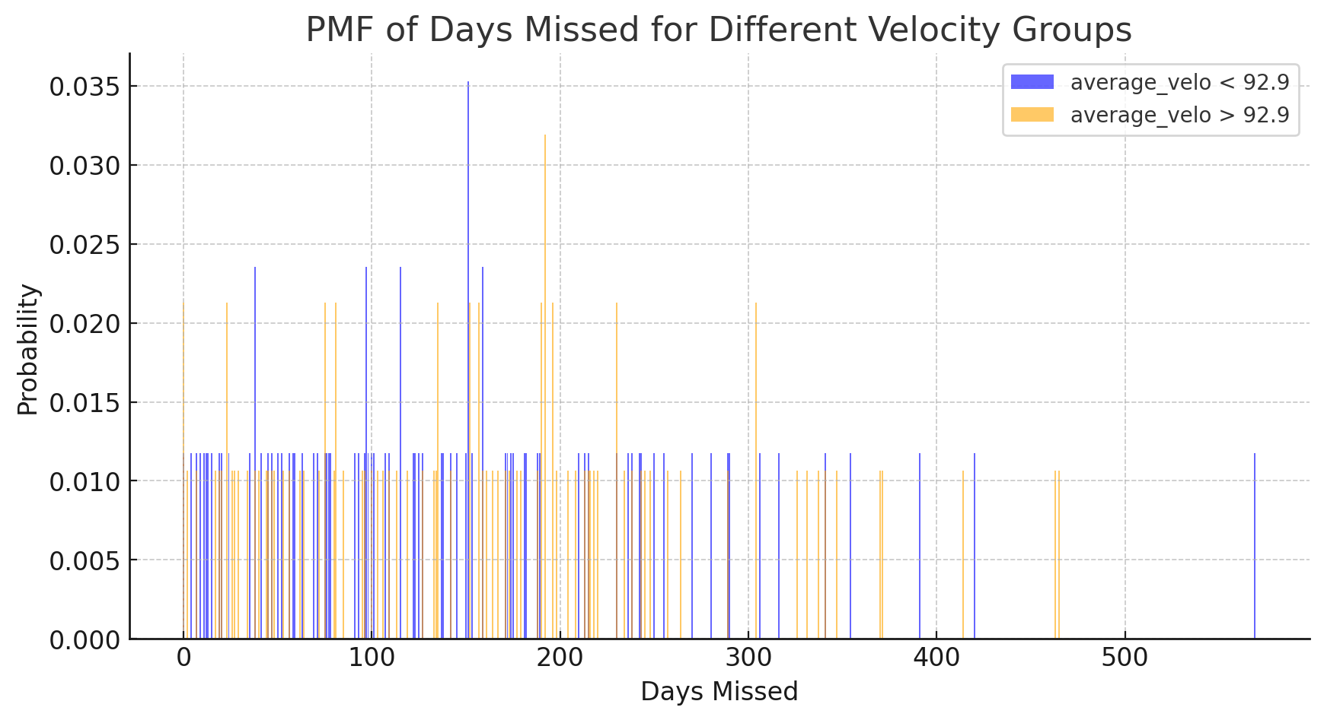

Slide 12
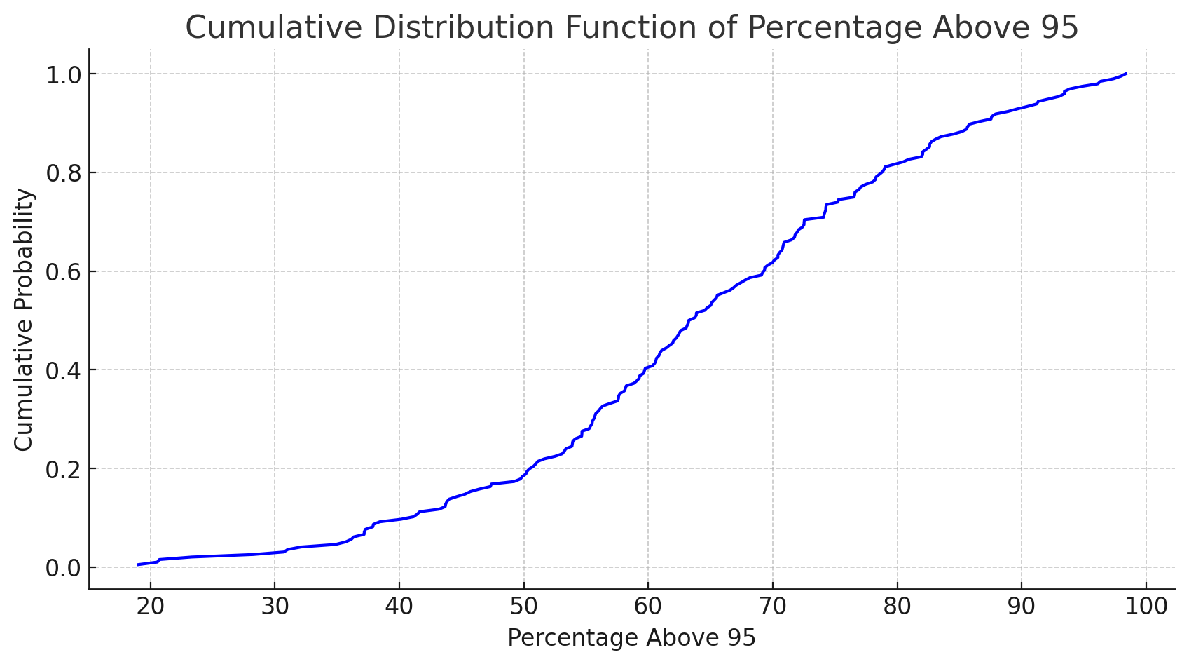

Slide 13
CDF Analysis
A "percentage_above_95" value of 50 indicates that a pitcher threw half of his fastballs at a speed that measured between 95 and 100 percent of his maximum recorded fastball velocity.
The value 50 has a cumulative probability of 0.2, meaning only about 20% of pitchers are throwing their hardest "stuff" 50 percent of The time or less.
The graph confirms that the vast majority of pitchers are throwing at, or very near, their absolute hardest on more than half of their throws.

Slide 14
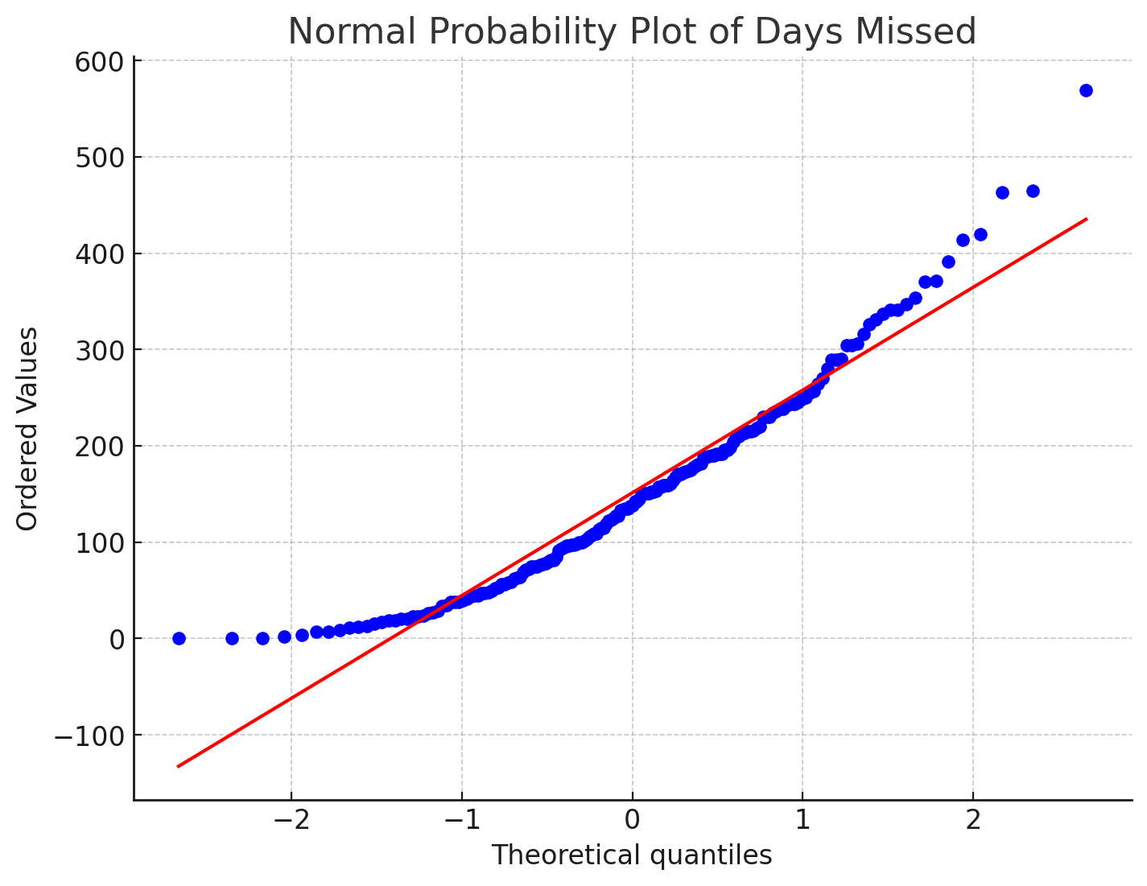

Slide 15
Normal Probability Analysis
The number of days missed due to injury for each player follows a normal distribution around the mean, but does deviate around the tails.
The maximum number of days missed, nearly 600, is higher than what would be expected with a normal distribution. And, the number of players who have missed zero days skews the distribution to the right.
Removing outliers or performing a transformation on this data might be necessary to better fit a model.

Slide 16
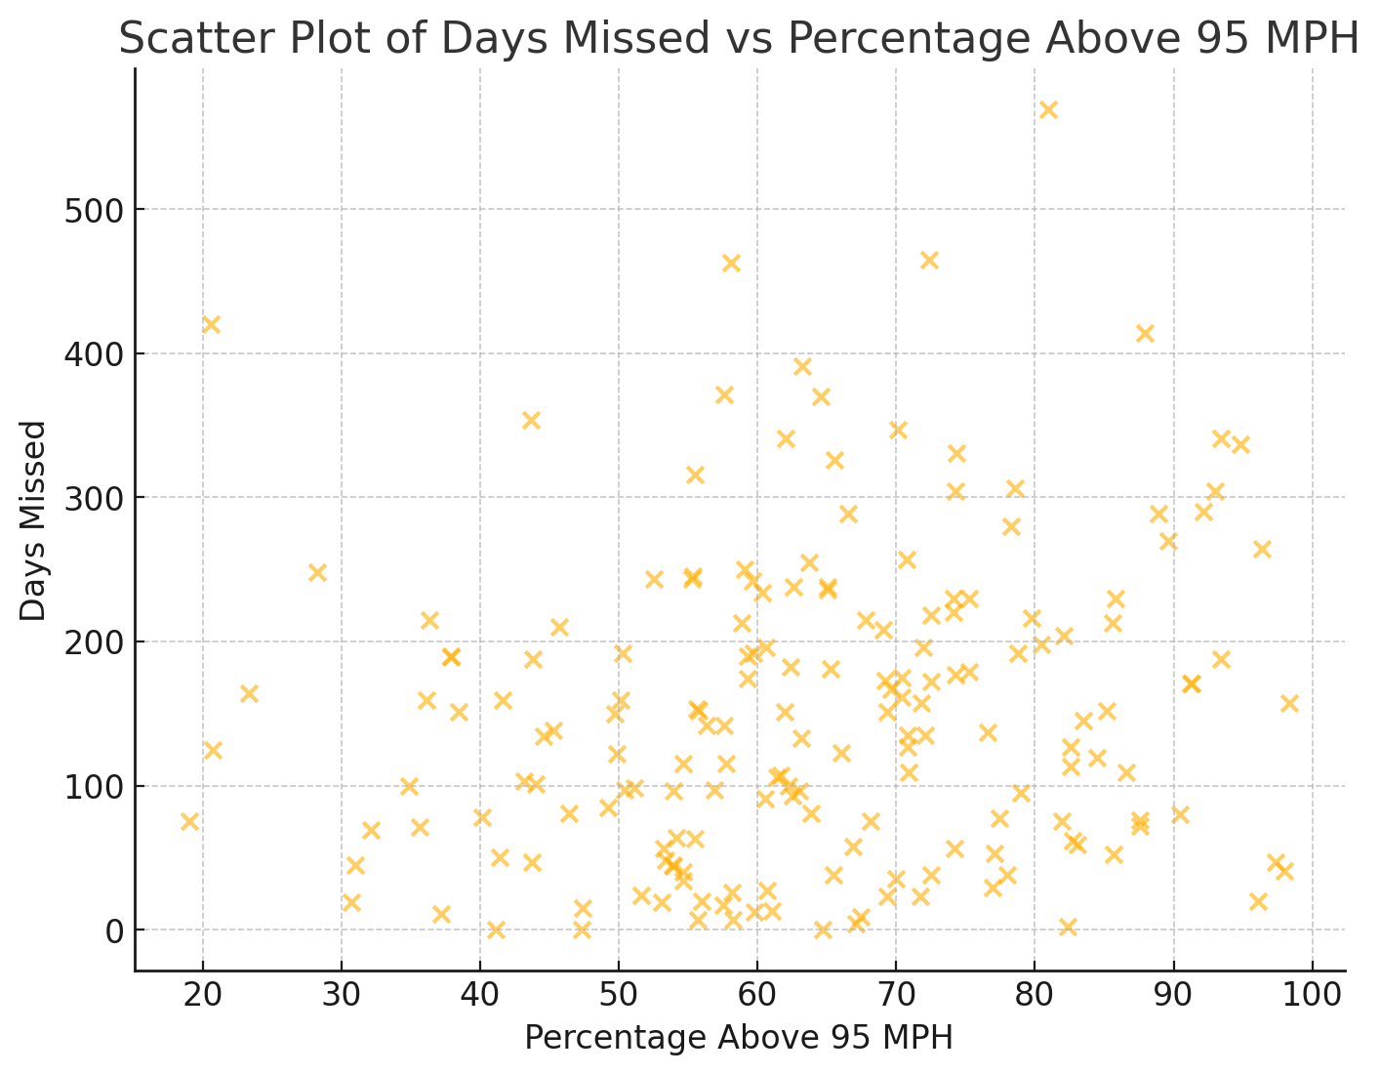

Slide 17
Correlation Analysis
There are not any distinct visual patterns in the scatter plot comparing "percentage_above_95" and "days_missed".
Pearson's correlation coefficient between the two variables is 0.161, indicating a very weak positive correlation.

Slide 18
Hypothesis Test
Using the CDF of "percentage_above_95" as a guide, I chose to test the mean Days Missed values of pitchers who throw 95% or more of the max velocity more than 70% of the time against those who exert this high amount of effort less than 70% of the time.
The null hypothesis is that a higher "percentage_above_95" value will have no difference on the mean of days missed due to injury.
A Welch's t-test is used to account for differences in the mean groups being tested and to account for unequal variances in the groups.

Slide 19
Hypothesis Test Results
The test produced a t-statistic of 2.377 and a p-value of 0.0189.
A p-value of less than 0.05 suggests that we can reject the null hypothesis.
There is a statistically significant difference in the mean of days missed due to injury between players with a "percentage_above_95" value above 70 and those below.

Slide 20
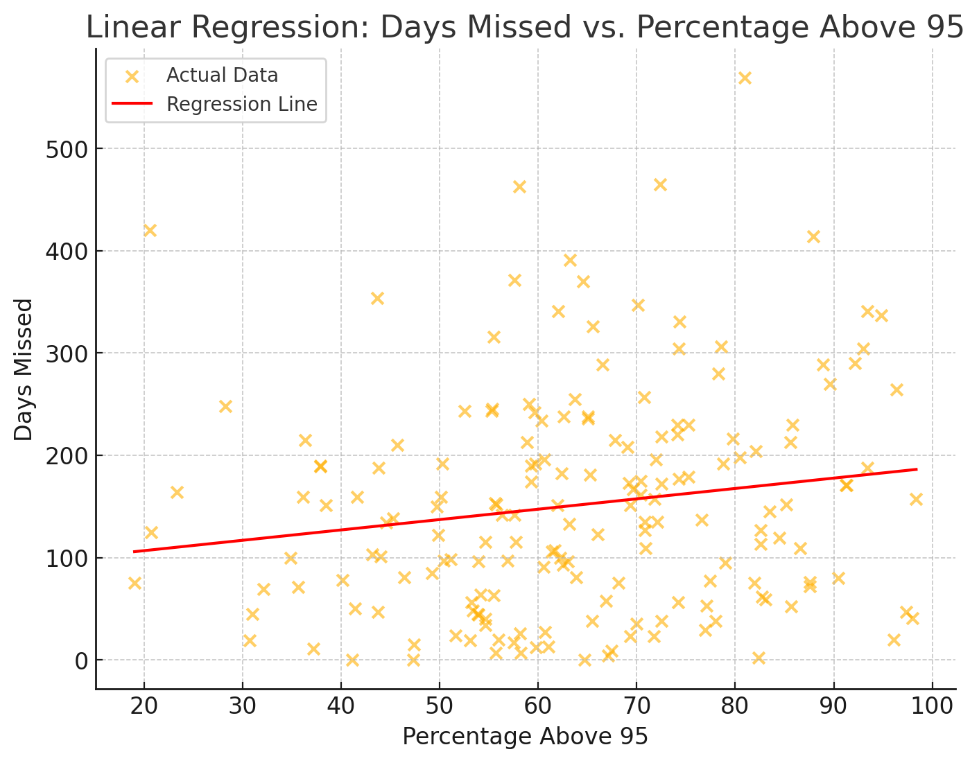

Slide 21
Linear Regression Analysis
R-squared = 0.026: This means that only 2.6% of the variation in "Days_missed" is explained by "percentage_above_95".
Coefficient for "percentage_above_95" = 1.0134: Each 1 percentage point increase in "percentage_above_95" is associated with 1.013 more days missed, on average.
p-value for "percentage_above_95" = 0.032: Since this is below 0.05, the effect of "percentage_above_95" on "Days_missed" is statistically significant.

Slide 22
Conclusion
Evidence has been found to support the hypothesis that pitchers who exert greater effort by throwing their fastballs at 95-100 percent of their maximum velocity more often are likely to miss more time due to injury.
Because there is not a strong linear correlation between these two variables other models, such as k clusters or random forests, may provide better predictions than the linear regression model.
Other factors, including environmental, biomechanics, and a deeper dive into the nature of injuries should be considered in further studies.

