Slide 1
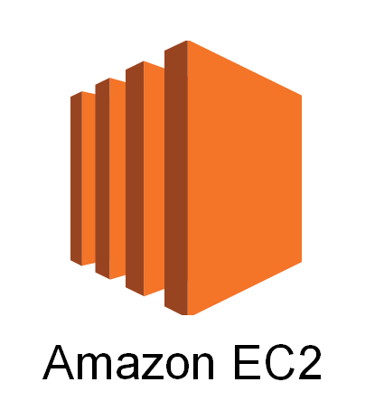
Amazon EC2

Slide 2
What we'll cover:
A brief look back
Amazon EC2
Key functionality
Companion services
Demo

Slide 3
What is Amazon EC2
• Single instance family and size – m1.small (1 vCPU, 1.7 GiB RAM, 160 GB storage)
• Linux only
• On Demand pricing only
• No AWS Management Console
• No EBS
• No Elastic Ips
• No VPC
• No Auto Scaling
• No Elastic Load Balancing

Slide 4
• Many new families and sizes – M1, M2, C1, C3, M3, CC1, CC2, CG1, G2, CR1, HS1, HI1, T1, G2, I2
• Windows (and Enterprise Linux)
• Reserved Instances and Spot Instances
• AWS Management Console
• Elastic Block Store
• Elastic IP Addresses
• Virtual Private Cloud (VPC)
• Auto Scaling
• Elastic Load Balancing
• Performance, security, manageability, and scalability improvements

Slide 5
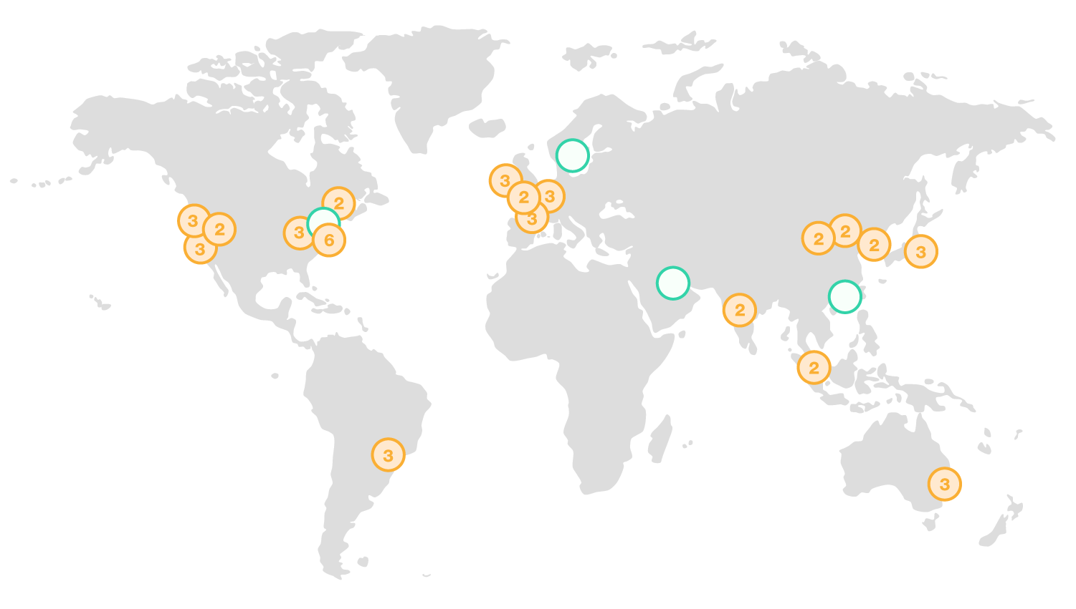
AWS Global Infrastructure
Region & Number of Availability Zones
US East
N. Virginia (6), Ohio (3)
US West
N. California (3), Oregon (3)
Asia Pacific
Mumbai (2), Seoul (2), Singapore (2), Sydney (3), Tokyo (3)
Canada
Central (2)
China
Beijing (2), Ningxia (2)
Europe
Frankfurt (3), Ireland (3), London (2), Paris (3)
South America
São Paulo (3)
AWS GovCloud (US-West) (2)

Slide 6
Amazon EC2
• Resizable compute instances in the cloud
• Provision 1 or many instances
• Pay for what you use; no minimum commitment
• Familiar operating systems, with cloud benefits
Amazon EC2 Instances - Families
Compute-Optimized
Storage-Optimized
Micro Instances
General Purpose
GPU Instances
Memory-Optimized

Slide 7
Amazon EC2 Instances - Generations
C1/CC2/C3
M1/M3
T1
M2/CR1
HI1/I2/HS1
G2
Amazon EC2 Instances – Types*
c3.large
m3.medium
g2.2xlarge
m2.xlarge
t1.micro
i2.xlarge

Slide 8
Recent Instance Highlights
• HI1– 120,000 random read IOPS on SSDs
• I2 - Next generation I/O optimized (350,000+ random read IOPS)
• M3 – Next generation general purpose
• HS1– 48 TB of storage per instance
• CR1– 244 GiB of RAM &Intel Xeon E5 2670 (Sandy Bridge) CPUs
• G2 – 1 NVIDIA GK104 GPU (Kepler)
• C3 - 2.8 GHz Intel Xeon E5-2680v2 (Ivy Bridge) CPUs (SSD)
A choice of block storage options
• Locally attached, “instance storage”
– Type/amount differs by instance
• Amazon EBS Standard Volumes
• Amazon EBS Provisioned IOPS Volumes

Slide 9
Some Amazon EC2 Benefits
• Elastic
• Completely Controlled
• Flexible
• Reliable
• Secure
• Inexpensive

Slide 10
Amazon EC2 is designed to help you:
• Simplify your operations
• Scale as required
• Improve resiliency
• Run applications securely
• Run any application
• Reduce your costs

Slide 11
Getting Started with Amazon EC2
Step 1: Sign up for Amazon EC2
Step 2: Create a key pair
Step 3: Launch an Amazon EC2 instance
Step 4: Connect to the instance
Step 5: Customize the instance
Step 6: Terminate instance and delete the volume created

Slide 12
Creating a key pair
1.AWS uses public-key cryptography to encrypt and decrypt login information.
2.AWS only stores the public key, and the user stores the private key.
3.There are two options for creating a key pair:
Have Amazon EC2 generate it for you
4.Generate it yourself using a third-party tool such as OpenSSH, then import the public key to Amazon EC2

Slide 13
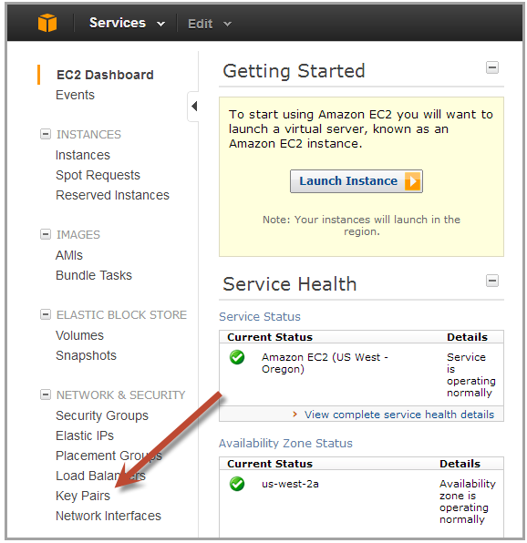
Generating a key pair with Amazon EC2
1.Open the Amazon EC2 console at http://console.aws.amazon.com/ec2/
2.On the navigation bar select region for the key pair
3.Click Key Pairs in the navigation pane to display the list of key pairs associated with the account 4.Click Create Key Pair
5.Enter a name for the key pair in the Key Pair Name field of the dialog box and click Create
6.The private key file, with .pem extension, will automatically be downloaded by the browser.

Slide 14
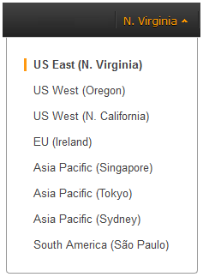
Launching an Amazon EC2 instance
1.Sign in to AWS Management Console and open the Amazon EC2 console at http://console.aws.amazon.com/ec2/
2.From the navigation bar select the region for the instance

Slide 15
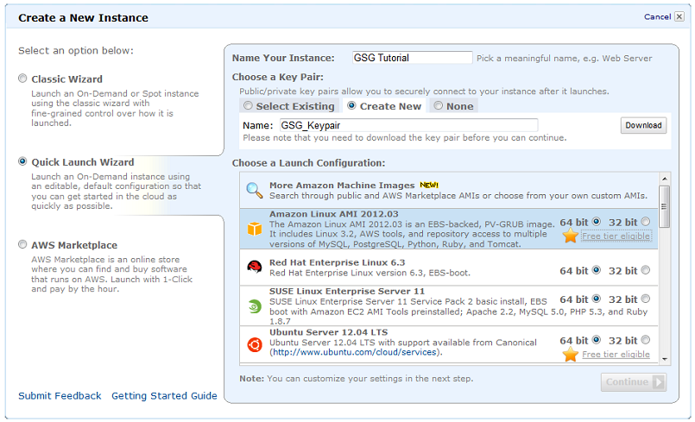
Launching an Amazon EC2 instance (cont.)
From the Amazon EC2 console dashboard, click Launch Instance

Slide 16
Connecting to an Amazon EC2 instance
There are several ways to connect to an EC2 instance once it’s launched.
Remote Desktop Connection is the standard way to connect to Windows instances.
An SSH client (standalone or web-based) is used to connect to Linux instances.

Slide 17
Connecting to Linux/UNIX Instances from Linux/UNIX with SSH
Prerequisites:
Most Linux/UNIX computers include an SSH client by default, if not it can be downloaded from openssh.org
Enable SSH traffic on the instance (using security groups)
Get the path the private key used when launching the instance
In a command line shell, change directory to the path of the private key file
Use the chmod command to make sure the private key file isn’t publicly viewable

Slide 18
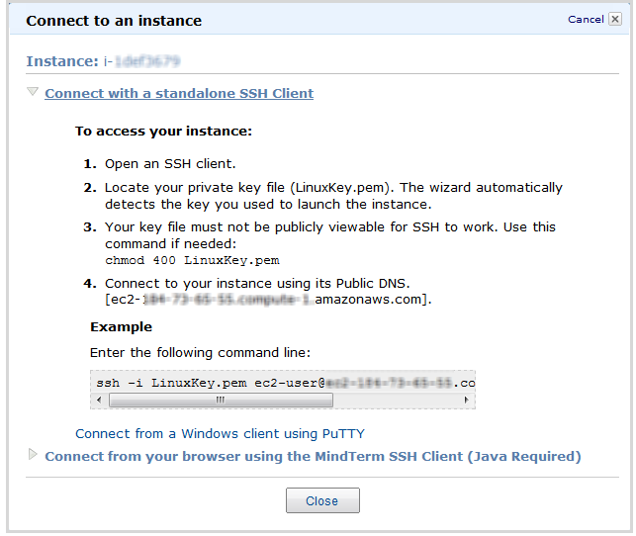
Connecting to Linux/UNIX Instances(cont.)
Right click on the instance to connect to on the AWS console, and click Connect.
Click Connect using a standalone SSH client.
Enter the example command provided in the Amazon EC2 console at the command line shell
Notes:
<number>

Slide 19
Transfering files to Linux/UNIX instances from Linux/UNIX with SCP
Prerequisites:
Enable SSH traffic on the instance
Install an SCP client (included by default mostly)
Get the ID of the Amazon EC2 instance, public DNS of the instance, and the path to the private key
If the key file is My_Keypair.pem, the file to transfer is samplefile.txt, and the instance’s DNS name is ec2-184-72-204-112.compute-1.amazonaws.com, the command below copies the file to the ec2-user home

Slide 20
Terminating Instances
If the instance launched is not in the free usage tier, as soon as the instance starts to boot, the user is billed for each hour the instance keeps running.
A terminated instance cannot be restarted.
To terminate an instance:
Open the Amazon EC2 console
In the navigation pane, click Instances
Right-click the instance, then click Terminate
Click Yes, Terminate when prompted for confirmation

