Slide 1
Amazon RDS
Notes:
<number>

Slide 2
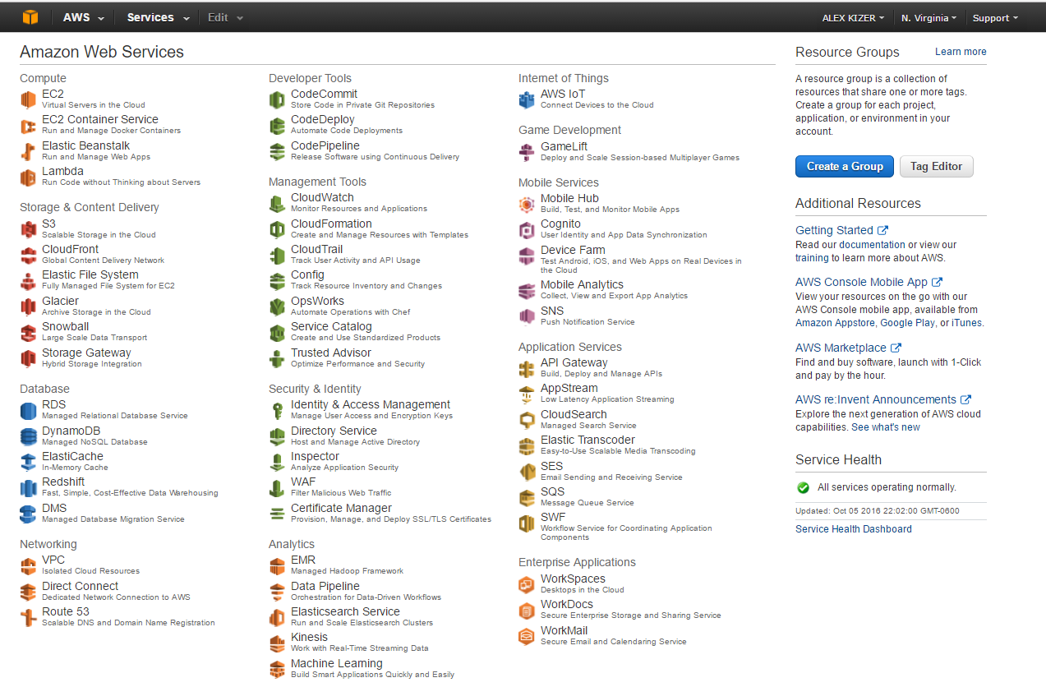
AWS - Managed Relational Database Service

Slide 3
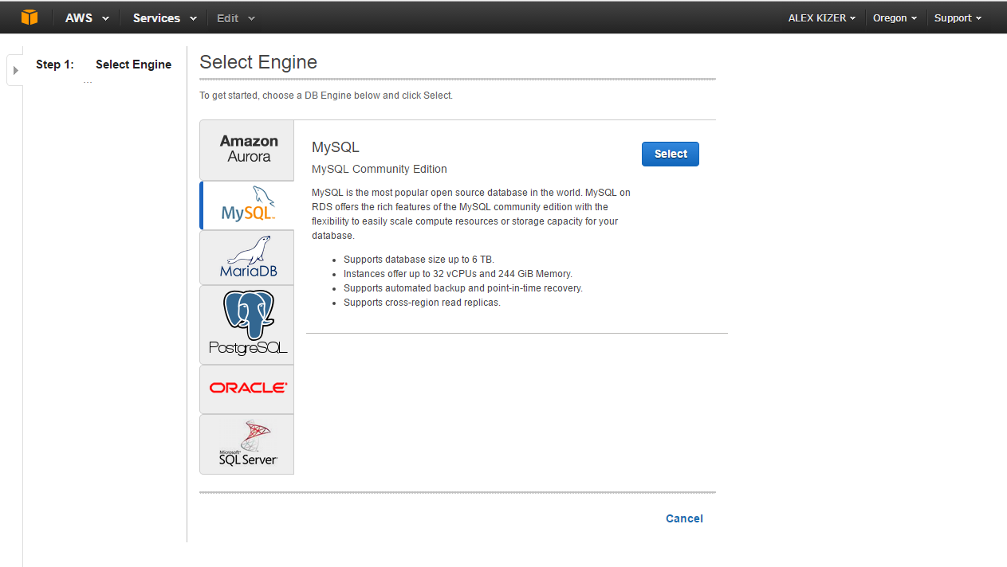
Launch DB Instance - Step 1: Select Engine

Slide 4
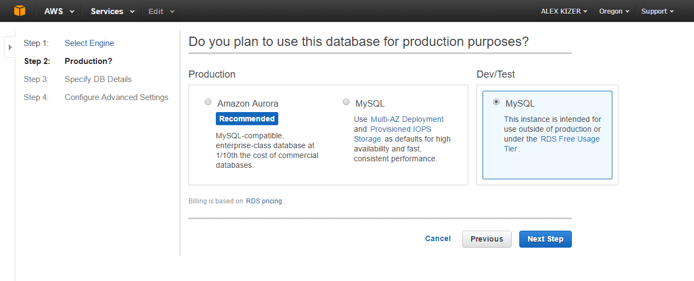
Launch DB Instance - Step 2: Production or Dev/Test?

Slide 5
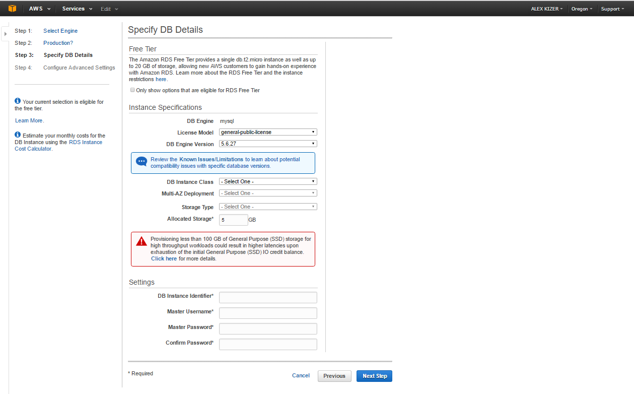
Launch DB Instance - Step 3: Specify DB Details
DB Instance Class- CPU and memory
1. General Purpose – M1,2,3,4
2. Memory Optimized - R3
3. Micro instances - T2
Multi-AZ Deployment
Creates a standby replica of your DB instance in another Availability Zone for failover support.
Storage Type
1. Magnetic (Standard) – Ideal for applications with light or burst I/O requirements
2. General Purpose (SSD) – Excellent for small to medium-sized databases.
3. Provisioned IOPS –Designed to meet the needs of I/O-intensive workloads.

Slide 6
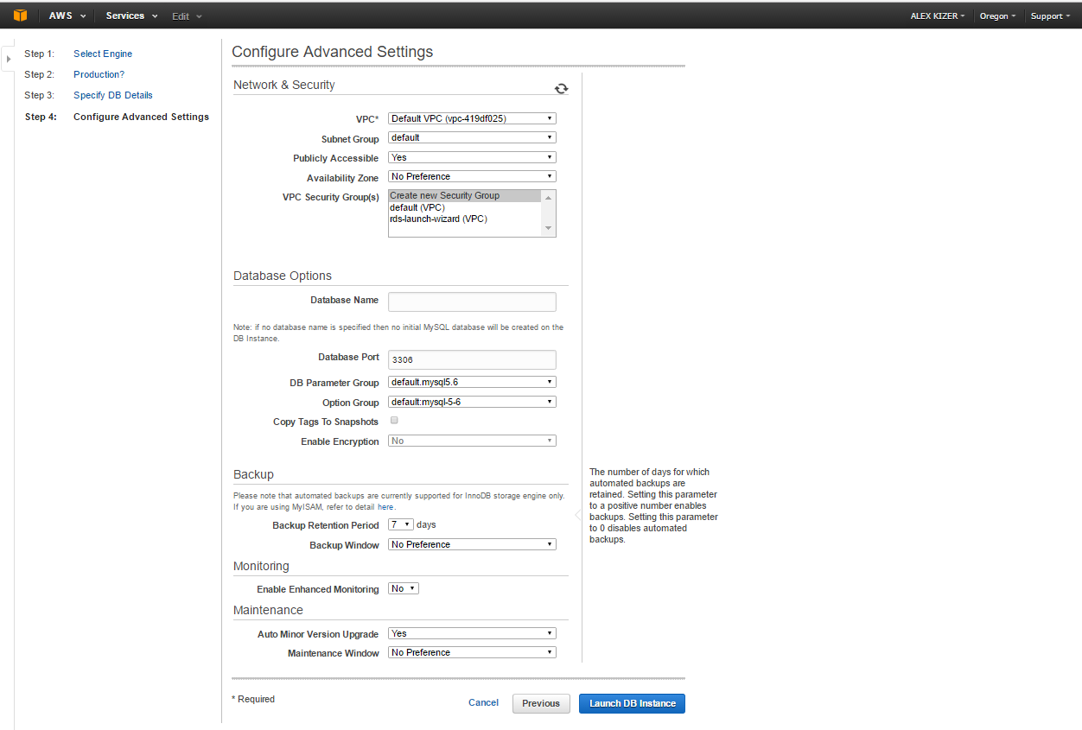
Launch DB Instance - Step 4: Configure Advanced Settings
VPC
Virtual Private Cloud enables you to launch AWS resources into a virtual network.
Availability Zone
Represented by a region code followed by a letter identifier; for example, us-east-1a.
Publicly Accessible
Yes- to give the DB instance a public IP address,
No- DB instance will only be accessible from inside the VPC.
Parameter Groups
act as a container for engine configuration values(my.cnf)
Backup
Schedule daily backup of entire instance.
Up to 35 day retention for backups.
VPC Security Group
A security group acts as a virtual firewall for your instance to control inbound and outbound traffic.
Enhanced Monitoring
Access to over 50 new CPU, memory, file system, and disk I/O metrics and low as 1 sec intervals

Slide 7
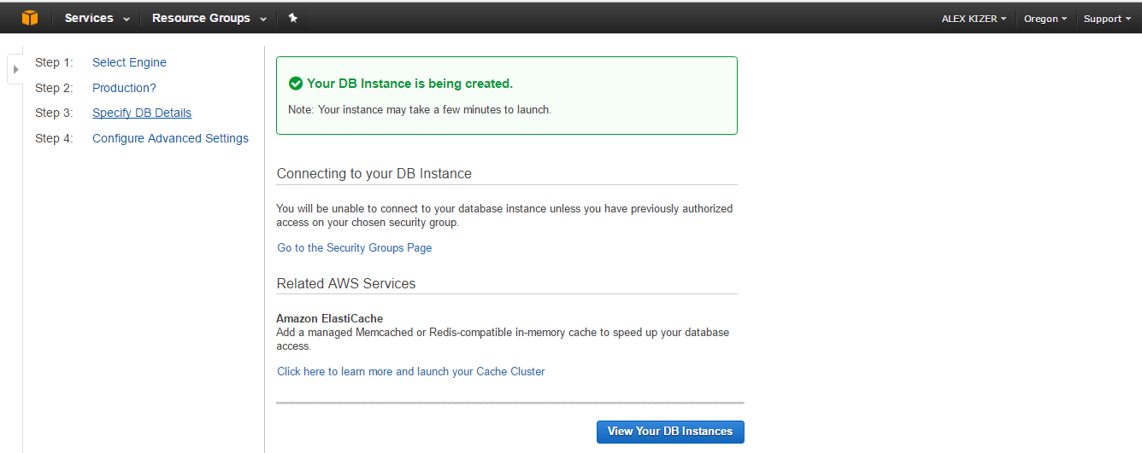
MySQL on AWS – Your DB Instance is being created.

Slide 8
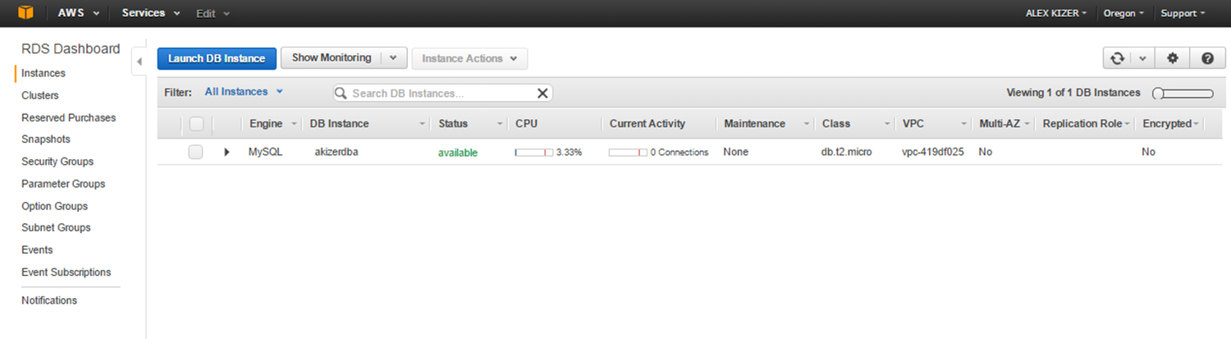
MySQL on AWS – RDS Dashboard

Slide 9
What Does “Managed” Mean?
The hardware for the data center is managed
The OS and database software is managed
Database installation and maintenance is managed
Database backups and scaling are managed All the above is done by AWS RDS

Slide 10
What Do We Get?
A preconfigured and installed database
Backups are taken care of for us
Patching the OS and the database are taken care of by AWS
Scaling(up/down) is as easy as pushing a button
Availability Zones
No need to acquire servers, tack and stack, install OS and DB software…

Slide 11
What Does the DBA Do?
Data Model
Logical Design – ERD
Physical Design
Data Dictionary
Performance Tuning, Schema Optimization
DB Application Development - SQL
Testing - Scripts, Backups
Develop Procedures and Documentation
RDS Administrations, Maintenance and Monitoring
Other AWS services

Slide 12
Backups
Backup / snapshot
Automated – allows to recover DB to any point in time in seconds. Enabled by default and the backup data is stored on Amazon S3.
Manual – done manually, user initiated.
When restoring backup – the restored version of the database will be a new RDS instance with a new endpoint.

Slide 13
HA Replication: Multi-AZ
Multi-AZ – allows you to have an exact copy of your DB in another Availability Zone (sync replication). Amazon RDS will automatically failover in case of DB instance failure or planned DB maintenance.
Multi-AZ is for Disaster Recovery only. It is not used for improving performance. For performance improvement you need Read Replica.

Slide 14
HA Replication: Read Replica
Read Replica – allows you to have a read only copy of you DB. This is achieved by using Asynchronous replication from the primary RDS instance to the read replica. You use read replicas primarily for very read-heavy DB workload. You can have up to 5 read replicas copies of any DB.
Read replica used for scaling out not for DR.

Slide 15
Isolation and Security
Virtual Multi-factor Authentication (MFA) Device - Uses a software application to generate a six-digit authentication code.(Google Authenticator App).
AWS Identity and Access Management (IAM) - enables you to securely control access to AWS services and resources for your users.
Virtual Private Cloud - you can isolate your DB Instances in your own virtual network. In addition, you can configure firewall settings and control network access to your DB Instances.
Data Encryption - allows you to encrypt your MySQL DB Instances using keys you manage through AWS Key Management Service (KMS).

Slide 16
COUG Demo-
MySQL on Amazon RDS
cougdemo1
Launch MySQL DB Instance on Amazon RDS
Connect to RDS instance from MySQL Workbench
Migrate Database To The Cloud
Create Read Replica in a different region (cougdemo1readreplica)
cougdemo2
Upgrade to MySQL 5.7
Scale Instance Vertically (add CPU/RAM, storage)
cougdemo3
Multi-AZ Deployment (us-west-1a, us-west-1b)
Reboot Instance with Failover
cougdemo4
Manual Backup (cougdemo4nov172016)
cougdemo5
Create DB Instance
Delete DB Instance

