Slide 1
Auto Scaling Web Application Security in the Cloud

Slide 2
Topics We’ll Cover
High-scale web app architecture components
Auto scaling principles
Common tools and approaches
Implications on security infrastructure
Architecting security infrastructure for auto scaling
Q&A
  What about PaaS?

Slide 3

Cloud Architecture is Evolving
Majority of applications in cloud environments are now using high-scale architecture
Most operational functions are automated
  Deployments are bootstrapped from Chef, Puppet, CloudFormation, Ansible
  Scaling is driven programmatically
Security is largely left behind

Slide 4
Security vs DevOps
role based organizations | role based infrastructure
management UIs | APIs
command line prompts | orchestration templates
deployment docs & run books | recipes & containers
appliances & software | services
change management windows | continuous deployment
scale up | scale out
deployment projects | auto-scaling

Slide 5
Basic Auto Scaling Tools
Amazon ELB with Auto Scaling groups
Health monitoring
  CloudWatch
Bootstrapping/configuration automation
  AWS CloudFormation
  Chef/Puppet/Cfengine
Orchestrator on Google App Engine
Auto Scale on Rackspace Cloud

Slide 6

Basic Auto Scaling Capabilities
Manage unhealthy EC2 compute instances
Ensure minimum number instances are always running
Launched new instances in event of failure or performance degradation (assume 30-120 seconds in most conditions)
Seamlessly attach auto scaled compute instances to load balancer (ELB)

Slide 7
Elastic Load Balancer
AWS ELB provides load balancing service with thousands of EC2 servers behind them
AWS ELB will automatically Scale up /down the load balancing servers in backend
The theoretical maximum response rate of AWS ELB is limitless
It can handle 20,000+ concurrent requests easily

Slide 8
Configuring Auto Scaling in AWS
Launch Configuration | Parameters for launching instances
Auto Scaling Groups | Post-launch parameters
Auto Scaling Policy | Scaling triggers
Scaling Event | Act of scaling itself

Slide 9

Configuring Auto Scaling in AWS
AMI ID
Instance size
Block devices
Key pairs
Security groups
Launch Configuration | Set of parameters used to launch EC2 instances – AMI, instance size, security groups
Auto Scaling Groups | Defines the post-launch parameters
Auto Scaling Policy | Rules for scaling or terminating autoscaled instances
Scaling Event | Act of scaling itself

Slide 10
Configuring Auto Scaling in AWS
Minimum & maximum number of EC instances to run
Cooldown parameters
AZ & VPC ids where these instances will run
Launch Configuration | Set of parameters used to launch EC2 instances – AMI, instance size, security groups
Auto Scaling Groups | Defines the post-launch parameters - AZ, ELB, min & max servers to run
Auto Scaling Policy | Rules for scaling or terminating autoscaled instances
Scaling Event | Act of scaling itself

Slide 11
Configuring Auto Scaling in AWS
Initiate scaling activity
Use CloudWatch metrics as triggers
  EC2: CPU, dish, memory, network
  ELB: healthy instances, HTTP code, latency, request count
  RDS: CPU, database connections, memory, latency
Launch Configuration | Set of parameters used to launch EC2 instances – AMI, instance size, security groups
Auto Scaling Groups | Defines the post-launch parameters
Auto Scaling Policy | Rules for scaling or terminating autoscaled instances
Scaling Event | Act of scaling itself

Slide 12
Configuring Auto Scaling in AWS
Act of scaling up/down
Notification of scaling activity
Launch Configuration | Set of parameters used to launch EC2 instances – AMI, instance size, security groups
Auto Scaling Groups | Defines the post-launch parameters
Auto Scaling Policy | Rules for scaling or terminating autoscaled instances
Scaling Event | Act of scaling itself

Slide 13
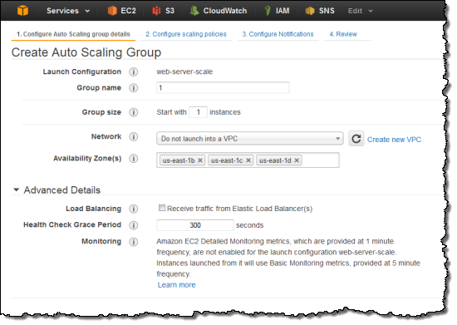
Creating an Auto Scaling Group
group name
launch config
min/max instances
as-create-auto-scaling-group my-appsec-asg
--launch-configuration my-test-config
--availability-zones us-east-1b --min-size 1
--max-size 40 --default-cooldown 420 --desired-capacity 1 --load-balancers my-waf-elb1
temporarily suspends time between scaling activities while new instances warm up

Slide 14
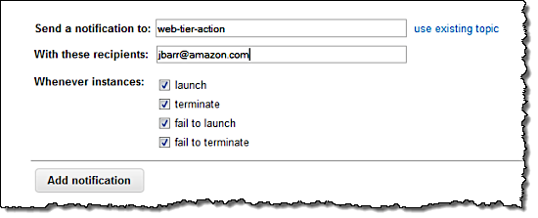
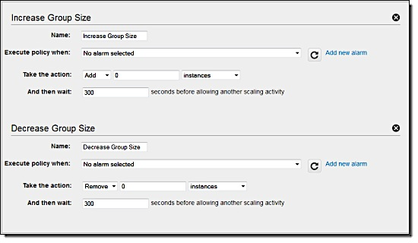
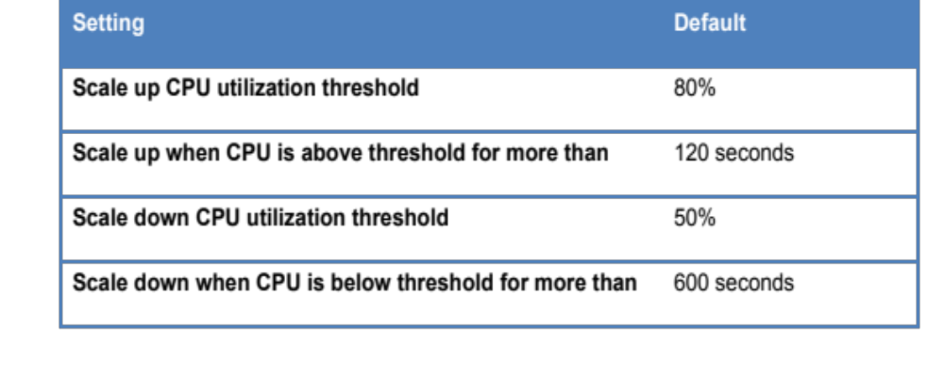
Create Auto Scaling Policy
Use AWS CloudFormation templates to set defaults
Allow admins to tune for specific requirements

Slide 15
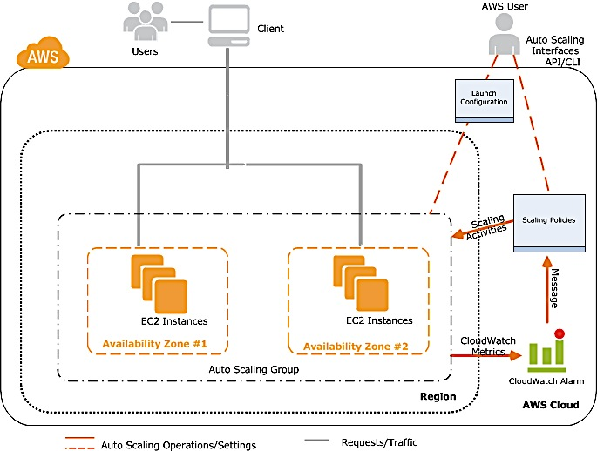
Auto Scaling In Action

Slide 16

Designing for Scale
DESIGN FOR FAILURE
MULTIPLE AVAILABILITY ZONES
SCALING
SELF-HEALING
LOOSE COUPLING

Slide 17
Architecture Principles
Designed for failure
  Horizontally scaled
  Fast bootstrap
  Health/load conditions as scaling triggers
Loosely coupled
  Independent components
  As stateless as possible
  Minimal interactions
web tier is easiest to scale
if you make right design decisions
…security infrastructure is another matter

Slide 18
Auto Scaling Web App Firewalls?
ELB
Simple auto-scaling stack
  2 layers of Elastic Load Balancers (ELB)
  WAF Proxies
  Web server tier
Problems
  Extremely slow bootstrap
  Tightly coupled
WAF
WAF
ELB
HTTP
HTTP
HTTP
HTTP

Slide 19
Abstracting Application Security Components
ELB
ELB
Make your security application stack stateless
  Every component is a black box
  Decouple interactions between management and data processing planes
  Use cloud infrastructure to make interactions asynchronous
WAF
WAF
WAF
Master
S3/EBS
ELB
HTTP
HTTP
HTTP
HTTP

Slide 20
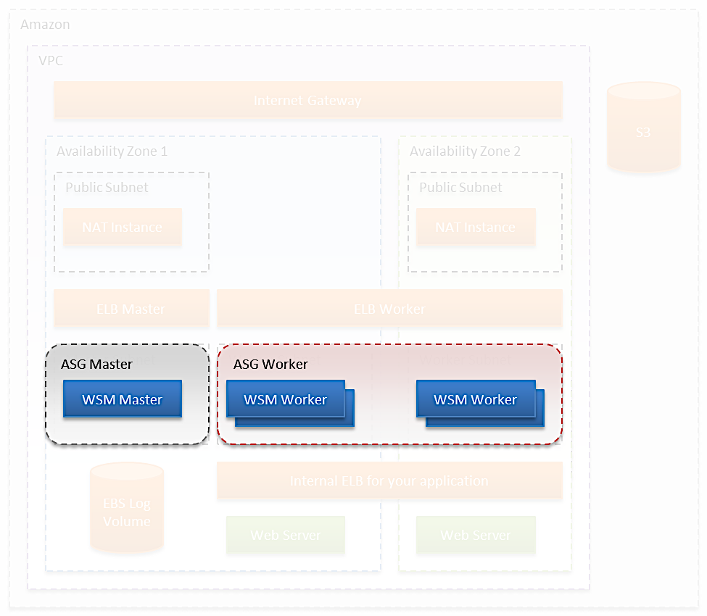
Separate Processing & Control Planes
ASG Group 1 -
Master Controller
Min-size 1
Max-size 1
ELB health checks to ensure an instance is up
Will recreate itself from configuration data in S3
ASG Group 2 -
Processing Workers
Min-size 2
Max-size (depends)
Use Auto Scaling policy to scale on-demand

Slide 21
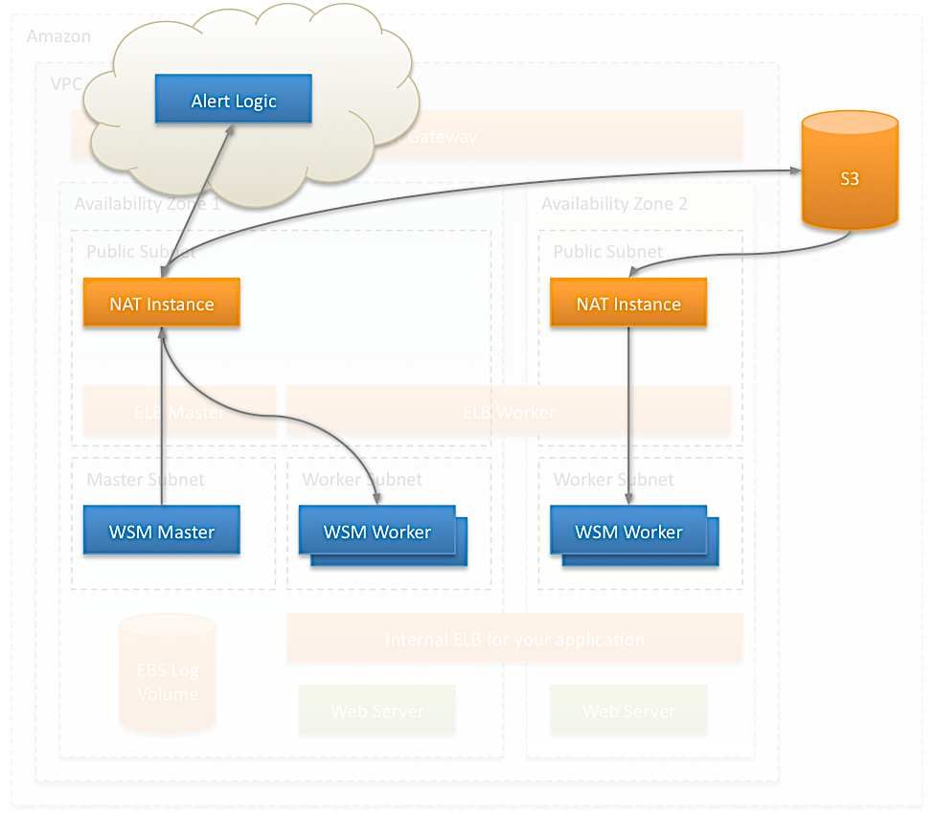
2. Reduce and Abstract Interactions
Store instance configuration data in S3
  Master instance stores data in Amazon S3
  Worker instances retrieve configuration as they spin up
  Simple way to make resource instantiation asynchronous

Slide 22
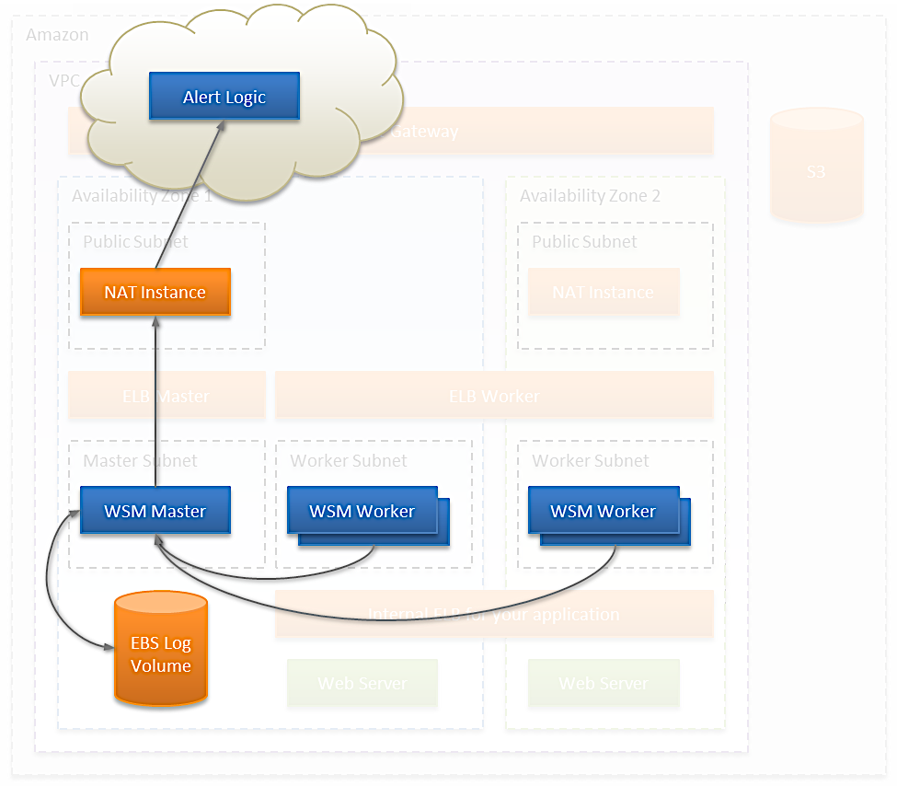
3. Store Persistent Data on EBS
Amazon EBS Log Volume
Store all log and statistics data for master instance
Persist data in case of master instance termination
If master has to be restarted, persisted data remains intact
– nothing stops working

Slide 23
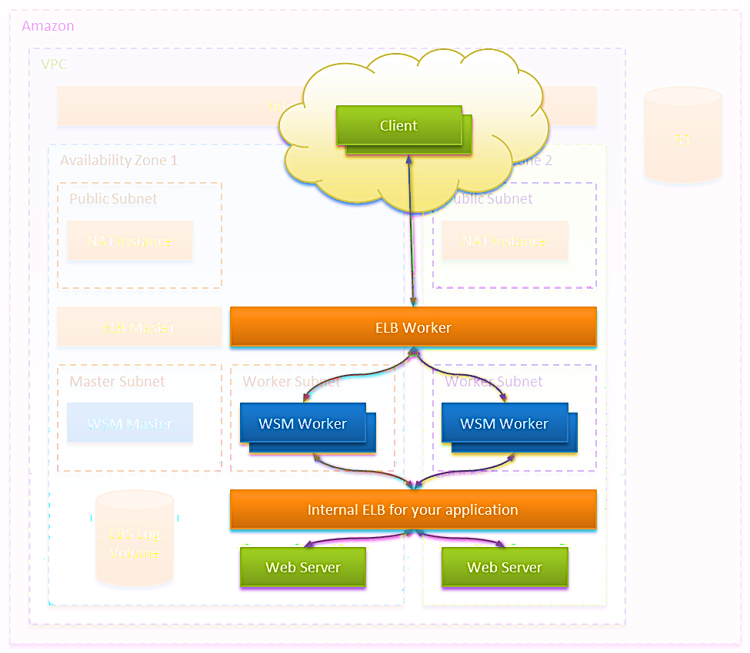
Web Traffic Flow
Browser clients connect to worker Amazon ELB
Traffic is load balanced to WAF workers
WAF workers proxy traffic Amazon ELB that scales web server instances

Slide 24
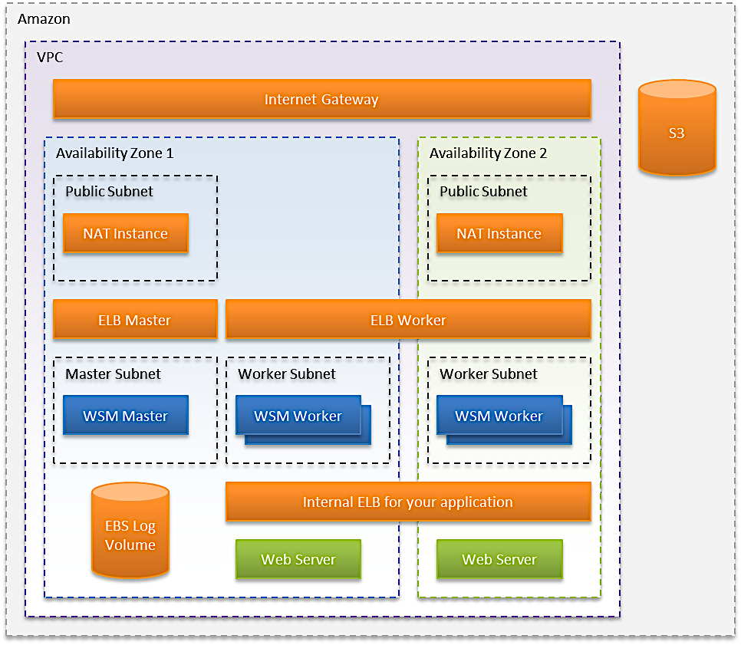
Complete Stack – Prior to Automation
Amazon Web Services
Amazon ELB Master Group
Amazon ELB Worker Group
Amazon S3 Buckets
NAT Instances
WAF Master Instance
Amazon EBS Log Volumes
WAF Worker Instances

Slide 25
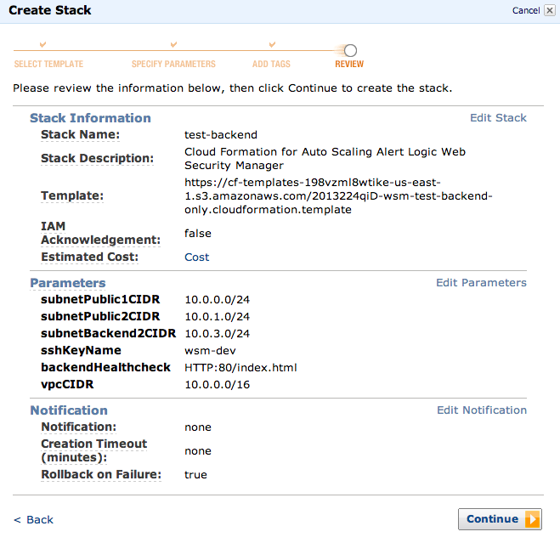
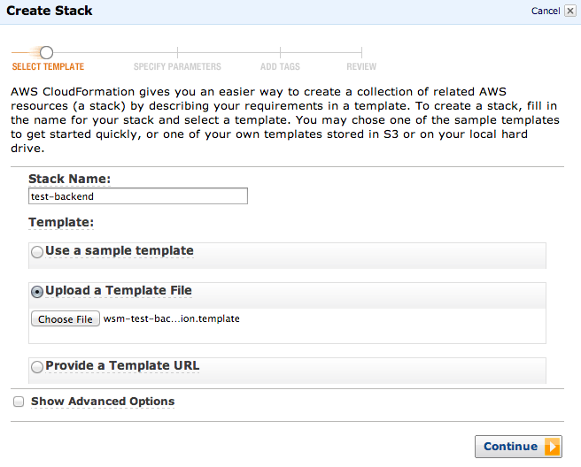
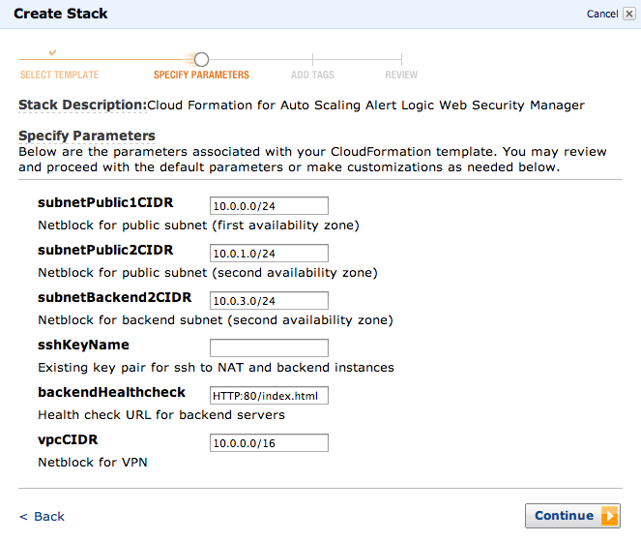
Using CloudFormation Templates
3
1
2

Slide 26
Command Line Example
Use cfn-create-stack to start creation.
$ cfn-create-stack test-backend --template-file wsm-test-backend-only.cloudformation.template --parameters "sshKeyName=wsm-dev"
arn:aws:cloudformation:us-east-1:355864928133:stack/test-backend/26028db0-0352-11e3-895a-500162a66ca8
You can use cfn-describe-stack-events along with watch to view the stack creation.
$ watch cfn-describe-stack-events test-backend
Every 2.0s: cfn-describe-stack-events test-backend Mon Aug 12 08:23:44 2013
STACK_EVENT test-backend test-backend AWS::CloudFormation::Stack 2013-08-12T13:24:20.321Z CREATE_COMPLETE
STACK_EVENT test-backend eipNAT2 AWS::EC2::EIP 2013-08-12T13:24:17.802Z CREATE_COMPLETE
STACK_EVENT test-backend eipNAT1 AWS::EC2::EIP 2013-08-12T13:24:17.769Z CREATE_COMPLETE
STACK_EVENT test-backend routeNAT2 AWS::EC2::Route 2013-08-12T13:24:01.615Z CREATE_COMPLETE
STACK_EVENT test-backend routeNAT1 AWS::EC2::Route 2013-08-12T13:24:01.144Z CREATE_COMPLETE
Once complete, cfn-describe-stacks will return the cloud formation stack outputs.
$ cfn-describe-stacks test-backend
STACK test-backend CREATE_COMPLETE Cloud Formation for Auto Scaling Alert Logic Web Security Manager vpc=vpc-591b9337;elbBackend=test-back-elbBacke-17N275T20CGQ9-1608750954.us-east-1.elb.amazonaws.com;routeTableNAT1=rtb-e71b9389;routeTableNAT2=rtb-e61b9388;paramsForWSM=vpc=vpc-591b9337;elbBackend=test-back-elbBacke-17N275T20CGQ9-1608750954.us-east-1.elb.amazonaws.com;routeTableNAT1=rtb-e71b9389;routeTableNAT2=rtb-e71b9389;subnetPublic1=subnet-fd1b9393;subnetPublic2=subnet-e21b938c 2013-08-12T13:21:51.116Z

Slide 27
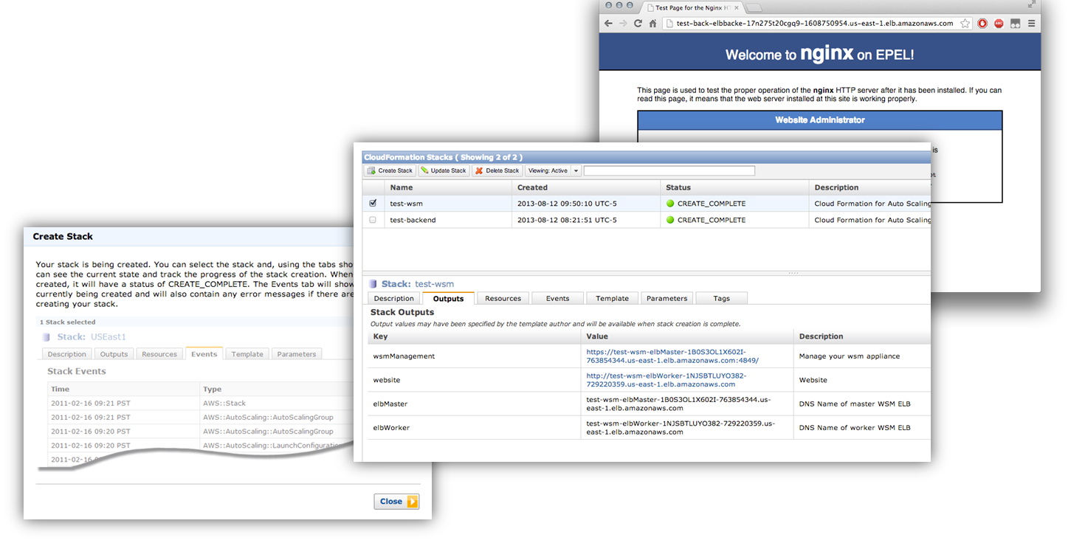
Base WAF Stack Ready

Slide 28
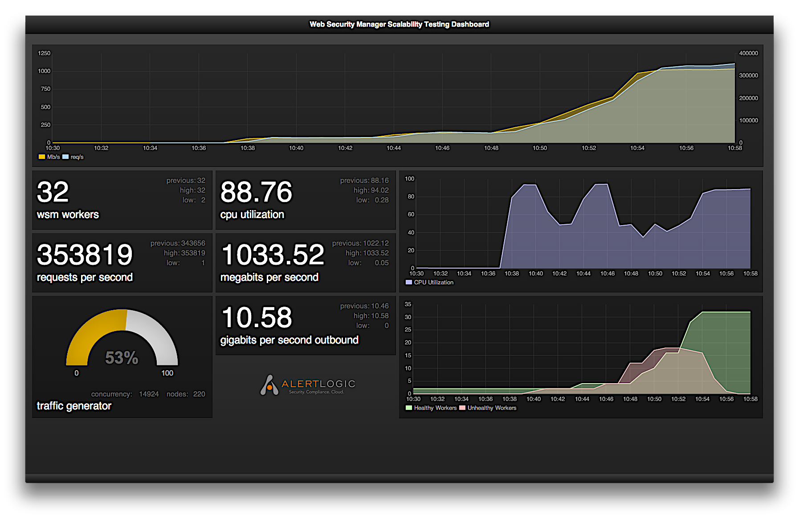
10gbps Environment Test

Slide 29
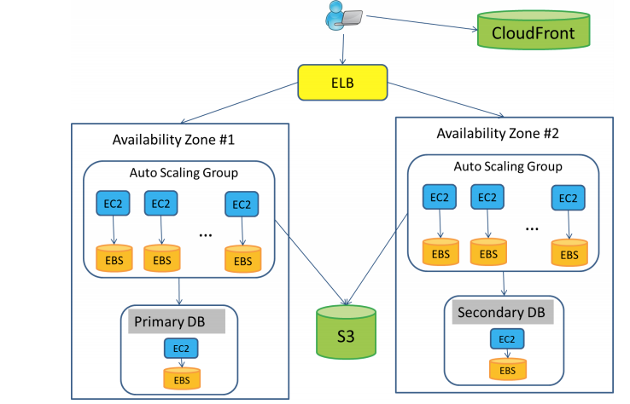
What happens when applications look like this?

