Slide 1


Quality Attributes for Technical Testing
Reliability

Slide 2

Reliability
Reliability is the ability of a system to continue operating in the expected way over time.

Slide 3


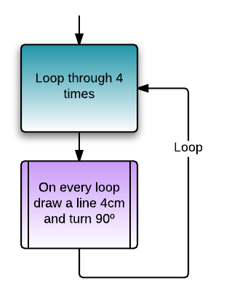
The ability of the software product to perform its required functions
Under stated conditions
For a specified period of time
Or for a specified number of operations

Slide 4
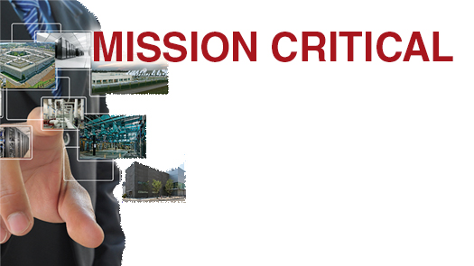
Reliability is very Important!
Mission-critical systems

Slide 5
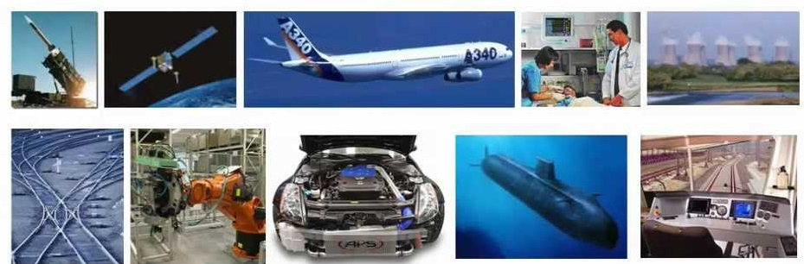
Safety-critical systems

Slide 6
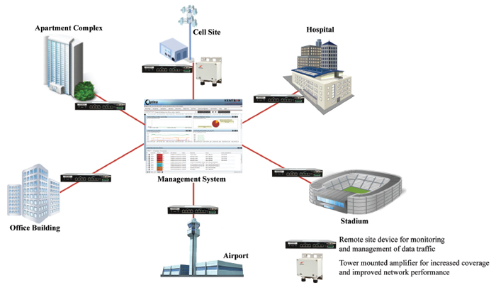
High-usage systems

Slide 7
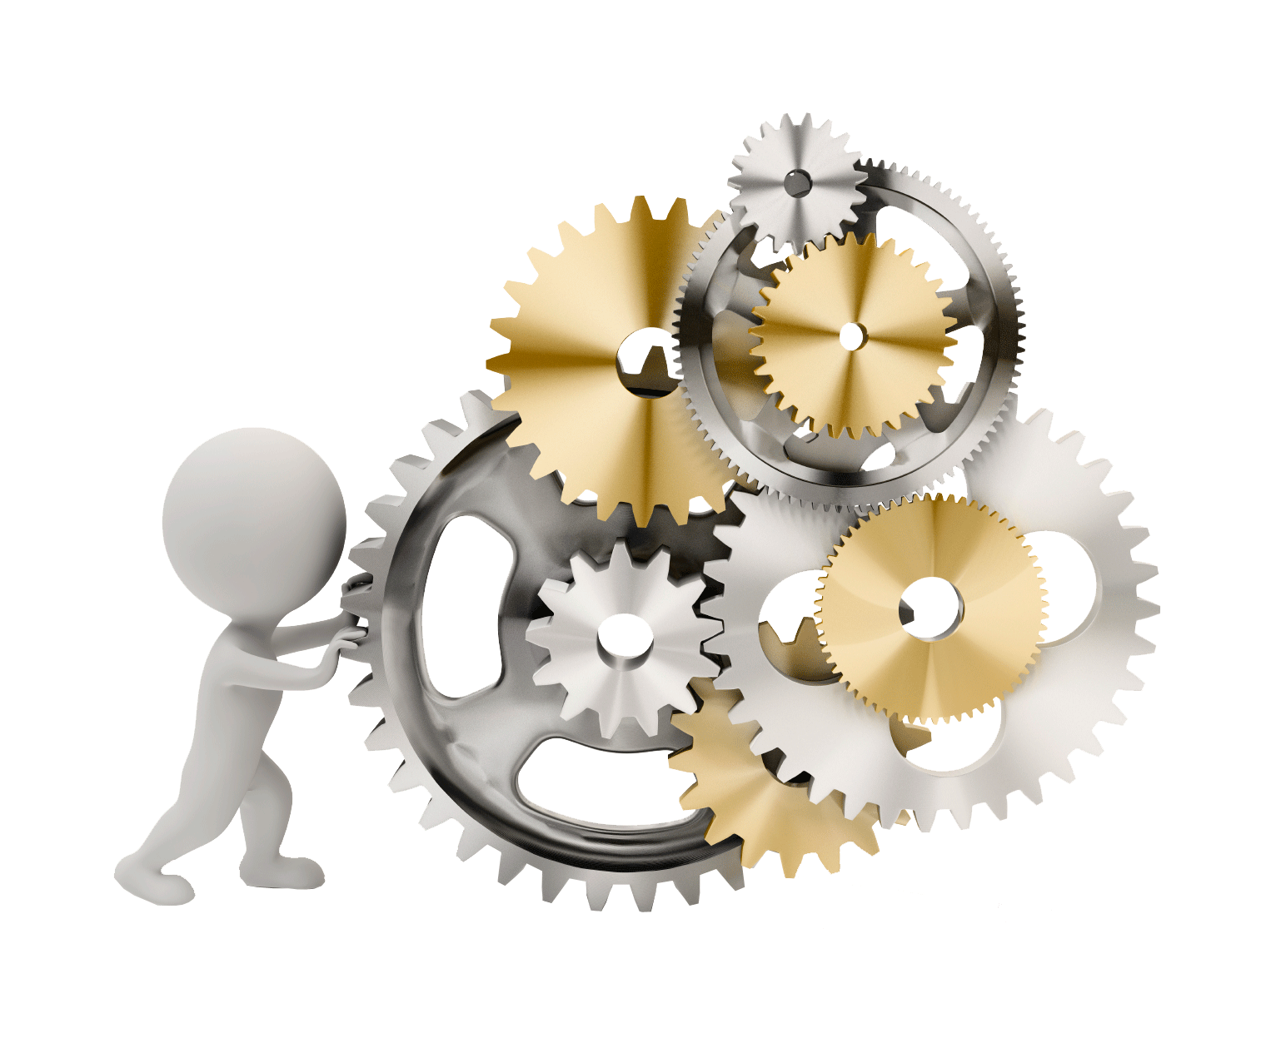
Reliability testing is almost always automated

Slide 8

Reliability tests and metrics can be used as
Exit criteria

Slide 9

How to measure Reliability?
Mean time between failures (MTBF)
Mean time to repair (MTTR)
Any other metric that counts the number of failures in terms of some interval or intensity

Slide 10
Generating Reliability Tests
Tests can be:
Small set of prescripted tests, run repeatedly and used for similar workflows
Pool of different tests, selected randomly
Generated on the fly, using some statistical model
Randomly generated

Slide 11

Software reliability is a key part in software quality.

Slide 12
Thank you

