Slide 1


Quality Attributes for Domain Testing
Suitability

Slide 2
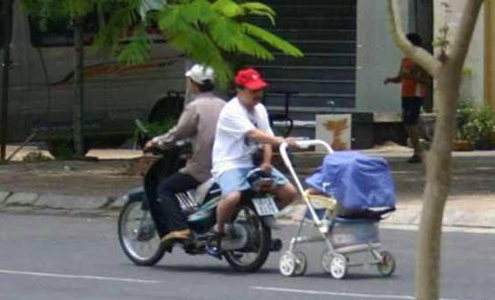
Validation
Functional suitability is related to validation
Suitability testing is a testing to verify if a set of functions is appropriate for their set of intended specified tasks

Slide 3

Suitability
Suitability is the capability of the software product to provide an appropriate set of functions for specified tasks and user objectives.

Slide 4
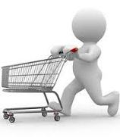

Example
E-commerce purchase: Normal workflow
Customer places one or more Items in shopping cart
Customer selects checkout
System gathers address, payment and shipping information from Customer
System displays all information for User confirmation
User confirms order to System for delivery

Slide 5

Example(2)
Exceptions
Customer attempts to check out with an empty shopping cart; System gives an error message
Customer provides invalid address, payment, or shipping information; System gives error messages as appropriate
Customer abandons transaction before or during checkout; System logs Customer out after 10 minutes of inactivity

Slide 6
Example(3)
A test case for the normal workflow can be:
# | Test Step | Expected Result
1 | Place 1 item in cart | Item in cart
2 | Click checkout | Checkout screen
3 | Input valid address, valid payment using American Express, and valid shipping method information | Each screen displays correctly and valid inputs are accepted
4 | Verify order information | Show as entered
5 | Confirm order | Order in system
6 | Repeat steps 1-5, but place 2 items in cart, and pay with Visa, and ship international | As shown in 1-5
7 | Repeat steps 1-5, but place the maximum number of items in cart and pay with MasterCard | As shown in 1-5
8 | Repeat steps 1-5, but pay with Discover | As shown in 1-5

Slide 7
Example(4)
An exceptional test case can be:
# | Test Step | Expected Result
1 | Do not place any items in cart | Cart empty
2 | Click Checkout | Error message
3 | Place item in cart, click checkout, enter invalid address, then invalid payment, then invalid shipping information | Error messages, can't proceed to next screen until resolved
4 | Verify order information | Shown as entered
5 | Confirm order | Order in system
6 | Repeat steps 1-3, but stop activity and abandon transaction after placing item in cart | User logged out exactly 10 minutes after activity
7 | Repeat steps 1-3, but stop activity and abandon transaction on each screen | As shown in 6
8 | Repeat steps 1-4, do not confirm order | As shown in 6

Slide 8


Suitability testing requires knowledge of the intended and expected use
What user need
What is user skill level
What is user’s environment
Don’t know? – Ferret it out

Slide 9


When Run Suitability testing?
End of the integration testing
During system testing
Very closed to usability testing

Slide 10

How to Measure Suitability?
Good Suitability Tester
Involved User or Product Owner
Valid use cases - effective test

Slide 11
Thank you

