Slide 1



ReguGuard AI
TEAM - HaCS

Slide 2




The problem - The "Compliance Debt"
What is compliance Debt ?
The total expense and risk incurred by a business when it is unable to stay up to date with new laws, rules, or internal policies is known as compliance debt
The laws change more quickly than people can keep up with them, modern compliance is failing, resulting in "Compliance Debt."
Companies today are reactive, finding legal violations only after they have already occurred. This results in a significant amount of manual labor and a high risk of legal action.
In summary, we are switching from laborious, manual audits to a continuous, self-governing system that stops legal errors before they happen.

Slide 3
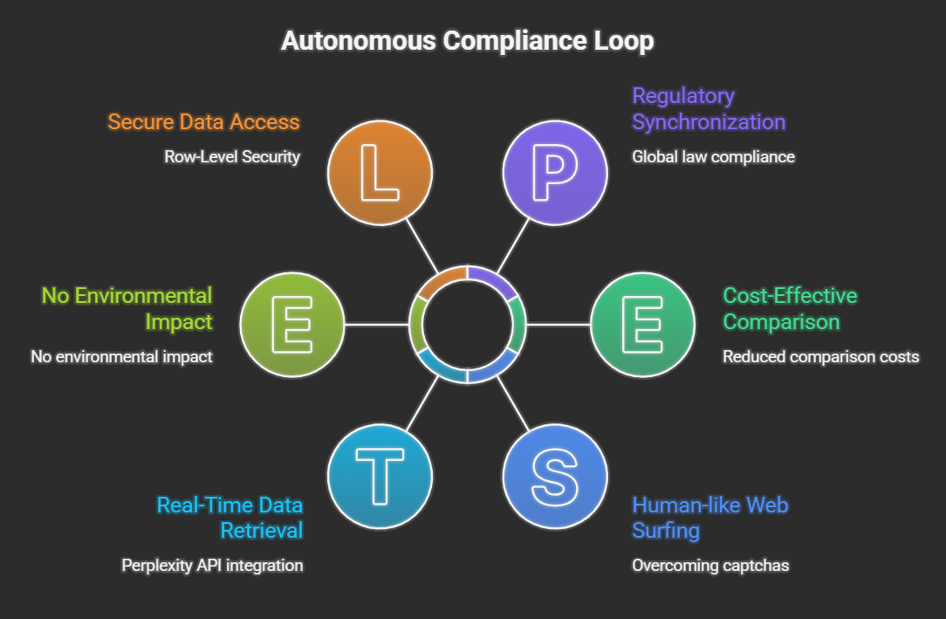
SOLUTION
What's being solved ?
Agentic Regulatory Synchronization
The solution is not a static tool, but an Autonomous Compliance Loop. It continuously bridges the gap between ever-changing global laws and your company's internal documents.
Feature | Traditional Legal Software | ReguGuardAI (Agentic AI)
Pace | Periodic / Manual Updates | Instant / Continuous
Nature | Reactive (Flagging errors) | Proactive (Preventing errors)
Accountability | Human-only oversight | Always-on Audit Trail
Integration | Siloed application | System-wide integration (via APIs)

Slide 4

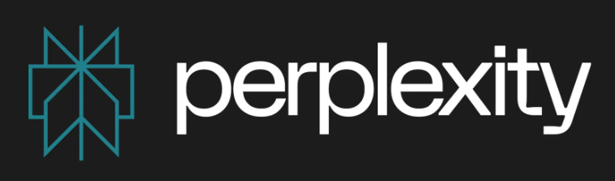




TECH STACK
Orchestration - Lang Graph (Python)
Vision (The Eyes) - Gemini 1.5 Pro
Research (The Brain)
Web Scraper
Frontend - Streamlit
Database

Slide 5
LEGAL AND FEASIBILITY
AI accuracy risks
Liability concerns
Data privacy concerns
Human approval layer
TECHNICAL FEASIBILITY
LLM + RAG Implementation
Document comparison logic
Dashboard Interface
Draft generation
ReguGuard AI is technically buildable,
economically viable, and legally controlled
OPERATIONAL FEASIBILITY
Easy onboarding
No behavioural shift required
No hardware needed
Works as SaaS model
MARKET FEASIBILITY
Clear regulatory pain in SMBs
High Cost of non – compliance
Recurring SaaS model

Slide 6
POTENTIAL CHALLENGES AND WAYS TO OVERCOME THEM
# | RISK / CHALLENGE | IMPACT | MITIGATION STRATERGY
1 | Legal Misinterpretation | High | Use RAG with citations; provide direct links to sources for human verification.
2 | Liability & Accountability | High | Position as "Decision Support"; mandatory human review before any filing/action.
3 | AI Hallucinations | Med-High | Ground outputs in specific documents; implement Rule-Based Validation checks.
4 | Data Privacy (SOPs) | High | Zero-retention policy; no training on user data; end-to-end encryption.
5 | Scope Creep (MVP) | Critical | Vertical focus (e.g., Pharmacy); demonstrate deep value in one niche over shallow breadth.

Slide 7
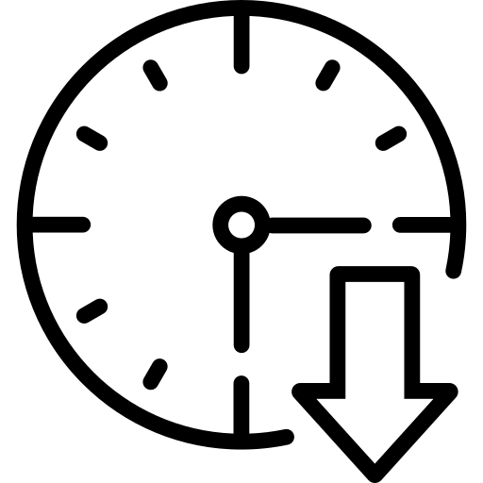





IMPACT AND BENEFITS
POTENTIAL IMPACTS:
CORE BENEFITS
Reduction in missed regulatory updates, preventing up to ₹5–10L in annual penalty exposure per SMB.
SMBs spend less time checking government portals and more time focusing on core operations.
Automated compliance gap detection, reducing manual review time by 60–70%.
Detects SOP mismatches before inspections or audits.
Real-time regulatory monitoring, cutting compliance response time from weeks to minutes.
Same architecture adaptable to pharmacies, food manufacturing, fintech, legal firms.

Slide 8
REFERENCES
Joswig, T., & Kurz, W. (2025). Regulatory and compliance requirements for SMEs operating AI systems through data centers in the EU, with a focus on data protection challenges in Germany. Journal of Next-Generation Research 5.0, 1(2). https://doi.org/10.70792/jngr5.0.v1i2.89
Khara, S., & Yadav, S. (2024). The legal liability of AI systems in India. Alochana Journal, 13(5), 448-452. https://alochana.org/wp-content/uploads/37-AJ2451.pdf
Lee, Z. P., Lin, A., & Tan, C. (2025). Finetune-RAG: Fine-tuning language models to resist hallucination in retrieval-augmented generation. arXiv. https://doi.org/10.48550/arxiv.2505.10792
Li, J., & Maiti, A. (2025). Applying large language model analysis and backend web services in regulatory technologies for continuous compliance checks. Future Internet, 17(3), 100. https://doi.org/10.3390/fi17030100

