Slide 2
MAS512 Assignment 1
Group 6: Bjørn Sødal

Slide 3
Question 1 - Object Detection and Depth Estimation
Goal:
Retrieve camera data
Train YOLO model on extracted frames
Validate model on test data
Utilize model for depth estimation and Question 2
Steps:
Preprocess data (annotation, labelling, directory structure)
Train model
Validate Model
Perform A, B and C

Slide 4
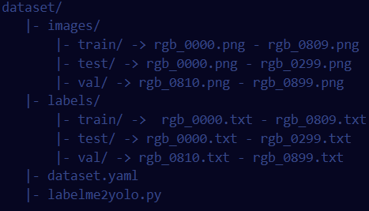
Question 1 - Preprocessing
Structure acquired data into YOLO folder structure
Utilize Labelme to produce label JSON
Have Gemini produce conversion script ‘labelme2yolo.py’
Convert JSON labels to YOLO ‘.txt’ label files using normalized ‘xywh’
Create dataset.yaml with appropriate pathing

Slide 5
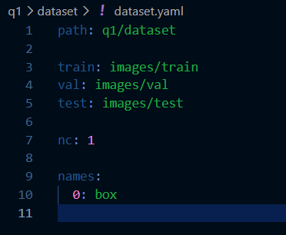

Slide 6
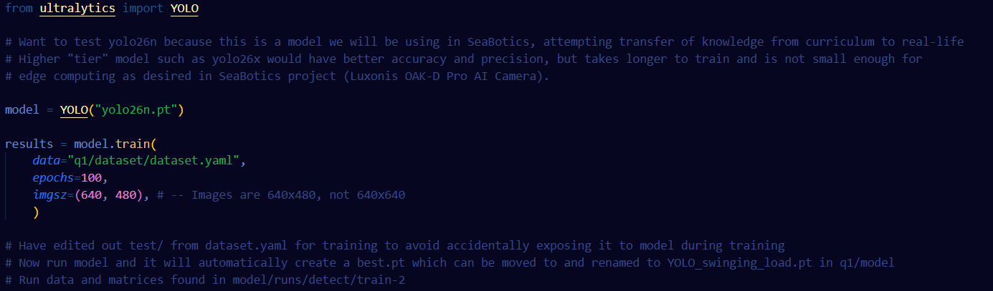
Question 1 - Training and Validation

Slide 7
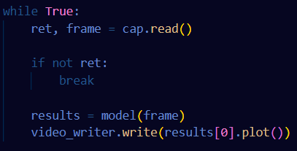
Question 1 - Part A
We now want to test the model, so we uncomment the test directory from dataset.yaml and run model.val with split=”test”.
The metrics are saved in runs.
Predictions can then be visualized by saving model inferences on frames of video and storing video using OpenCV

Slide 8
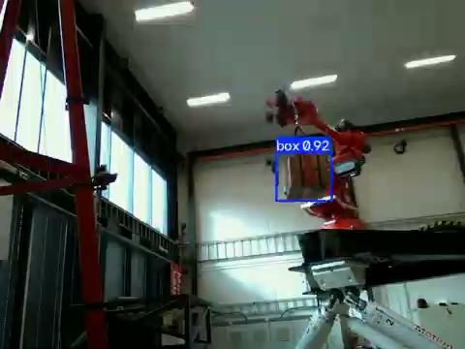

Slide 9
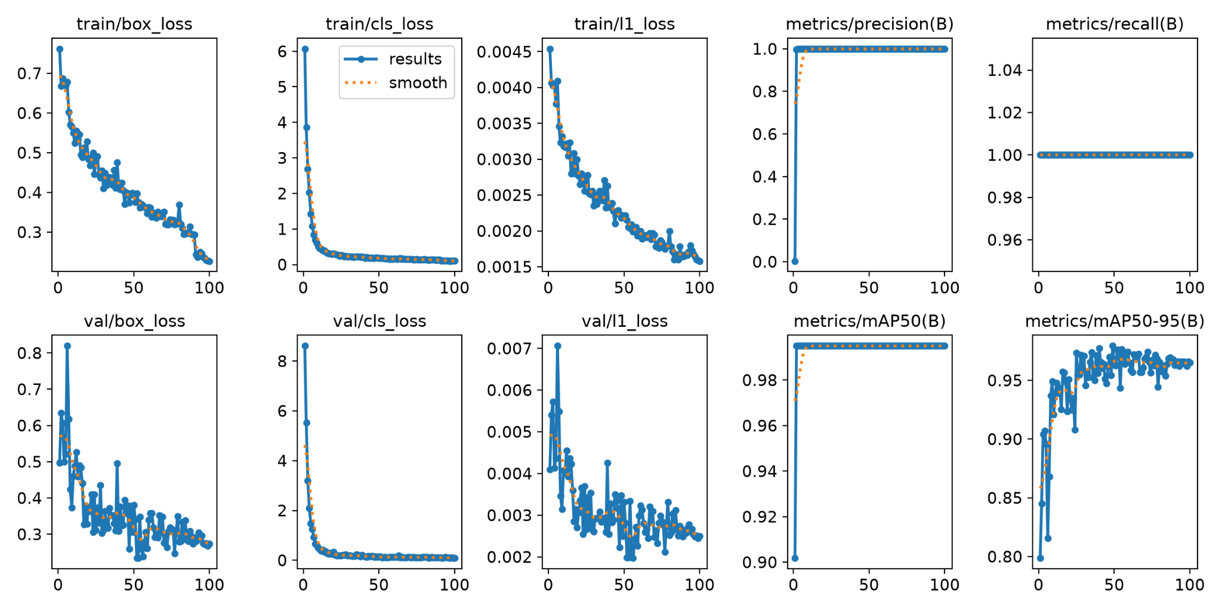

Slide 10
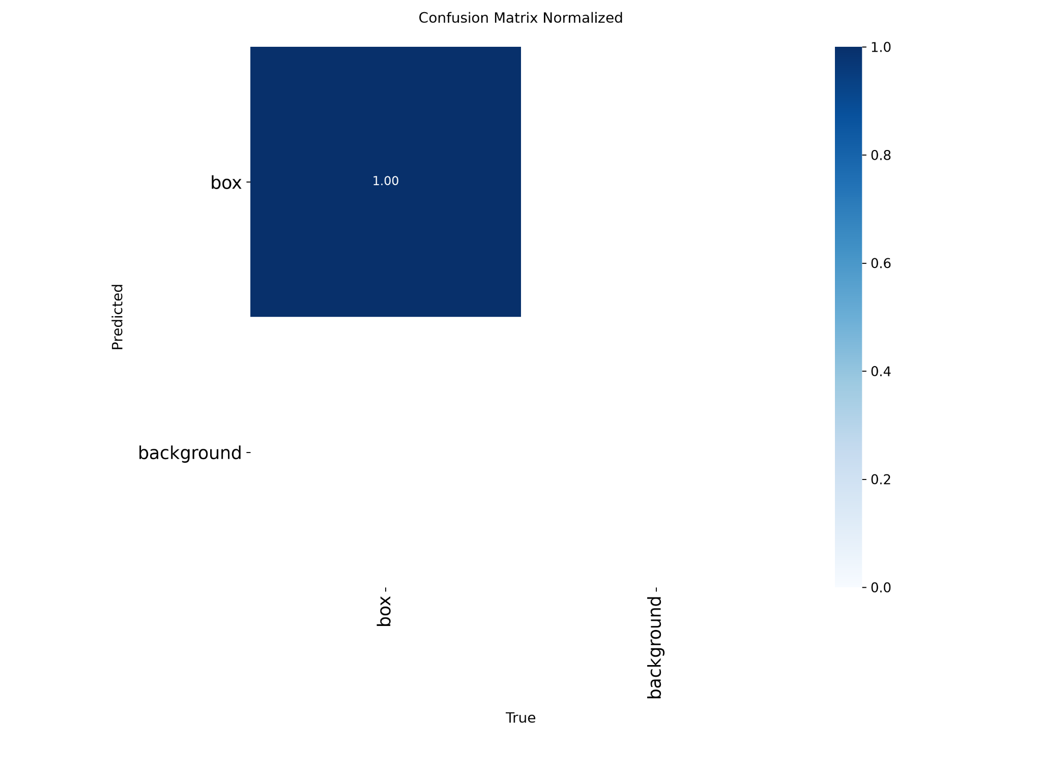

Slide 12
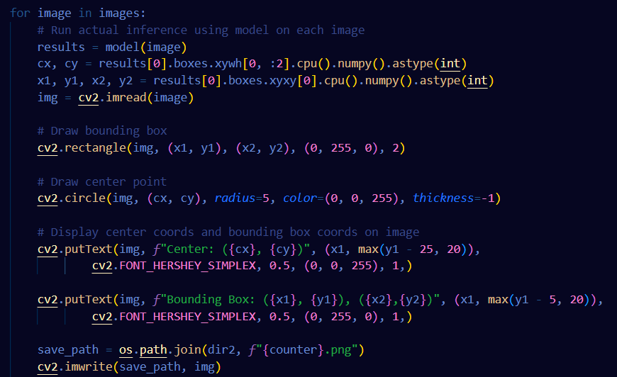
Question 1 - Part B
Want to run inference on five random images from test samples
Generate random number between 0 and 300 five times
Get image with number as name padded to fit rgb_0000.png
Then run inference on all five images and retrieve coordinates and save to new images

Slide 13
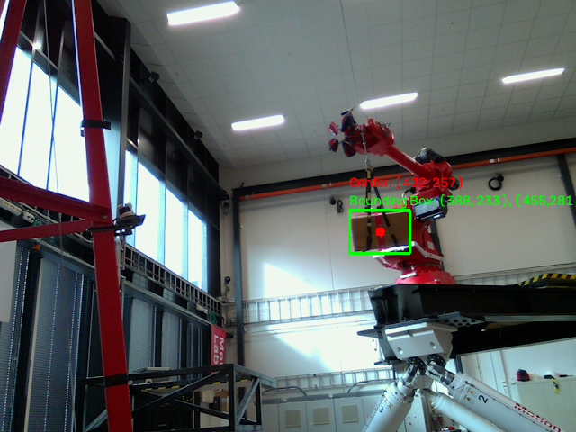
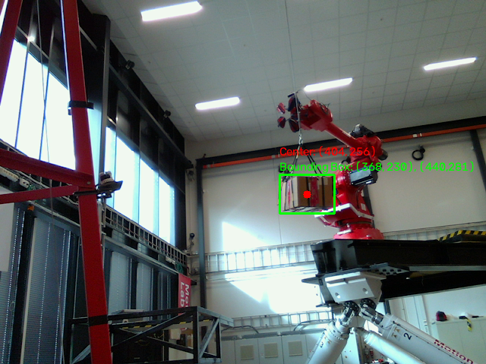
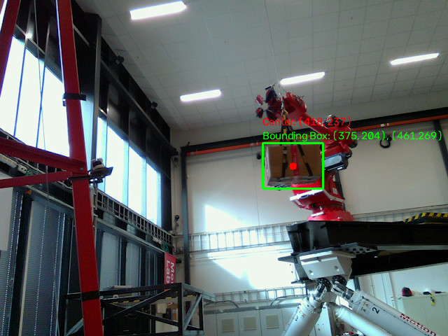

Slide 14
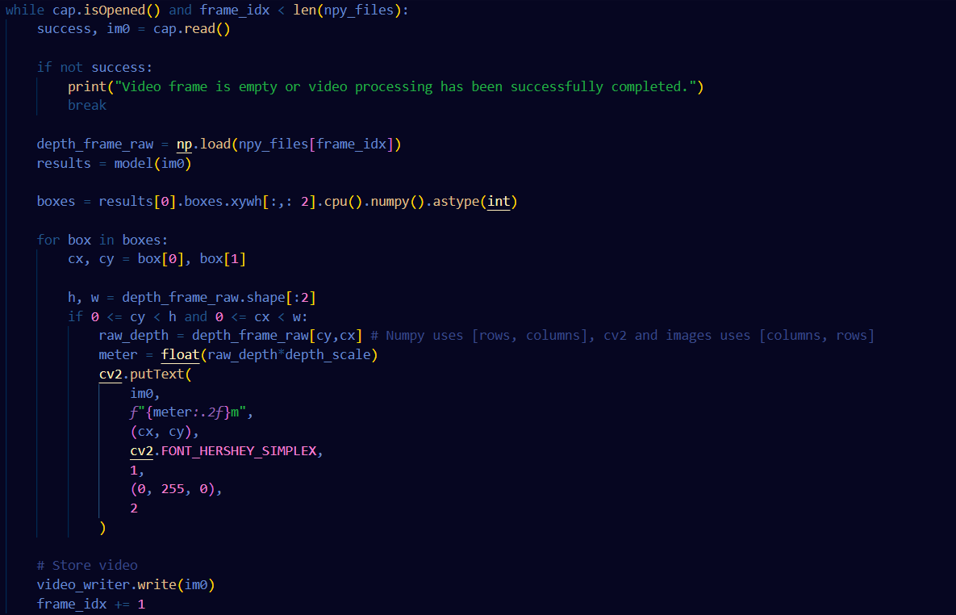
Question 1 - Part C
We want to estimate depth, i.e distance from camera to detected object
Depth = Depth frames * Depth scale
Find depth at given xy-coords
Choose center of bounding box as depth estimation point

Slide 15
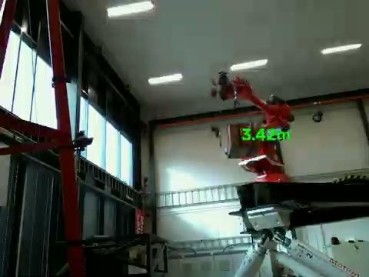

Slide 16
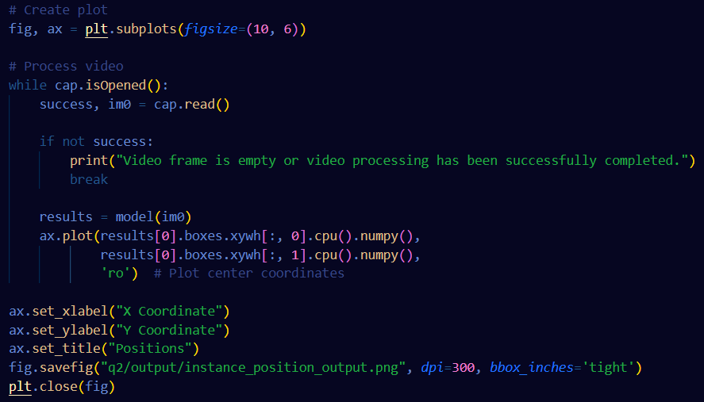
Question 2 - Object Tracking
We want to track position of detected object
We can plot the xy coordinates of center of bounding box across all frames

Slide 17
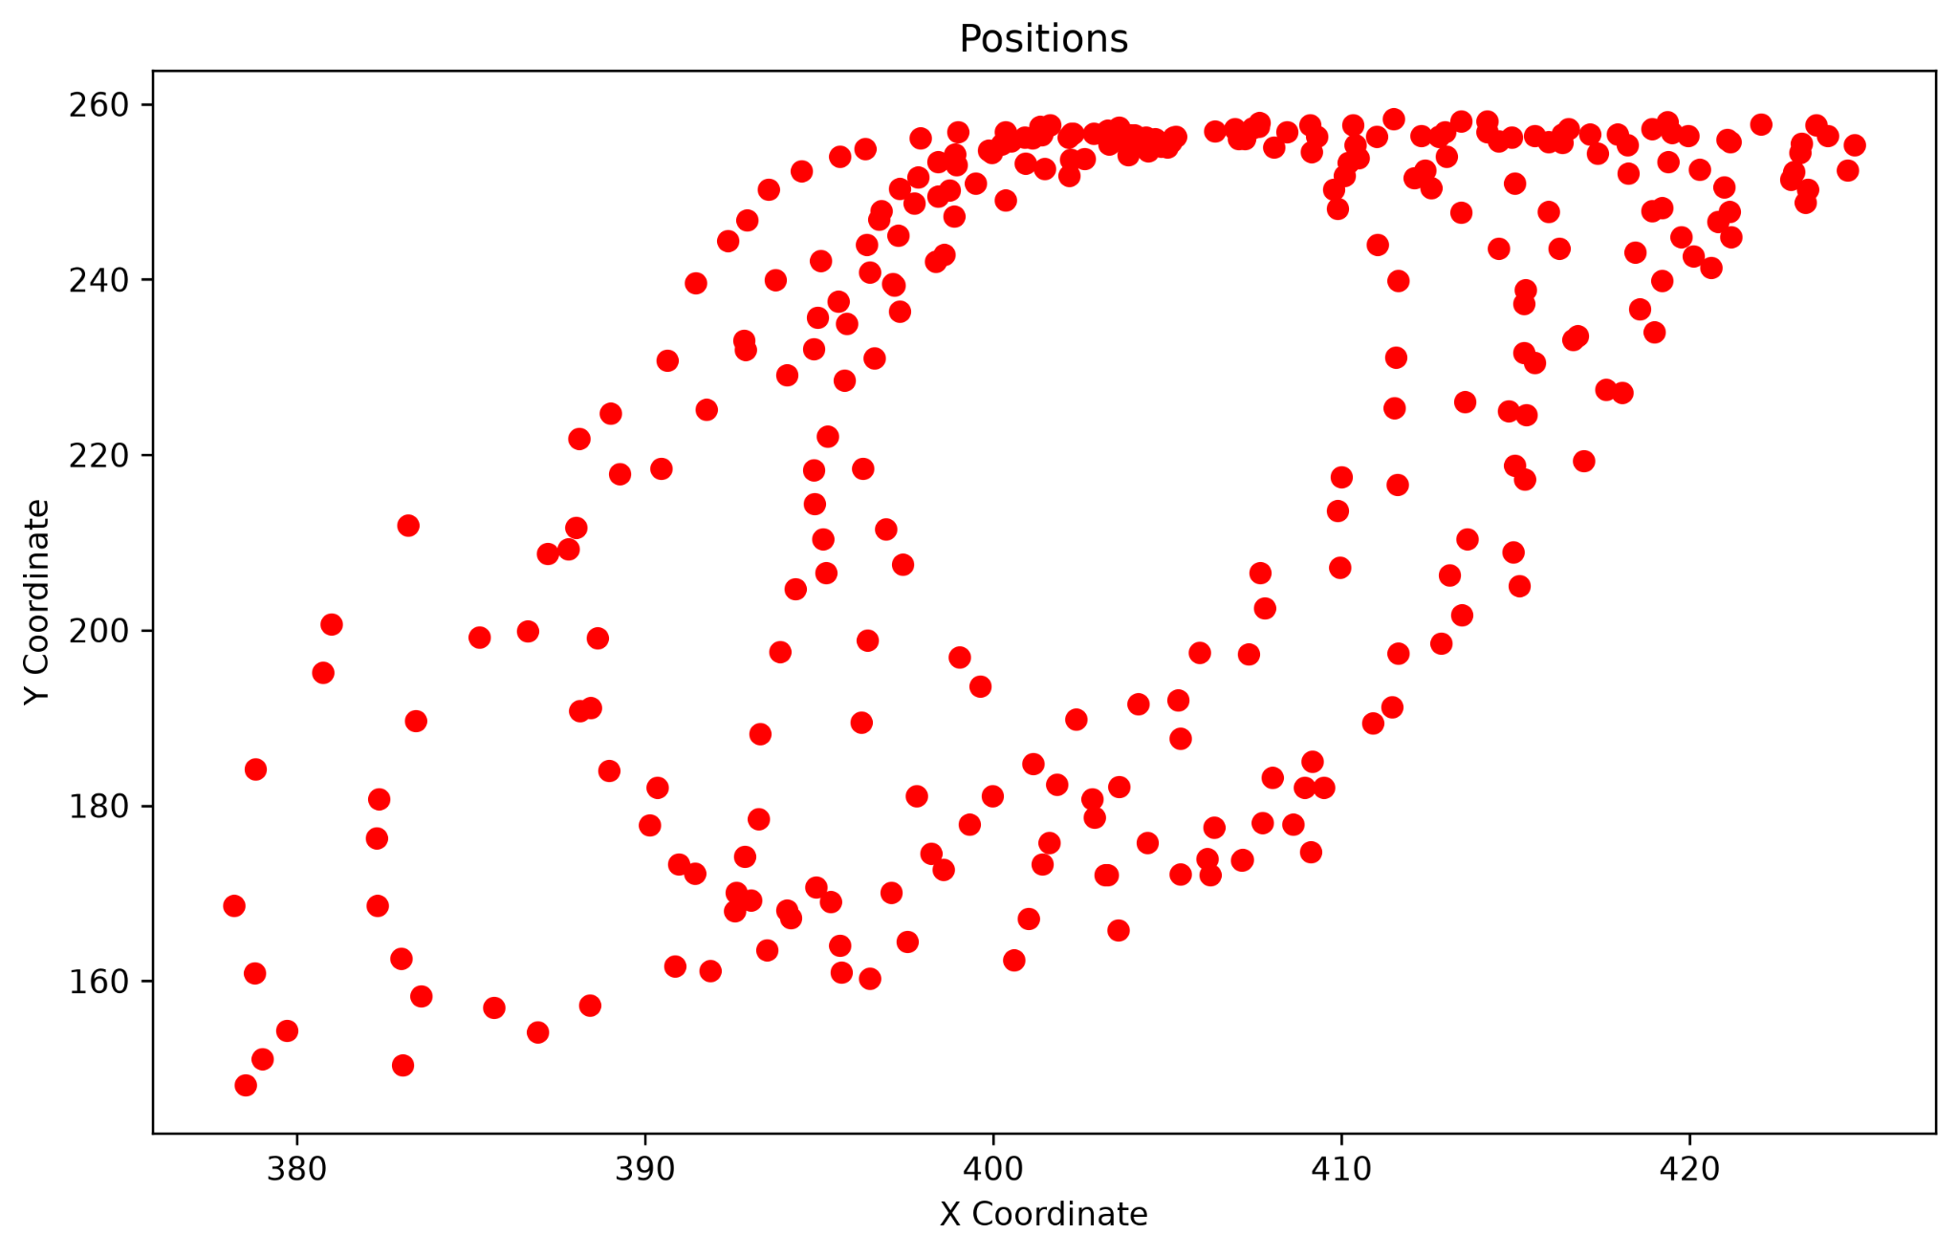

Slide 18
Question 3 - Multi object Segmentation, Tracking and Counting
Goal:
Train a model on public dataset
Perform inference on video displaying multiple instances of classes
Complete A, B, C and D
Steps:
Pull in COCO pretrained segmentation model
Grab test video
Perform A, B, C and D on test video

Slide 19
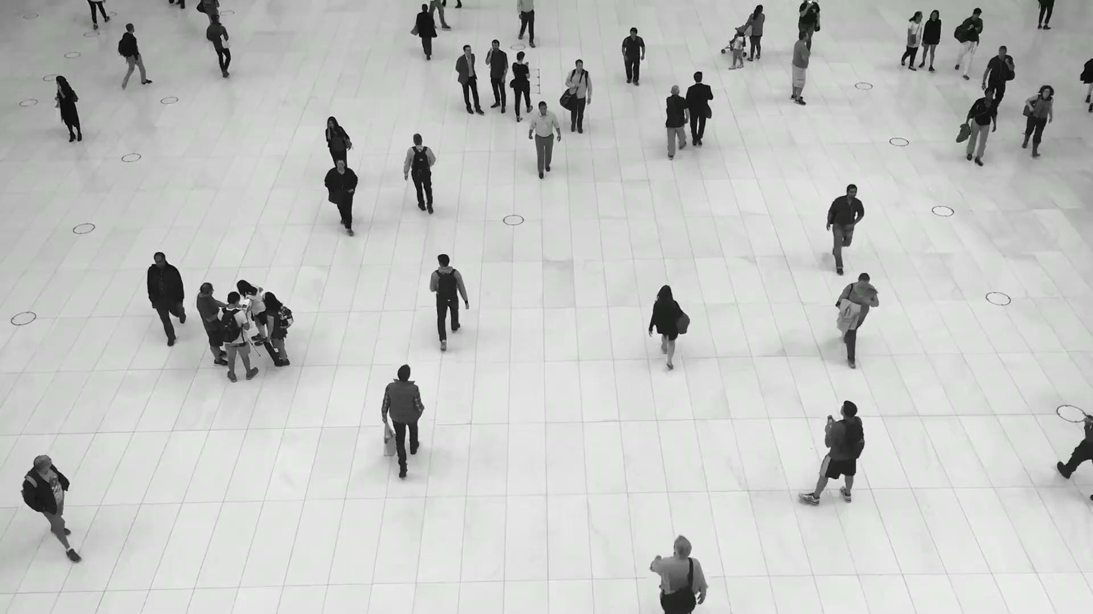
Question 3 - Part A

Slide 20
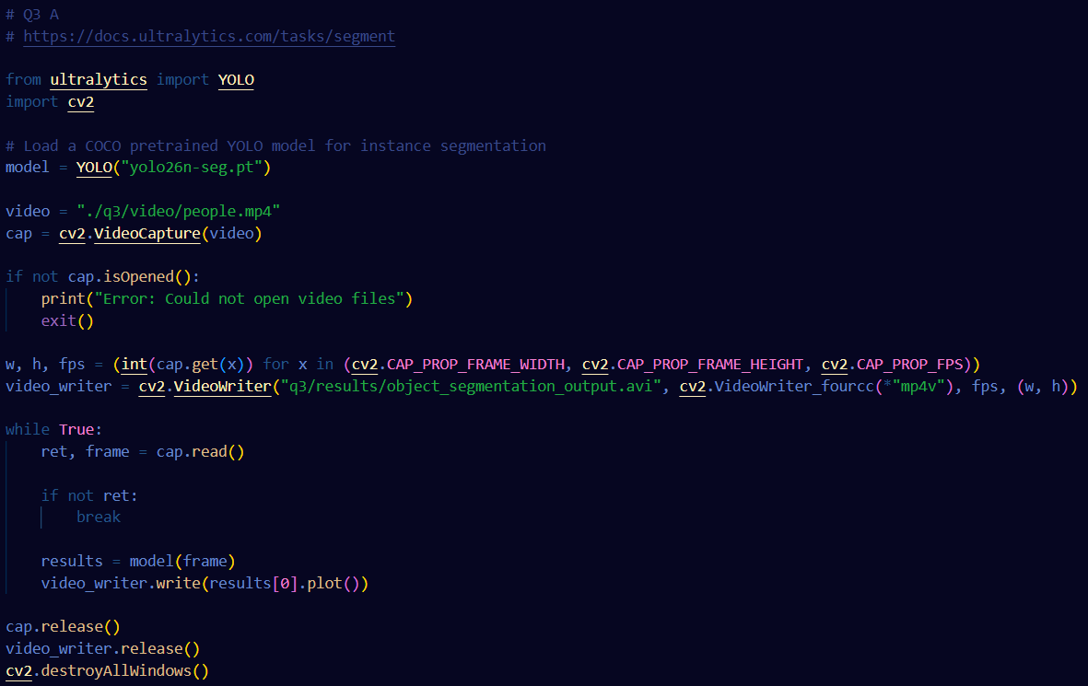

Slide 21
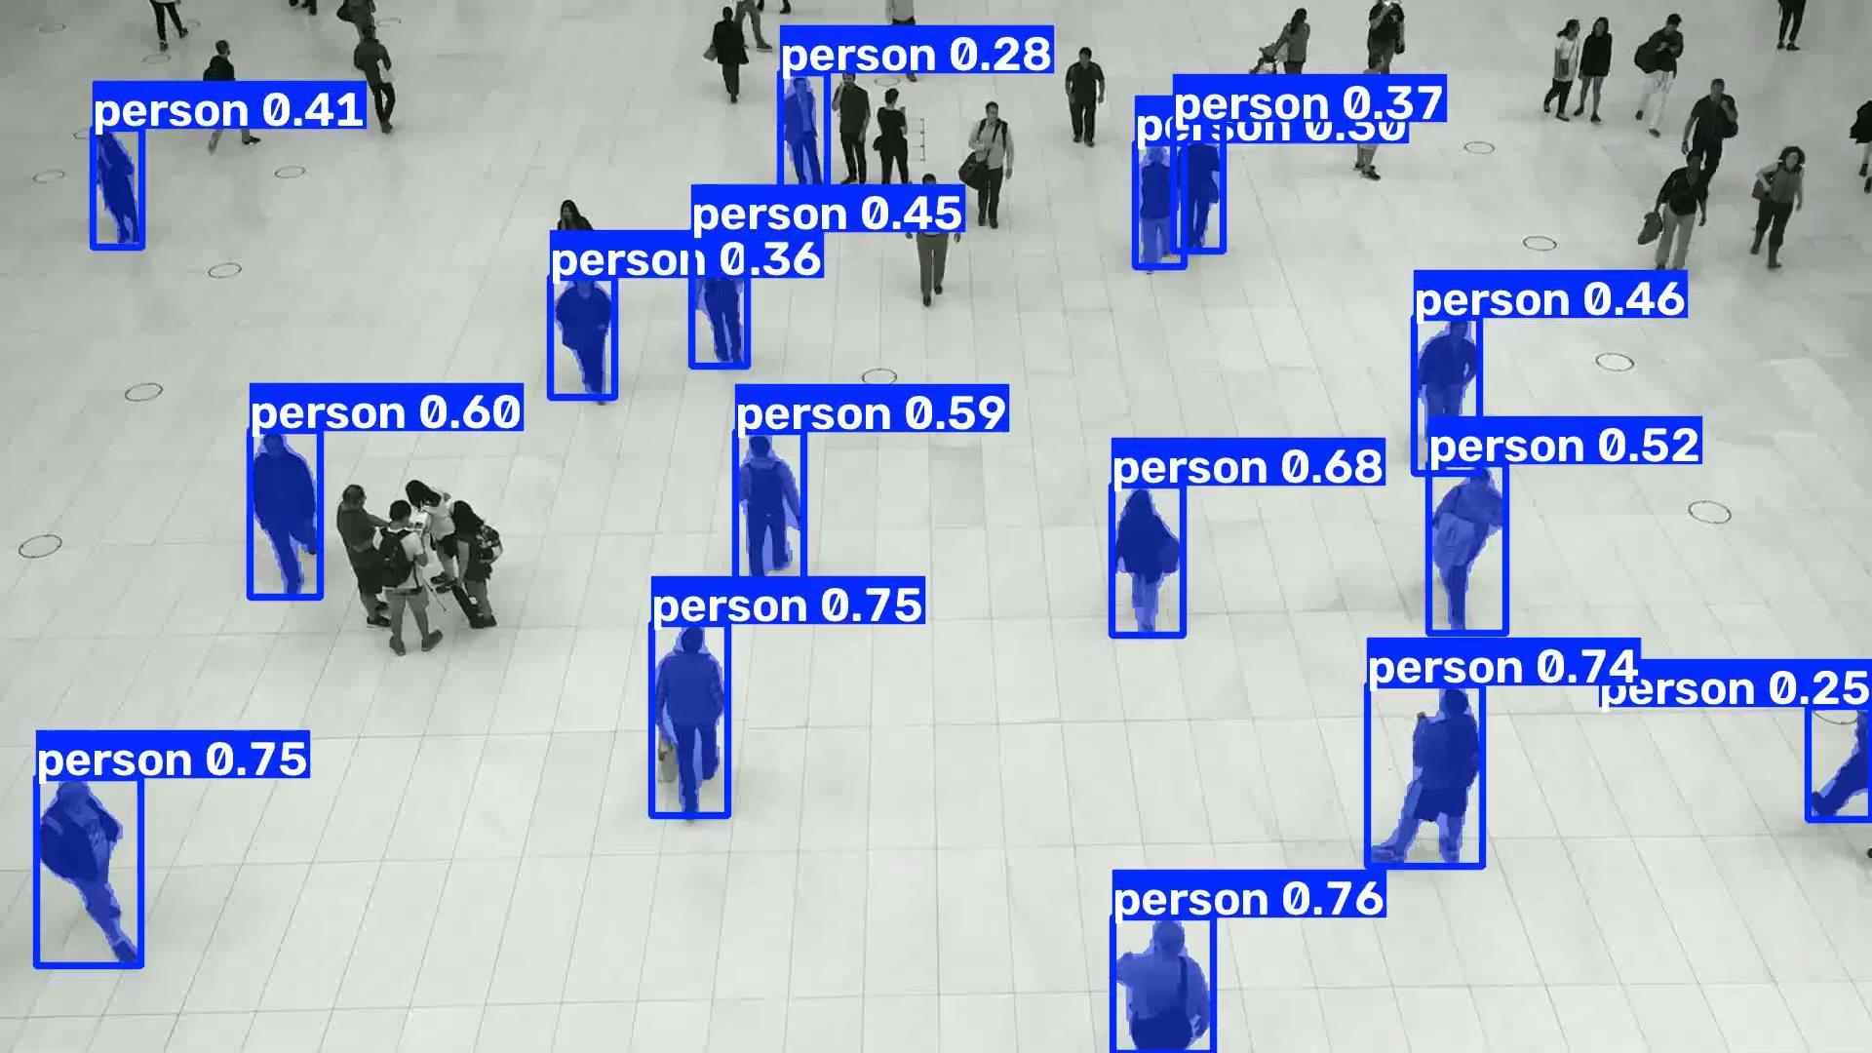

Slide 22
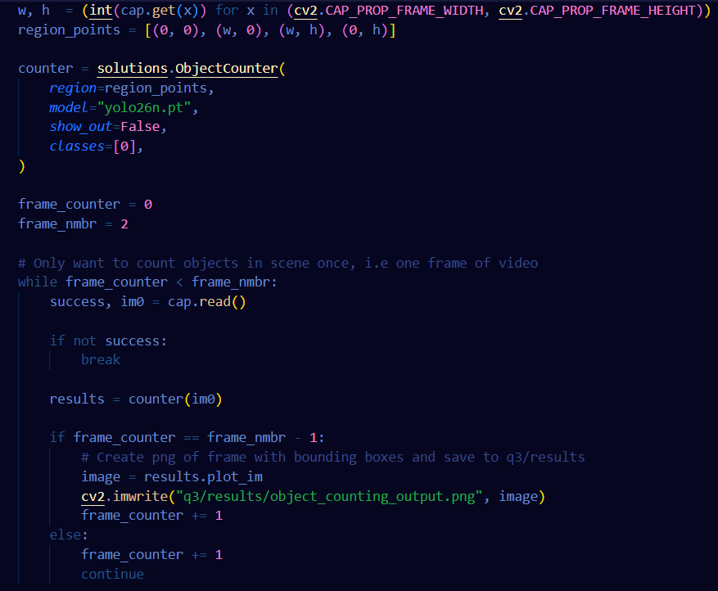
Question 3 - Part B
Only want to count amount of people in one scene, i.e one frame of video
We can open video, and only perform inference on a single instance of the video by setting a frame counter and only capturing frame while less than frame counter
Utilize Ultralytics Counter solution to count amount of classes in single frame

Slide 23
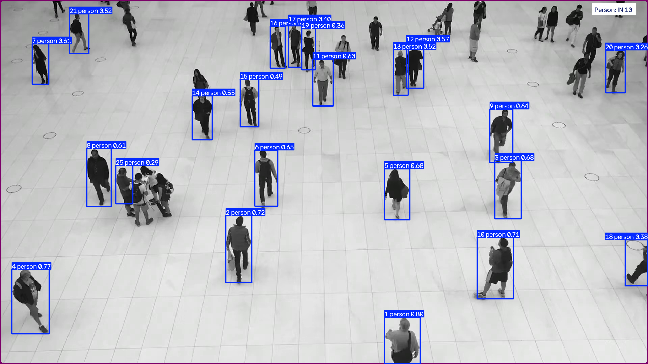

Slide 24
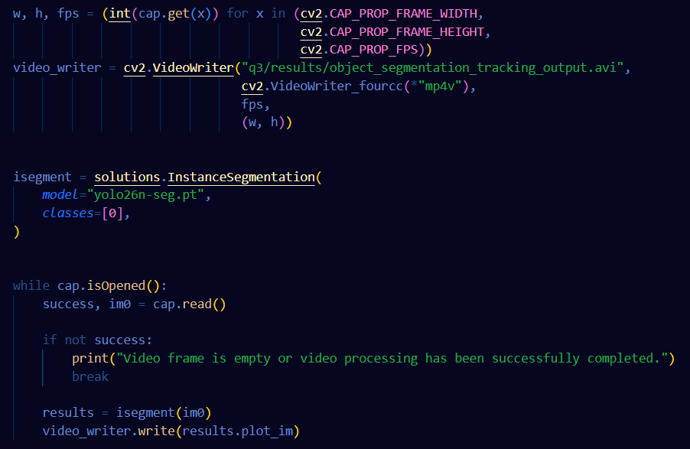
Question 3 - Part C
Now want to track individual instances of each class, distinguishing them from each other
Can utilize InstanceSegmentation Solution from Ultralytics and only segment for specific class (0 = person)

Slide 25
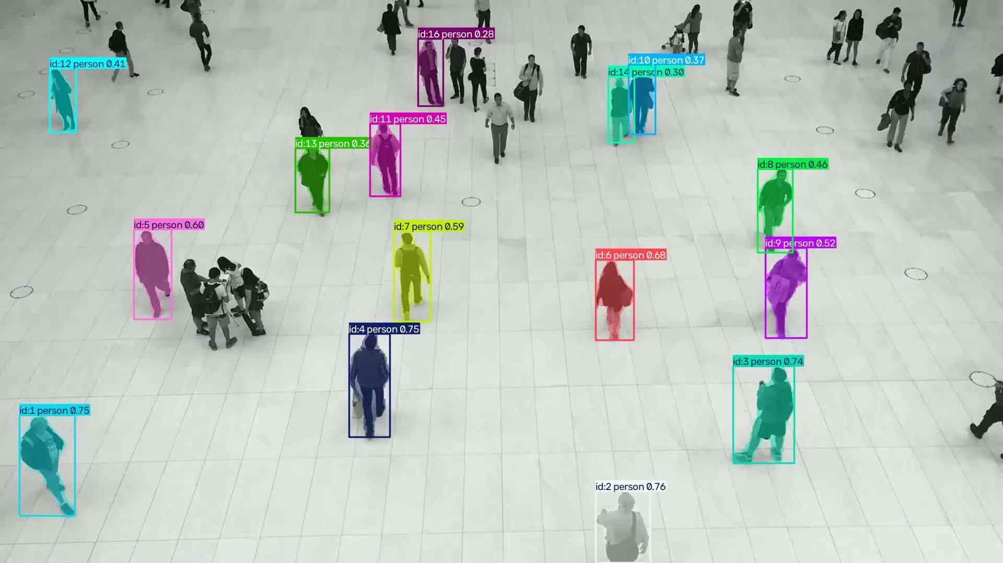

Slide 26
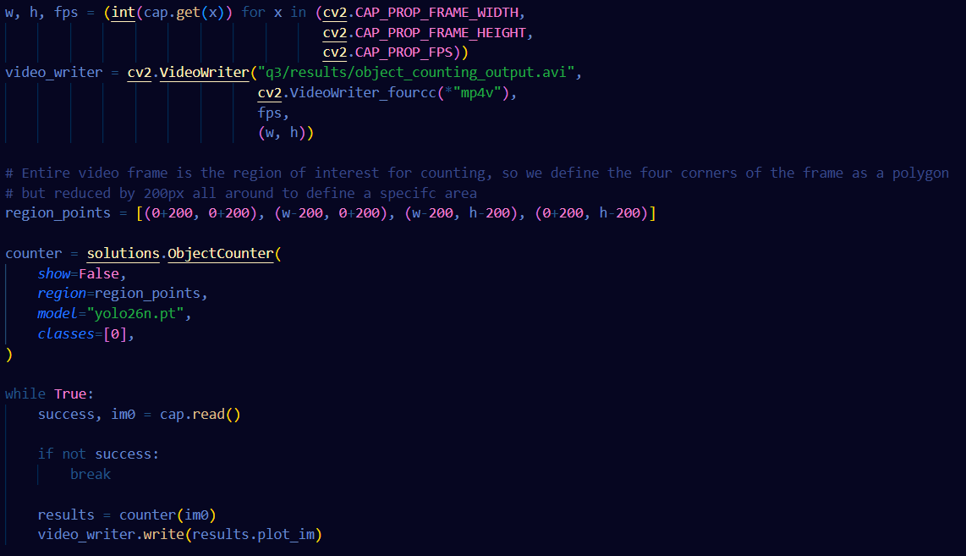
Question 3 - Part D
We can repeat steps from part B, but narrow region_points to a specific section and show both incoming and going classes

Slide 27
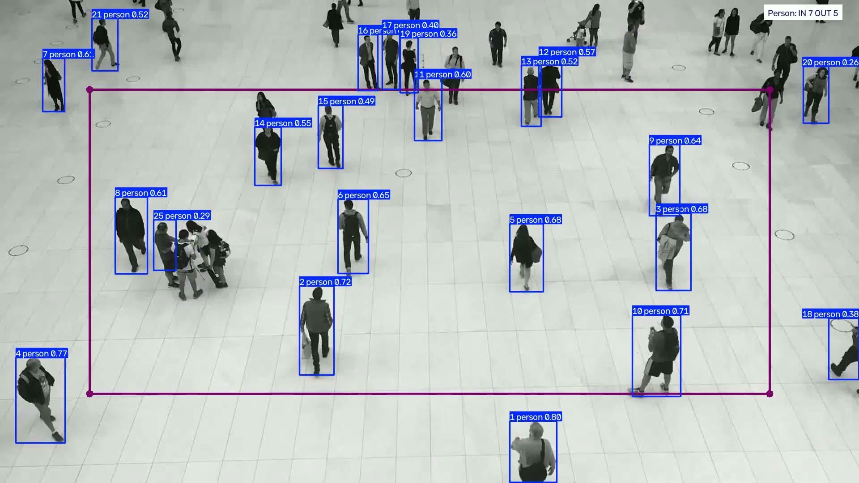

Slide 28
Question 6 - Autoencoder
We want to employ an auto encoder to encode and decode images from the fault-classification class dataset
Then we want to display for 10 images from each of the classes the original image, the latent vector, the decoded image and the reconstruction error.
Steps:
Load images from training and test directory
Train autoencoder and validate with test images
Encode test images and decode them
Display ten of the images with each step A, B, C and D performed

Slide 29
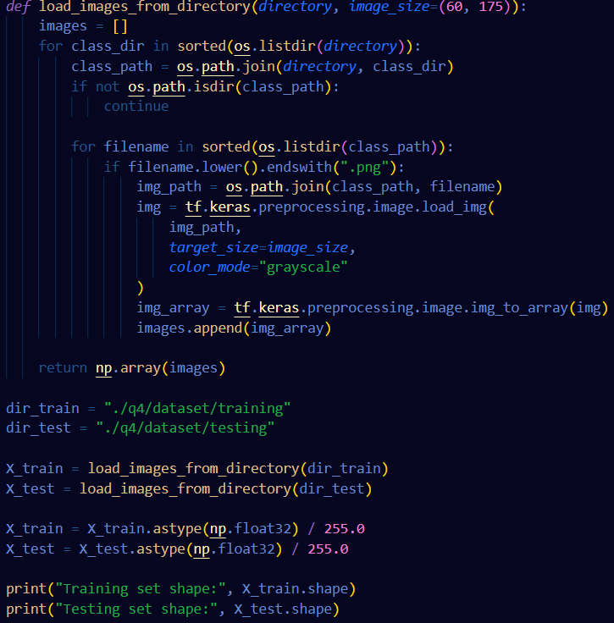
Question 6 -Load images

Slide 30
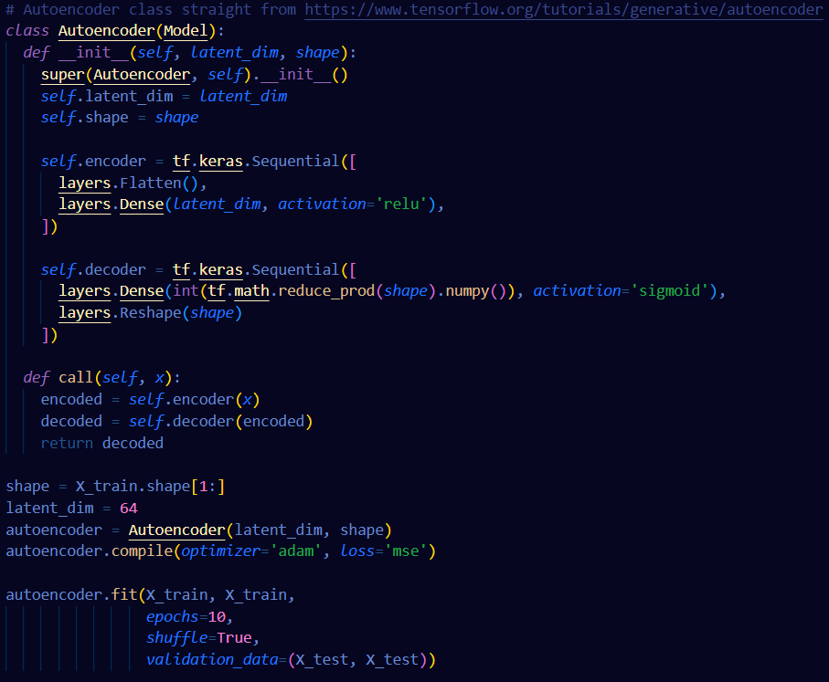
Question 6 - Train autoencoder
Use Encoder example straight from Tensorflow Auto Encoder example

Slide 31
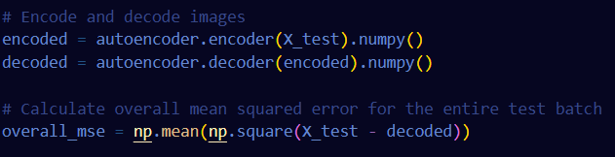
Question 6 - Encode and decode

Slide 32
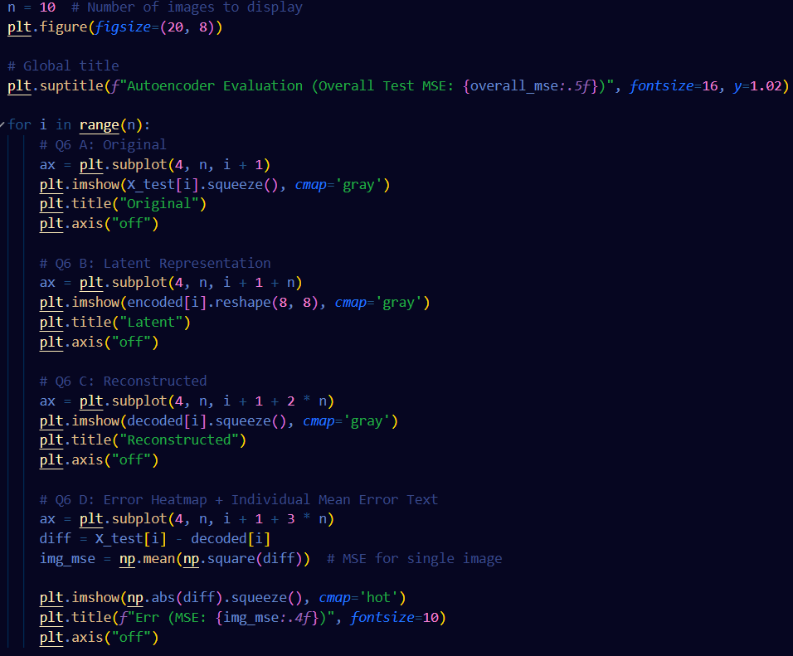
Question 6 - Display A, B, C and D

Slide 33
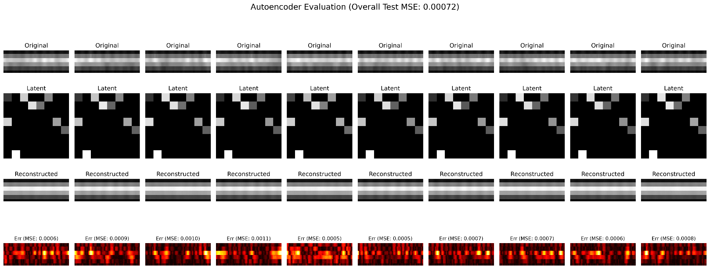

Slide 34
References
Repository: https://github.com/BjarkanDev/MAS512

