Slide 1

MOLECULAR CLOCK, ZOONOMIA PAPER
EVOLUTIONARY THINKING 2023
WEEK 37

Slide 2
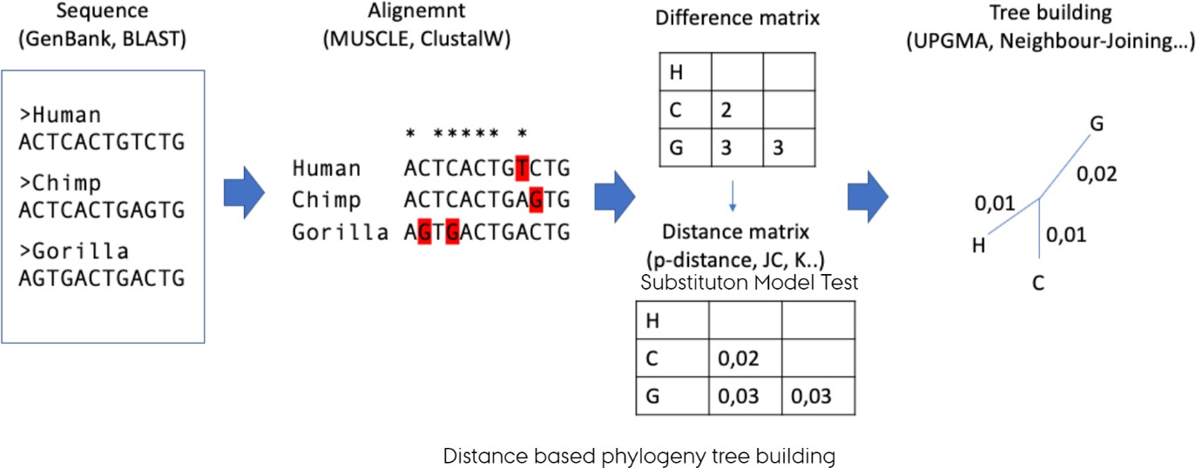

BRIEF RECAP
EVOLUTIONARY THINKING 2023
WEEK 37

Slide 3
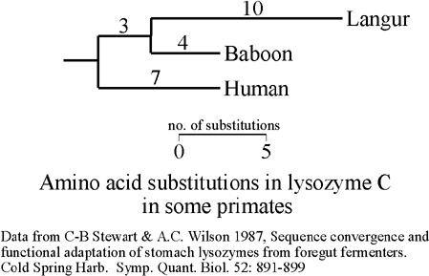
MOLECULAR CLOCK
sequence evolution rate constant across time or among lineages?
discrepancy between molecular divergence dates and fossil-based estimates
why?
substitution rate heterozygosity
also why? And how to circumvent this?
EVOLUTIONARY THINKING 2023
WEEK 37

Slide 4
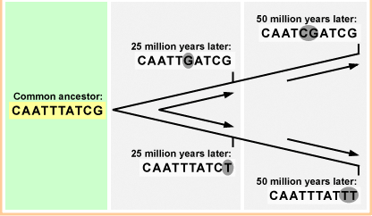
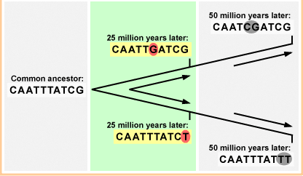
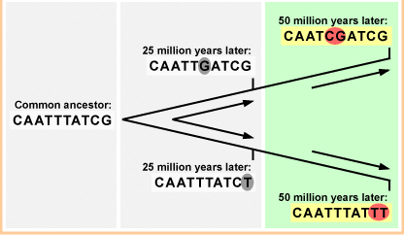
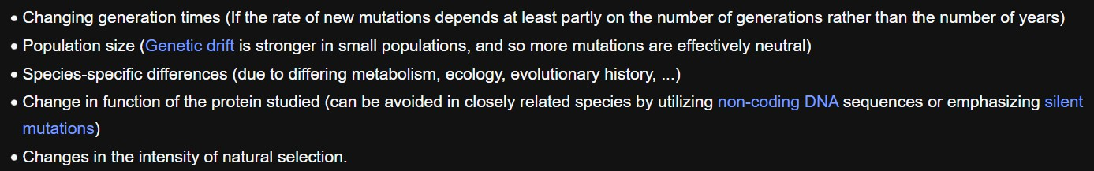
MOLECULAR CLOCK
12:15-12:25
But!
Molecular clock mirages (Ayala 1999) – nice summary on Wikipedia:
EVOLUTIONARY THINKING 2023
WEEK 37

Slide 5
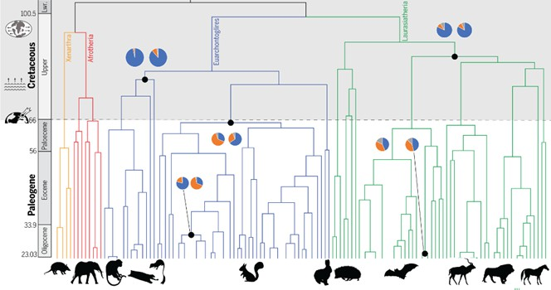
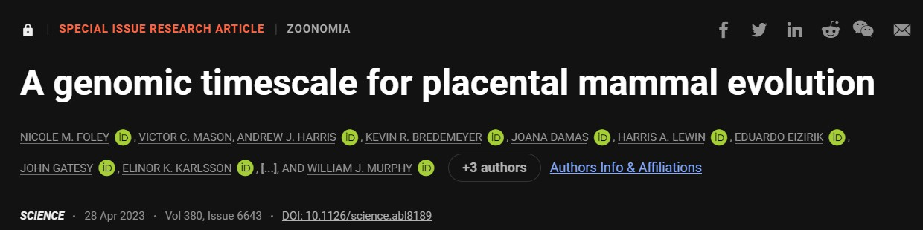

ZOONOMIA PAPER
A look into estimating divergence times based on multiple clock models
Simple idea: look at how differently recombining chromosomes evolve
Let’s see how that went!

Slide 6


ZOONOMIA PAPER

Slide 7
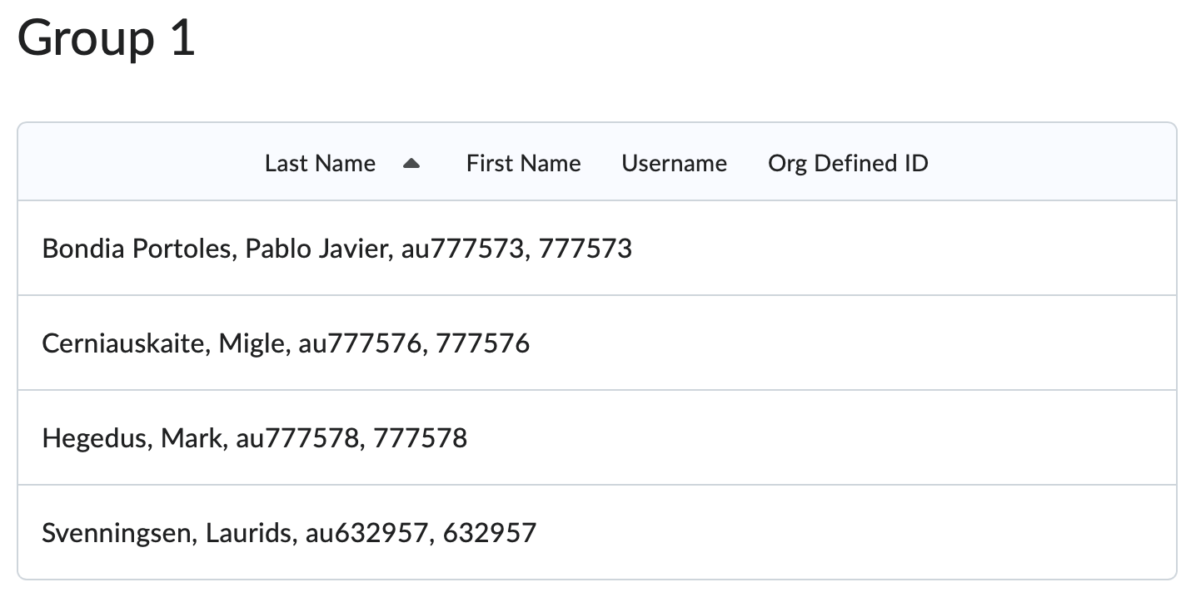
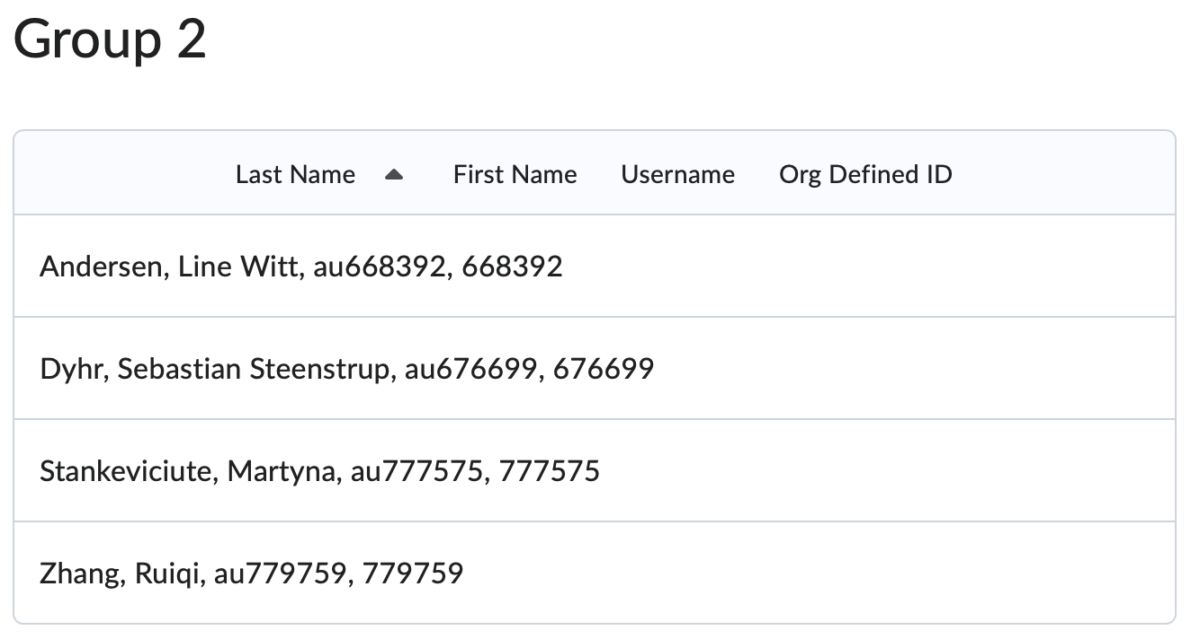
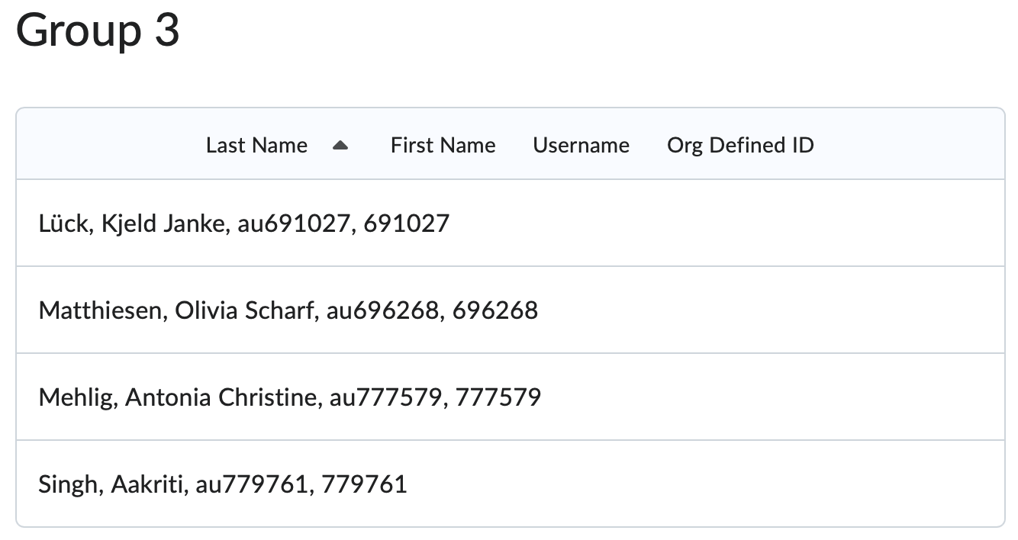
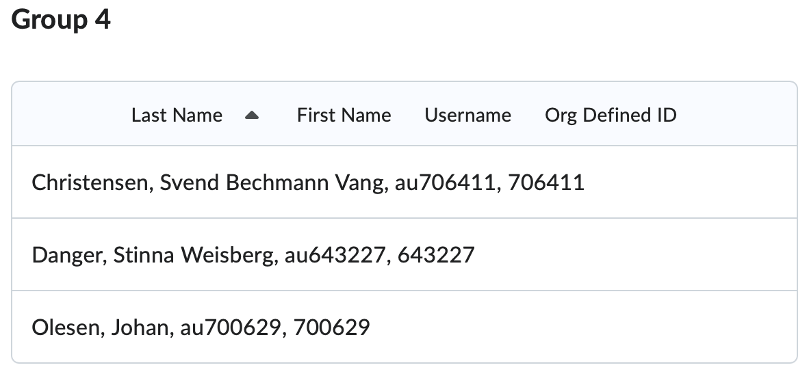
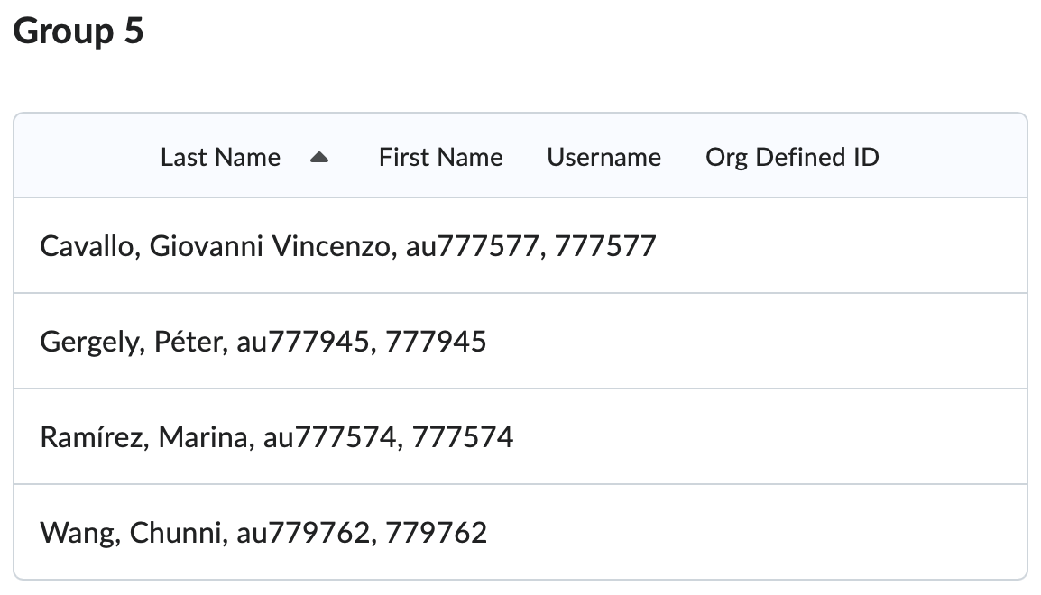
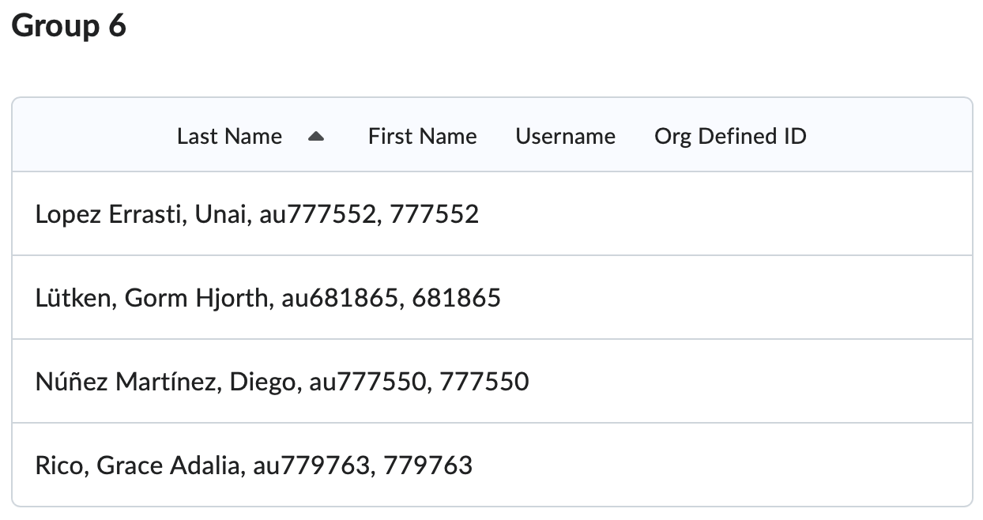
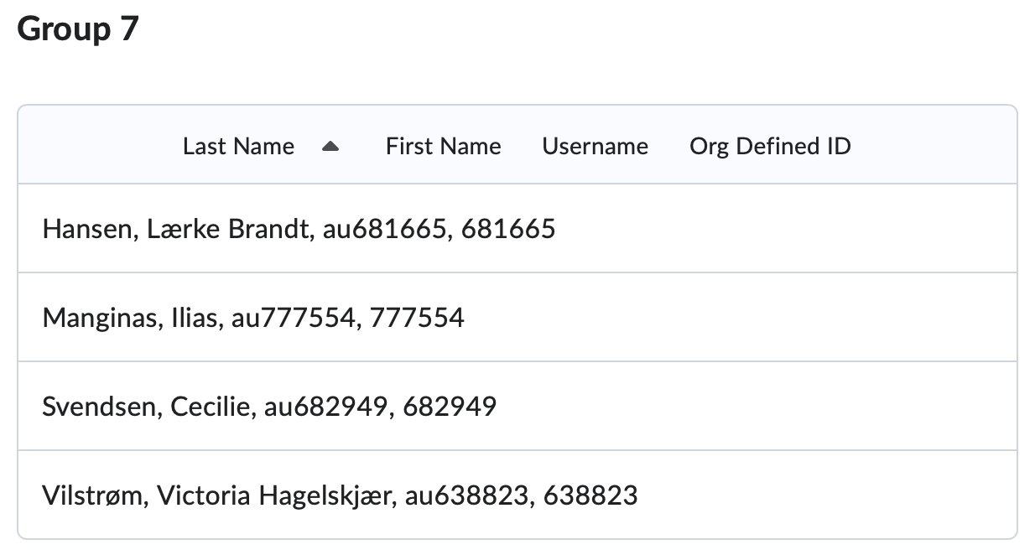
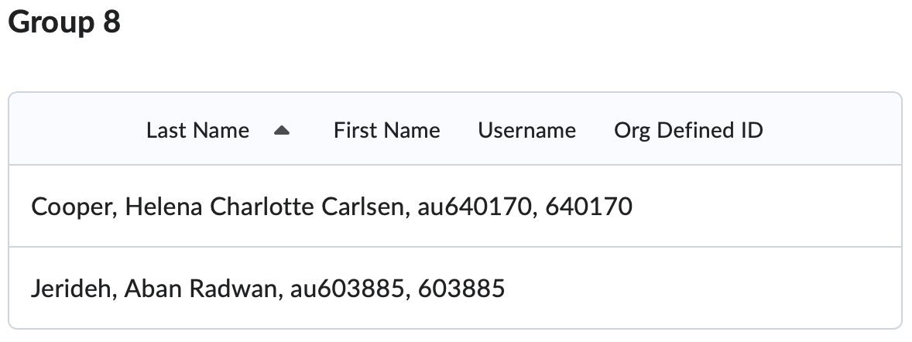
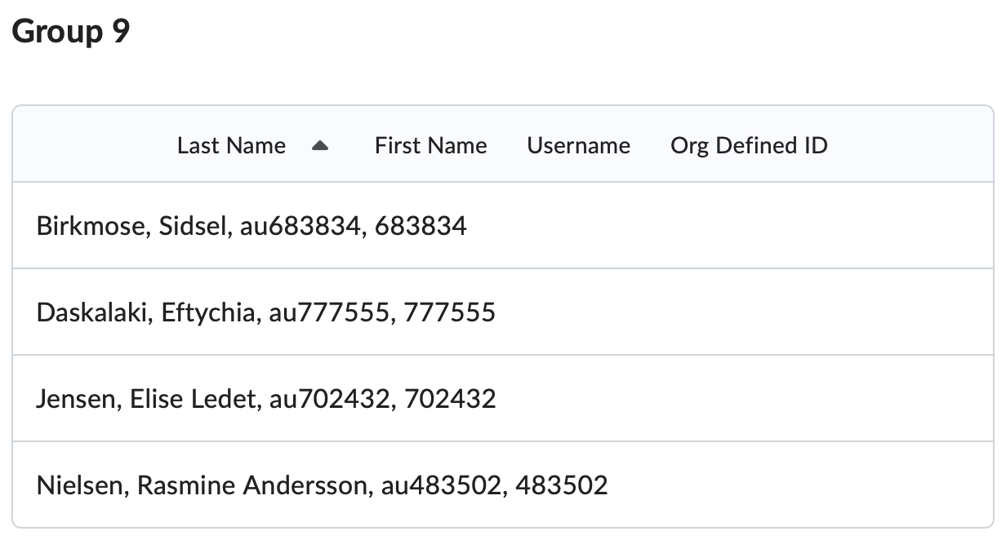
GROUP DISCUSSIONS

Slide 8

BREAK

Slide 9
ZOONOMIA PAPER

Slide 10
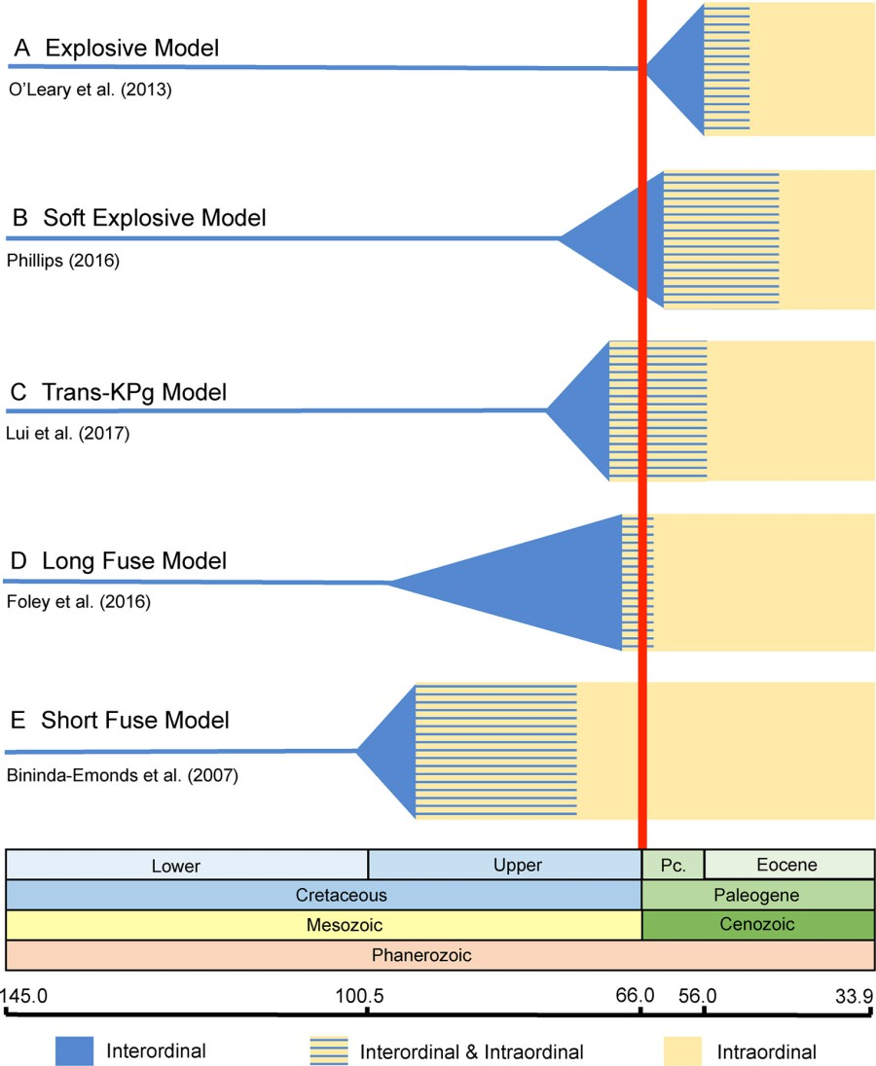
EUTHERIAN DIVERSIFICATION
Very brief discussion on the models
Use your intuition from the Zoonomia paper: does the long fuse model make sense?
What arguments supporting the other models can you think of?

Slide 11

Cake?

Slide 12
AARHUS UNIVERSITY

