Slide 1
Evolutionary thinking ta session Wednesday population genetics 1

Slide 2
Plan for today
Motivation for population genetics
The Basic Coalescent (3.0)
Exercises from the book chapter 1-3
BREAK (15 MIN)
Exercises from the book chapter 1-3
~13:30 evaluation of some of the exercises

Slide 3
Motivation for the studies of population genetics
Evolution: Population genetics provides a framework for understanding how evolutionary change occurs, and it has helped us to identify the forces that drive evolution, such as natural selection, genetic drift, and gene flow.
Conservation: Population genetics can be used to assess the genetic health of populations and to identify populations that are at risk of extinction. This information can then be used to develop conservation strategies.
Agriculture: Population genetics can be used to improve crop yields and disease resistance by selecting for desirable traits.
Medicine: Population genetics can be used to identify genetic variants that are associated with diseases, and to develop new diagnostic tests and treatments.

Slide 4
The wright fisher population
Assumptions
Finite populations
Non-overlapping generations
Random mating

Slide 5




Genetic drift
What do we expect the allele freq. to be in the next gen
$$E\left[f_{A}\left(t+1\right)\right]=\frac{2Nf_{A}\left(t\right)}{2N}=f_{A}(t)$$
How unlikely is this outcome?
$$P\left(f_{A}\left(t+1\right)=\frac{2}{6}\right)=\left({n \atop x}\right){∗f}_{A}{\left(t\right)}^{x}∗{\left(1−f_{A}\left(t\right)\right)}^{n−x}$$
$$=\left({6 \atop 2}\right)∗{\left(\frac{1}{2}\right)}^{2}∗{\left(1−\frac{1}{2}\right)}^{4}$$
= 0.234

Slide 6

The probability of fixation
$$P\left(fixation of allele A\right)=N_{A}∗\frac{1}{2N}=\frac{N_{A}}{2N}=f_{A}(t)$$

Slide 7
The basic coalescent (3.0)
TMRCA

Slide 8
The basic coalescent (3.0)

Slide 9
The basic coalescent (3.0)
TMRCA

Slide 10
The basic coalescent (3.0)

Slide 11


The basic coalescent (3.0)
What is the probability that any 2 individuals
Coalesce in the previous generation?
$$2n∗\frac{1}{2n}∗\frac{1}{2n}=1∗\frac{1}{2n}=\frac{1}{2n}$$
What is the probability not seeing any coalescent
In the previous generation?
$$1−\frac{1}{2n}$$

Slide 12
The basic coalescent (3.0)
Waiting time untill the first coalescent
Is geometrically distributed
Ananalogy might help understand

Slide 13
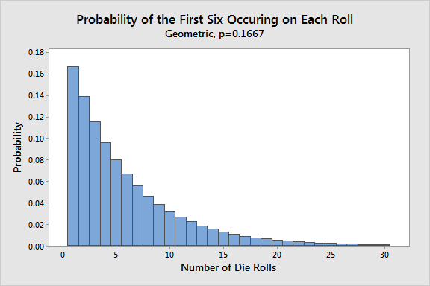
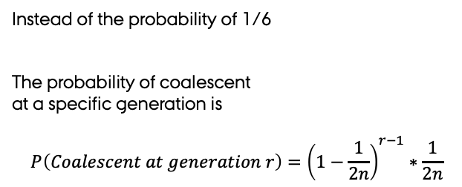
Back to the dice
Instead of the probability of 1/6
The probability of coalescent
at a specific generation is
$$P\left(Coalescent at generation r\right)={\left(1−\frac{1}{2n}\right)}^{r−1}∗\frac{1}{2n}$$

Slide 14
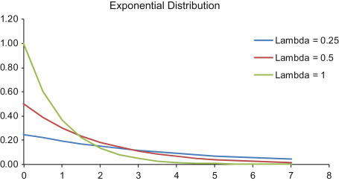

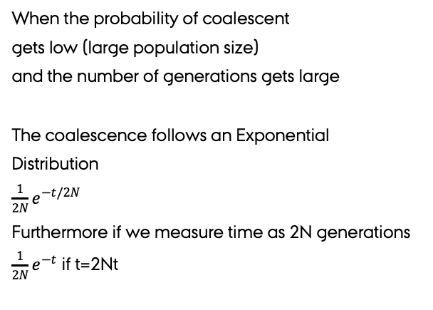
The slightly wierd bus analogy
Used to model waiting times
“What is the probability that I have to wait less than 30 minutes till the next bus arrives?”
When the probability of coalescent
gets low (large population size)
and the number of generations gets large
The coalescence follows an Exponential
Distribution
${\frac{1}{2N}e}^{−t/2N}$
Furthermore if we measure time as 2N generations
${\frac{1}{2N}e}^{−t}$ if t=2Nt

Slide 15
Exercises
Let do the ones you found difficult
Menti: https://www.mentimeter.com/app/presentation/alnuwsre8vmzz4n3yo1m3oez36sjeucr/dqqwh8qjah1n/edit
Code: 39684241

Slide 16
MENTI QUIZ OF THE WEEK
https://www.mentimeter.com/app/presentation/al43sajyxpepe95nyneezwcjprs6rbu6/y9aamkbywutm/edit

Slide 17
EVALUATION OF WEEK 38 and 39
https://www.mentimeter.com/app/presentation/alvqhhijamhegohfz9kt1faf7zygu5dp/qdxhbiunqp3y/edit

