Slide 1
Evolutionary Thinking Wednesday paper discussion

Slide 2
Plan for today
Very brief talk about unclear terminology or other stuff that was noted on the menti
Introduction to the paper
Group work addressing questions
Wrap up discussion with the whole class

Slide 3
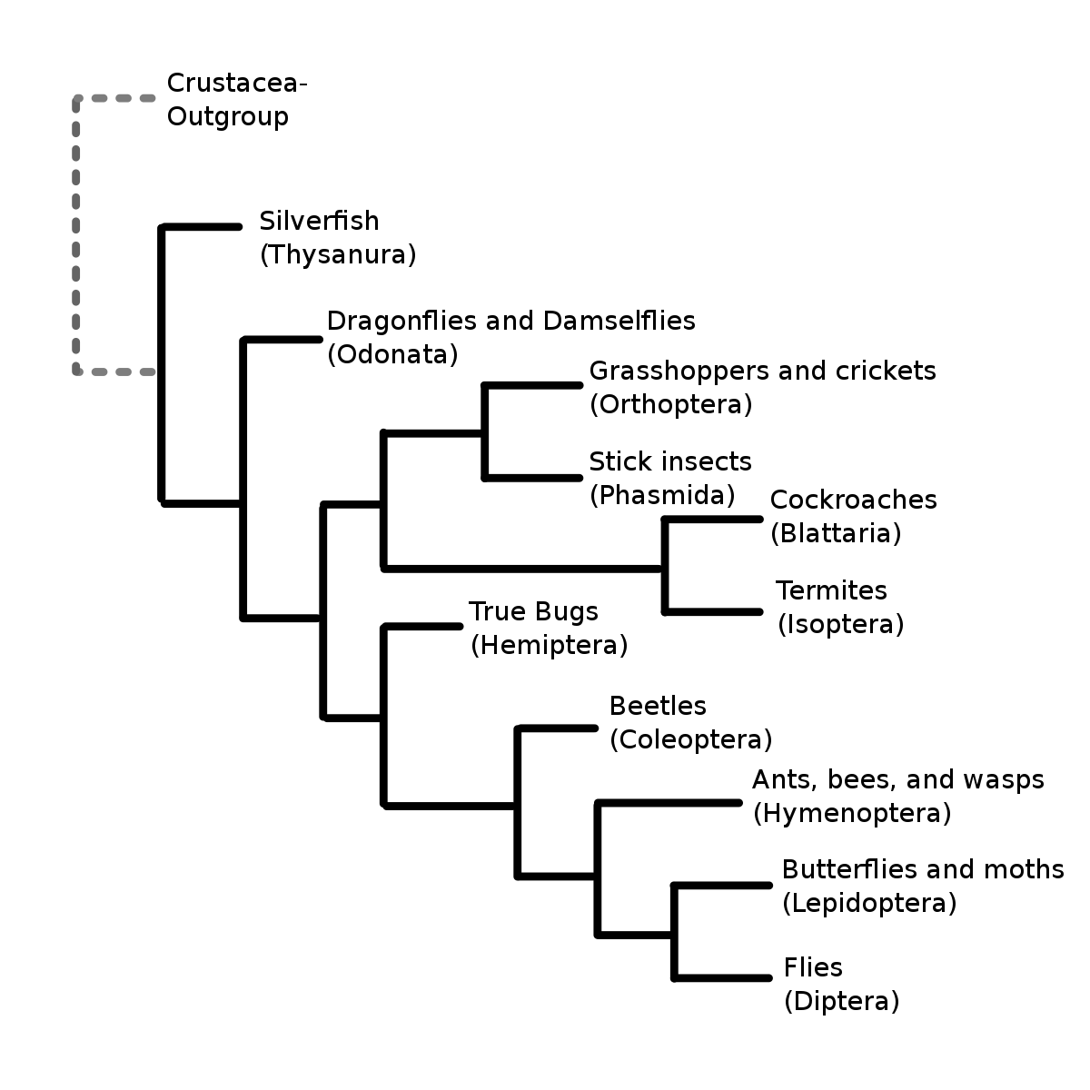
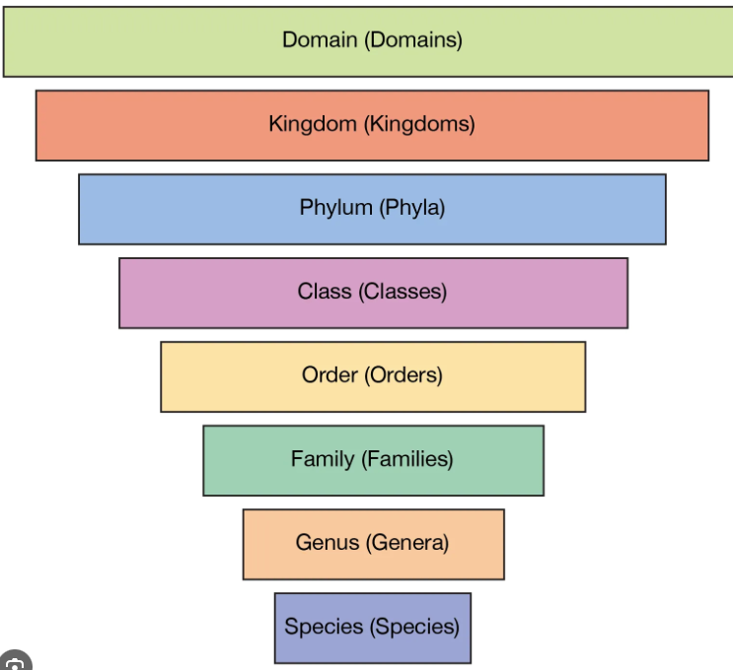
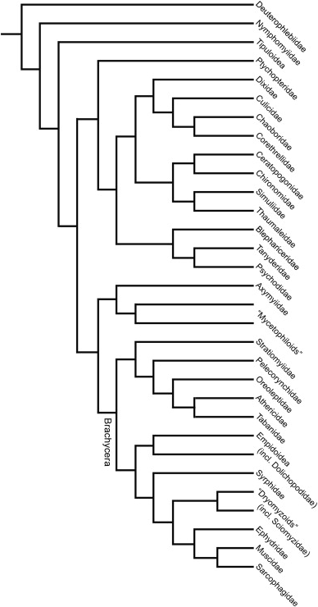
interordinal and Intraordinal relationships/trees
Interordinal
Intraordinal

Slide 4
The coalescent
The next chapther of the course
Very cool way to model genetics
Based on probability theory

Slide 5

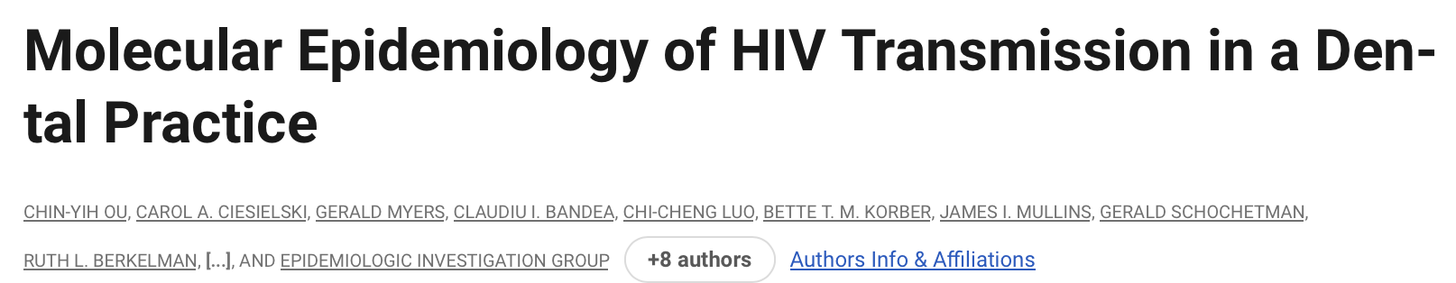
Hiv at the dentist: A Hercule Poirot adventure

Slide 6
Explain what the study is about in a few lines and summarize the results. Focus on how one can complement epidemiologic linkage studies between patients which are thought to have been infected from the same source.
This paper is a case-study about a dental practice in Florida where a dentist infected several of his patients with HIV, and they used phylogenetics to prove that he was the source of his patient’s infections. Several of the patients were thought to have been infected by the dentist because they did not have other “risk factors” associated with HIV infection besides having an HIV-positive dentist, but this was not proven until the researchers performed sequencing analysis on their HIV env protein samples and confirmed that the patient samples were more closely associated with the Dentist’s samples than with their geographically related community member samples.

Slide 7
Even though you find that all patients treated by the same dentist are seropositive, can you ensure that they have been infected from the same source? Are there alternative explanations?
Seropositivity does not confirm that they were infected by the dentist, there are other risk factors that could explain how a patient became HIV positive (needle sharing, unprotected sex etc.)

Slide 8
Is it possible that the results are explained by methodological errors? Which ones are mentioned by the authors? How can they be avoided?
Due to the large number of LCs, not all clone sequences available in this study could be satisfactorily represented in a single tree. Therefore, we focused the analysis on trees constituted from the two most divergent sequences (when available) from each of the samples and included only those LC sequences that by distance measurement (Table 1) or signature pattern analysis (Table 2) were found to be most closely related to the dental group sequences.

Slide 9
What are the factors that contribute to genetic variation of HIV viruses? Why do you think these factors can perturb the variation among viruses?
Duration of infection
Host immune pressure
Disease stage
Therapy
Possibly others

Slide 10
Which gene was used in the study? Why?
C2 and V3 domains these domains contain nucleotide sequences with sufficient variability to distinguish between strains, a feature essential for establishing HIV transmission linkage,
C2-V3 sequences have been used in previous studies of epidemiologically linked infections (2, 11, 12, 14)
The HIV Sequence Database (3) contains a relative abundance of C2-V3 sequences for comparative purposes.

Slide 11
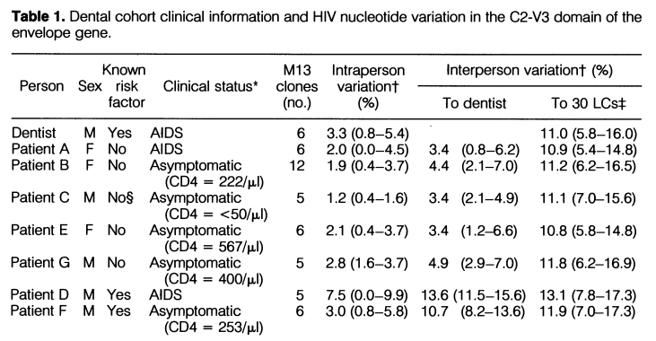
Interpret table 1. Why were patients D and F thought to not have been infected by the dentist? Do you think it is correct? What do they test when they compare to the LCs?
Interperson variation with the dentist is higher and lies among the expected values of variation of non-related variants of the virus, whereas the interperson variation to the other LC retrieves similar values as the rest of the patients. Patient D and F has higher interperson Variation, therefore indicating a higher likelihood of the patient virus source not being the doctor.

Slide 12
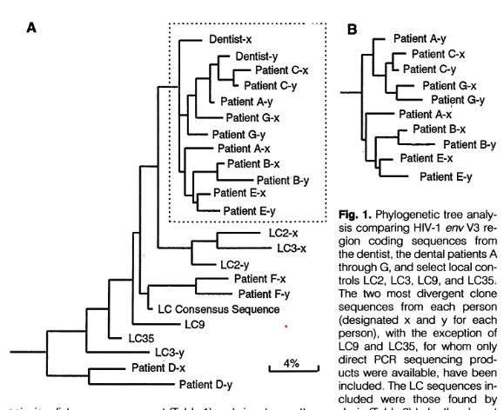
Interpret Figure 1. Explain the topology of patient A sequences compared to other patients. Can you relate with information from Table 1?
Figure 1 describes the virus phylogeny of the different patients using pairwise distance measurements and signature pattern analysis.
Patient A had the same version of the virus as the doctor while having little interperson variation from the doctor. This indicates a high likelihood that patient a was infected by the doctor. Figure 1 phylogeny compared to table a of patient A, indicates that there is close common ancestry between the doctor and patient viruses.

Slide 13
What method did they use to construct the tree? How did they confirm that the infected patients cluster were consistent?
Maximum parsimony for tree building and bootstrap replication for robustness testing.

Slide 14
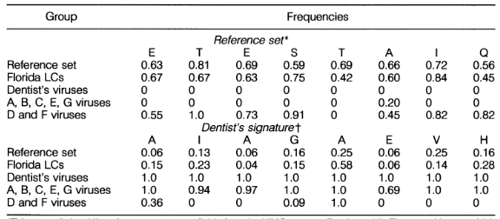
What does the “Signature Pattern Analysis” from the aminoacid data consist of? Could they have tested if there was correlation between the pattern and the molecular difference in another way? How?
A unique signature pattern of eight residues was detected within the 120-amino acid C2-V3 region of the dentist's viruses by comparing an alignment of his viral amino acid sequences to an alignment of a reference set [...]. The resulting pattern consisted of all sites in which all six clones from the dentist differed from what is found in over 50% of sequences in a reference set.”

Slide 15
Is the dentist guilty?

