Slide 1
Evolutionary thinking ta session Wednesday population genetics 1

Slide 2
Plan for today
Motivation for population genetics
The Basic Coalescent (3.0)
Exercises from the book chapter 1-3
BREAK (15 MIN)
Exercises from the book chapter 1-3
~13:30 evaluation of some of the exercises

Slide 3
Motivation for the studies of population genetics
Evolution: Population genetics provides a framework for understanding how evolutionary change occurs, and it has helped us to identify the forces that drive evolution, such as natural selection, genetic drift, and gene flow.
Conservation: Population genetics can be used to assess the genetic health of populations and to identify populations that are at risk of extinction. This information can then be used to develop conservation strategies.
Agriculture: Population genetics can be used to improve crop yields and disease resistance by selecting for desirable traits.
Medicine: Population genetics can be used to identify genetic variants that are associated with diseases, and to develop new diagnostic tests and treatments.

Slide 4
The wright fisher population
Assumptions
Finite populations
Non-overlapping generations
Random mating

Slide 5




Genetic drift
What do we expect the allele freq. to be in the next gen
$$E\left[f_{A}\left(t+1\right)\right]=\frac{2Nf_{A}\left(t\right)}{2N}=f_{A}(t)$$
How likely is this outcome?
$$P\left(f_{A}\left(t+1\right)=\frac{2}{6}\right)=\left({n \atop x}\right){∗f}_{A}{\left(t\right)}^{x}∗{\left(1−f_{A}\left(t\right)\right)}^{n−x}$$
$$=\left({6 \atop 2}\right)∗{\left(\frac{1}{2}\right)}^{2}∗{\left(1−\frac{1}{2}\right)}^{4}$$
= 0.234

Slide 6

The probability of fixation
$$P\left(fixation of allele A\right)=N_{A}∗\frac{1}{2N}=\frac{N_{A}}{2N}=f_{A}(t)$$

Slide 7
The basic coalescent
TMRCA

Slide 8
The basic coalescent

Slide 9
The basic coalescent
TMRCA

Slide 10
The basic coalescent

Slide 11


The basic coalescent
What is the probability that any 2 individuals
coalesce in the previous generation?
$$2n∗\frac{1}{2n}∗\frac{1}{2n}=1∗\frac{1}{2n}=\frac{1}{2n}$$
What is the probability not seeing any coalescent
In the previous generation?
$$1−\frac{1}{2n}$$

Slide 12
The basic coalescent
Waiting time untill the first coalescent
Is geometrically distributed
Ananalogy might help understand

Slide 13
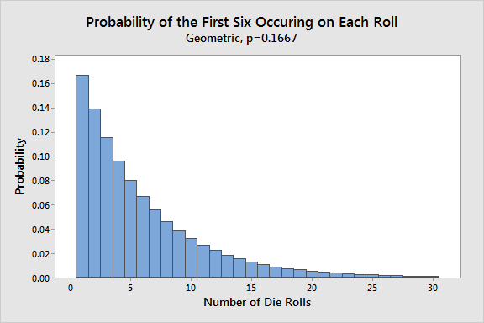
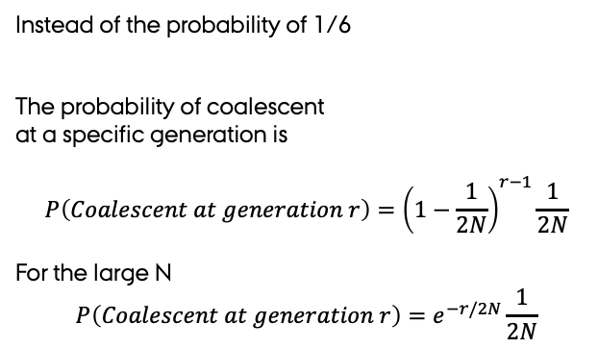
Back to the dice
Instead of the probability of 1/6
The probability of coalescent
at a specific generation is
$$P\left(Coalescent at generation r\right)={\left(1−\frac{1}{2N}\right)}^{r−1}\frac{1}{2N}$$
For the large N
$$P\left(Coalescent at generation r\right)=e^{−r/2N}\frac{1}{2N}$$

Slide 14

Exercises
Let do the ones you found difficult

Slide 15

MENTI QUIZ OF THE WEEK

Slide 16

EVALUATION OF WEEK 38 and 39

