Slide 1
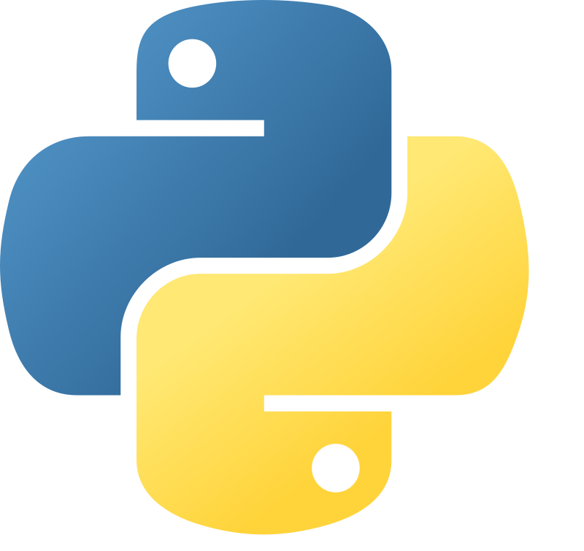

Python for Testers

Slide 2

Basic setup
Visual Studio Code: https://code.visualstudio.com/download
GIT: https://git-scm.com/downloads
Python: https://www.python.org/downloads/release/python-3132/
Github: https://github.com/BjarneHelgesen/PythonForTestere
git clone https://github.com/BjarneHelgesen/PythonForTestere
to a source folder

Slide 3
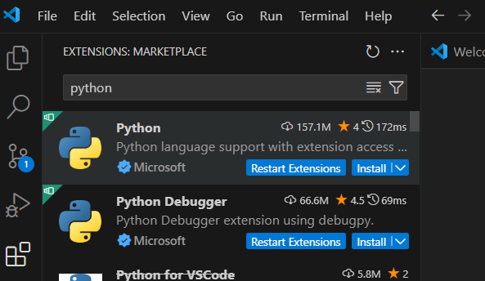
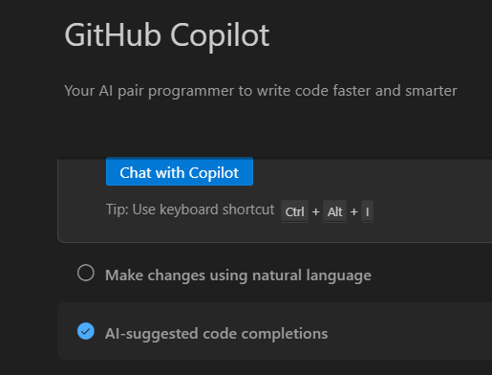
Install plugins

Slide 4

Ambition level
Write basic Python code
Understand basic Python code
Understand what Python can be used for and focus on how to use it for testing.
We will use procedural Python.
Metaprogramming, Object oriented and Functional Python are for more advanced classes.

Slide 5

Ready to dive in?

Slide 6
Basic built-in types
Type | Description
int | Whole numbers, positive, zero or negative. E.g. 1, 5, -2, -2012302
float | Any number. E.g. 3.14159265, 100000000000, 0.000000007
string | Characters. E.g. “Python for Testers”,
bool | True or False

Slide 7
Basic math operators
Operator | Description
* | Multiply, e.g. 10 * 1.2
/ | Divide, e.g. 1 / 5
+ | Add, e.g. 1 + 1
- | Subtract e.g. 8 – 2
% | Modulus, e.g. 17 % 2

Slide 8

Unit tests - code that tests code
Reading unit tests show how the code is supposed to work. It is documentation in code.
Helps design code with low coupling, e.g. combined with test-driven development, TDD
Catches regressions

Slide 9
Exercise 1
Convert miles to km
1 mile is 1.6 km.
Remember unit test

Slide 10
Test Driven Development (TDD)
Make a simple unit test
Ensure that the test fails
Implement just enough code to make the test pass
Refactor
Repeat

Slide 11
TDD Exercise
Create a function that accepts an age and returns the following:
age < 0 : “Error”
age == 0 “Home”
age 1-5: “Kindergarden”
age 6-15: “School”
age 16-18: “College”
age > 18: “Work or university”
After completing the function using TDD, accept user input and write the result.

Slide 12
TDD exercises
1. Create a function called odd that takes a list as a parameter and returns a list with all the odd numbers.
2. Create a function compound_interest that works like a bank account. It takes three parameters (amount, interest_rate, years) and calculates the amount.
e.g. If the amount is 1000 and the interest rate is 5%, the return values are:
After 0 years: 1000
After 1 year: 1000 * 1.05 = 1050
After 2 years: 1050 * 1.05 = 1102.50

Slide 13
TDD: Draw Christmas Tree
Height 1:
#
#
Height 2:
#
###
#
Height 3:
#
###
#####
#
Height 4:
#
###
#####
#######
#
Height 5:
#
###
#####
#######
#########
#
Height 6:
#
###
#####
#######
#########
###########
#

Slide 14
Importing Modules
import math
from math import pi
from math import *
Available modules are listed at https://pypi.org/
Download with pip install

Slide 15
REST APIS
http://ip-api.com/json/195.1.207.138
http://ip-api.com/xml/195.1.207.138
http://ip-api.com/csv/195.1.207.138
https://api.dictionaryapi.dev/api/v2/entries/en/pancake
http://universities.hipolabs.com/search?name=norway
1. Lag en test for et antall ip.adresser. Krev at land er definert
2. Lag en test for et antall ord. Krev at de har en fonetisk definisjon
3, Søk etter universiteter som inneholder en valgt streng, og sjekk at alle har et navn

Slide 16
Exercise
Get all US car manufacturers and ID from
https://vpic.nhtsa.dot.gov/api/vehicles/getallmakes?format=json
Make a Python dictonary where the ID can be looked up from the name. It should be possile to look up ID like this.
CarID["VOLVO"]
Save the Dictionary to disk as a JSON file.

Slide 17
Exercise
Loop through 10 car manufacturers from the previous exercise, and get the models using the following REST API (example for ID 440):
vpic.nhtsa.dot.gov/api/vehicles/GetModelsForMakeId/440?format=json
Test that number of models in the header is equal to the number of models in the actual data.
Write results to a CSV file. (e.g. "VOLVO", "PASSED" )

Slide 18
COM – Component Object Model
Allows one program to communicate with and control another program.
COM support must be built into both programs.
We can write Python programs to programs written in any programming language that supports COM.
Install the COM library by running
pip install pywin32

Slide 19
Syntax
import win32com.client
com_application = win32com.client.Dispatch(ProgID)
Common ProgIDs
"Excel.Application"
"Word.Application"
"Outlook.Application"
"PowerPoint.Application"
"Access.Application"
"OneNote.Application"
"Shell.Application" (File explorer)
"InternetExplorer.Application"
"WMPlayer.OCX" (Media Player)
"ShockwaveFlash.ShockwaveFlash"
"AcroExch.App" (Acrobat)

Slide 20
COM Exercise
Create an Excel file.
Make a Python program that makes Excel open the file and search for the string “1234”.
Write “PASSED” if found, “FAILED” if not found
Useful COM functions (using the conventions from the example)
workbook = excel.Workbooks.Open(file_name)
if sheet.Cells.Find(search_string):
…

Slide 21
Extra work: Automate more
Property Purpose
excel.Visible = True/False Show/hide Excel window
excel.DisplayAlerts = False Suppress prompts (e.g., overwrite warnings)
excel.Quit() Quit Excel
workbook.Sheets(index or name) Access a specific worksheet
workbook.Sheets.Count Get number of sheets
workbook.Sheets.Add() Add a new sheet
sheet.Name Get/set sheet name
excel.Workbooks.Open(path) Open an existing workbook
excel.Workbooks.Add() Create a new workbook
workbook.Close(SaveChanges=False) Close the workbook
workbook.Save() Save current workbook
workbook.SaveAs(filename) Save with a new name

