Slide 1
Webtechnology Project
Project Goal:
To create a web application that displays CPU temperature in real-time using HTML, CSS, JavaScript, PHP, and JSON.
Team memebers:
Bjarni Heselmans
Emiel Mangelschots
Lucas Reynders
University:
PXL Hasselt, België

Slide 2
Collaboration
Team Dynamics:
Good teamwork and efficient task distribution.
Regular meetings to monitor progress.
Use of GitHub for version control and task management.
Communication:
Open and transparent communication channels.
Quick problem-solving and implementation of suggestions.

Slide 3
Task Distribution
Bjarni Heselmans:
Setting up the server.
Server-side templates and scripts.
Emiel Mangelschots:
Creating web pages.
Developing charts and navigation bar.
Lucas Reynders:
PHP scripts for data handling.
JSON handling.
Preparing the presentation.

Slide 4
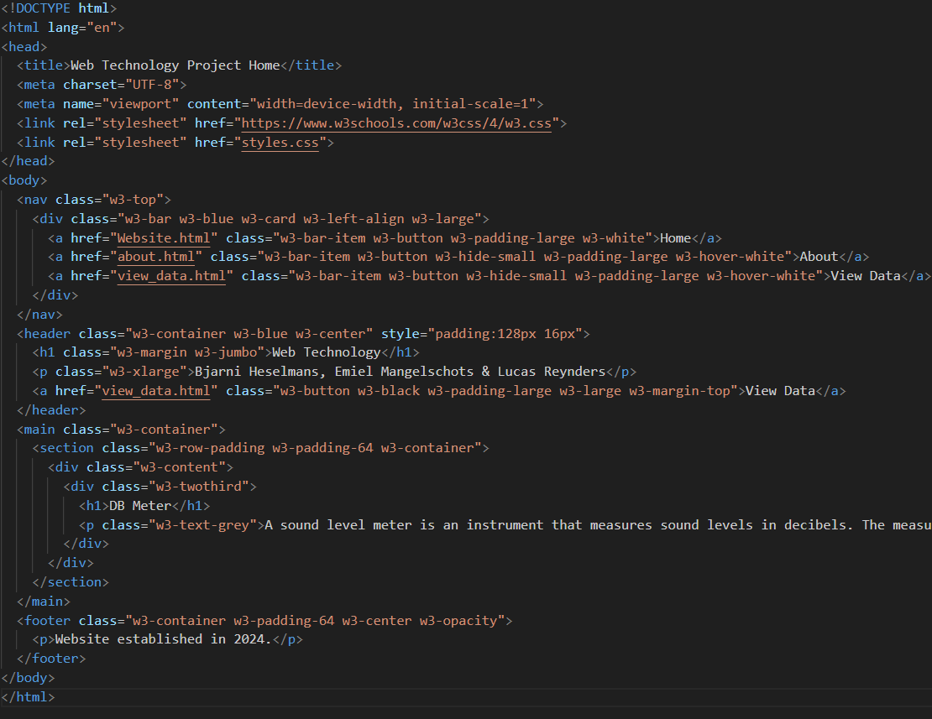
Website Layout :

Slide 5
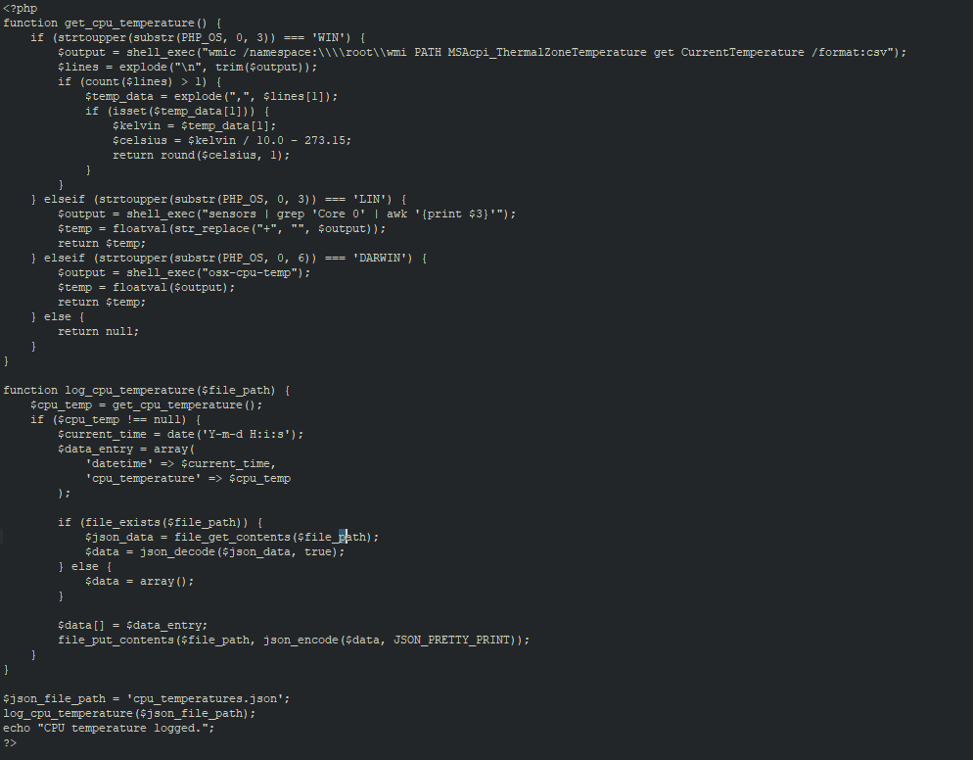
PHP for CPU Temperature :

Slide 6
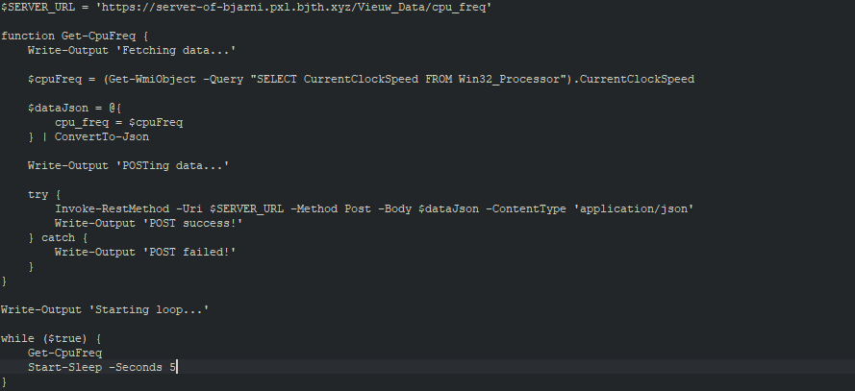
Server Setup :

Slide 7
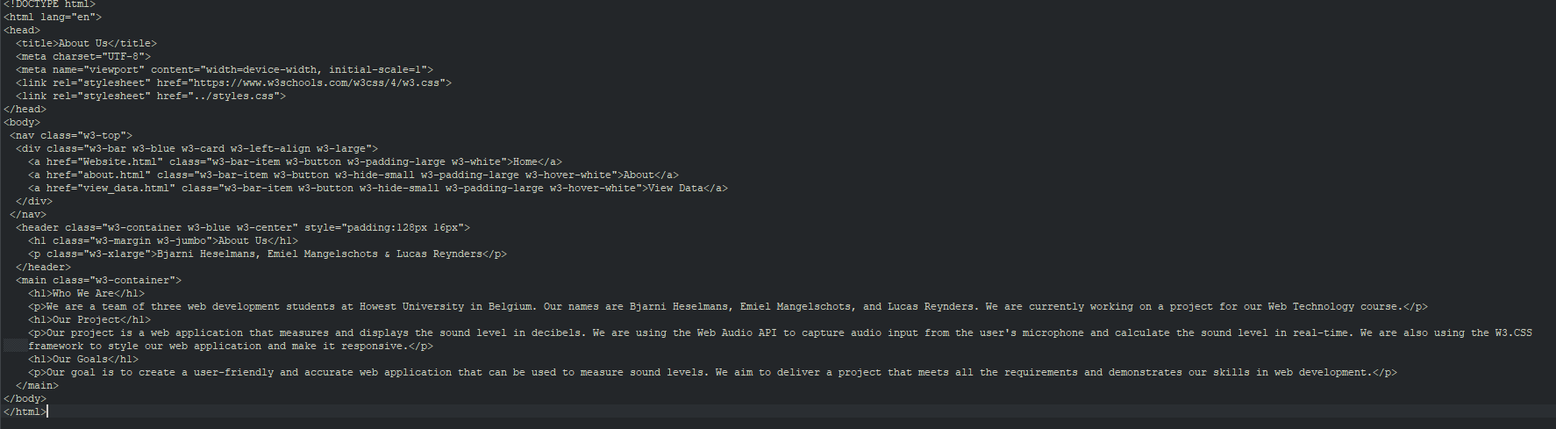
About Page :

Slide 8
END

