Slide 1
PROJECT NAME:ADMIN DEVICE
Need Of Invention:
Currently in India there are approximately 2 to 2.5 million rural schools operated
for the education of the children's.
The recording of the students data manually is a tedious task.
So the handheld gadget is identified.

Slide 2
Solution:
The handheld electronics gadget comprising auto storage of records.
Easy to use as a data logger .
Can collect number of records like attendance, performance, examination records and other operational data.
Affordable for user.
System Usage is protected by User Passwords.

Slide 3
Technology Used:
Microcontroller used here is 51Core (AT89c51/52).
Peripheral devices are RTC, RS-232 , LCD, KEYPAD, EEPROM.
USB driver and GPS system are to be include.
AVR controller is the parallel technology.
Adequate memory ROM used for storing the records.

Slide 4
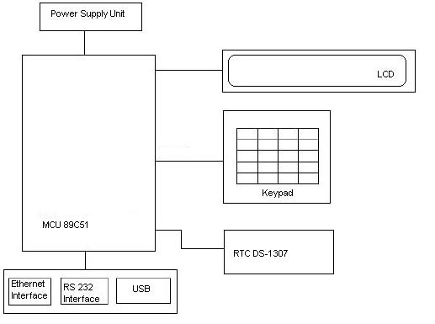
Block Diagram:
Admin Block Diagram:

Slide 5
Why not existing platforms?
Not all the schools are equipped with PCs.
Consuming a PC for this purpose is not practical .
Not all the mobile phones used in India can be uploaded with custom software's.
Not all the mobile phones have same OS, which indicates that the custom application will have to be developed for each type of the OS.

Slide 6
Features of technology used:
Connectivity by means of USB, RS232 and Ethernet ports, for computer interfacing.
Adequate Flash memory on-board. Right now, we intend it to be 512 MB – this will store records for 100 students for one year.
In-System Programmable 8-bit MCU. System can be upgraded on Internet through various communication means (such as Ethernet, Wireless Cards etc.)
Capable of working on AC 230V input, as well as 9V, 1A batteries.

