Slide 1
Project Title: Ultrasonic Animal Repellant
Need of Invention:
Scenario -
The Vigyan ashram has Farm tank in its premises.
Contamination of water and threat to animal life, both persist at
a time, if animals around fall inside the tank and can’t come
out.
The plastic sheets being used in such tanks are very costly
one.
Aim -
To keep the Animals like dog, fox away from the tank hence to
avoid damage to their own life as well as to the tank from them.
Electronic technique identified to solve this problem, as the
such scenarios are usually unmanned.

Slide 2
Project:
The digital and analog device for generating the ultrasonic waves.
Frequency required for the dog to repel is between 30 to 40 kHz (as per research).
The frequency generated is only to run away the dogs and not physically harmful them.
Developed solution is less costly.

Slide 3
Technology used:
The MCU based controller for generating ultrasonic frequencies.
Analog circuits such as-
  1.Amplifiers
  2. transistors
  3.. transducers.

Slide 4
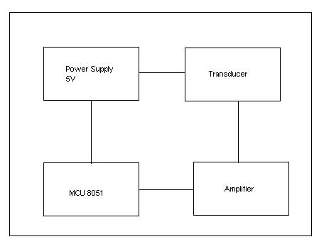
Block Diagram:
System Blocks

Slide 5
Why not existing techniques?
The existing techniques like Electronic paste are costly.
The system developed is simple and affordable.

Slide 6
Stuck at-
Unable to generate the required frequency (30 to 40 kHz).
Hardware and software is ready.

Slide 7
Thank You.

