Slide 2
EARTH’S GRAVITY FIELD
Part A and B

Slide 3
EARTH’S GRAVITY FIELD
This assignment is concerned with the gravity field of the Earth and modelling of geophysical structures. It addresses chapters 3 and 4 in the 3rd edition of “Fundamentals of Geophysics” (corresponding to chapter 2 in the 2nd edition) and is structured into two parts:
Loading, Manipulating and Gridding of Spatially Distributed Data
Loading, Manipulating and Gridding of Spatially Distributed Data
File name | File type
Add_costline.m | MATLAB script
db.dat | ASCII data file
Denmark.mat | Coast line file
Gauss2Dconv_v1.py | Python function

Slide 4
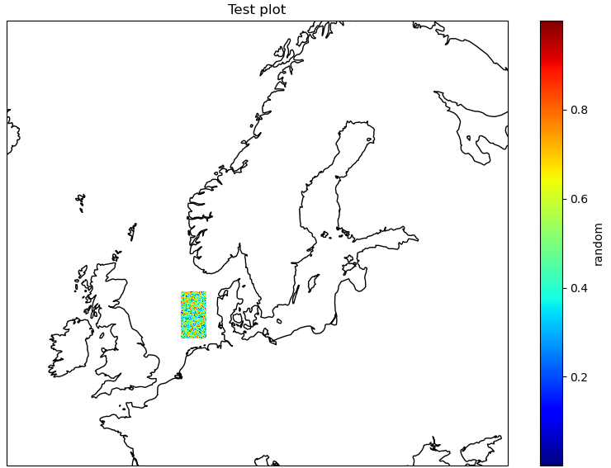
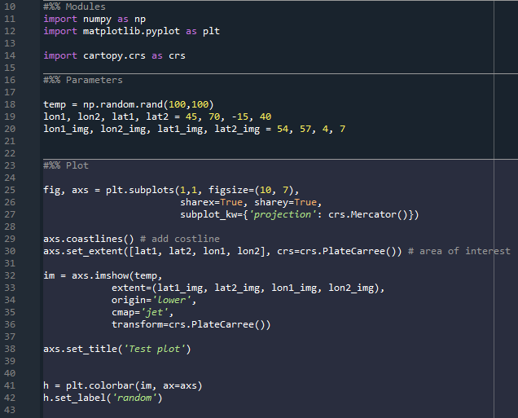
Python modules
Cartopy and scipy

Slide 5
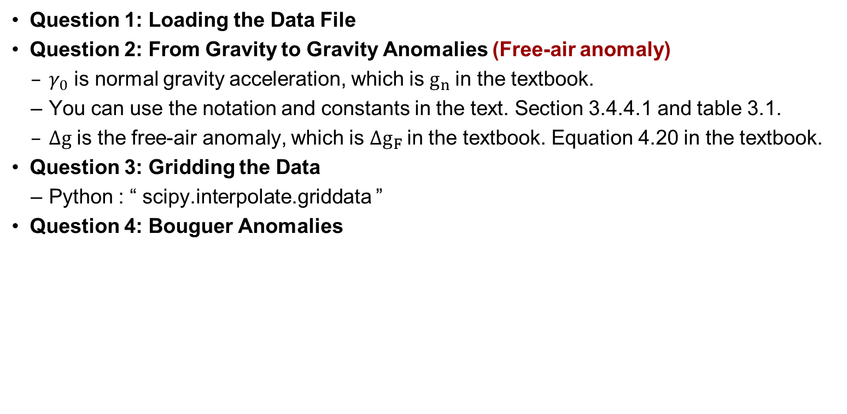
Part A:
Loading, Manipulating and Gridding of Spatially Distributed Data
Question 1: Loading the Data File
Question 2: From Gravity to Gravity Anomalies (Free-air anomaly)
  $γ_{0}$ is normal gravity acceleration, which is $g_{n}$in the textbook.
  You can use the notation and constants in the text. Section 3.4.4.1 and table 3.1.
  $Δg$ is the free-air anomaly, which is $Δg_{F}$in the textbook. Equation 4.20 in the textbook.
Question 3: Gridding the Data
  Python : “ scipy.interpolate.griddata ”
Question 4: Bouguer Anomalies

Slide 6
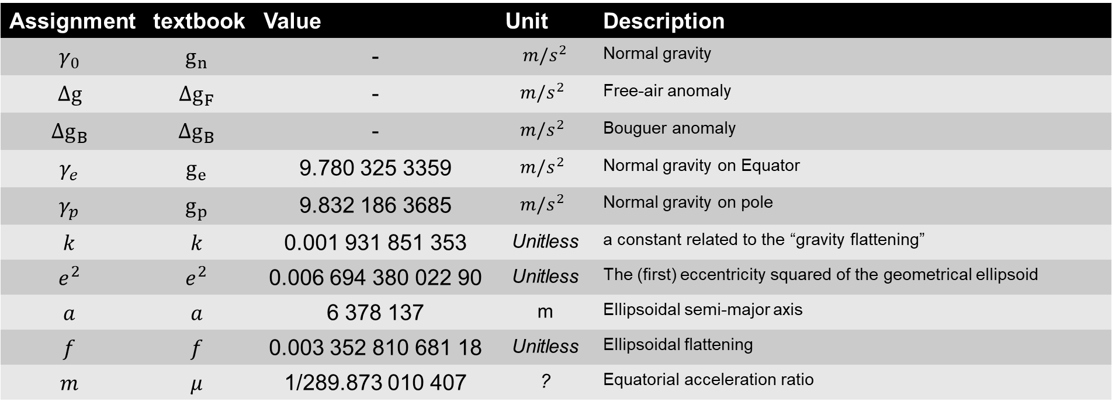
Part A:
Parameters
Assignment | textbook | Value | Unit | Description
$$γ_{0}$$ | $$g_{n}$$ | - | $$m/s^{2}$$ | Normal gravity
$$Δg$$ | $$Δg_{F}$$ | - | $$m/s^{2}$$ | Free-air anomaly
$$Δg_{B}$$ | $$Δg_{B}$$ | - | $$m/s^{2}$$ | Bouguer anomaly
$$γ_{e}$$ | $$g_{e}$$ | 9.780 325 3359 | $$m/s^{2}$$ | Normal gravity on Equator
$$γ_{p}$$ | $$g_{p}$$ | 9.832 186 3685 | $$m/s^{2}$$ | Normal gravity on pole
$$k$$ | $$k$$ | 0.001 931 851 353 | Unitless | a constant related to the “gravity flattening”
$$e^{2}$$ | $$e^{2}$$ | 0.006 694 380 022 90 | Unitless | The (first) eccentricity squared of the geometrical ellipsoid
$$a$$ | $$a$$ | 6 378 137 | m | Ellipsoidal semi-major axis
$$f$$ | $$f$$ | 0.003 352 810 681 18 | Unitless | Ellipsoidal flattening
$$m$$ | $$μ$$ | 1/289.873 010 407 | ? | Equatorial acceleration ratio

