Slide 2
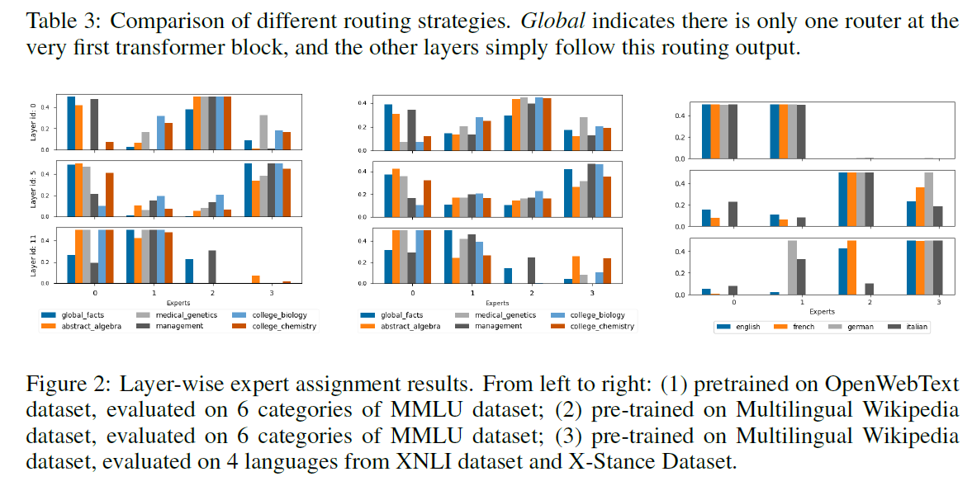
Fan et al

Slide 3

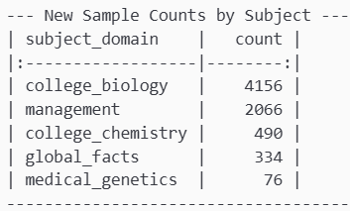
Data we need
Global facts: weak (possibly combine?)
Medical genetics (very weak, genetics and medicine?)
College biology – strong
Abstarct algebra – non exsisting (external?)
Management – Decent
College chemistry- weak (other chem?)

Slide 4
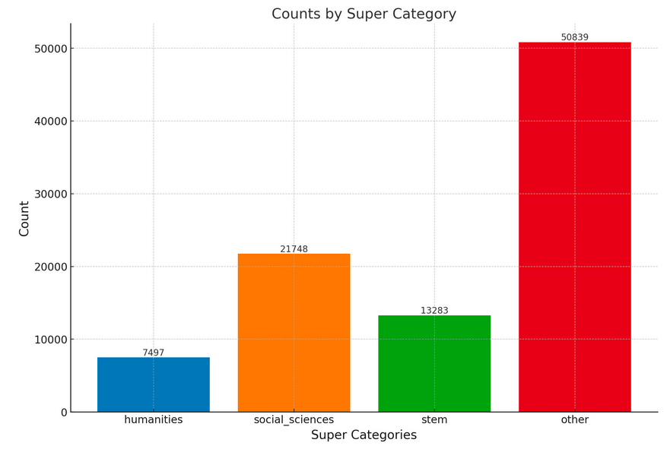
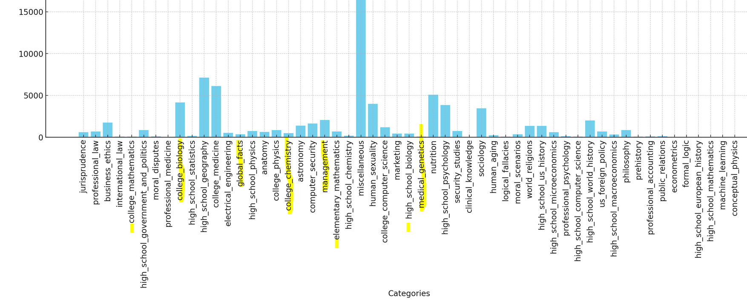
Aux distribution
https://huggingface.co/datasets/kz919/mmlu-auxiliary-train-auto-labelled/blob/main/per_category_distribution.png

Slide 5
From Aux loader.ipynb

Slide 6
Math dataset
https://huggingface.co/datasets/meta-math/MetaMathQA

Slide 7
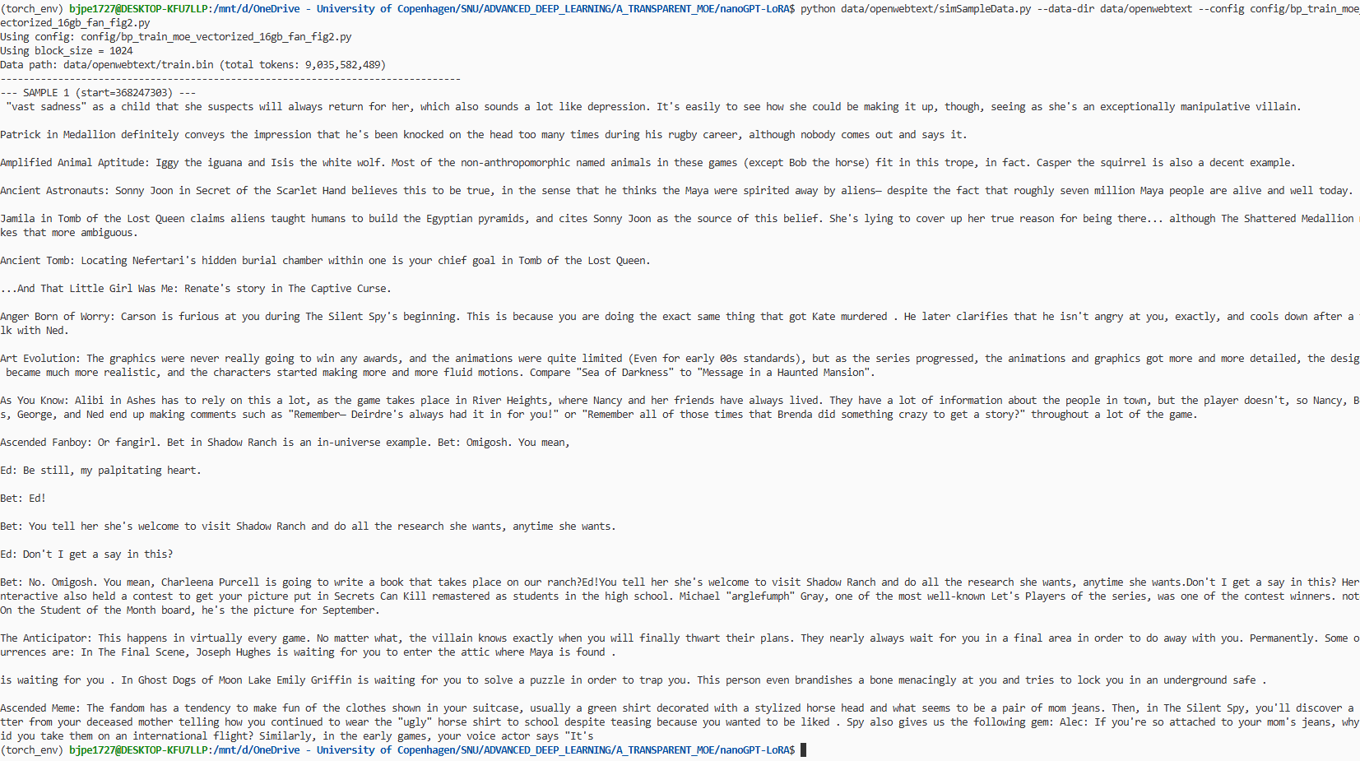
Sampling from OpenWebText

Slide 8
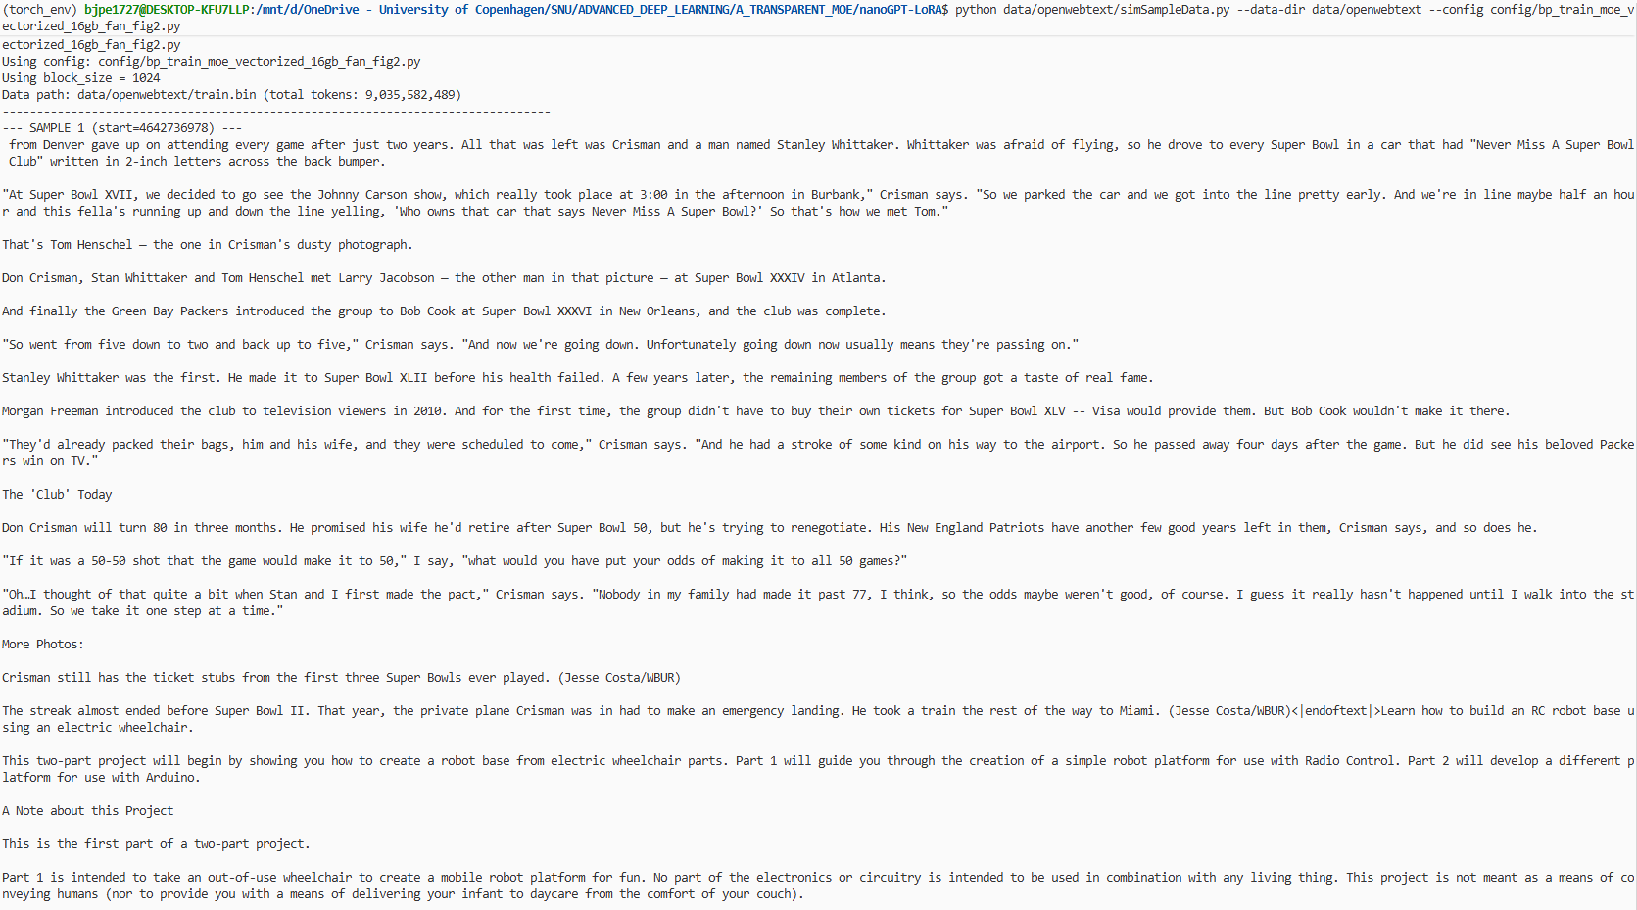

Slide 9
Sampling from MMLU auxiliary train
Math/STEM: https://huggingface.co/datasets/open-web-math/open-web-math , https://huggingface.co/datasets/HuggingFaceTB/finemath
Legal: https://huggingface.co/datasets/pile-of-law/pile-of-law?utm_source=chatgpt.com
Litterature: https://huggingface.co/datasets/ACOSharma/literature/viewer/default/train?row=0 , https://huggingface.co/datasets/TheBritishLibrary/blbooks?utm_source=chatgpt.com
Medical: https://huggingface.co/datasets/armanc/pubmed-rct20k?utm_source=chatgpt.com , https://huggingface.co/datasets/MedRAG/pubmed?utm_source=chatgpt.com

