Slide 1
Recreating weak specialisation

Slide 2
Repo
https://github.com/danielgrittner/nanoGPT-LoRA
experiments based on the publicly available LoRA extension (Grittner, 2023) of the
nanoGPT library (Karpathy, 2023) on a single A100-SXM4-40GB GPU

Slide 3
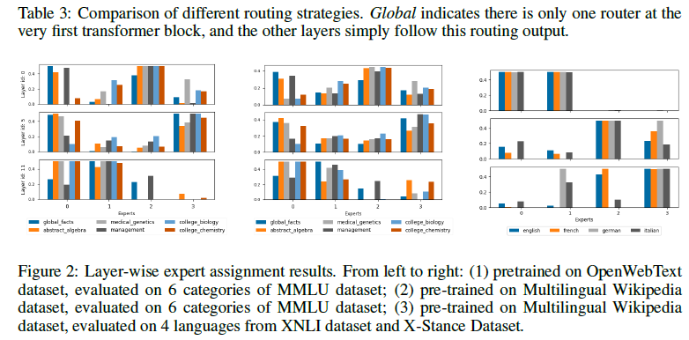

Slide 4
Base model | nanoGPT with LoRA extention
Dropout | 0.2
Learning rate | 9.6e-4 (min 9.6e-5)
Weight decay | 0.5
Enbaled biases | For 6k itterations
Token passed through /itteration | 1048576
Gradient accumulation | 128
Batch size | 8
Sequence lenght | 1024
Total tokens see by model | 6B
N experts | 4
Tokens / parameter | 20 (chincilla)
Optional load balancing loss (experts) | Weight lambda=0.01
Tokenizer | Openai gpt-2

Slide 5
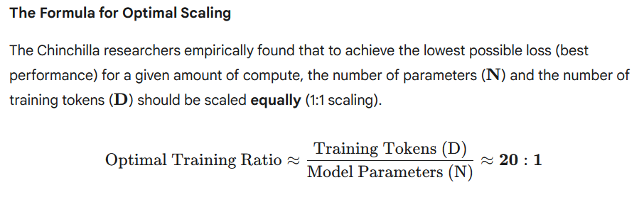
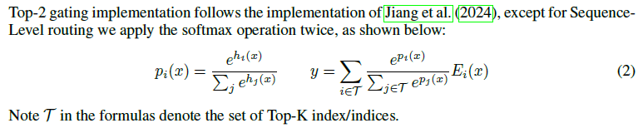
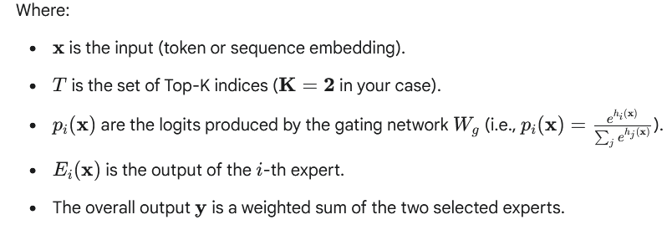

Slide 6
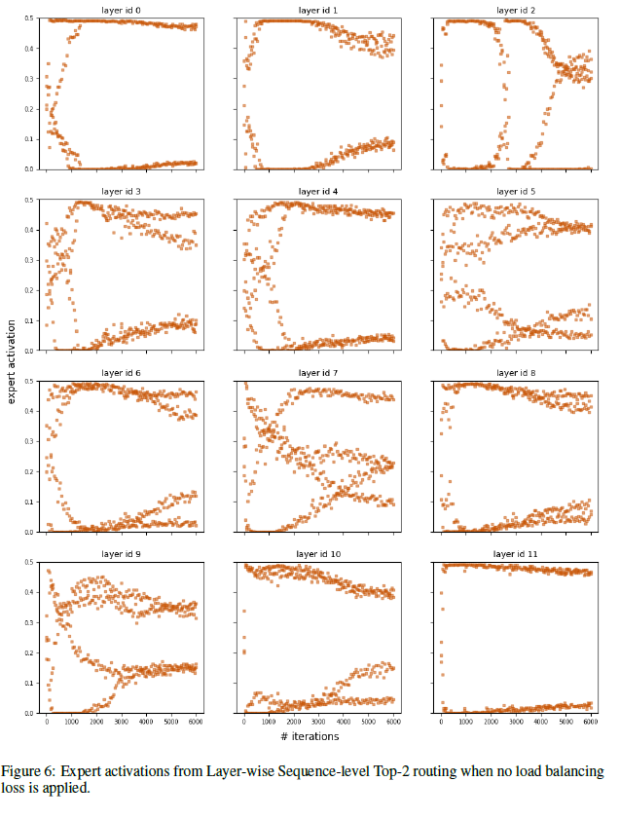
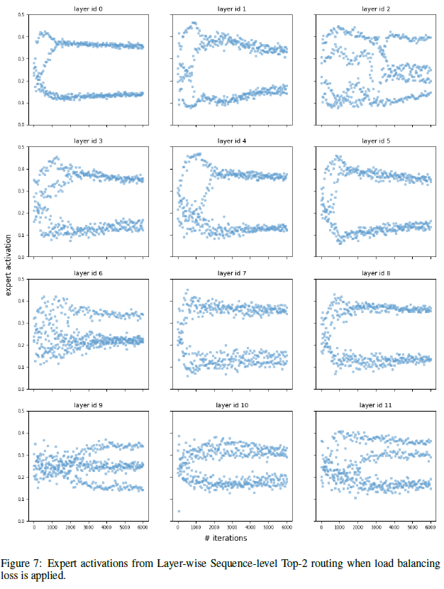
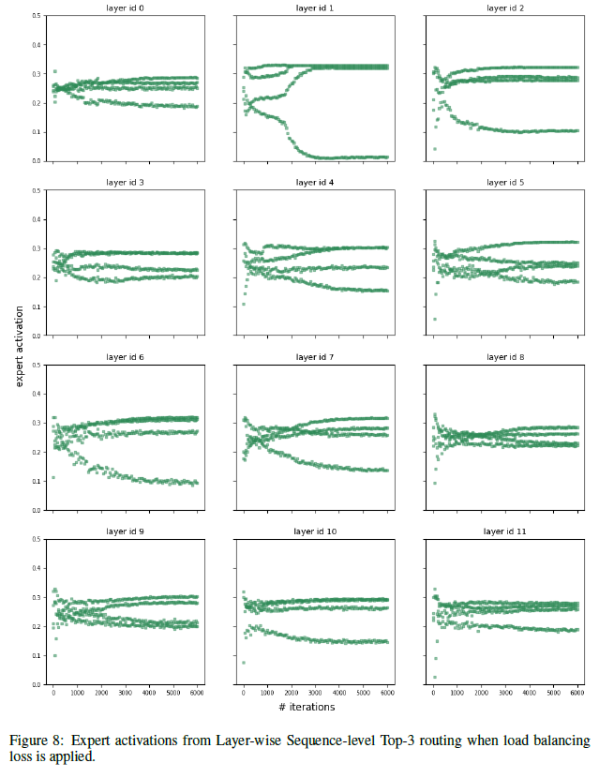
so for teh language modelling tasks, it looks like it uses on rolling average each expert some given % of the time? Suggesting possible specialisation when not 25% because it is unlikely that each specialisation would be exactly equally needed for this lanauge task

Slide 7
