Slide 2
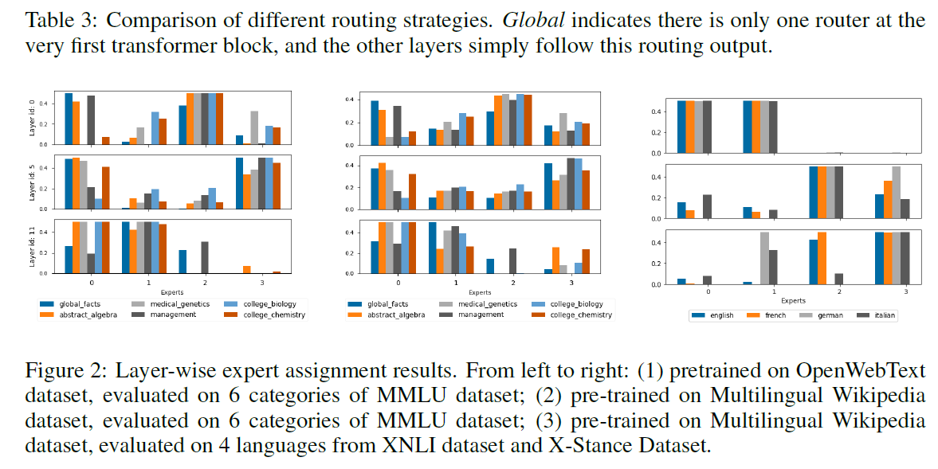
Fan et al

Slide 3

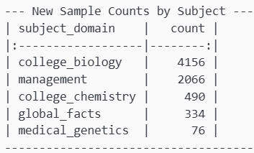
Data we need
Global facts: weak (possibly combine?)
Medical genetics (very weak, genetics and medicine?)
College biology – strong
Abstarct algebra – non exsisting (external?)
Management – Decent
College chemistry- weak (other chem?)

Slide 4
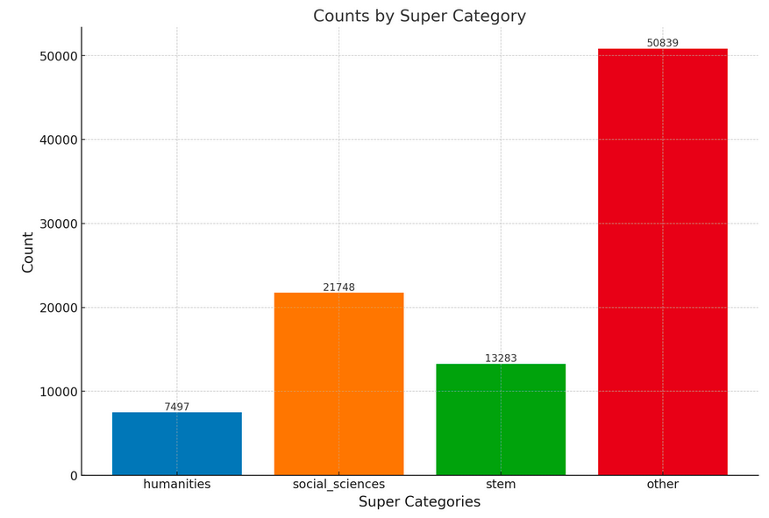
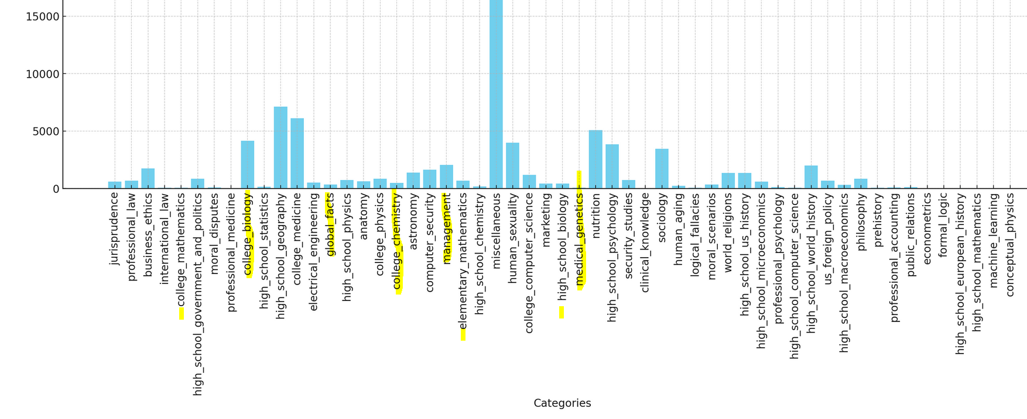
Aux distribution
https://huggingface.co/datasets/kz919/mmlu-auxiliary-train-auto-labelled/blob/main/per_category_distribution.png

Slide 5
From Aux loader.ipynb

Slide 6
Math dataset
https://huggingface.co/datasets/meta-math/MetaMathQA

