Slide 1
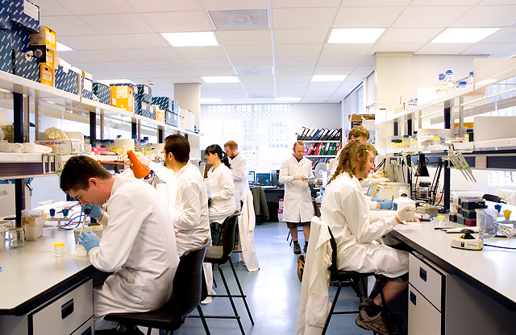
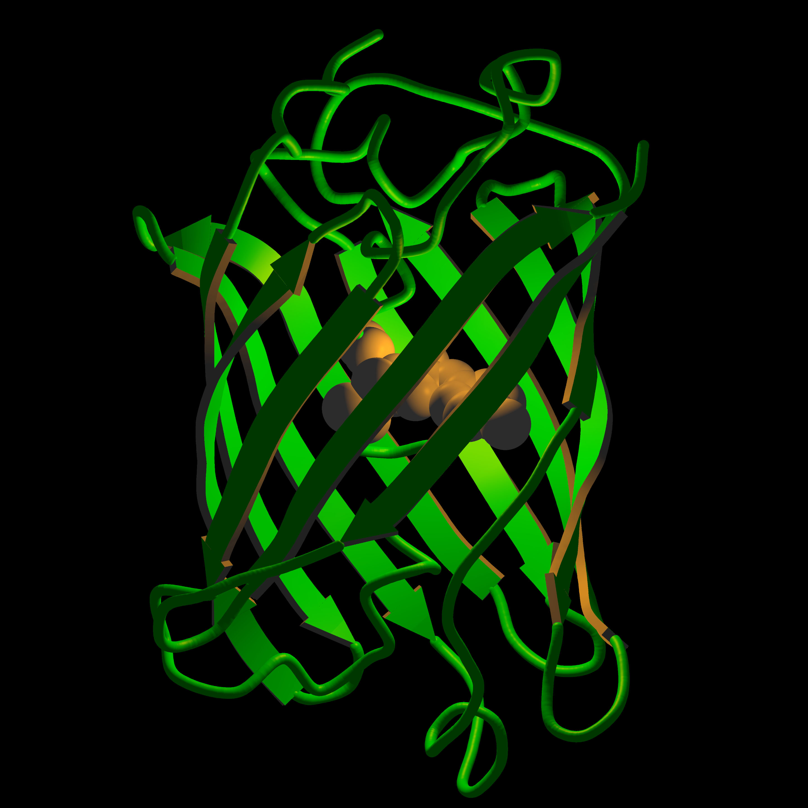
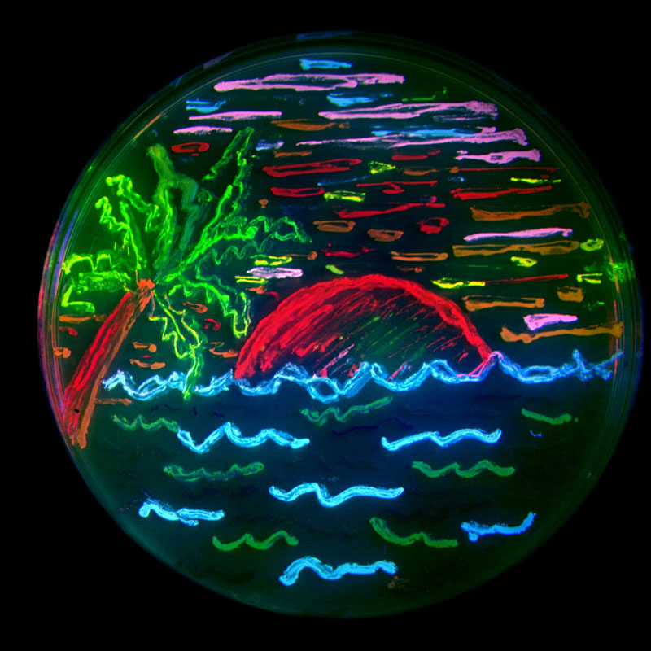
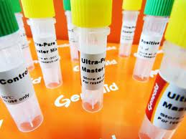
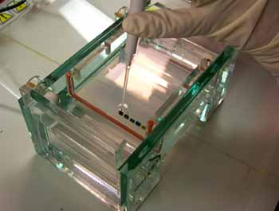
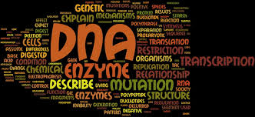
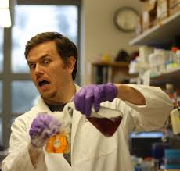
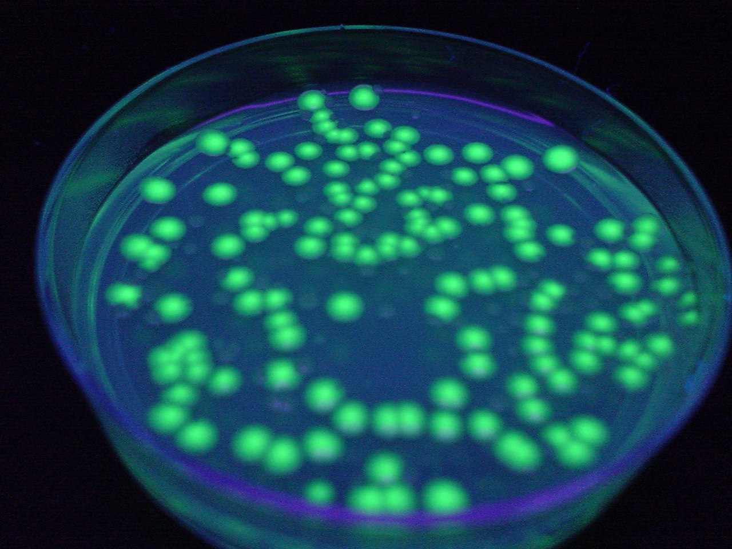
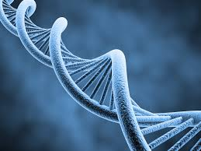
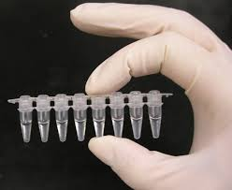
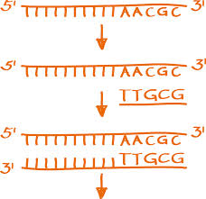
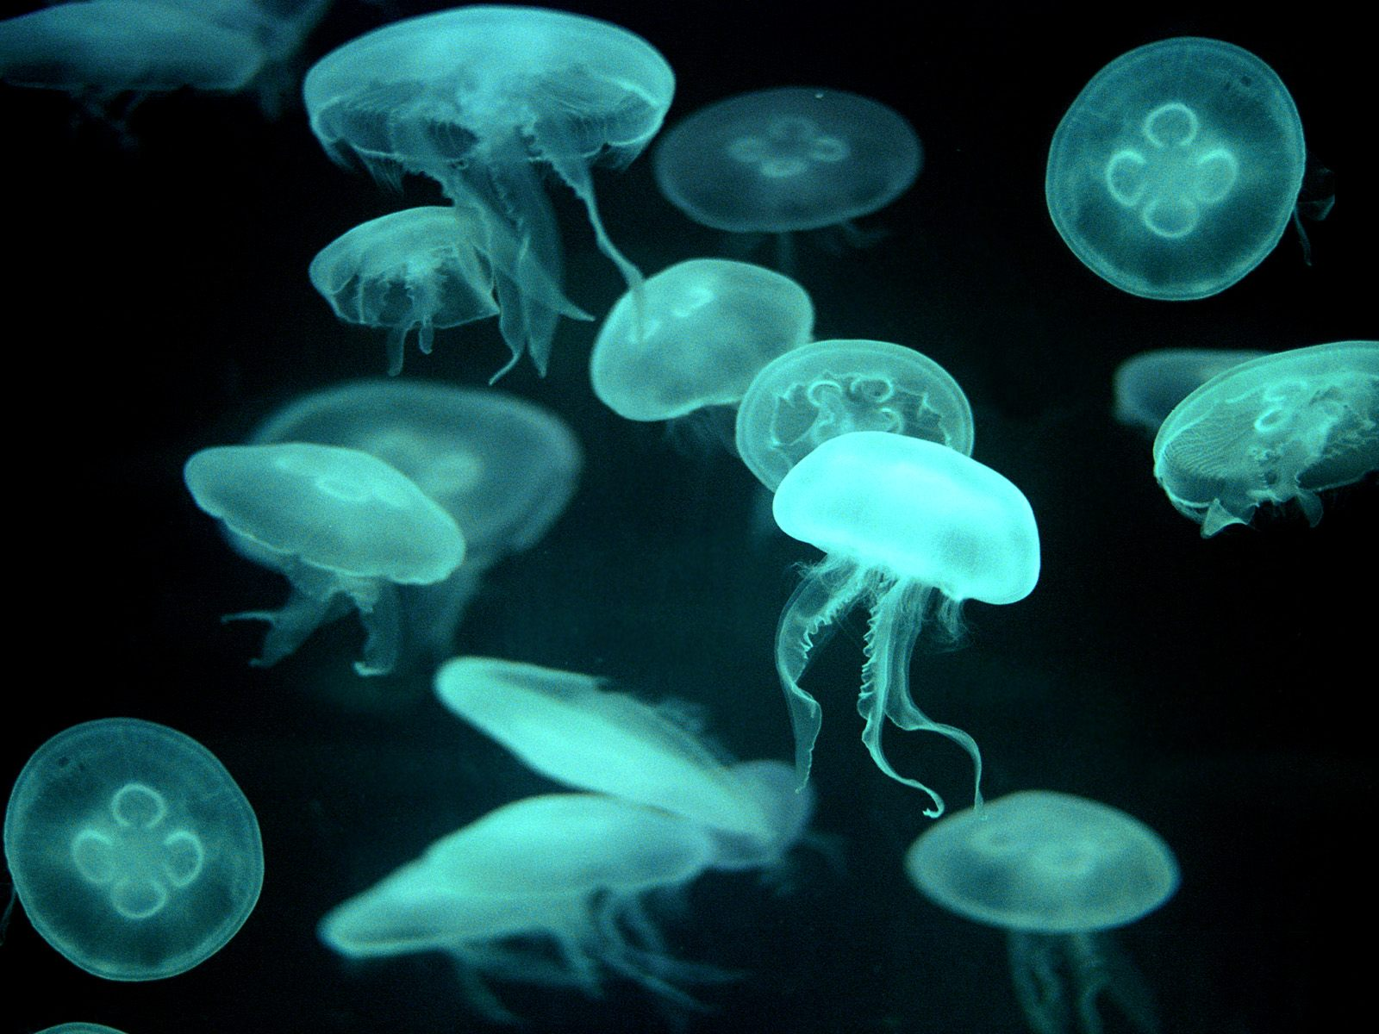
Genética Molecular & Bioinformática 2704N9

Slide 2
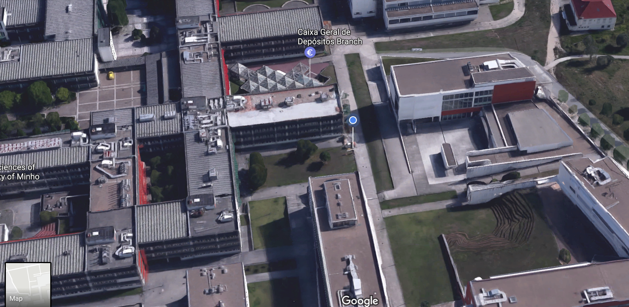
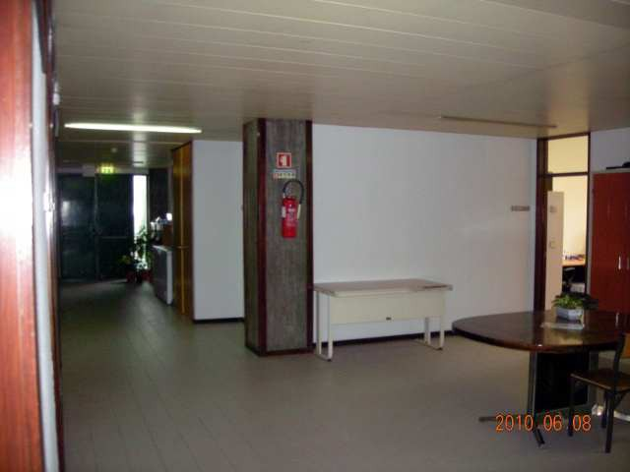
Docente
Björn Johansson
Departamento de Biologia
Ext. 60 1517
Gab. 2017
Mob. 967 147 704
Hor. atend.: Sexta-feira 16:00 – 17:00
bjorn_johansson@bio.uminho.pt

Slide 3
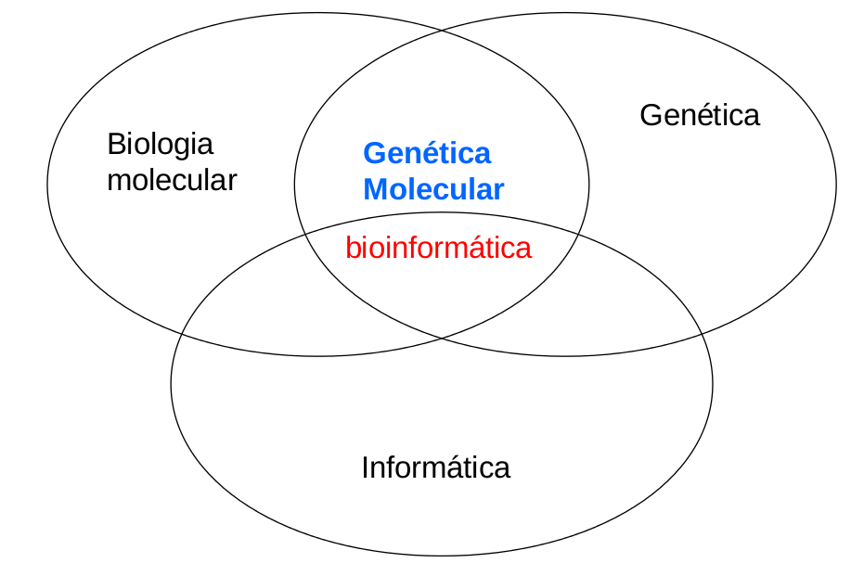
Molecular genetics is the interface between molecular biology, genetics

Slide 4
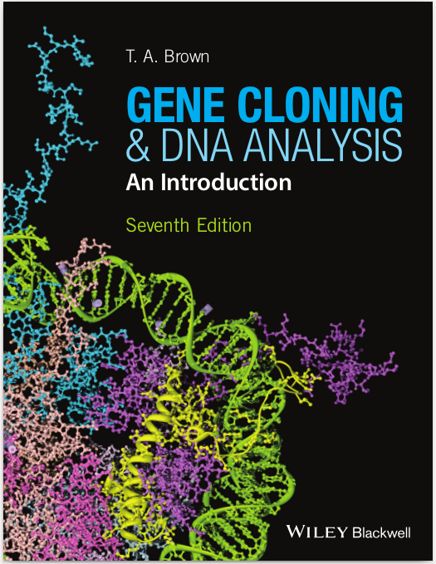
Course literature
16 chapters, ~300 pages
All chapters except 12, 14, 16
1 Why Gene Cloning and DNA Analysis are Important
2 Vectors for Gene Cloning: Plasmids and Bacteriophages
3 Purification of DNA from Living Cells
4 Manipulation of Purified DNA
5 Introduction of DNA into Living Cells
6 Cloning Vectors for E. coli
7 Cloning Vectors for Eukaryotes
8 How to Obtain a Clone of a Specific Gene
9 The Polymerase Chain Reaction
10 Sequencing Genes and Genomes
11 Studying Gene Expression and Function
12 Studying Genomes (excluded)
13 Production of Protein from Cloned Genes
14 Gene Cloning and DNA Analysis in Medicine (excluded)
15 Gene Cloning and DNA Analysis in Agriculture
16 Gene Cloning and DNA Analysis in Forensic Science
and Archaeology (excluded)
http://www.blackwellpublishing.com/genecloning/

Slide 5
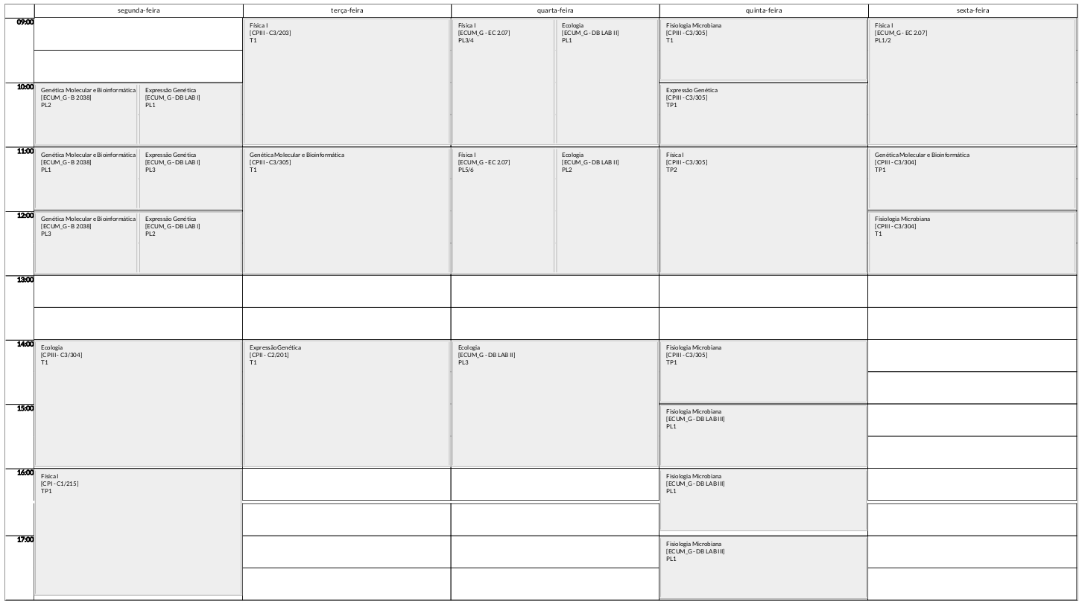
Schedule

Slide 6
Bioinformatics
In silico sub-cloning
Sequence retrieval from databases
Simple sequence analysis and comparison
Search for sequences in databases

Slide 7
Critérios de Avaliação
Nota final :
60% Teste Genetica Molecular
20% Teste Bioinformática
20% Relatorio
Presenca nás TPs >= 2/3
Uma falta permitido nás práticas

Slide 8

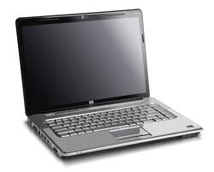

Computers
Mac / PC ?

