Slide 1
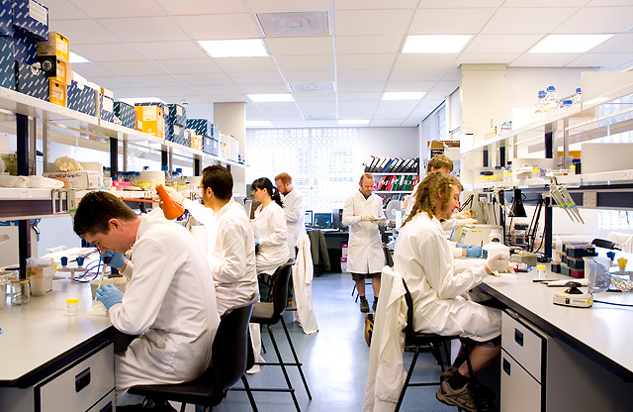
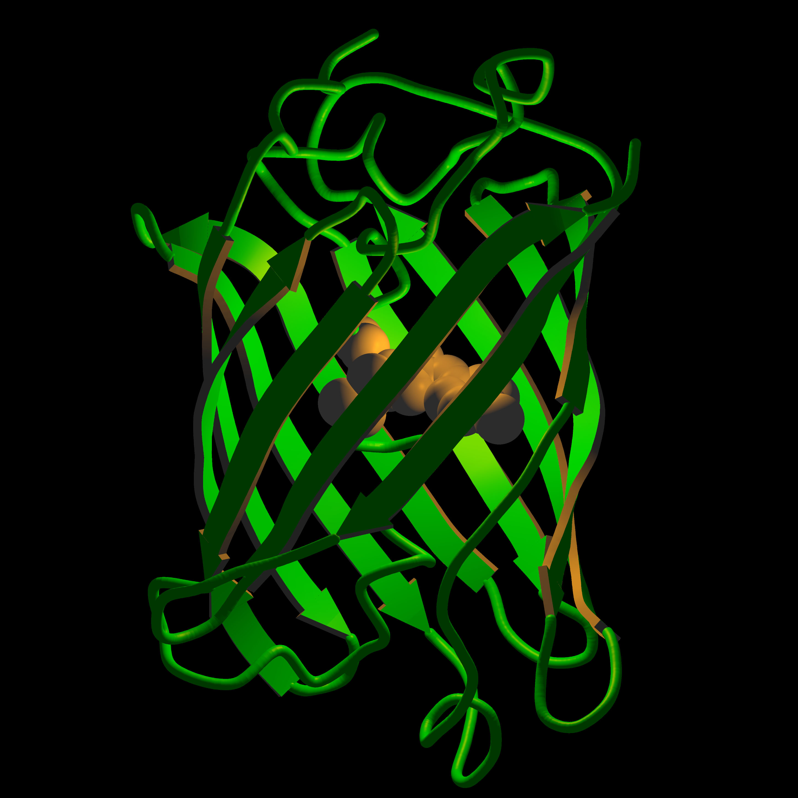
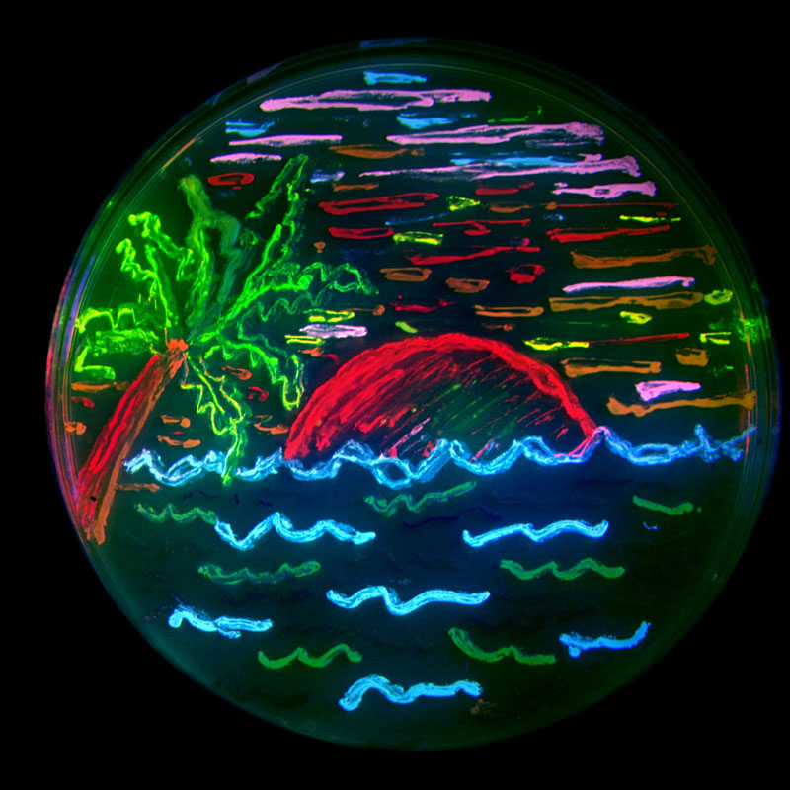
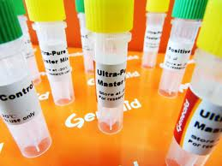
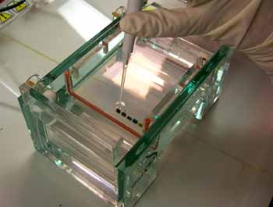
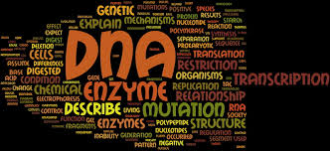
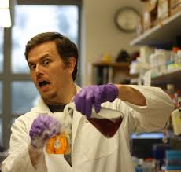
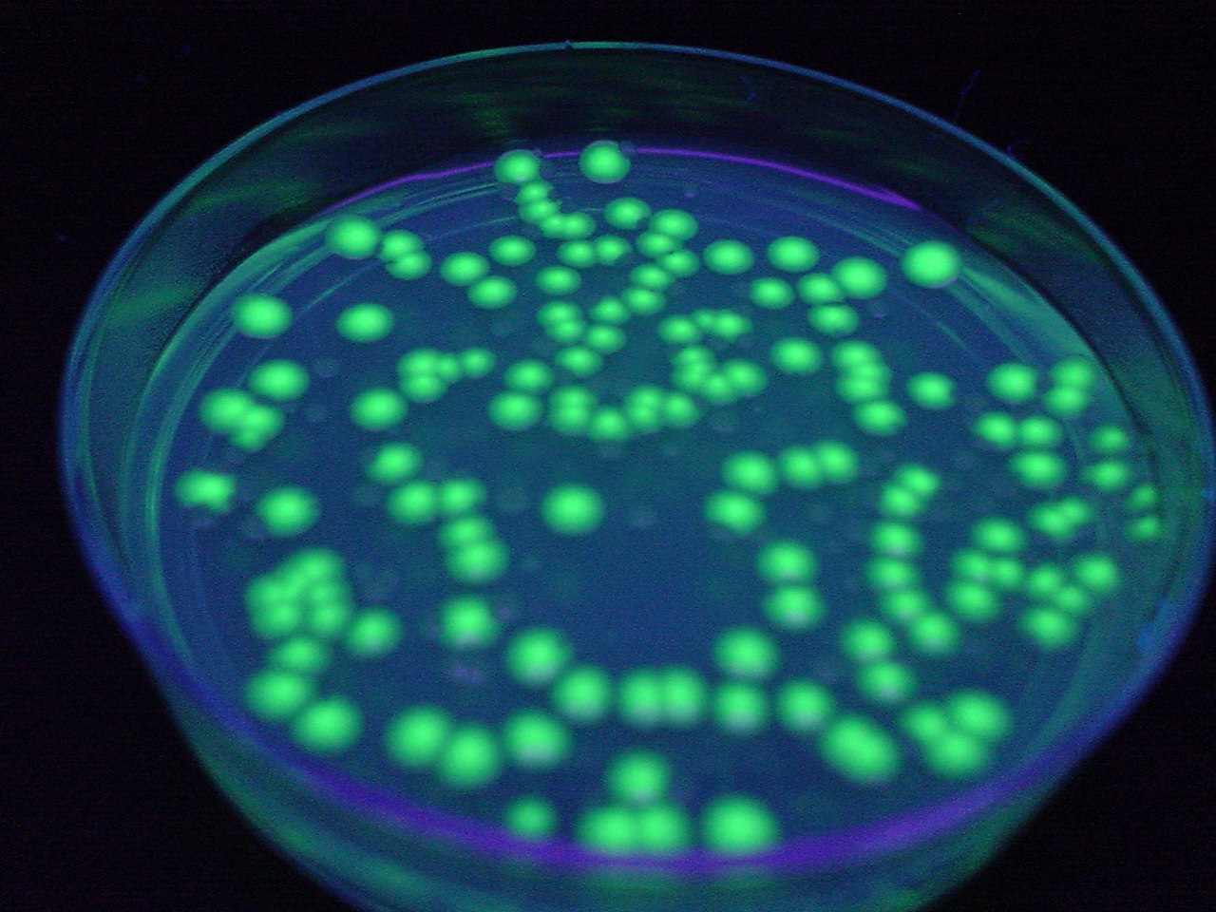
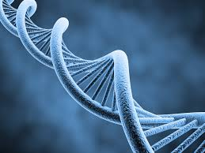
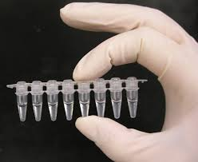
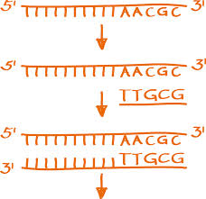
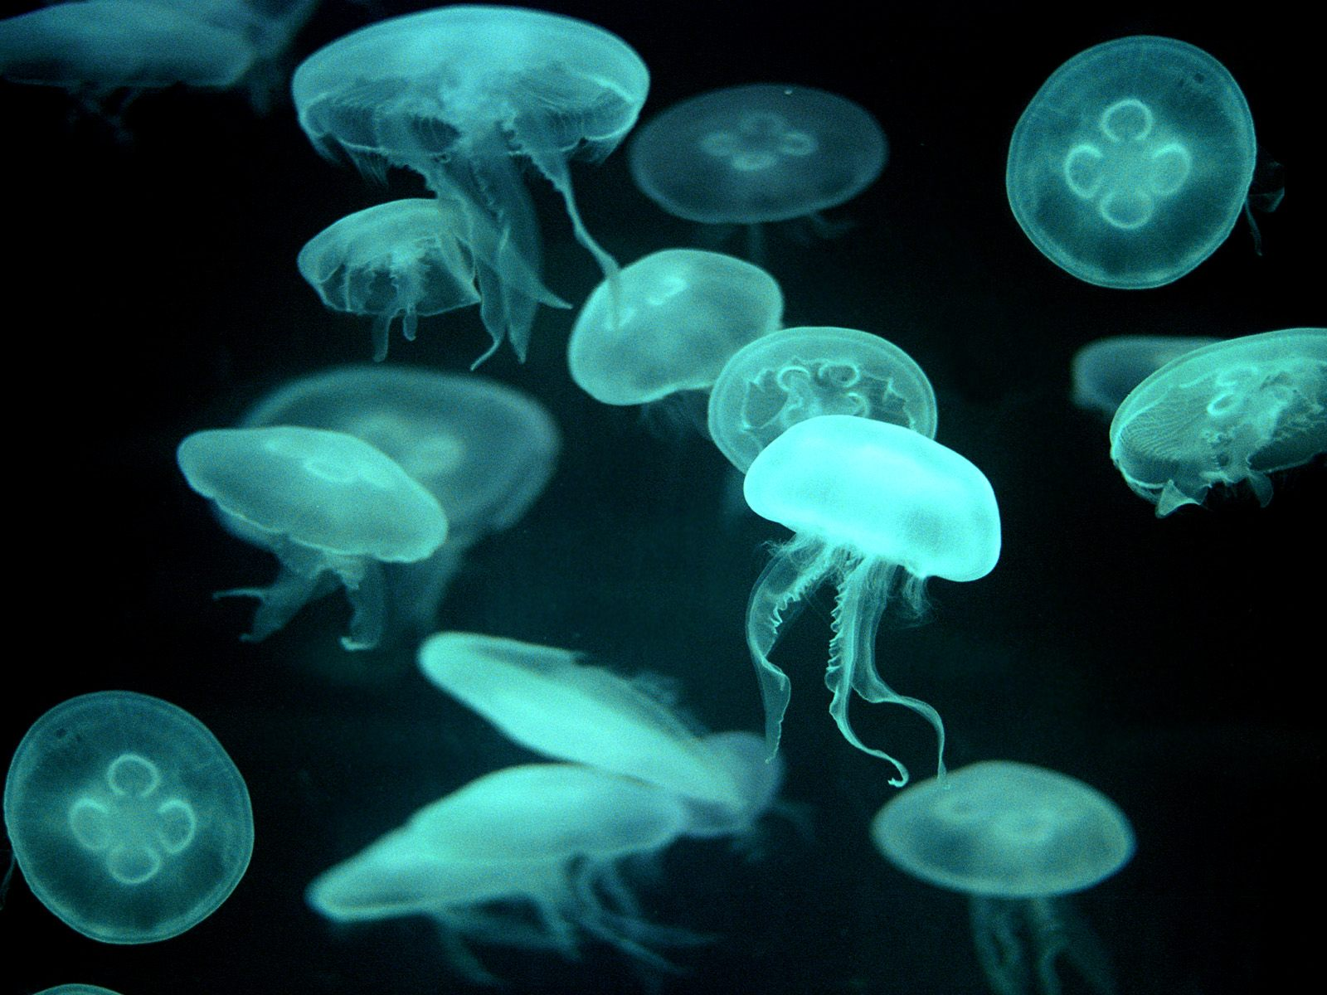
Biology 101

Slide 2
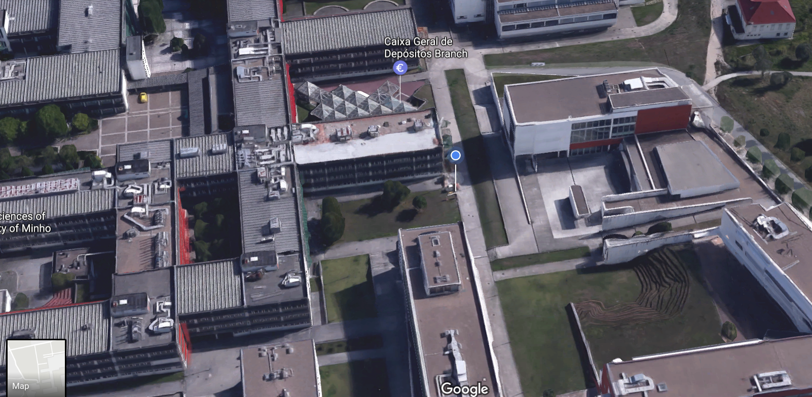
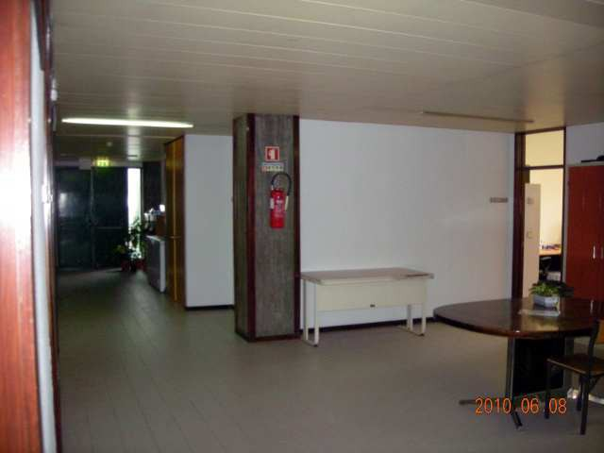
Your teacher
Björn Johansson
Departamento de Biologia
bjorn_johansson@bio.uminho.pt

Slide 3
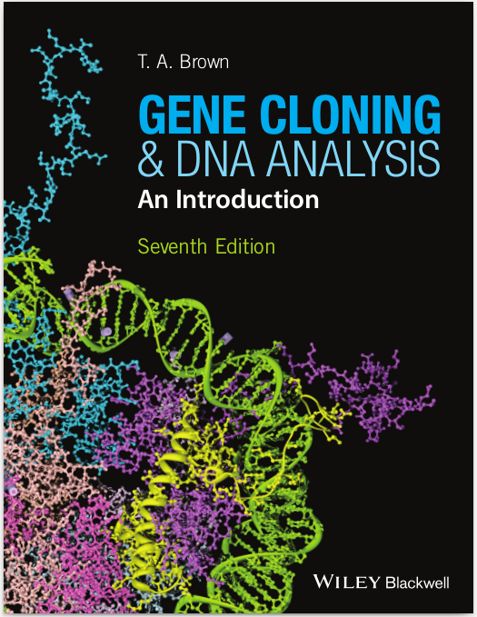
Course literature
16 chapters, ~300 pages
All chapters except 12, 14, 16
1 Why Gene Cloning and DNA Analysis are Important
2 Vectors for Gene Cloning: Plasmids and Bacteriophages
3 Purification of DNA from Living Cells
4 Manipulation of Purified DNA
5 Introduction of DNA into Living Cells
6 Cloning Vectors for E. coli
7 Cloning Vectors for Eukaryotes
8 How to Obtain a Clone of a Specific Gene
9 The Polymerase Chain Reaction
10 Sequencing Genes and Genomes
11 Studying Gene Expression and Function
12 Studying Genomes (excluded)
13 Production of Protein from Cloned Genes
14 Gene Cloning and DNA Analysis in Medicine (excluded)
15 Gene Cloning and DNA Analysis in Agriculture
16 Gene Cloning and DNA Analysis in Forensic Science
and Archaeology (excluded)
http://www.blackwellpublishing.com/genecloning/

Slide 4
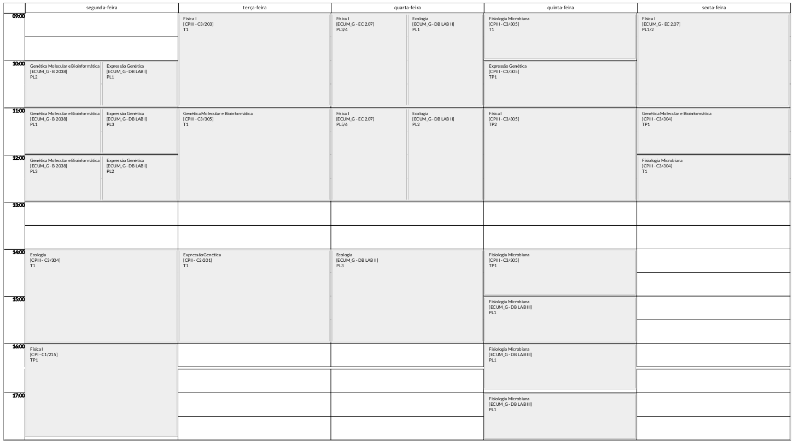
Schedule

Slide 5

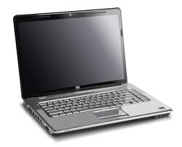

Computers
Mac / PC ?

