Slide 1
Introduction to Python: Day two
Stephanie Spielman
UT CCBB Big data in biology summer school, 2015

Slide 2
another data type: dictionaries
Dictionaries are defined with braces: {}
Contain key:value pairs
Known in other contexts as "associative arrays"
# Define a dictionary of names
names = {"Stephanie": "Spielman", "Eleisha": "Jackson", "Claus": "Wilke"}
# Each key:value pair is a single item
print len(names)
3
# Index dictionaries via *keys* (not position!!)
print names["Eleisha"]
"Jackson"

Slide 3
another data type: dictionaries
names = {"Stephanie": "Spielman", "Eleisha": "Jackson", "Claus": "Wilke"}
# Add a key:value pair to a dictionary and print to confirm
names["Bob"] = "Smith"
print names
{'Eleisha': 'Jackson', 'Claus': 'Wilke', 'Stephanie': 'Spielman', 'Bob': 'Smith'}
Did you expect this output?

Slide 4
dictionaries are unordered
Unique key:value pairs are *always* preserved, but their order is not
One of many reasons why we index with keys, not positions

Slide 5
dictionary Keys must be unique
Keys must be unique, but values may be repeated:
Adding an existing key will overwrite the original:
acceptable_dict = {"a": 5, "b": 3, "c": 5}
acceptable_dict["a"] = 7
print acceptable_dict
{"a": 7, "c": 5, "b": 3}

Slide 6
Common dictionary methods
# Define a dictionary
medals = {"gold": "first", "silver": "second", "bronze": "third"}
# The .keys() method returns a list of dictionary keys
print medals.keys()
['bronze', 'silver', 'gold']
# The .values() method returns a list of dictionary values
print medals.values()
['third', 'second', 'first']

Slide 7
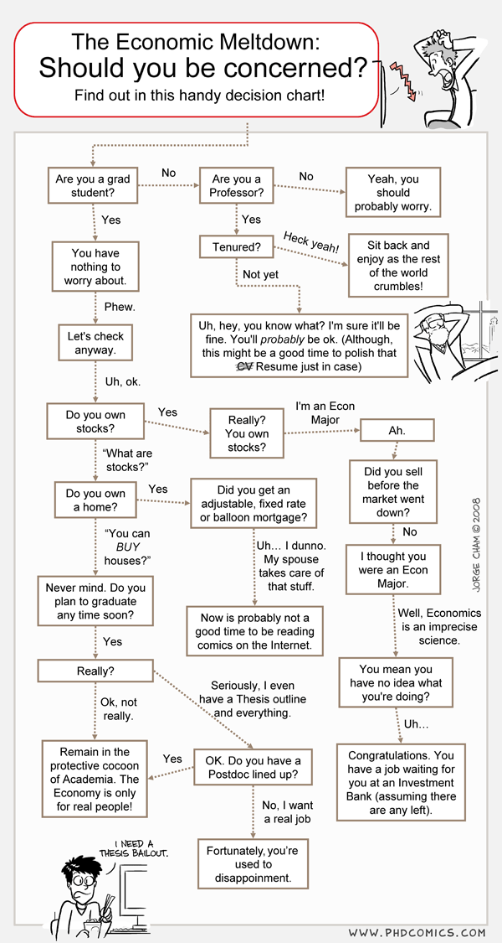
title of some kind
introduce that we have to talk to computers, and computers really only understand a few things.
we now know how to store data, but how do we do anything with the data? We use two basic constructs:
logical evaluation and iteration
Basically, computer programs are just flow charts

Slide 8
logical operators
Evaluate a condition as True or False using logical operators
Variables with True/False values are of a type called boolean
Operator | Meaning
== | Equal to*
!= | Not equal to
>, < | Greater than; less than
>=, <= | Greater than or equal to ; less than or equal to

Slide 9
performing logical operations
a = 6
b = 120
print b > a
True
print 6 == 6
True
print 7 != "this isn't even a number"
True
c = 1.2345
print -99 >= c
False

Slide 10
combining logical statements
Use the Python operators and and or to combine logical statements
and: both conditions must be True
or: only one condition must be True

Slide 11
combining logical statements
a = 6
b = 120
c = ["z", "x", "y", "w"]
print (a == 6 and b == 120)
True
print (a == 6 or b == 92)
True
print (b < 10 or a > 55)
False
print (b != 7 and len(c) <= 8)
True
print (c[1] == "x" and a == b)
False

Slide 12
program control flow with if statements

