Slide 1
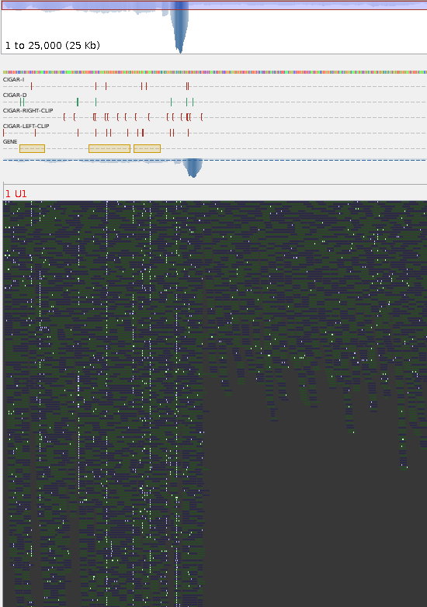


Slide 2
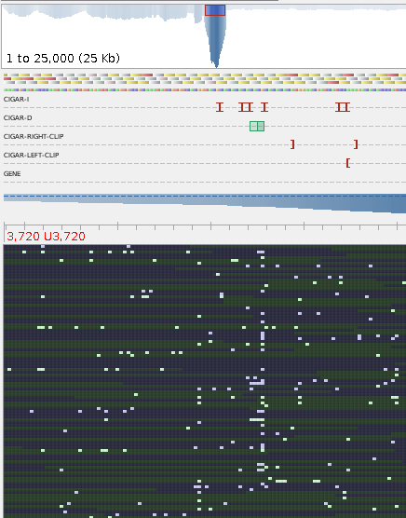

Slide 3
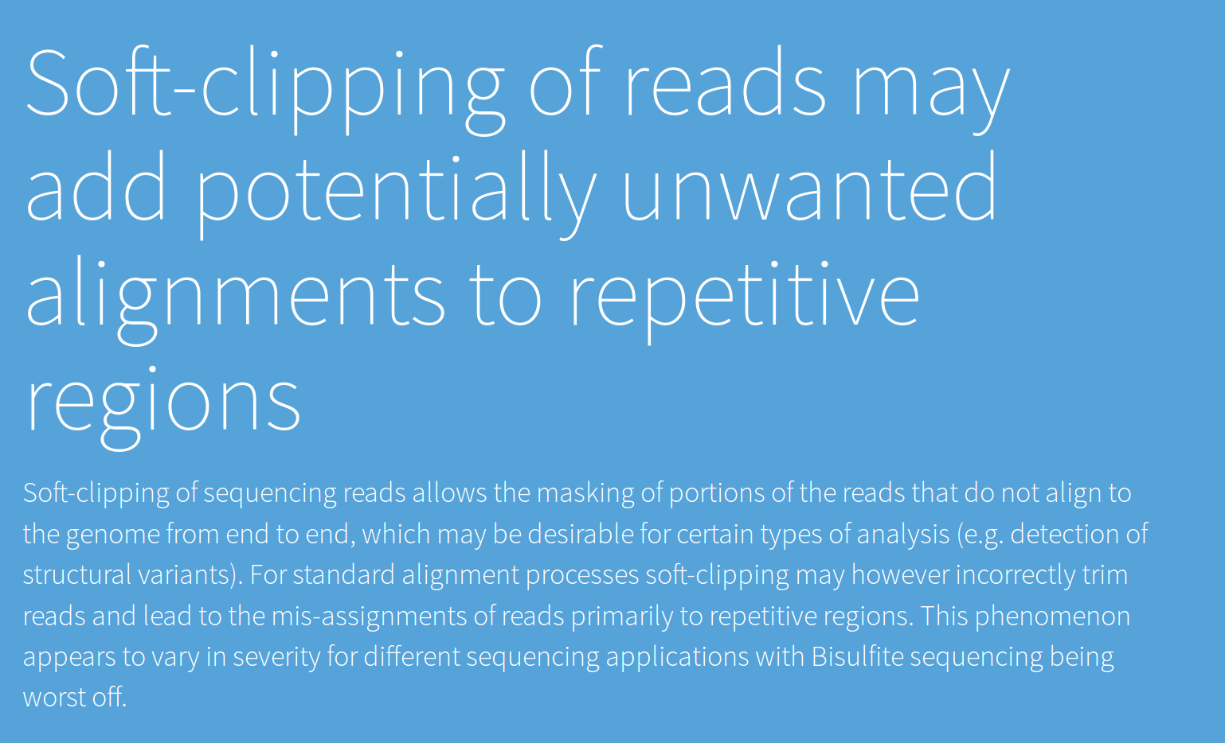

Slide 4
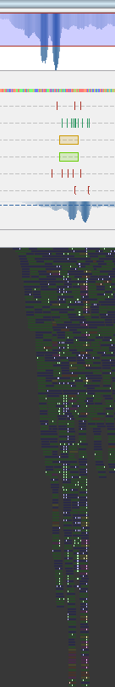
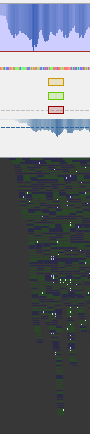
pfs1|28271
Filter reads

Slide 5
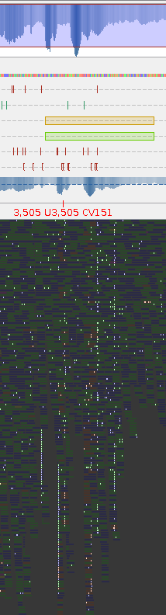
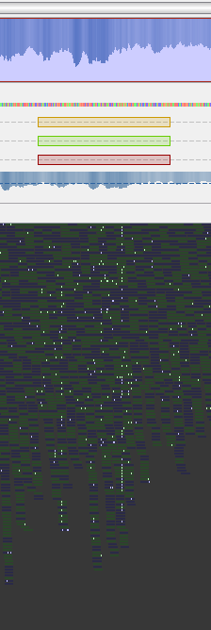
Pfs1|12406

Slide 6
Unfiltered: 439 genes >2 coverage
Filtered: 362 genes >2 coverage
What genes are still overrepresented?

Slide 7
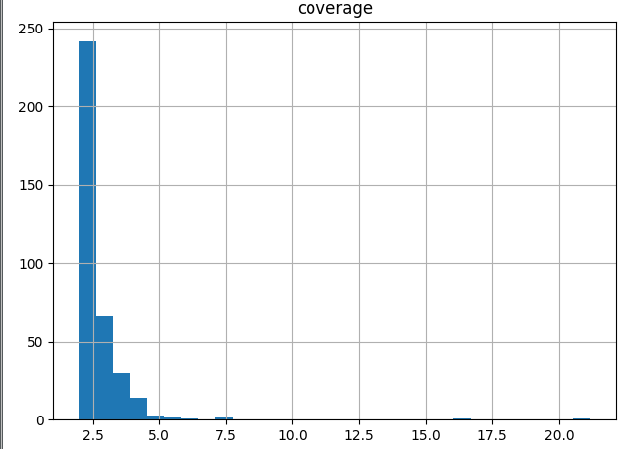
Filtered distribution
Total: 362

Slide 8
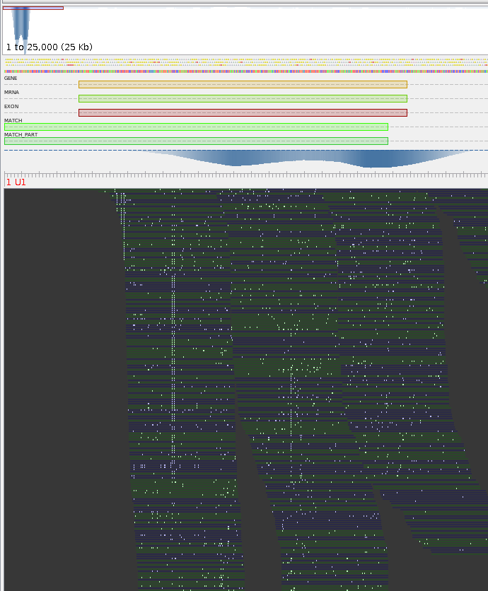
Pfs1|3126
- 21x overrepresented
- Inside repeat region
- Transposon Ty3-G Gag-Pol polyprotein

Slide 9
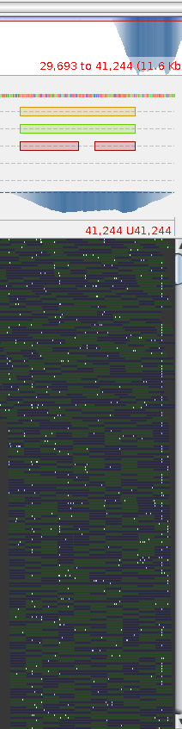
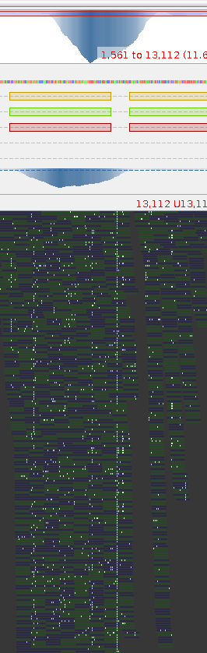
Pfs1|3863
- 16,50x overrepresented
- NOT Inside repeat region
- No Blast hit
Pfs1|10238
- 7,35x overrepresented
- NOT Inside repeat region
- No Blast hit

Slide 10
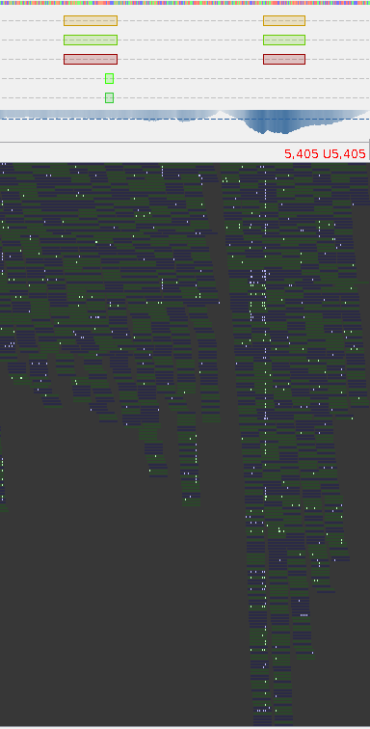
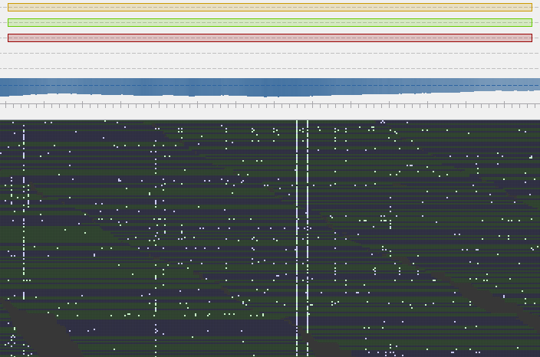
Pfs1|13080
- 3,24x overrepresented
- NOT Inside repeat region
- No Blast hit
What to do with this one?
Paralogous or badly mapped??

Slide 11
If paralogous
Find overrepresented gene
Create alternative reference sequence with homozygous reference SNPs
Remap raw .bam reads on both sequences

