Slide 1
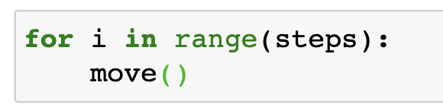
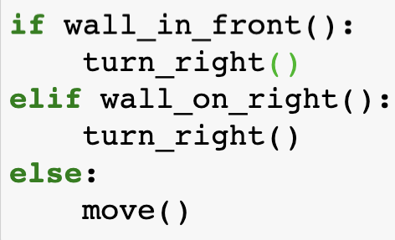
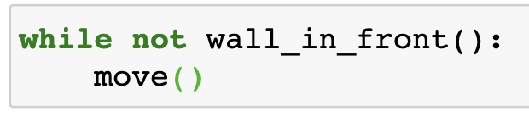
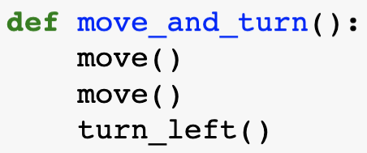
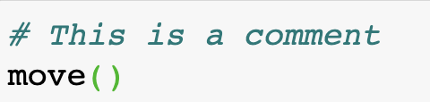
Cheat Sheet
Actions you can take
move() - take a single step
turn_left() - take a left turn
put() - place a ball
take() - pick up object underneath
Conditions you can check
wall_in_front() – Is there is a wall facing you
wall_on_right() - Is there is a wall on your right
object_here() - Is there is an object at your spot
Iteration:
Use for loops when you need to repeat some code for a certain amount of times
Selection (if, else and elif):
Use if when you need to choose different options depending on the value of something.
Conditions 1
Use a while loop when you need to repeat some code until a condition is met
Conditions 2
Conditions 3
Functions:
Create a function when you need the same lines of code multiple times or to improve readability.
Operators:
Use below operators in if and while statement
Comparison operators
Logical operators
AND OR NOT
Comments:
Let you add notes to your code to explain what you have done.
== | Equal to | >= | Greater than or equal to
> | Greater than | <= | Less than or equal to
< | Less than | != | Not equal to

