Slide 1
TwitterTruth – A DistilBERT-Powered Defense Against Misinformation
Team Details
Bharath Kandimalla (20EG105457)
Project Supervisor
B. Ravinder Reddy Assistant Professor,
Department of CSE

Slide 2
Introduction
In the digital age, social media platforms like Twitter have become central to the dissemination of information, connecting users worldwide with real-time updates on global events, social issues, and personal anecdotes. However, this rapid and widespread exchange of information is not without its challenges. Among the most pressing is the proliferation of misinformation or rumors, which can have far-reaching consequences on public opinion, health, and safety. Addressing this challenge necessitates the development of sophisticated tools capable of distinguishing between factual information and rumors efficiently and accurately.
What It Is:
This project is a specialized application of natural language processing (NLP), utilizing the distilled power of the DistilBERT model. The fine-tuning of this pre-trained model on a diverse set of social media posts allows it to discern the subtleties between true, false, unverified, and non-rumor statements. Our model operates with heightened accuracy and efficiency, standing as a sentinel in the fight against misinformation.

Slide 3
Introduction
What Is Needed:
To embark on this endeavor, we require access to comprehensive and annotated datasets, like those provided by Twitter 15 and Twitter 16. These datasets are essential for training and evaluating our model. Additionally, computational resources for model training, a pipeline for real-time data processing, and an interface for interaction and output presentation are necessary.
Applications:
The practical applications of this project are vast and vital. Our system can serve as a tool for social media platforms to automatically flag and review potential misinformation, aiding content moderation efforts. It can also be an invaluable resource for journalists, fact-checkers, and researchers who strive to maintain the integrity of information online. In a broader sense, this technology can contribute to safeguarding public discourse, promoting informed decision-making, and protecting democratic processes from the disruptive influence of false narratives.

Slide 4
Problem Statement
Social media platforms are a double-edged sword, offering rapid dissemination of information while also posing the risk of spreading rumors, which can have widespread consequences on public opinion and safety. The proposed project focuses on overcoming the challenges of accurately detecting and classifying these rumors by leveraging the advanced capabilities of Natural Language Processing.

Slide 5
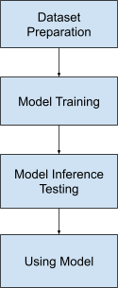
Proposed Method
Step 1: Data Acquisition and Preprocessing
We curate our dataset from two primary sources: the Twitter15 and Twitter16 rumor detection datasets, known for their labeled examples encompassing various rumor types. The data undergoes preprocessing to remove non-textual elements, normalize language use, and correct for common web artifacts. This preparation ensures the integrity and quality of input data for model training. Step 2: Model Configuration:
DistilBERT is configured with a sequence classification head to categorize tweets into one of four classes: 'True', 'False', 'Unverified', and 'Non-rumor'. This multi-class classification framework allows for a nuanced understanding of the veracity of information disseminated on Twitter.

Slide 6
Proposed Method
Step 3: Tokenization and Input Representation
We employ the DistilBERT tokenizer to convert raw text into a format amenable to the model. This step involves breaking down tweets into tokens, padding, and truncating sequences to a fixed length, and mapping tokens to their corresponding input IDs.
Step 4: Model Training
Using the preprocessed and tokenized dataset, the model is fine-tuned for the task of rumor detection. We use a dynamic learning rate schedule that adapts over the course of training. The training process is closely monitored for model convergence and performance optimization. Step 5: Performance Metrics
We employ a suite of metrics to evaluate model performance, including Precision, Recall, and the F1 Score, ensuring a comprehensive assessment of the model's capability in rumor detection. These metrics allow us to quantify the model's accuracy in identifying true positives while balancing the trade-off between precision and recall.

Slide 7
Proposed Method
Step 6: Implementation and Deployment
Finally, the trained model is encapsulated into an application interface, designed for real-time rumor detection on Twitter. The deployment is configured to handle streaming data, applying the trained DistilBERT model to incoming tweets and classifying them according to their predicted veracity.

Slide 8
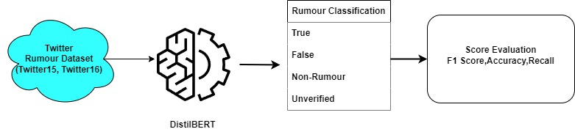
Proposed Method
Illustration :

Slide 9
Experiment Environment
The environment used is Google Colab, Google Drive, Hugging Face and Streamlit
The packages used in our Python code are:
NumPy: To work with arrays or matrices.
Transformers: This package from Hugging Face offers thousands of pre-trained models.
Shutil, os: This package provides a range of functions to interact with the file system.
Pandas: Used for loading and preprocessing the dataset, including reading CSV files.
Datasets: Part of the Hugging Face's ecosystem, this package is designed for loading, transforming, and managing large-scale datasets in a streamlined manner.
Torch: Used for applications such as computer vision and natural language processing.
Sklearn.metrics: This module provides a set of simple and efficient tools for data mining and data analysis.

Slide 10
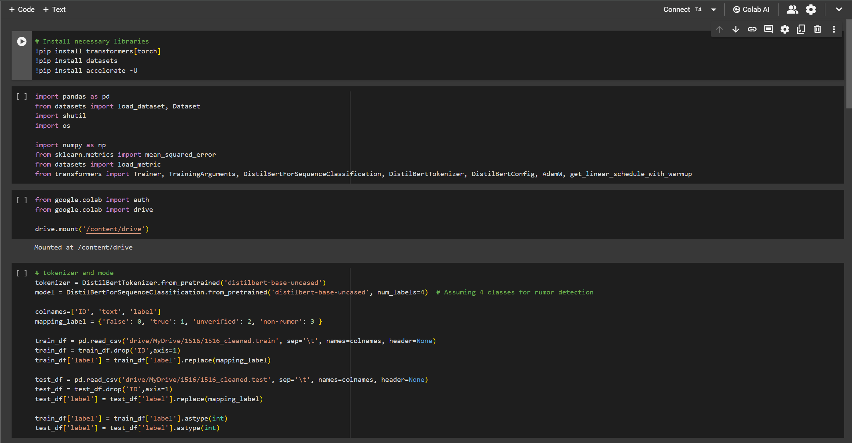
Experiment Screenshots
Training Process

Slide 11
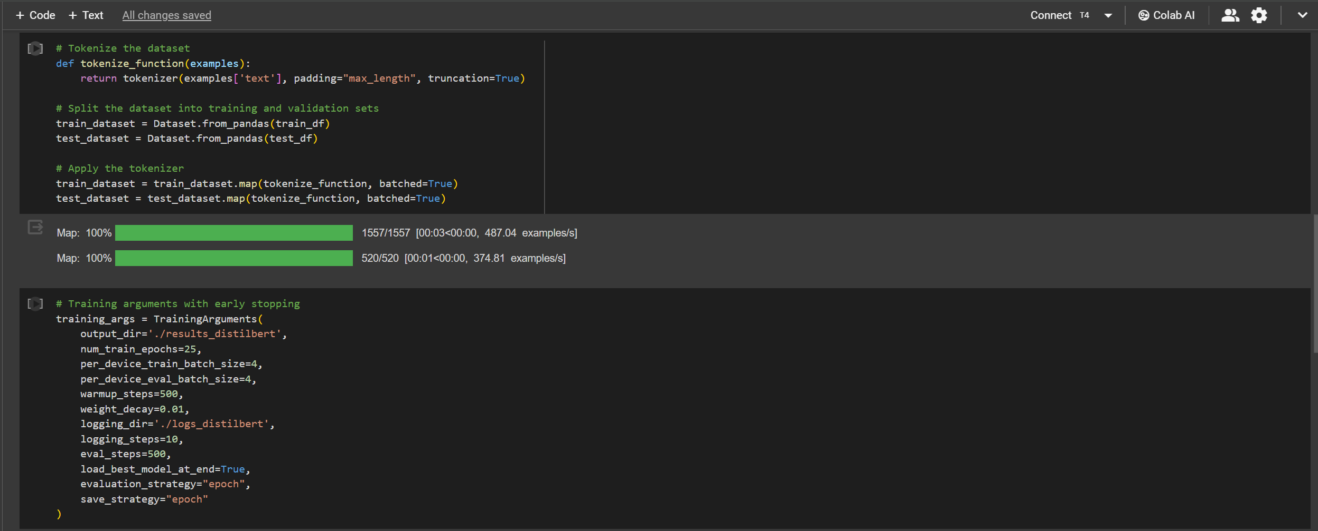
Experiment Screen shorts

Slide 12
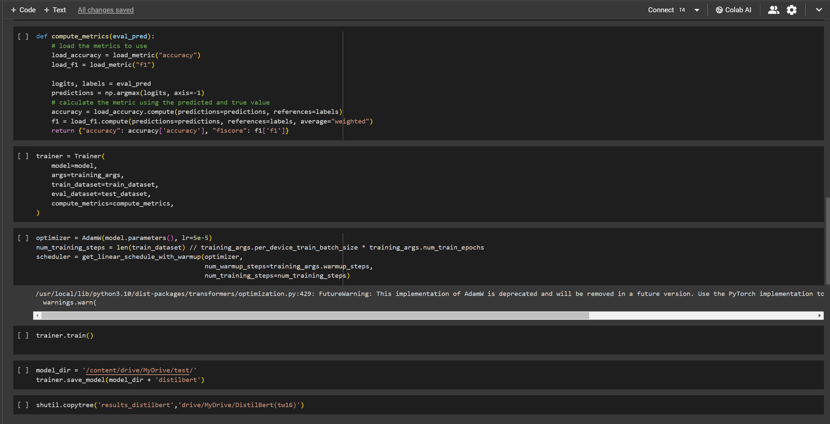
Experiment Screenshots

Slide 13
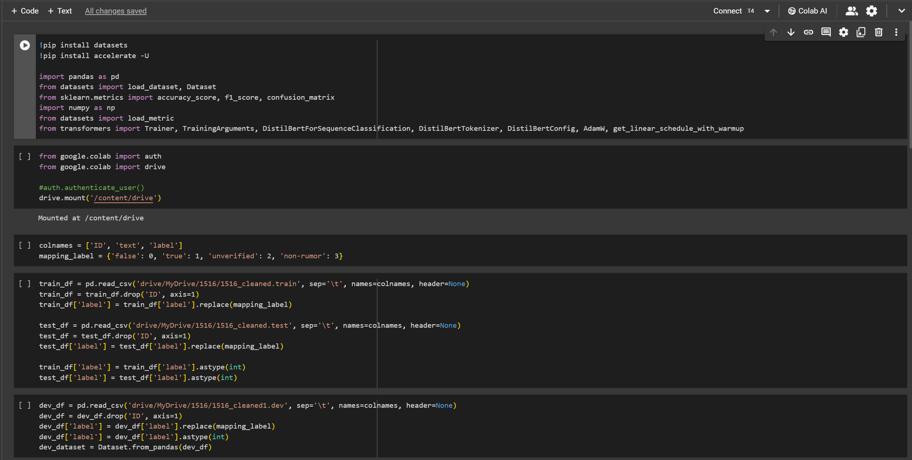
Experiment Screenshots
Parameter check

Slide 14
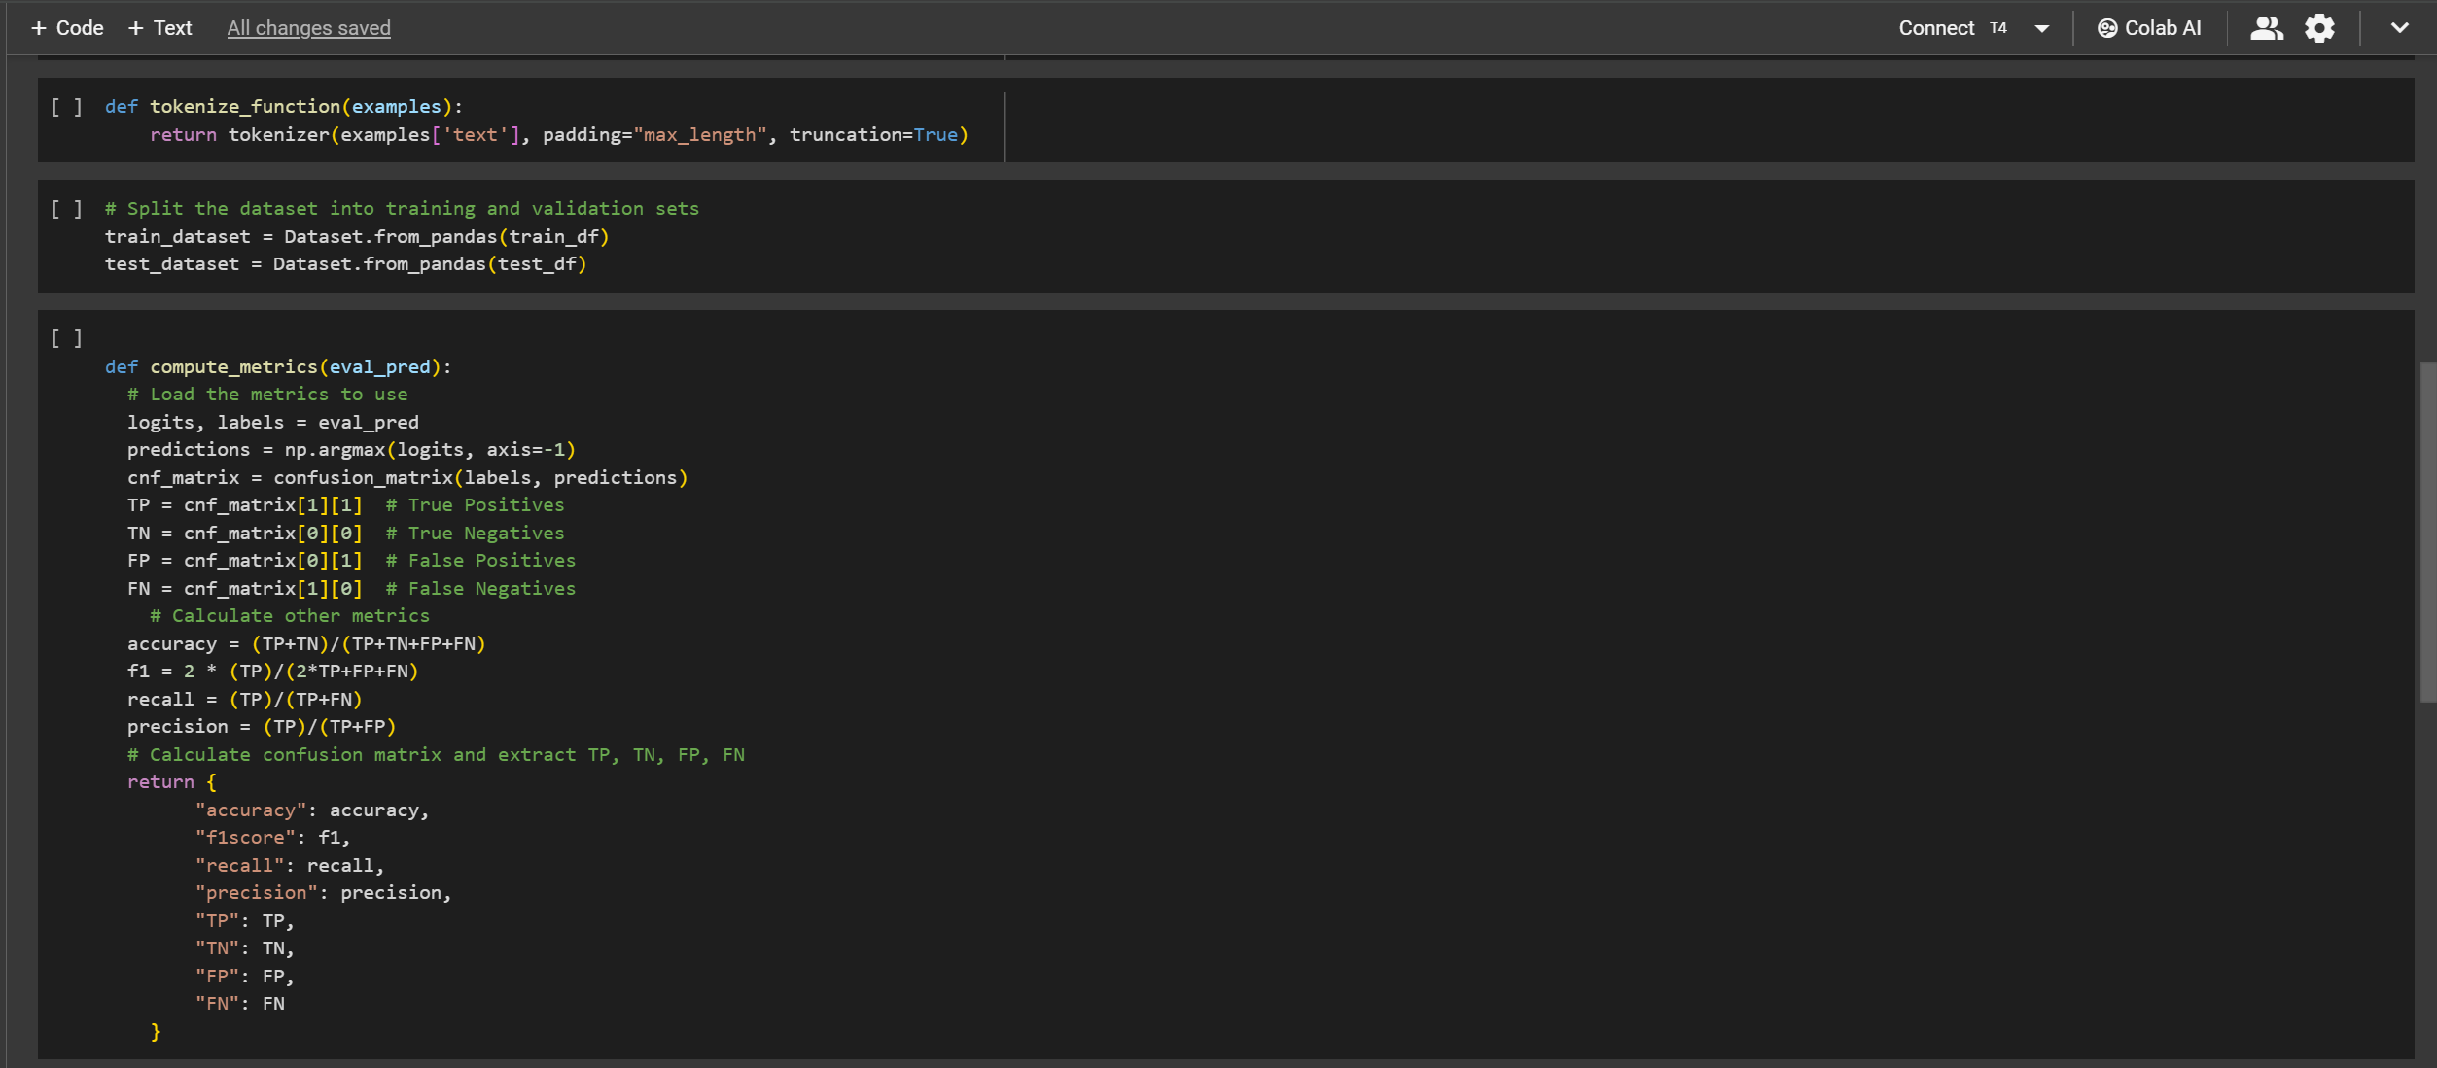
Experiment Screenshots

Slide 15
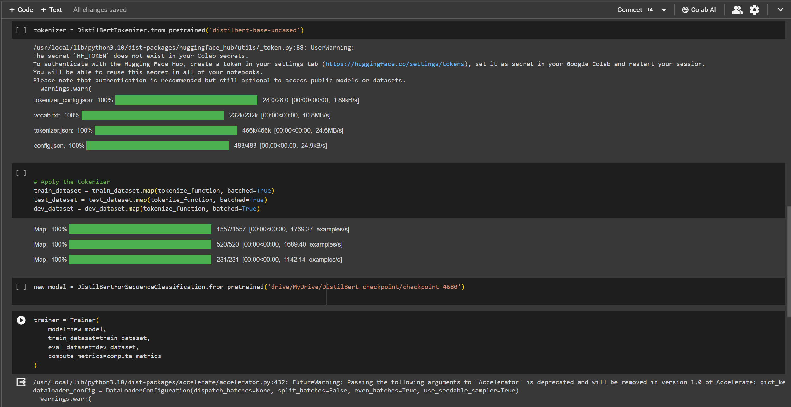
Experiment Screenshots

Slide 16
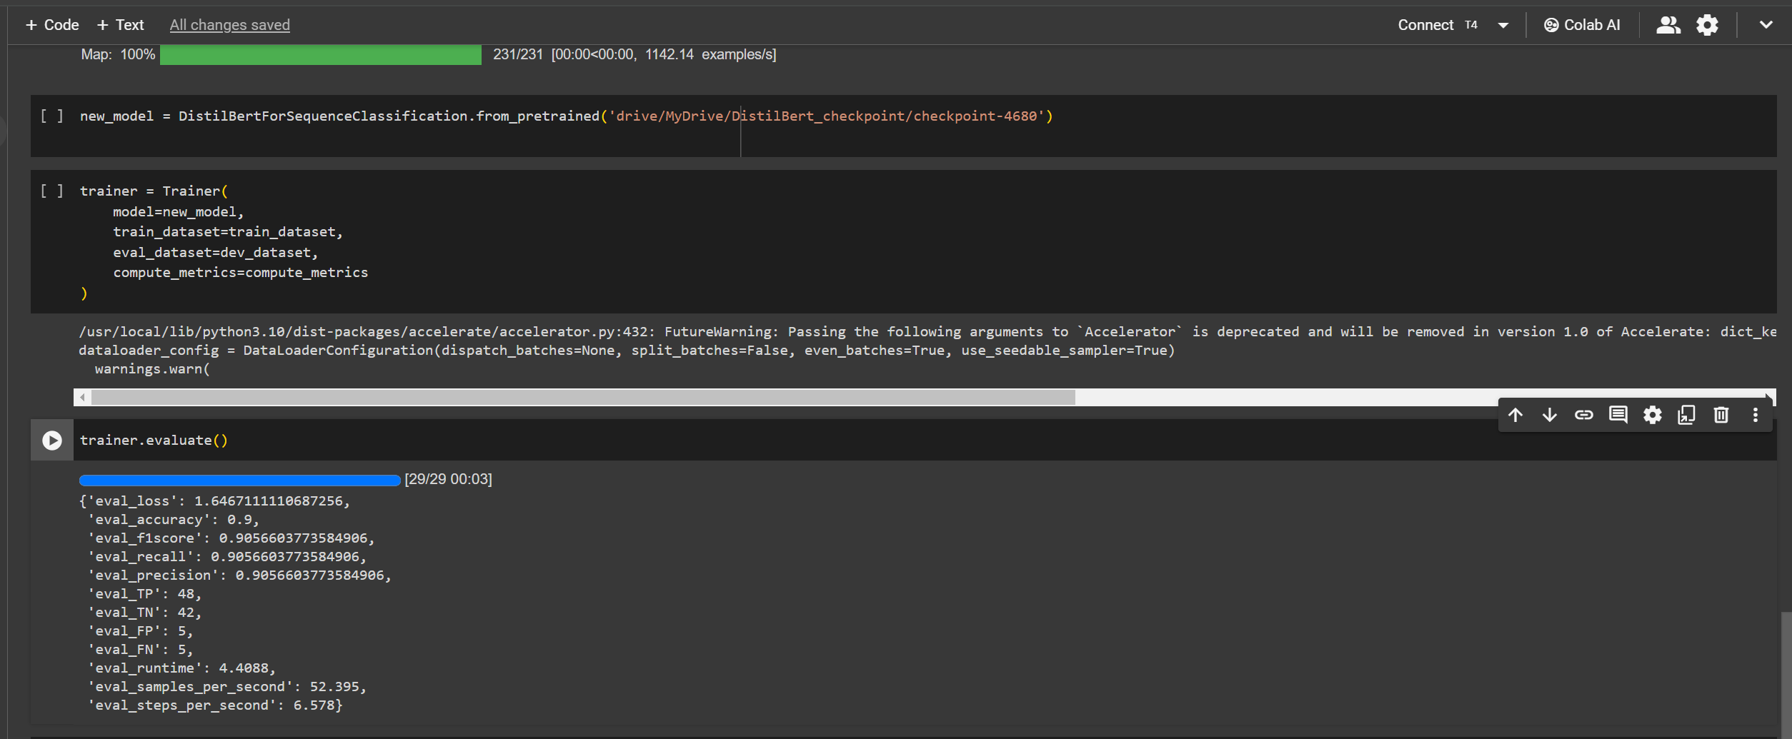
Experiment Screenshots

Slide 17
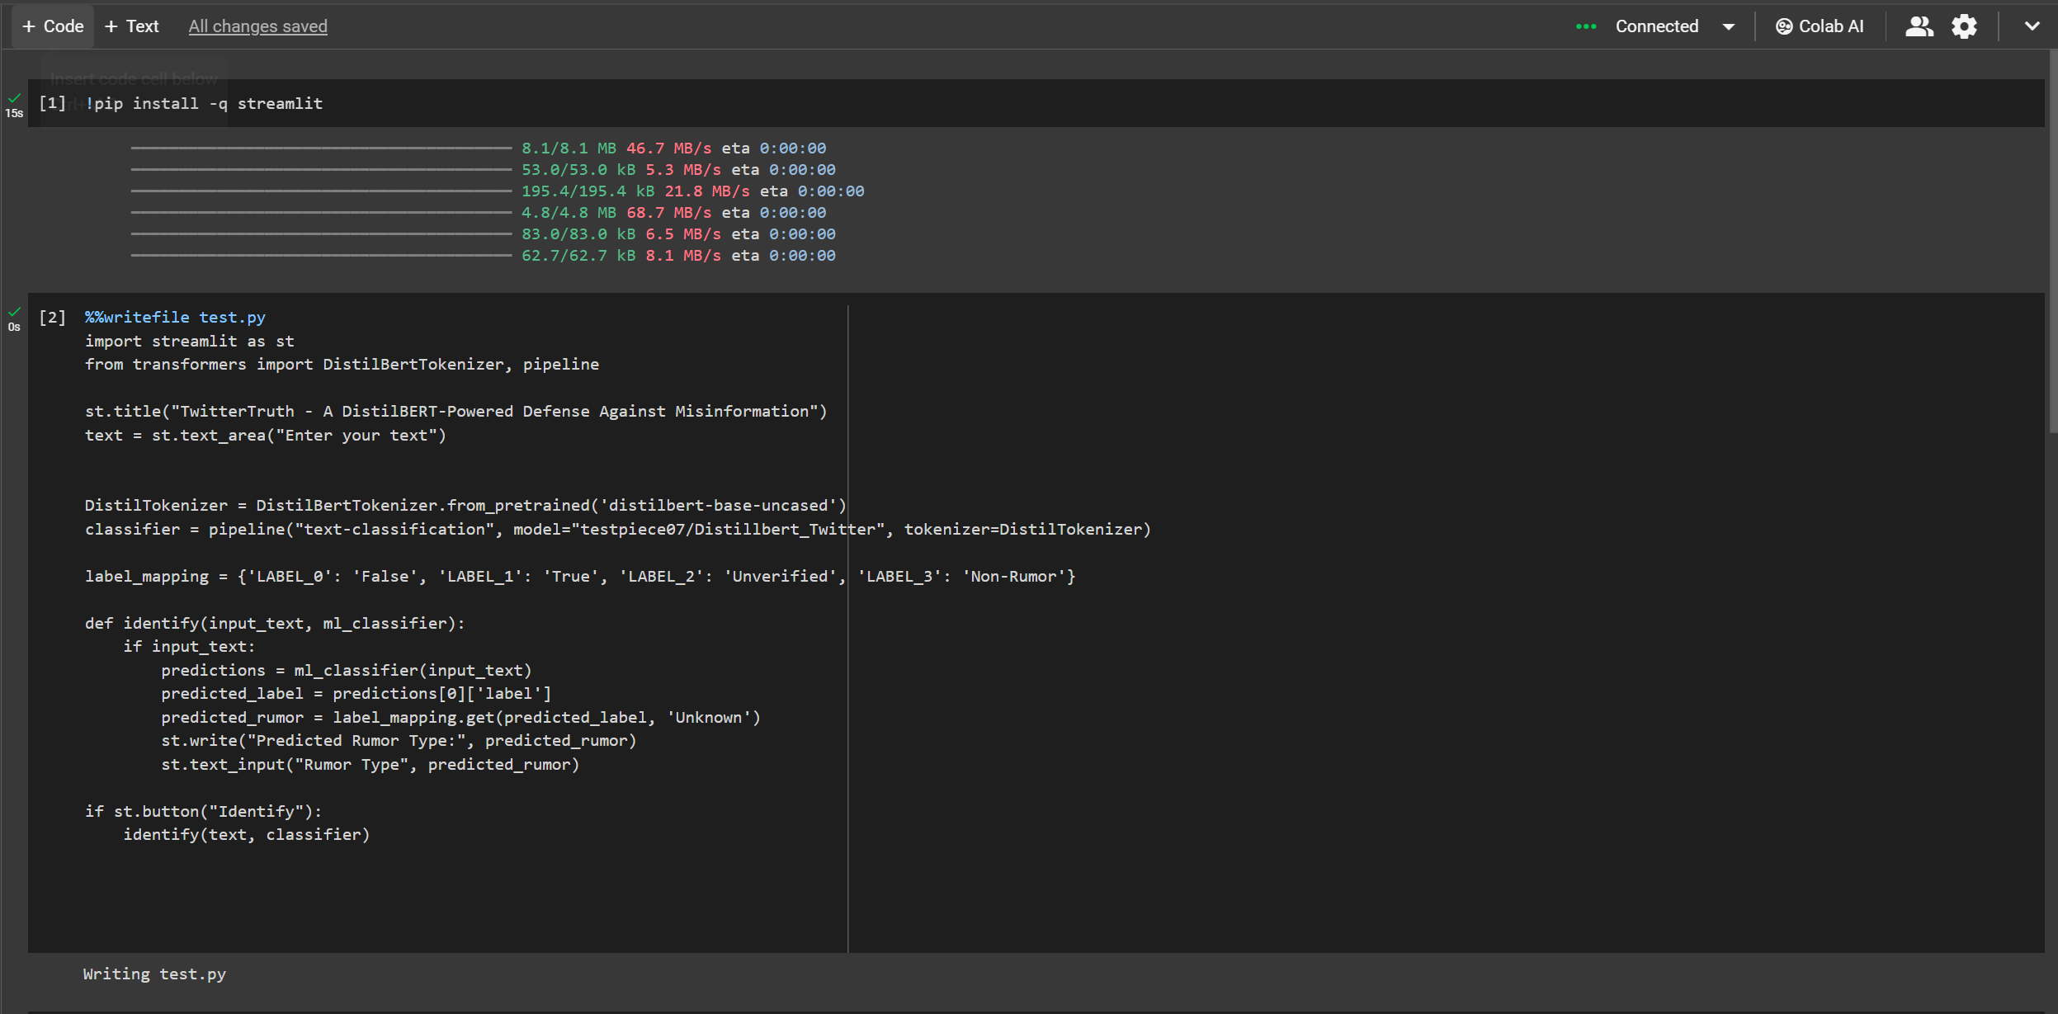
Experiment Screenshots
Deployment [Streamlit]

Slide 18
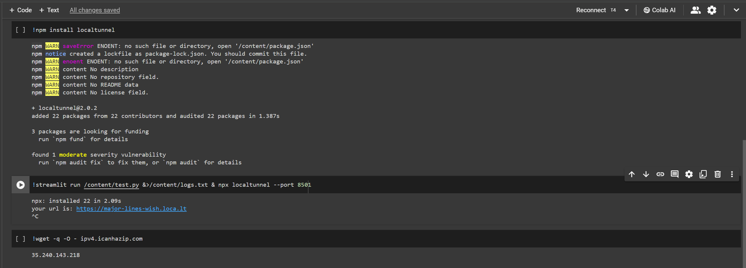
Experiment Screenshots

Slide 19
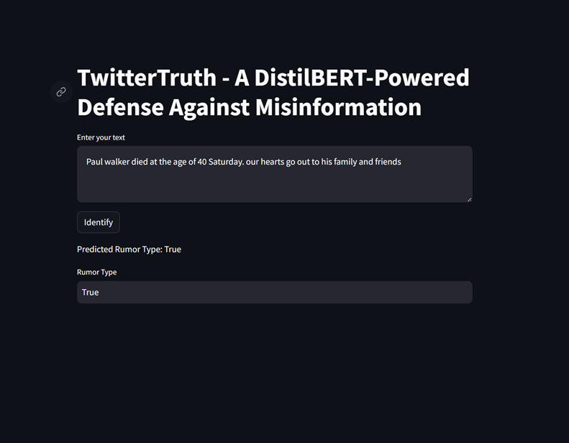
Experiment Results

Slide 20
Experiment Results
An experiment was conducted using Twitter 15 and Twitter 16 datasets against the proposed model and the existing model. The numbers below represent the average scores obtained by experimenting on those datasets
Parameter | Previous methods | Proposed method
Accuracy | 0.89 | 0.905
F1 Score | 0.89 | 0.905
Recall Score | _ | 0.90
Precision Score | _ | 0.90

Slide 21
Finding
High Accuracy Achieved: The fine-tuned DistilBERT model demonstrated a high accuracy level of 0.905 in detecting and classifying rumors on social media platforms. This indicates the model's strong capability to distinguish between true, false, unverified, and non-rumor content effectively.
Effective Model Fine-tuning: The project successfully adapted the pre-trained DistilBERT model for the specific task of rumor detection through comprehensive fine-tuning, utilizing a dataset that included diverse examples from Twitter 15 and Twitter 16 datasets.
Improved Model Generalization: The use of a split dataset for training and testing, along with rigorous evaluation metrics (including F1 score), helped improve the model's generalization capabilities. This ensures the model's effectiveness across various types of rumors and social media content.
Significant F1 Score: The project achieved a weighted F1 score of 0.905, underscoring the model's balanced precision and recall in classifying rumors. This metric highlights the model's reliability in differentiating between rumor categories with minimal error.

Slide 22
Finding
Streamlined Integration: Integration with Google Colab and Google Drive facilitated seamless access to datasets and streamlined the model training and evaluation process. This setup underscores the project's adaptability and ease of use in real-world applications.
Scalability and Real-world Application: The findings suggest that the developed model is scalable and can be integrated into real-time social media platforms to monitor and classify rumors effectively. This capability is crucial for timely intervention by moderators and fact-checkers.

Slide 23



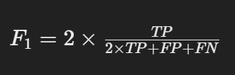
Justification
Parameters | Mathematical formula | Existing Value | Improved Value | Justification
Accuracy |  | 0.89 | 0.905 | Specifically trained our model with a wide range of examples.
Precision Score |  | - | 0.90 | improved accuracy in identifying true rumors, effectively reducing the number of false positives
Recall Score |  | - | 0.90 | Enhanced focus on accurately categorizing real and fake news,
F1 Score |  | 0.89 | 0.905 | Improved recall and precision scores.

