Slide 1





Data Analytics Master Class
1
Introduction to A.I & D.A

Slide 2
About Pantech
01
02
03
Profile
R&D
Training
04
05
06
Products & Projects
Course
Mission
Established on 2004
Manufacturer of Lab equipment‘s & Development boards
2000+ Workshops | 250+ FDP | 100+ Seminars
www.pantechsolutions.net
Learn.pantechsolutions.net
To Serve

Slide 3
10,000,000
To Help people in field on Learning

Slide 4
Problems in Learning

Slide 5
More Content Hard to Learn Less Applications Not Interactive Not Precise Problem is Lack of Information

Slide 6
More Content Hard to Learn Less Applications Not Interactive Not Precise Problem is Lack of Information

Slide 7
Problem is Information Overload

Slide 8
Clear-cut, Precise & Focused Implementation with clear Mentorship
What People need?

Slide 9
What u will learn
01
02
03
Week-1
Week-2
Week-3
04
Week-4
Excel, Statistics & Probability
BI Tools
Python, Numpy & Pandas
Database, ML & DL

Slide 10

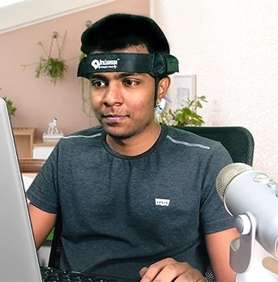
About Me
Technology Expertise: AI, Brain Computer Interface(BCI), Robotic Operating System(ROS), IoT, Autonomous Robot design, Microcontroller
Programming: Python, Matlab, C.
AI Boards: NVidia Jetson Boards, Beagle bone, PYNQ FPGA, Raspberry Pi

Slide 11
Why 30 Day Challenge ?
01
02
SkillSet
Mindset
+

Slide 12
01.
Introduction to A.I

Slide 13
What you will get in this 30 Day Internship
 | Data Analytics (2 Month Validity)
Video Coaching Lesson – 30 Days | ₹4000
Source Code & Materials | ₹2999
Internship Certificate & Support System | ₹1999

Slide 14
What you will get in this 30 Day Internship
 | Data Analytics (2 Month Validity)
Video Coaching Lesson – 30 Days | ₹4000
Source Code & Materials | ₹2999
Internship Certificate & Support System | ₹1999
Total Value: ₹8998
₹999 only

Slide 15
What you will get in this 30 Day Internship
 | Data Analytics (2 Month Validity)
Video Coaching Lesson – 30 Days | ₹4000
Source Code & Materials | ₹2999
Internship Certificate & Support System | ₹1999
Total Value: ₹8998
₹999 only
Special Offer waiting for the people who gonna stay till end

Slide 16
02.
Data Analytics

Slide 17
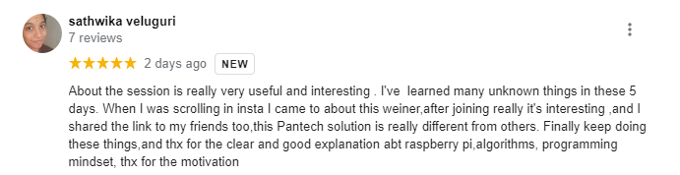
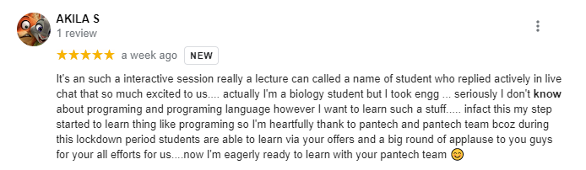
Feedback - People in Pantech Community

Slide 18
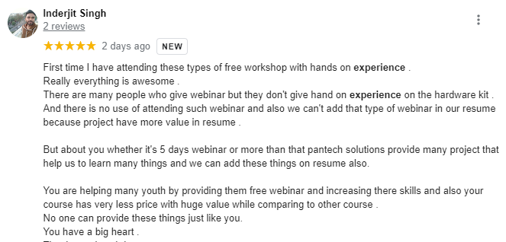
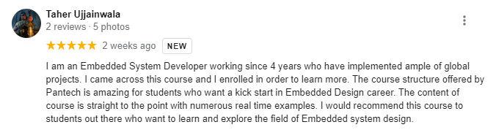
Feedback - People in Pantech Community

Slide 19
Actual Price ₹999
Shocking offer – People stays till end

Slide 20
Actual Price ₹999 Offer Price ₹590
Shocking offer – People present in this webinar

Slide 21
30 Day Success Mindset

Slide 22
01.
Write down everything, you think you need to do – 25+

Slide 23
I am learning ___ I started buisness I own a BMW Car
Goal without deadline in a dream

Slide 24
Q & A Session

Slide 25
Thanks!
Do you have any questions? sanjay@pantechmail.com
Course Queries: +91 9840974408
www.pantechsolutions.net

