Slide 1
Understanding and Reducing Customer Churn at Zencom
Leveraging Data to Improve Customer Retention

Slide 2
Table of contents
01
02
03
04
05
Introduction
Problem Statement
Methodology
Results
Conclusion and Next Steps

Slide 3

01
Introduction
Zencom, a leading telecom company offering mobile, internet, and landline services, is facing a rising customer churn rate. To address this, Zencom seeks to identify the causes and develop strategies to retain its customers.

Slide 4
Problem statement
02
Problem statement
Key Objectives
Zencom wants to analyze the churn rate among its customers over a period to identify the key factors that influence churn behavior. The company aims to develop actionable insights to reduce churn and improve customer retention.
Analyze historical churn data to identify trends and patterns.
Identify demographic or behavioral factors associated with higher churn rates.
Build predictive models to forecast future churn and prioritize at-risk customers.

Slide 5
Methodology
03
Data
Data analysis
Data used was from kaggle
Churn in Telecom's dataset (kaggle.com)
Explore data to uncover trends and patterns.
Use visualizations to identify correlations and insights.
Model Building
Model Evaluation
Split data into training and test sets.
Apply various classification models to identify the best model to predict churn.
Assess model performance using metrics:- Accuracy, Recall, Precision and F1 Score

Slide 6
Results
04
Data analysis
The data set was check for missing records and duplicates.
The data was then visualised to understand the various relationship that exist amoungs the features.
A correlation matrix was generated and visualised to enable select the fetures that have a high correlation with whether the customer stays or leaves.

Slide 7
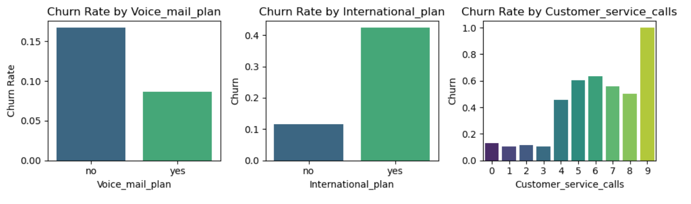
Results cont.
Visualisations
From the analysis of the customer care call, as the number of calls increases the churn rate also increases. Customers who had international plan had a high churn rate as compared to those who do not have.

Slide 8
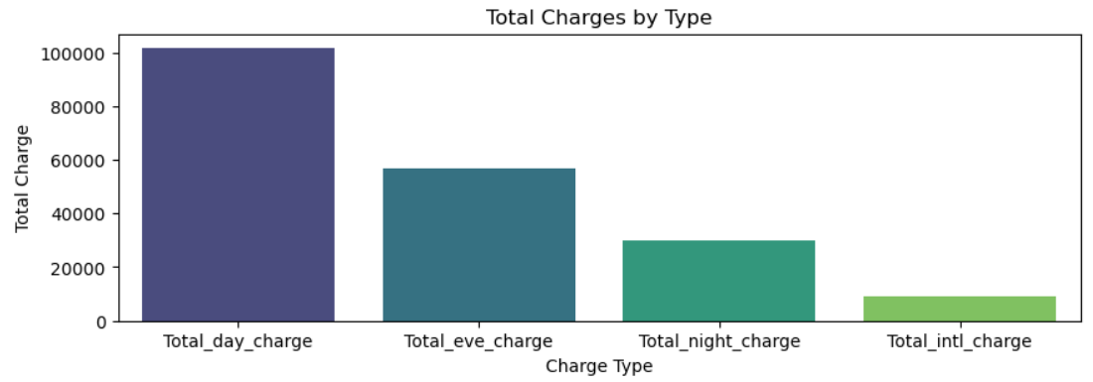
Results cont.
Visualisations
From the analysis Zencom generates most of its income from day calls and the least income is from international calls.

Slide 9
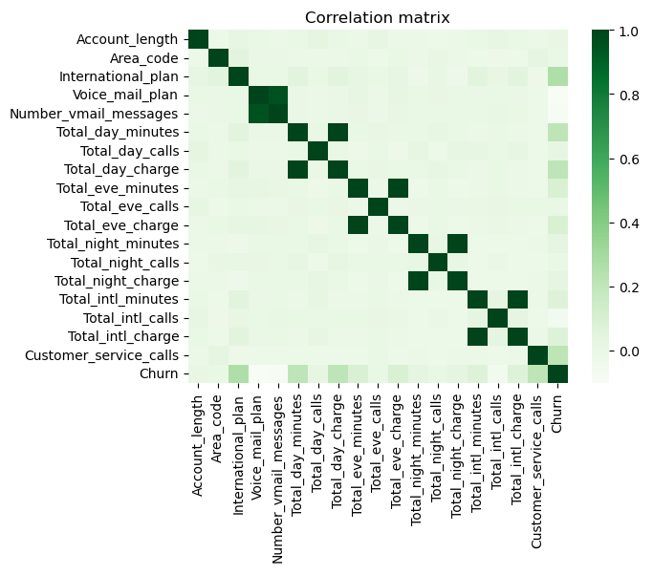
Results cont.
Visualisations
From the correlation hit map the features that have a relative high correlation to the churn rate are :-
International plan,
Total day minutes,
Total eve minutes,
Total night minutes,
Total international minutes,
Customer service calls

Slide 10
14.49%
Results cont.
The current Churn rate for Zencom is 14%. This is relatively high.

Slide 11
Results cont.
Key Model Metrics
Four models were fitted i.e.. Logistic regression, Decision tree classifier, Kneighbor classifier and a random forest classifier.
The Random Forest classifier achieved the highest accuracy among the four models. It also had a high precision, indicating a low false positive rate, and a relatively higher recall compared to the other models, suggesting better performance in identifying positive cases. The F1 score is also the highest, indicating a good balance between precision and recall.
Below is a summary of the results.
Accuracy: 90%
90% of predictions are correct
Recall: 47.9%
Identifies actual churn cases
Precision: 76.4%
Correctly predicted churn cases out of all predicted churn cases
F1 Score: 58.1%
Balances recall and precision

Slide 12
Conclusion
05
These predictors provide valuable insights into customer behavior, usage patterns, and potential pain points that may contribute to churn. Zencom should take proactive measures to retain customers, such as
Targeted marketing campaigns,
Personalized offers,
Improving customer service experiences.

Slide 13


